Slide 1
ESMO 2020 (Virtual)
Congress Report
Solid tumors:
PD-1/PD-L1 inhibition and PARP inhibition
Focus on GI and ovarian cancers

Slide 2
Contents – GI cancers
GI cancers
Slide numbers | Study
5-11 | CheckMate 649: Nivolumab plus chemotherapy versus chemotherapy as 1L treatment for advanced gastric cancer/gastroesophageal junction cancer (GC/GEJC)/esophageal adenocarcinoma (EAC): first results
12-19 | ATTRACTION-4: Nivolumab plus chemotherapy versus chemotherapy alone in patients with previously untreated advanced or recurrent gastric/gastroesophageal junction (G/GEJ) cancer
20-27 | KEYNOTE-590: Pembrolizumab plus chemotherapy versus chemotherapy as first-line therapy in patients with advanced esophageal cancer.
28-36 | New wave PD-1 inhibitors: Investigation of PD-L1 expression and tislelizumab efficacy in gastroesophageal adenocarcinoma using a novel tumor and immune cell score with VENTANA PD-L1 (SP263) assay and combined positive score (CPS)

Slide 3
Contents – Ovarian cancer and other solid tumors
Ovarian cancer
Slide numbers | Study
38-43 | MEDIOLA: Phase 2 study of PARP inhibitor olaparib plus durvalumab and bevacizumab: initial results in patients with non-germline BRCA-mutated (non-gBRCAm) platinum sensitive relapsed (PSR) ovarian cancer (OC)
44-52 | PARP inhibition in OC: Phase 2 study of PARP inhibitor pamiparib in Chinese patients with advanced ovarian cancer (aOC)
53-62 | NORA: Individualized starting dose of PARP inhibitor niraparib in Chinese patients with platinum-sensitive recurrent ovarian cancer (PSROC): A randomized, double-blind, placebo-controlled, phase 3 trial
Other solid tumors
Slide numbers | Study
65-74 | LEAP-005: Phase 2 study of lenvatinib plus pembrolizumab in patients with previously treated advanced solid tumors
75-80 | New wave PD-1 inhibitors: BGB-A333, an anti-PD-L1 monoclonal antibody, in combination with tislelizumab in patients with urothelial carcinoma (UC)
81-86 | PARP inhibition in solid tumors: Clinical benefit in biomarker-positive patients with locally advanced or metastatic solid tumors treated with the PARP1/2 inhibitor pamiparib in combination with low-dose temozolomide (LD-TMZ)

Slide 4
GI Cancers

Slide 5
CheckMate 649
PD-1i plus chemotherapy vs chemotherapy in gastric cancer/gastroesophageal junction cancer/esophageal adenocarcinoma: Nivolumab

Slide 6
Checkmate 649 Study design
Randomized, open-label, pivotal phase 3 trial evaluating nivolumab plus chemotherapy vs chemotherapy alone as a first-line treatment for metastatic gastric cancer, gastroesophageal junction cancer or esophageal adenocarcinoma
Key eligibility criteria
Previously untreated, unresectable, advanced or metastatic gastric/GEJ/ esophageal adenocarcinoma
No known HER2-positive status
ECOG PS 0–1
NIVO1 + IPI3
Q3W × 4 then NIVO 240 mg Q2W^{d}
Dual primary endpoints:
OS and PFS^{g} (PD-L1 CPS ≥ 5)
Secondary endpoints:
OS (PD-L1 CPS ≥ 1 or all randomized)
OS (PD-L1 CPS ≥ 10)
PFS^{g} (PD-L1 CPS ≥ 10, 1, or all randomized)
ORR^{g}
R 1:1:1^{c}
N = 789
NIVO 360 mg + XELOXe Q3W^{d} or
NIVO 240 mg + FOLFOX^{f} Q2W^{d}
N = 792
XELOXe Q3W^{d}
or FOLFOX^{f} Q2W^{d}
Stratification factors
Tumor cell PD-L1 expression (≥ 1% vs < 1%^{b})
Region (Asia vs United States/Canada vs ROW)
ECOG PS (0 vs 1)
Chemo (XELOX vs FOLFOX)
N = 1581, including 955 patients (60%) with PD-L1 CPS ≥ 5
At data cutoff (May 27, 2020),
the minimum follow-up was 12.1 months^{h}

Slide 7
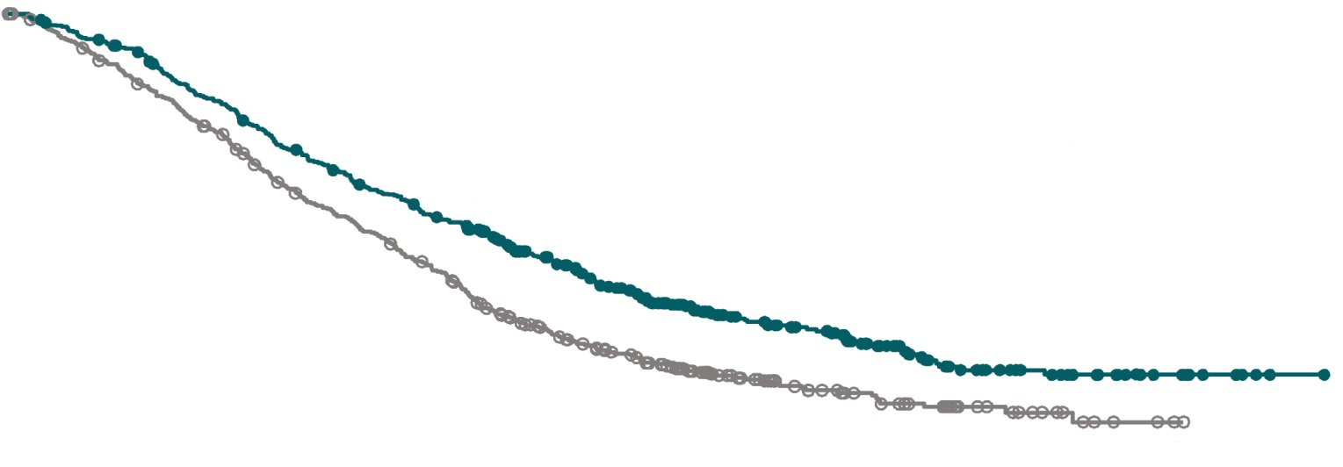
Primary endpoint: Overall survival (OS)
PD-L1 combined positive score (CPS) ≥ 5
Superior OS, 29% reduced risk of death, and a 3.3-month improvement in median OS with nivolumab+ chemotherapy vs chemotherapy in patients whose tumors expressed PD-L1 CPS ≥5
100
 | Nivo + chemo (N=473) | Chemo (N= 482)
Median OS, mo | 14.4 | 11.1
(95% CI) | (13.1–16.2) | (10.0–12.1)
HR (98.4% CI) | 0.71 (0.59–0.86)
P value | < 0.0001
12-mo rate
80
OS (%)*
60
57%
40
46%
NIVO + chemo
20
Chemo
0
0
3
6
9
12
15
18 21
Months
24
27
30
33
36
39
No. at risk
Nivo + chemo | 473 | 438 | 377 | 313 | 261 | 198 | 149 | 96 | 65 | 33 | 22 | 9 | 1 | 0
Chemo | 482 | 421 | 350 | 271 | 211 | 138 | 98 | 56 | 34 | 19 | 8 | 2 | 0 | 0
*Minimum follow-up 12.1 months.

Slide 8
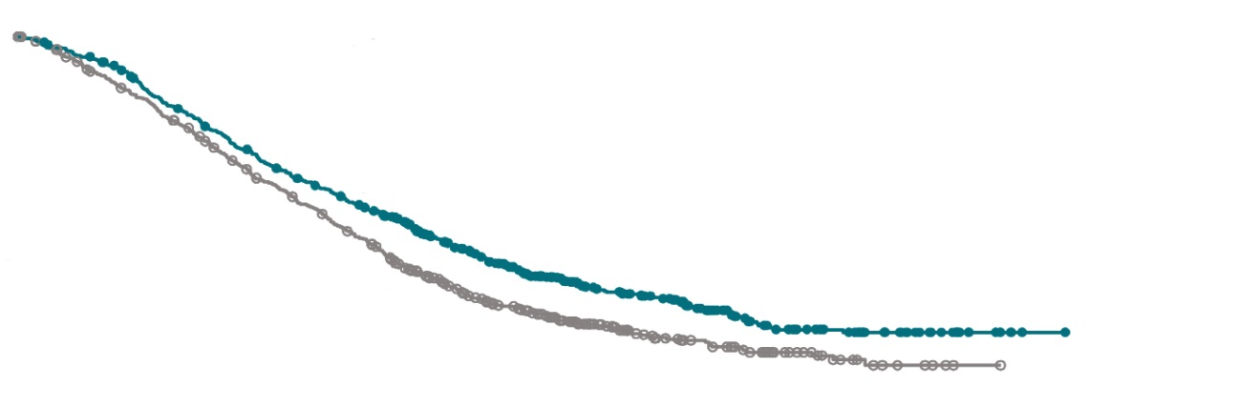
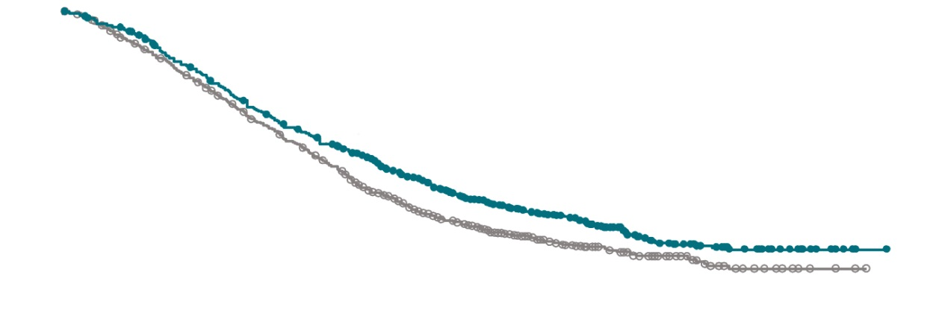
Overall survival
PD-L1 CPS ≥ 1
All randomized
 | Nivo + chemo (N=641) | Chemo (N=655)
Median OS, mo | 14.0 | 11.3
(95% CI) | (12.6–15.0) | (10.6–12.3)
HR (99.3% CI) | 0.77 (0.64–0.92)
P value | 0.0001
 | Nivo + chemo (N=789) | Chemo (N=792)
Median OS, mo | 13.8 | 11.6
(95% CI) | (12.6–14.6) | (10.9–12.5)
HR (99.3% CI) | 0.80 (0.68–0.94)
P value | 0.0002
12-mo rate
12-mo rate
OS (%)ª
100
OS (%)*
100
80
80
60
56%
60
55%
40
40
20
47%
NIVO + chemo
20
48%
NIVO + chemo
0
Chemo
0
Chemo
0
3
6
9
12
15
18
21
24
27
30
33
36
39
0
3
6
9
12
15
18
21
24
27
30
33
36
39
Months
Months
No. at risk
Nivo + chemo | 641 | 595 | 502 | 412 | 344 | 254 | 183 | 118 | 80 | 40 | 28 | 11 | 1 | 0
Chemo | 655 | 575 | 483 | 383 | 292 | 194 | 131 | 77 | 45 | 25 | 10 | 3 | 0 | 0
No. at risk
Nivo + chemo | 789 | 731 | 621 | 506 | 420 | 308 | 226 | 147 | 100 | 49 | 34 | 14 | 2 | 0
Chemo | 792 | 697 | 586 | 469 | 359 | 239 | 160 | 94 | 59 | 35 | 15 | 7 | 2 | 0
*Minimum follow-up 12.1 months.
OS benefit in PD-L1 CPS ≥ 1 and all randomized patients with nivolumab + chemotherapy vs chemotherapy

Slide 9
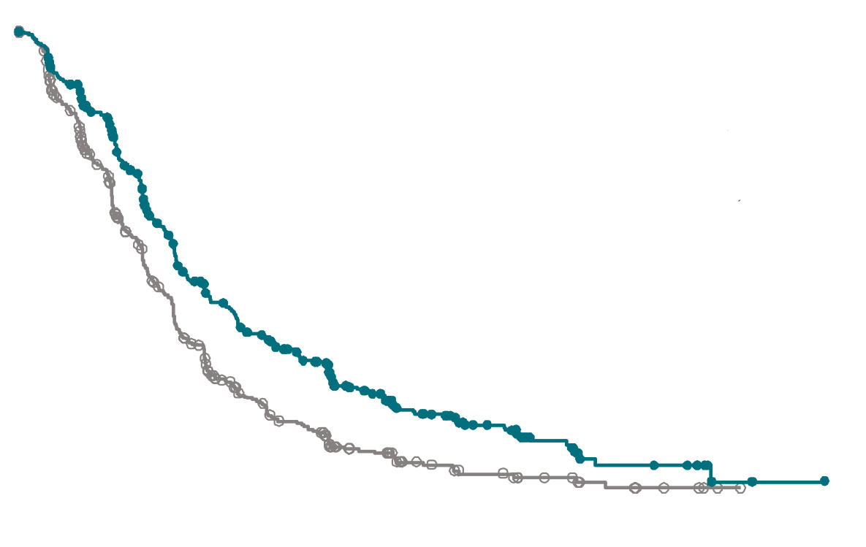
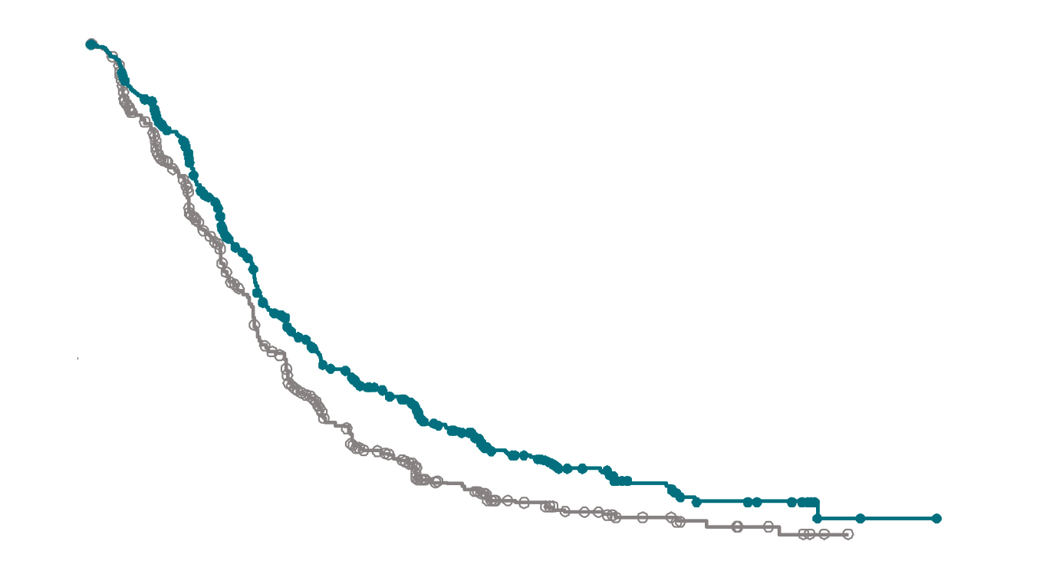
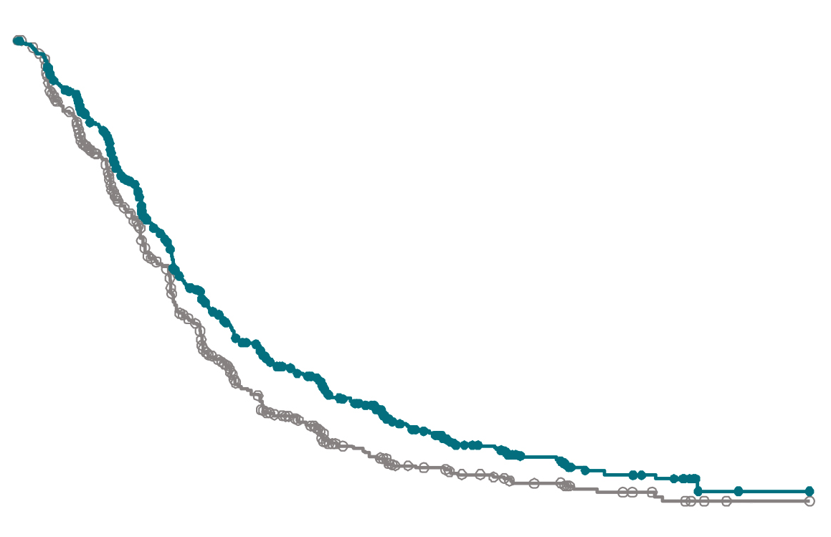
Progression-free survival
PD-L1 CPS ≥ 5
PD-L1 CPS ≥ 1
All randomized
100
 | Nivo + chemo (N=473) |  | Chemo (N= 482)
Median PFS, mo | 7.7 |  | 6.0
(95% CI) | (7.0–9.2) |  | (5.6–6.9)
HR (98% CI) | 0.68 (0.56–0.81)
P value | < 0.0001
12-mo rate | 36% | 22%
100
 | Nivo + chemo (N=641) |  | Chemo (N=655)
Median PFS, mo | 7.5 |  | 6.9
(95% CI) | (7.0–8.4) |  | (6.1–7.0)
HR (95% CI) | 0.74 (0.65–0.85)
12-mo rate | 34% | 22%
100
 | Nivo + chemo (N=789) |  | Chemo (N= 792)
Median PFS, mo | 7.7 |  | 6.9
(95% CI) | (7.1–8.5) |  | (6.6–7.1)
HR (95% CI) | 0.77 (0.68–0.87)
12-mo rate | 33% | 23%
PFS (%)^{a,b}
80
PFS (%)^{a,b}
PFS (%)^{a,b}
80
80
60
60
60
40
40
40
20
NIVO + chemo
20
NIVO + chemo
20
NIVO + chemo
0
Chemo
0
Chemo
0
Chemo
0
3
6
9
12
15
18
21
24
27
30
33
36
0
3
6
9
12
15
18
21
24
27
30
33
36
0
3
6
9
12
15
18
21
24
27
30
33
36
Months
Months
Months
No. at risk
Nivo + chemo | 473 | 384 | 258 | 181 | 132 | 89 | 60 | 39 | 23 | 10 | 8 | 1 | 0
Chemo | 482 | 325 | 200 | 109 | 72 | 41 | 25 | 18 | 12 | 7 | 4 | 0 | 0
No. at risk
641 | 522 | 351 | 234 | 167 | 113 | 71 | 46 | 27 | 13 | 10 | 1 | 0
655 | 452 | 291 | 167 | 99 | 53 | 31 | 21 | 13 | 8 | 4 | 0 | 0
No. at risk
789 | 639 | 429 | 287 | 197 | 136 | 83 | 51 | 31 | 15 | 11 | 1 | 0
792 | 544 | 351 | 202 | 120 | 65 | 38 | 28 | 18 | 12 | 6 | 1 | 0
Superior PFS, 32% reduction in risk of progression or death with nivolumab + chemotherapy vs chemotherapy in patients whose tumors expressed PD-L1 CPS ≥ 5
PFS benefit with nivolumab + chemotherapy vs chemotherapy in PD-L1 CPS ≥ 1 and all randomized patients

Slide 10
Safety and tolerability
Summary of treatment related adverse events (TRAEs)
Patients, N (%) | All treated
 | Nivolumab + chemotherapy (N=782) |  | Chemotherapy (N=767)
 | Any grade | Grade 3−4 | Any grade | Grade 3−4
Any TRAEs | 738 (94) | 462 (59) | 679 (89) | 341 (44)
Serious TRAEs | 172 (22) | 131 (17) | 93 (12) | 77 (10)
TRAEs leading to discontinuation | 284 (36) | 132 (17) | 181 (24) | 67 (9)
Treatment-related deaths | 12 (2) |  | 4 (<1)
Nivolumab plus chemotherapy elicited an expected toxicity profile; no new safety signals reported
TRAEs with potential immunologic etiology
Select TRAEs, N (%) | All treated
 | Nivolumab + chemotherapy (N=782) |  | Chemotherapy (N=767)
 | Any grade | Grade 3−4 | Any grade | Grade 3−4
Endocrine | 107 (14) | 5 (<1) | 3 (<1) | 0
Gastrointestinal | 262 (34) | 43 (5) | 207 (27) | 25 (3)
Hepatic | 203 (26) | 29 (4) | 134 (17) | 16 (2)
Pulmonary | 40 (5) | 14 (2) | 4 (<1) | 1 (<1)
Renal | 26 (3) | 6 (<1) | 8 (1) | 1 (<1)
Skin | 214 (27) | 26 (3) | 105 (14) | 6 (<1)

Slide 11
Checkmate 649 Conclusions
Nivolumab is the first PD-1 inhibitor to demonstrate superior OS and PFS in combination with chemotherapy versus chemotherapy alone in previously untreated patients with advanced GC/GEJC/EAC
Statistically significant and clinically meaningful OS benefit in patients whose tumors expressed PD-L1 CPS ≥ 5 and ≥ 1 and in all randomized patients
Survival benefit across multiple pre-specified subgroups (assessed in primary population)
PFS benefit in PD-L1 CPS ≥ 5 (statistically significant), PD-L1 CPS ≥ 1, and all randomized patients
No new safety signals were identified with nivolumab + chemotherapy
Nivolumab + chemotherapy represents a new potential standard first line treatment for patients with advanced gastric cancer/gastroesophageal junction cancer/esophageal adenocarcinoma

Slide 12
ATTRACTION-4
PD-1i plus chemotherapy vs chemotherapy in advanced/ recurrent gastric or gastroesophageal junction cancer: Nivolumab

Slide 13
ATTRACTION-4 Study design
Randomized, multicenter, phase 2/3 study of nivolumab plus chemotherapy in patients with previously untreated advanced or recurrent gastric or gastroesophageal junction cancer
Key eligibility criteria:
Unresectable advanced or recurrent HER2 (-) G/GEJ cancer
ECOG PS of 0-1
Chemo-naive
Neoadjuvant or adjuvant chemotherapy allowed if completed ≥180 days prior to recurrence
Nivolumab 360 mg IV Q3W
+
SOX^{b} or CapeOX^{c} therapy
Treatment continued until:
Progressive disease per RECIST v1.1
Unacceptable toxicity
Withdrawal of consent
Co-primary endpoints:
PFS (central assessment by IRRC) and OS
Other key endpoints:
PFS (investigator´s assessment)), ORR, DOR, DCR, TTR, BOR, and safety
R
1:1
Placebo
+
SOX^{b} or CapeOX^{c} therapy
Stratification factors:
Country
ECOG PS
Tumor cell PD-L1 expression
Disease status
At data cutoff for interim analysis of PFS (31 Oct 2018), the median follow-up period was 11.6 months
At data cutoff for final analysis of OS (31 Jan 2020), the median follow-up period was 26.6 months
A total of 724 patients were randomized between March 2017 and May 2018
ªNCT02746796; ^{b}SOX, S-1 (tegafur-gimeracil-oteracil potassium) 40 mg/m2 orally twice daily (days 1-14) and Oxaliplatin 130 mg/m2 IV (day 1), q3w; ^{c}CapeOX, Capecitabine 1000 mg/m2 orally twice daily (days 1-14) and Oxaliplatin 130 mg/m2 IV (day 1), Q3W.

Slide 14
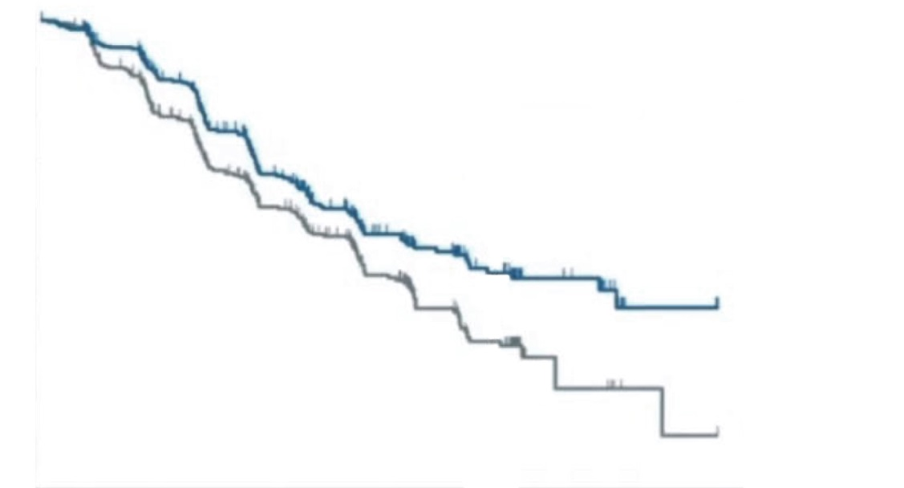
Progression-free survival
Interim analysis
100
Nivolumab + Chemotherapy
Placebo + Chemotherapy
90
 | Nivo + Chemo (N=362) | Placebo + Chemo (N=362)
Median PFS, months (95% CI) | 10.45 (8.44-14.75) | 8.34 (6.97-9.40)
Hazard ratio (98.51% CI) | 0.68 (0.51-0.90)
P value | 0.0007
1yr PFS rate (%) | 45.4 | 30.6
Probability of PFS (%)
80
70
1-yr rate
60
50
45%
40
30
20
31%
10
Significant improvement in PFS with nivolumab + chemotherapy vs chemotherapy alone
0
0
3
6
9
12
15
18
Time (months)
No. at risk
Nivo + Chemo | 362 | 274 | 168 | 94 | 46 | 13 | 0
Placebo + Chemo | 362 | 259 | 160 | 80 | 30 | 5 | 0

Slide 15
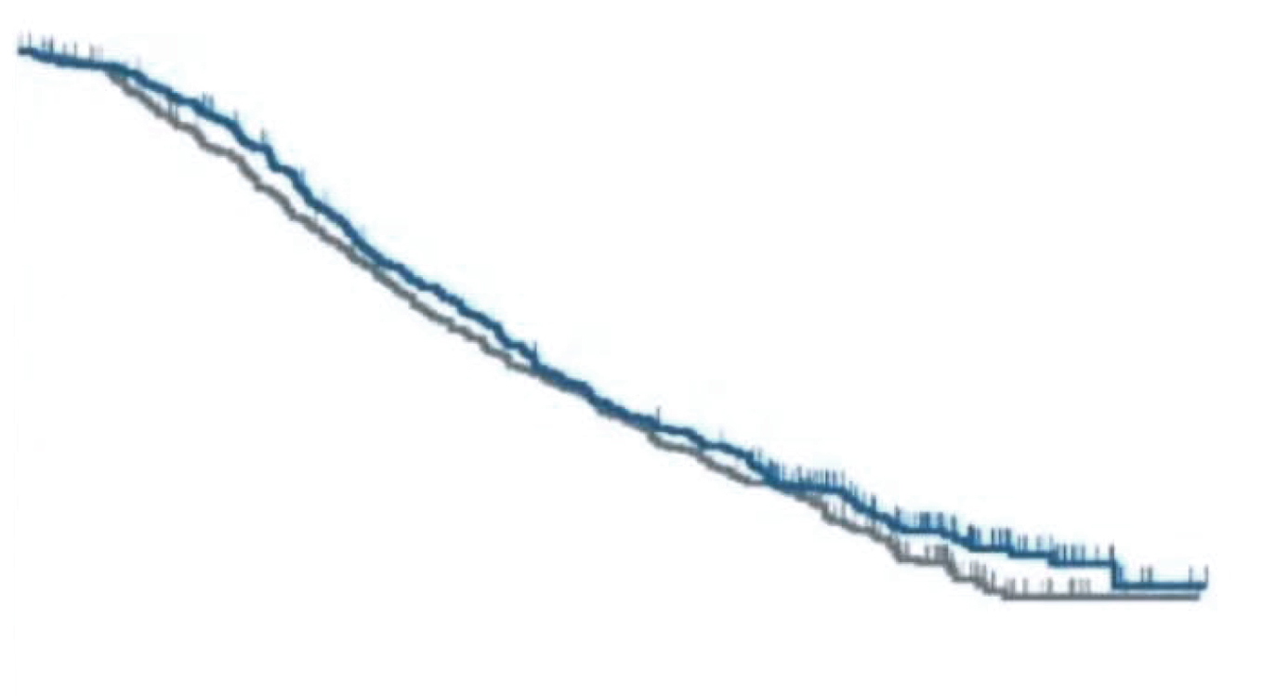
Overall survival
Final analysis
100
Nivolumab + Chemotherapy
Placebo + Chemotherapy
Probability of survival (%)
90
 | Nivo + Chemo (N=362) | Placebo + Chemo (N=362)
Median OS, months (95% CI) | 17.45 (15.67-20.83) | 17.15 (15.18-19.65)
Hazard ratio (95% CI) | 0.90 (0.75-1.08)
P value | 0.257
80
70
60
50
40
30
20
No significant improvement in OS with nivolumab + chemotherapy vs chemotherapy alone
10
0
0
3
6
9
12
15
18
21
24
27
30
33
36
Time (months)
No. at risk
Nivo + Chemo | 362 | 364 | 318 | 269 | 232 | 193 | 169 | 150 | 102 | 58 | 23 | 2 | 0
Placebo + Chemo | 362 | 342 | 301 | 259 | 219 | 192 | 167 | 141 | 97 | 48 | 16 | 5 | 0

Slide 16
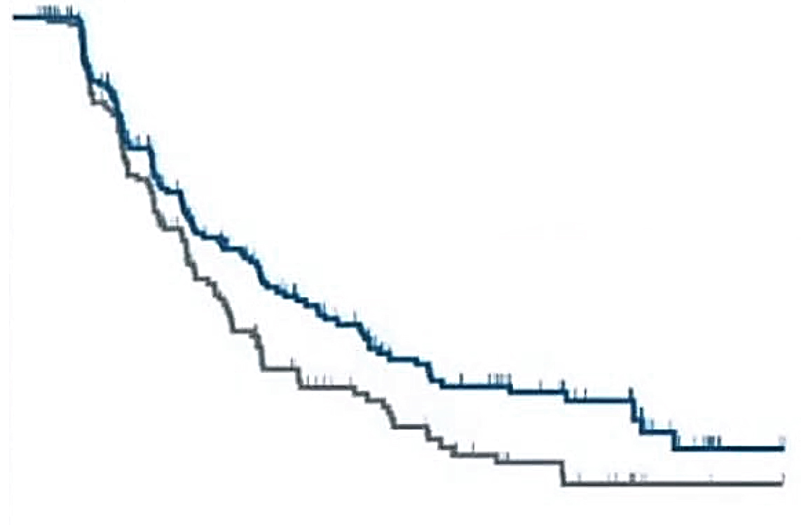
Secondary efficacy endpoints*
Duration of response (DOR)
Overall response rate (ORR)
 | Nivolumab + Chemotherapy (N=362) | Placebo + Chemotherapy (N=362)
ORR, n (%) | 208 (57.5) | 173 (47.8)
95% Cl | 52.2-62.6 | 42.2-53.1
P value | 0.0088
Best overall response, n (%)
Complete response | 70 (19.3) | 48 (13.3)
Partial response | 138 (38.1) | 125 (34.5)
Stable disease | 52 (14.4) | 75 (20.7)
Progressive disease | 25 (6.9) | 46 (12.7)
Not evaluable# | 77 (21.3) | 68 (18.8)
DCR, n (%) | 260 (71.8) | 248 (68.5)
95% Cl | 66.9-76.4 | 63.4-73.3
Median TTR (range), months | 1.4 (1.0-8-3) | 1.4 (1.0-15.3)
 | Nivolumab + Chemotherapy (N=208) | Placebo + Chemotherapy (N=173)
Median DOR, months (95% CI) | 12.91 (9.89-16.56) | 8.67 (7.20-11.37)
100
Probability of DOR (%)
90
80
70
60
50
40
30
20
Nivolumab + Chemotherapy
Placebo + Chemotherapy
10
0
0
3
6
9
12
15
18
21
24
27
30
33
Time (months)
No. at risk
Nivolumab + Chemotherapy | 208 | 174 | 119 | 90 | 71 | 50 | 43 | 34 | 27 | 10 | 2 | 0
Placebo + Chemotherapy | 173 | 139 | 84 | 57 | 40 | 32 | 22 | 16 | 9 | 3 | 2 | 0
OS: Overall survival. CI: Confidence interval. DCR: Disease control rate. DOR: Duration of response, ORR: Overall response rate, TTR: Time to treatment response.
Boku, N. et al, 2020. Abstract LBA7 presented at ESMO 2020.

Slide 17
Adverse event summary
Patients, N (%) | Nivolumab + Chemotherapy (N=359)ª |  |  | Placebo + Chemotherapy (N=358)ª
 | Any grade | Grade 3-4 | Grade 5 | Any grade | Grade 3-4 | Grade 5
AEs^{b}
Any AEs | 358 (99.7) | 249 (69.4) | 8 (2.2) | 357 (99.7) | 226 (63.1) | 6 (1.7)
Serious AEs | 135 (37.6) | 103 (28.7) | 8 (2.2) | 120 (33.5) | 89 (24.9) | 6 (1.7)
AEs leading to discontinuation | 38 (10.6) | 19 (5.3) | 5 (1.4) | 26 (7.3) | 12 (3.4) | 4 (1.1)
AEs leading to dose delay or reduction | 314 (87.5) | 190 (52.9) | 2 (0.6) | 312 (87.2) | 170 (47.5) | 1 (0.3)
Drug-related AEs^{b}
Any AEs | 351 (97.8) | 205 (57.1) | 3 (0.8)^{c} | 349 (97.5) | 174 (48.6) | 2 (0.6)^{d}
Serious AEs | 88 (24.5) | 66 (18.4) | 3 (0.8)^{c} | 51 (14.2) | 33 (9.2) | 2 (0.6)^{d}
AEs leading to discontinuation | 22 (6.1) | 11 (3.1) | 3 (0.8)^{c} | 17 (4.7) | 8 (2.2) | 2 (0.6)^{d}
AEs leading to dose delay or reduction | 307 (85.5) | 169 (47.1) | 0 | 291 (81.3) | 140 (39.1) | 0
ª Patients who received ≥1 dose of study treatment.
^{b} AEs occuring from the date of initiating the study treatment to the earlier date of initiating the subsequent therapy or 28 days after the last dose of the study treatment.
^{c} One event each of febrile neutropenia, hepatic failure and sudden death.
^{d} One event each of sepsis and haemolytic anaemia.

Slide 18
Drug-related adverse events
Adverse events with potential immunologic etiology
Selected Drug-related AEs, N (%)^{a,b} | Nivolumab + Chemotherapy (N=359)^{c} |  |  | Placebo + Chemotherapy (N=358)^{c}
 | Any grade | Grade 3-4 | Grade 5 | Any grade | Grade 3-4 | Grade 5
Endocrine | 41 (11.4) | 8 (2.2) | 0 | 12 (3.4) | 0 | 0
Gastrointestinal | 129 (35.9) | 21 (5.9) | 0 | 113 (31.6) | 19 (5.3) | 0
Hepatic | 83 (12.1) | 14 (3.9) | 1 (0.3)^{d} | 68 (19.0) | 12 (3.4) | 0
Hypersensitivity/ Infusion reaction | 48 (13.4) | 12 (3.3) | 0 | 26 (7.3) | 4 (1.1) | 0
Pulmonary | 12 (3.3) | 4 (1.1) | 0 | 7 (2.0) | 1 (0.3) | 0
Renal | 9 (2.5) | 1 (0.3) | 0 | 4 (1.1) | 1 (0.3) | 0
Skin | 134 (37.3) | 14 (3.9) | 0 | 86 (24.0) | 4 (1.1) | 0
ª AEs occuring from the date of initiating the study treatment to the earlier date of initiating the subsequent therapy or 28 days after the last dose of the study treatment.
^{b} Selected Drug-related AEs are those with potential immunologie etiology that require frequent monitoring/intervention.
^{c} Patients who received ≥1 dose of study treatment.
^{d} One event of hepatic failure..

Slide 19
ATTRACTION-4 Conclusions
Nivolumab plus chemotherapy demonstrated a statistically significant improvement in PFS, but not in OS
Higher overall response rates and more durable response
The pre-specified objective of the phase 3 part of ATTRACTION-4 was achieved, showing clinically meaningful efficacy
Nivolumab plus chemotherapy demonstrated a manageable safety profile
Nivolumab plus chemotherapy could be considered a new first-line treatment option in unresectable advanced or recurrent gastric/gastroesophageal cancer

Slide 20
KEYNOTE-590
PD-1i plus chemotherapy vs chemotherapy in advanced esophageal or esophagogastric junction cancer: Pembrolizumab

Slide 21
KEYNOTE-590: Study design
Phase 3 study of chemotherapy + pembrolizumab vs chemotherapy + placebo as first-line therapy for patients with advanced esophageal or esophagogastric junction cancer
Pembrolizumab 200 mg IV Q3W for ≤35 cycles
+
Chemotherapy
5-FU 800 mg/m² IV for days 1-5 Q3W for ≤35 cycles
+ Cisplatin 80 mg/m² IV Q3W for ≤6 cycles
Key Eligibility Criteria
Locally advanced unresectable or metastatic EAC or ESCC or advanced/metastatic EGJ Siewert type 1 adenocarcinoma
Treatment naive
ECOG PS 0 or 1
Measurable
R
(1:1)
Placeboª
+Chemotherapy
5-Fu 800 mg/m² IV for days 1-5 Q3W for ≤35 cycles
+ Cisplatin 80 mg/m² IV Q3W for ≤6 cycles
Stratification Factors
Asia vs Non-Asia region
ESCC vs EAC
ECOG PS 0 vs 1
Dual-Primary endpoints: OS and PFS (RECIST v1.1, investigator)
Secondary endpoint: ORR (RECIST v1.1, investigator)
Tumor response assessed at week 9 then Q9W (RECIST v1.1, investigator)
,..
Dual-Primary endpoints: OS and PFS (RECIST v1.1, investigator)
Secondary endpoint: ORR (RECIST v1.1, investigator)
Tumor response assessed at week 9 then Q9W (RECIST v1.1, investigator)

Slide 22
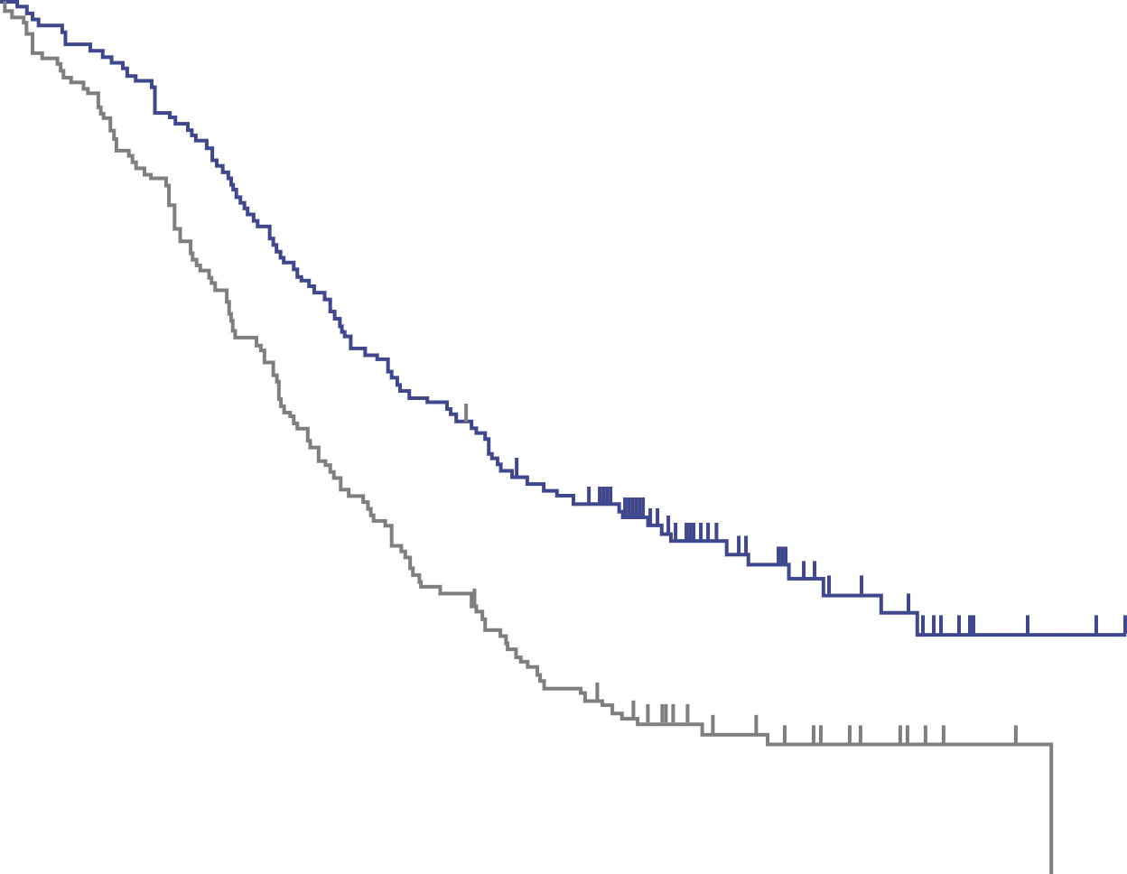
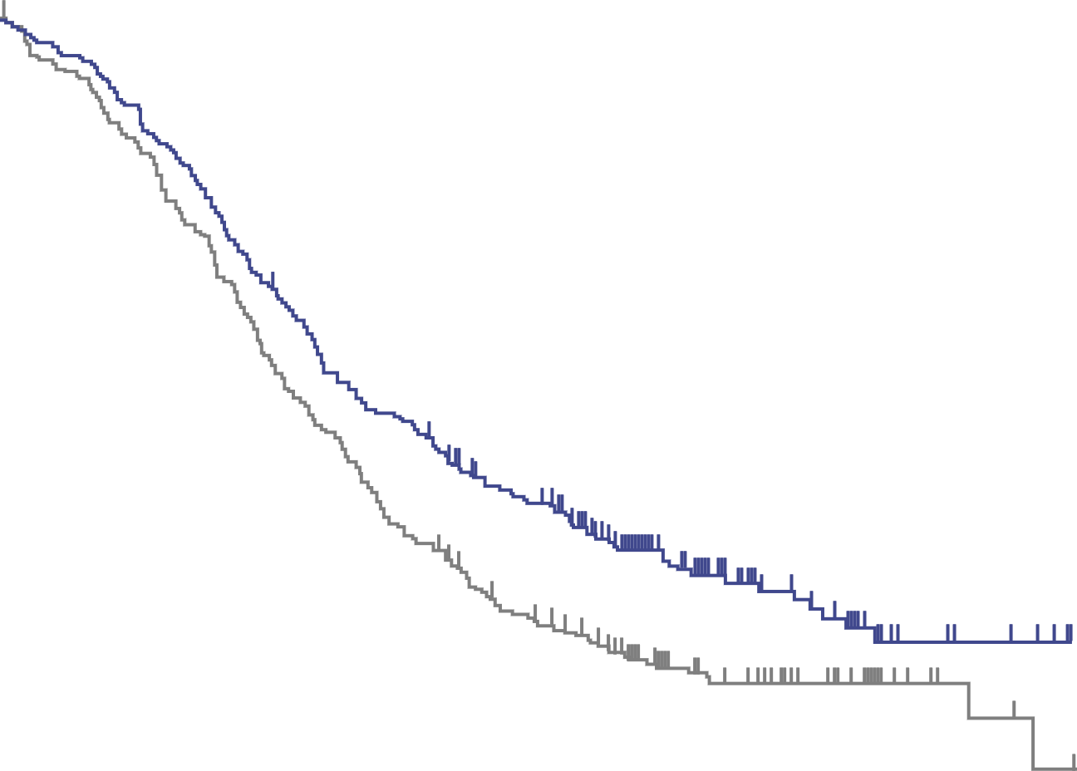
Overall survival (OS) - ESCC population only
ESCC PD-L1 CPS ≥10
All ESCC patients
 | Events | HR (95% CI) | p
Pembro + Chemo | 66% | 0.57 | <0.0001
Chemo | 85% | (0.43-0.75)
 | Events | HR (95% CI) | p
Pembro + Chemo | 69% | 0.72 | 0.0006
Chemo | 81% | (0.60-0.88)
100
100
OS (%)
90
OS (%)
90
80
12-mo rate
55%
34%
24-mo rate
31%
15%
80
12-mo rate
51%
38%
24-mo rate
29%
17%
70
70
60
Median (95% CI)
13.9 mo (11.1-17.7)
8.8 mo (7.8-10.5)
60
Median (95% CI)
12.6 mo (10.2-14.3)
9.8 mo (8.6-11.1)
50
50
40
40
30
30
20
20
10
10
0
0
0
3
6
9
12
15
18
21
24
27
30
33
36
0
3
6
9
12
15
18
21
24
27
30
33
36
Time (months)
Time (months)
No. at risk
Pembro + Chemo | 143 | 134 | 119 | 96 | 78 | 61 | 51 | 29 | 16 | 7 | 3 | 0 | 0
Chemo | 143 | 124 | 99 | 70 | 48 | 34 | 24 | 15 | 10 | 4 | 1 | 0 | 0
No. at risk
Pembro + Chemo | 274 | 258 | 221 | 175 | 139 | 111 | 89 | 60 | 27 | 14 | 6 | 2 | 0
Chemo | 274 | 247 | 203 | 146 | 103 | 75 | 57 | 34 | 23 | 13 | 4 | 1 | 0

Slide 23
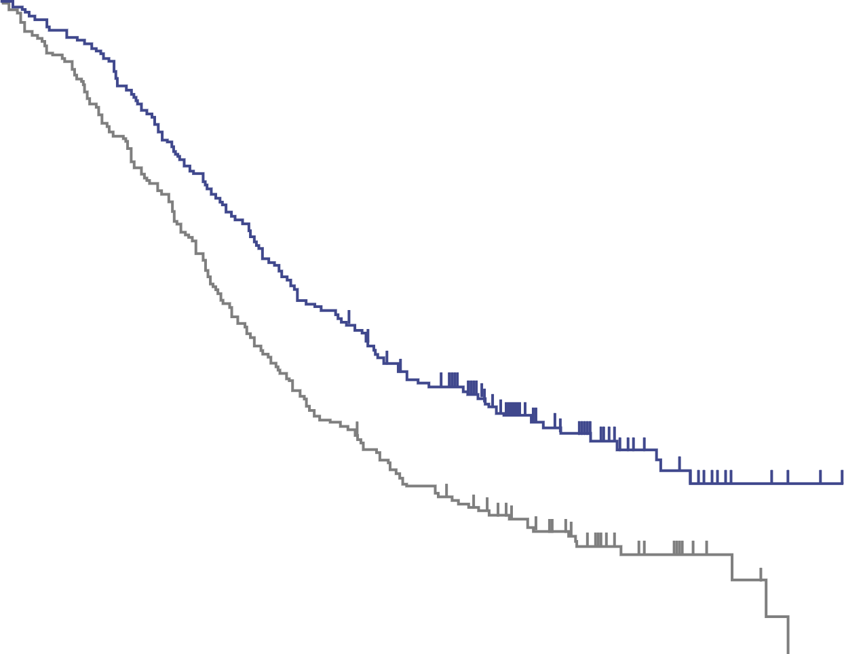
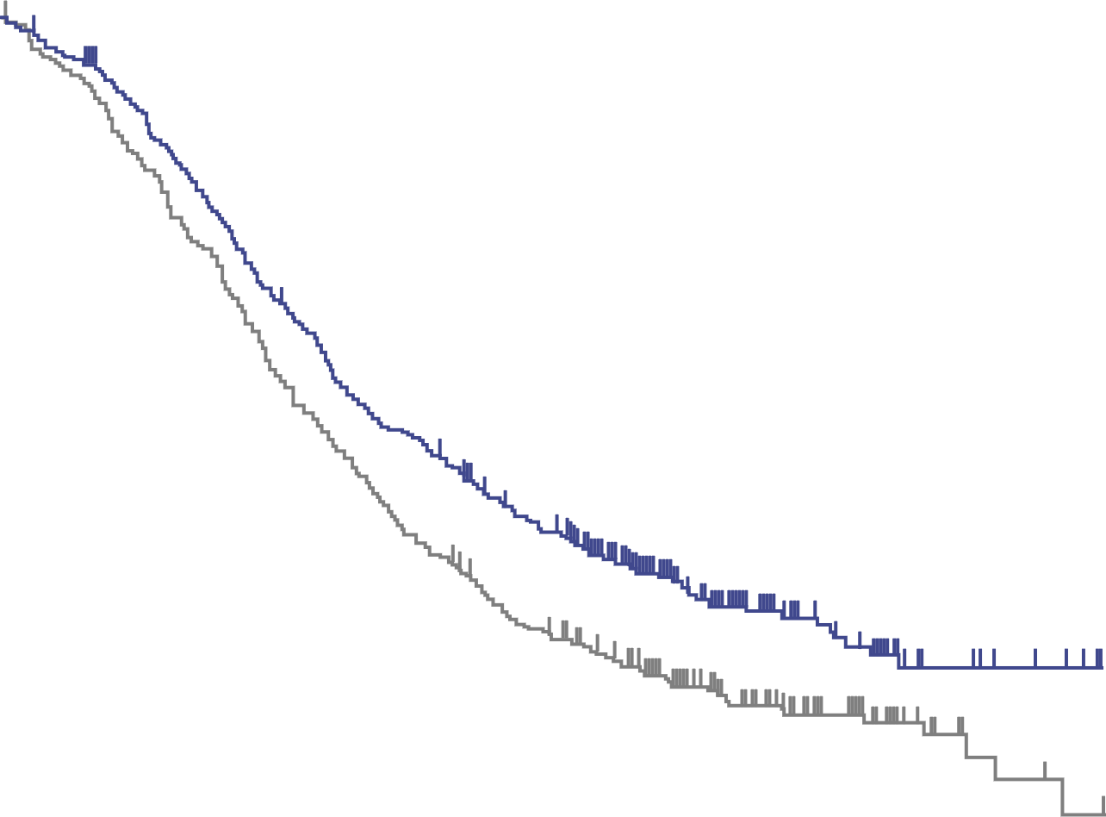
Overall survival (OS) - Full population (ESCC & EAC)
PD-L1 CPS ≥10
All patients
 | Events | HR (95% CI) | p
Pembro + Chemo | 67% | 0.62 (0.49-0.78) | <0.0001
Chemo | 84%
 | Events | HR (95% CI) | p
Pembro + Chemo | 70% | 0.73 (0.62-0.86) | <0.0001
Chemo | 82%
100
100
OS (%)
90
OS (%)
90
80
12-mo rate
54%
37%
24-mo rate
31%
15%
80
12-mo rate
51%
39%
24-mo rate
28%
16%
70
70
60
Median (95% CI)
13.5 mo (11.1-15.6)
9.4 mo (8.0-10.7)
60
Median (95% CI)
12.4 mo (10.5-14.0)
9.8 mo (8.8-10.8)
50
50
40
40
30
30
20
20
10
10
0
0
0
3
6
9
12
15
18
21
24
27
30
33
36
0
3
6
9
12
15
18
21
24
27
30
33
36
Time (months)
Time (months)
No. at risk
Pembro + Chemo | 186 | 175 | 151 | 125 | 100 | 79 | 66 | 40 | 23 | 10 | 4 | 0 | 0
Chemo | 197 | 174 | 142 | 102 | 73 | 55 | 42 | 28 | 13 | 6 | 1 | 0 | 0
No. at risk
Pembro + Chemo | 373 | 348 | 295 | 235 | 187 | 151 | 118 | 68 | 36 | 17 | 7 | 2 | 0
Chemo | 376 | 338 | 274 | 200 | 147 | 108 | 82 | 51 | 28 | 15 | 4 | 1 | 0

Slide 24
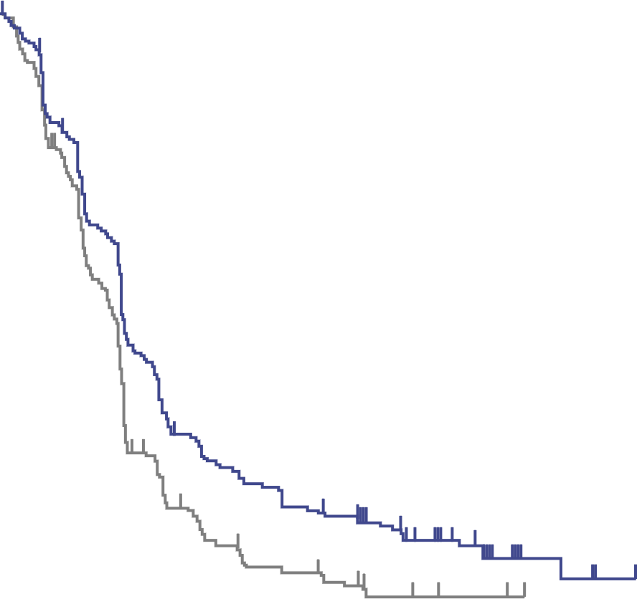
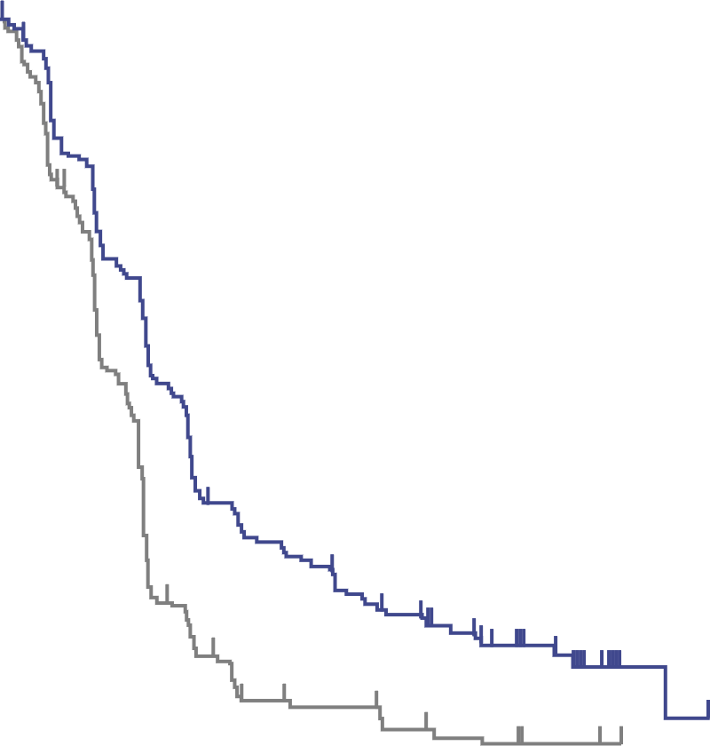
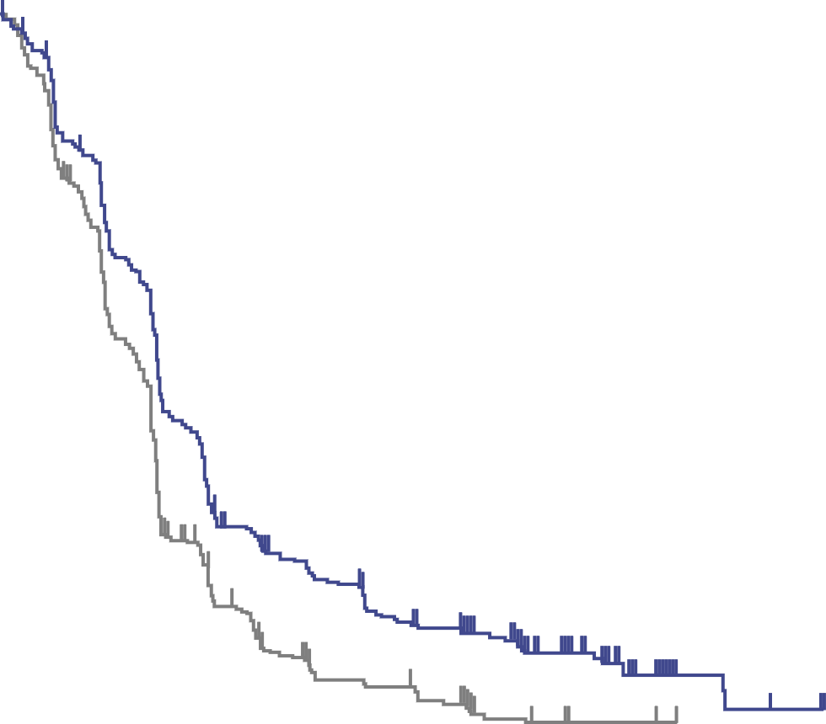
Progression-free survival (PFS)
ESCC, irrespective of CPS
PD-L1 CPS ≥10, irrespective of histology
All Patients
 | Events | HR (95% CI) | p
Pembro + Chemo | 80% | 0.65 (0.54-0.78) | <0.0001
Chemo | 89%
 | Events | HR (95% CI) | p
Pembro + Chemo | 75% | 0.51 (0.41-0.65) | <0.0001
Chemo | 88%
 | Events | HR (95% CI) | p
Pembro + Chemo | 80% | 0.65 (0.55-0.76) | <0.0001
Chemo | 89%
100
100
100
PFS (%)
90
PFS (%)
90
PFS (%)
90
80
80
80
70
12-mo rate
24%
12%
70
12-mo rate
30%
9%
70
12-mo rate
25%
12%
18-mo rate
16%
6%
60
18-mo rate
17%
6%
60
18-mo rate
21%
5%
60
50
Median (95% CI)
6.3 mo (6.2-6.9)
5.8 mo (5.0-6.1)
50
Median (95% CI)
7.5 mo (6.2-8.2)
5.5 mo (4.3-6.0)
50
Median (95% CI)
6.3 mo (6.2-6.9)
5.8 mo (5.0-6.0)
40
40
40
30
30
30
20
20
20
10
10
10
0
0
0
0
3
6
9
12
15
18
21
24
27
30
33
36
0
3
6
9
12
15
18
21
24
27
30
33
36
0
3
6
9
12
15
18
21
24
27
30
33
36
Time (months)
Time (months)
Time (months)
No. at risk
Pembro + Chemo | 274 | 211 | 156 | 71 | 57 | 41 | 35 | 19 | 13 | 3 | 2 | 0 | 0
Chemo | 274 | 205 | 127 | 45 | 26 | 16 | 11 | 5 | 2 | 1 | 0 | 0 | 0
186 | 143 | 109 | 56 | 48 | 36 | 29 | 17 | 12 | 2 | 1 | 0 | 0
197 | 145 | 85 | 26 | 14 | 12 | 7 | 5 | 2 | 1 | 0 | 0 | 0
373 | 289 | 210 | 96 | 79 | 55 | 45 | 25 | 17 | 4 | 2 | 0 | 0
376 | 278 | 172 | 62 | 36 | 22 | 14 | 6 | 2 | 1 | 0 | 0 | 0

Slide 25
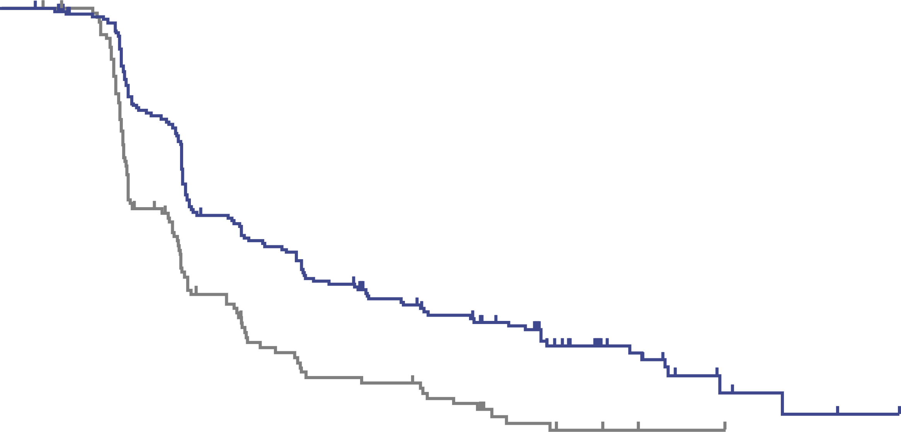
Response rate and duration
In all patients: By investigator according to RECIST v1.1
Patients in Response, %
100
90
 | ORR, % (95% CI) | % differenceª P
Pembro + Chemo | 45.0 (39.9-50.2) | 15.8 <0.0001
Chemo | 29.3 (24.7-34.1)
80
70
12-mo rate
38.6%
17.8%
24-mo rate
18.1%
6.1%
60
50
Median DOR, (range)
8.3 mo (1.2+ to 31.0+)
6.0 mo (1.5+ to 25.0+)
40
30
20
10
0
0
3
6
9
12
15
18
21
24
27
30
33
36
Time (months)
No. at risk
Pembro + Chemo | 168 | 162 | 117 | 75 | 60 | 43 | 35 | 16 | 6 | 2 | 1 | 0 | 0
Chemo | 110 | 106 | 50 | 22 | 16 | 11 | 5 | 2 | 1 | 0 | 0 | 0 | 0
ªEstimate based on Miettinen & Nurminen method stratified by geographic region. histology. and ECOG performance status; Data cut-off: July 2. 2020

Slide 26
Safety and tolerability
Adverse events in all treated patients
AEs | Pembro + Chemo (N=370) | Chemo (N=370)
Any | 100% | 99.5%
Treatment-related | 98.4% | 97.3%
Grade 3 | 71.9% | 67.6%
Led to discontinuation | 19.5% | 11.6%
Led to death | 2.4% | 1.4%
Immune-mediated AEs and infusion reactions | 25.7% | 11.6%
Grade 3 | 7.0% | 2.2%
Grade
1-2 3-5
Pembro + Chemo
Chemo

Slide 27
KEYNOTE-590 Conclusions
First-line pembrolizumab plus chemotherapy provided a statistically significant and clinically meaningful improvement in OS, PFS, and ORR in patients with locally advanced and metastatic esophageal cancer including EGJ adenocarcinoma when compared to chemotherapy plus placebo
  Superior OS: ESCC CPS ≥10 (HR 0.57, P<0.001), ESCC (HR 0.72, P=0.006), CPS ≥10 (HR 0.62, P<0.001), all patients (HR 0.73, P<0.001)
  Superior PFS: ESCC (HR 0.65), CPS ≥10 (HR 0.51), all patients (HR 0.65), all P<0.001
  Superior ORR: All patients (45.0% vs 29.3%, Δ15.8%, P<0.001)
Comparable safety profile between the two treatment groups
  No new safety signals detected
Pembrolizumab plus chemotherapy should be a new standard-of-care as first-line therapy in patients with locally advanced and metastatic esophageal cancer including EGJ adenocarcinoma

Slide 28
PD-L1 expression and tislelizumab efficacy in gastroesophageal adenocarcinoma
Novel tumor and immune cell score with VENTANA PD-L1 (SP263) assay and combined positive score (CPS)

Slide 29
Study background
Tumor cell (TC) and immune cell (IC) PD-L1 expression may be associated with anti-PD-1 efficacy in gastroesophageal adenocarcinoma (GEA)
PD‑L1 protein expression on TCs and ICs can be assessed via cell counting using Combined Positive Score (CPS) with Dako 22C3 assay
CPS is the number of PD-L1 staining cells (TCs, lymphocytes, macrophages) divided by the total number of viable tumor cells, multiplied by 100
However, the CPS scoring method can be challenging
A novel combined algorithm, tumor and immune Cell (TIC) score, was developed for the Ventana SP263 assay to assess TC and IC PD-L1 expression based on tumor area
Associations between CPS and TIC scoring methods, and potential correlations with efficacy, were investigated in patients with GEA from the tislelizumab first-in-human study (NCT02407990)

Slide 30
Methods
PD-L1 Assessment:
PD-L1 expression in tumor samples from GEA cohort of the tislelizumab first-in-human study (BGB-A317-001) were analyzed post-hoc
Clinical utilization of two PD-L1 assays were evaluated, vCPS (Ventana SP263 assay; N=74) and CPS (Dako 22C3 assay; N=49)
Methodology of PD‑L1 expression assessment | Visually estimated Combined Positive Score (vCPS) | Combined Positive Score (CPS)
Assay | VENTANA PD-L1 (SP263) assay on automated VENTANA Benchmark ULTRA® platform | Dako PD‑L1 IHC 22C3 assay on Dako Autostainer Link 48
PD-L1 scoring algorithm | Percent area occupied by PD‑L1 staining cells (tumor cell, immune cell*) Tumor area** | Number of PD‑L1 staining cells (tumor cell, macrophage, lymphocyte) Total number of viable tumor cells
Measurement method | Derived by visual estimation of area occupied by PD‑L1 staining TC and IC against tumor area | Derived by cell counting
×100
Statistical analysis:
ORR
OS and PFS (Brookmeyer and Crowley method with log-log transformation
Kaplan-Meier curves of PD-L1 subgroups compared log-rank test)
Analytical validation of VENTANA PD-L1 assay in GC and GEJ adenocarcinoma:
The VENTANA PD‑L1 (SP263) assay was validated for use in GC/GEJ adenocarcinoma FFPE samples in a series of studies that addressed assay repeatability, intermediate precision, reader precision, and inter-laboratory reproducibility

Slide 31
Baseline characteristics and clinical outcome
Of 81 patients enrolled in BGB-A317-001 GEA cohort, PD‑L1 expression was evaluable by vCPS (by VENTANA PD‑L1 SP263) and CPS (by Dako 22C3) in 74 and 49 patients with available FFPE tumors, respectively; 45 were evaluable by both assays
Baseline characteristics and clinical outcome
Characteristic |  | vCPS Evaluable N = 74 | CPS Evaluable N = 49 | All GEA Patients N = 81
Age, N (%) | <65 ≥65 | 45 (60.8) 29 (39.2) | 33 (67.3) 16 (32.7) | 48 (59) 33 (41)
Sex, N (%) | Male Female | 48 (65) 26 (35) | 33 (67) 16 (33) | 54 (67) 27 (33)
Tumor type, N (%) | GC/GEJ adenocarcinoma EAC | 48 (65) 26 (35) | 27 (55) 22 (45) | 54 (67) 27 (33)
Tumor stage, N (%) | III IV | 4 (5.4) 70 (95) | 1 (2.0) 48 (98) | 5 (6.2) 76 (94)
Response, N (%) | PR SD PD NA | 7 (9.5) 14 (19) 43 (58) 1 (1.4) | 4 (8.2) 10 (20) 30 (61) 1 (2.0) | 8 (9.9) 17 (21) 46 (57) 1 (1.2)
ORR, % (95% CI) |  | 10.9 (4.5, 21.2) | 9.1 (2.5, 21.7) | 11.3 (5, 21)
Median PFS, months (95% CI) |  | 2.0 (1.7, 2.1) | 2.0 (1.5, 2.1) | 2.0 (1.8, 2.1)
Median OS, months (95% CI) |  | 5.6 (3.9, 6.7) | 5.6 (3.8, 8.6) | 5.9 (4.2, 9.1)
Median follow-up, months (95% CI) |  | 14.2 (10.9, 21.2) | NE (13.9, NE) | 17.4 (13.9, NE)

Slide 32
Clinical utility of vCPS and CPS
Response, prevalence, positive predictive value (PPV), and negative predictive value (NPV) for vCPS ≥5% and CPS ≥1
Scoring method | PD-L1 | BEP | ORR (%) | PD-L1 Prevalence (%) | Response Odds Ratio | PPV (%) | NPV (%)
vCPS (SP263) | ≥5% <5% | 38 36 | 18.2 3.2 | 51 | 6.67 | 15.8 | 83.3
CPS (22C3) | ≥1 <1 | 22 27 | 20.0 0 | 45 | ∞* | 18.2 | 88.9
*Odds ratio could not be estimated due to no responders in CPS <1.
Enriched ORR was observed in patients with vCPS ≥5% tumors versus vCPS <5% tumors (ORR=18.2% vs 3.2%); similar to those using a CPS ≥1 cutoff

Slide 33
Clinical utility of vCPS and CPS
At a 17.4-month median follow-up, patients with vCPS ≥5% or CPS ≥1 tumors showed survival benefit
PFS by vCPS Status
Median
vCPS ≥5% 2.07 months
vCPS <5% 1.77 months
HR (95% CI)=0.497 (0.298, 0.823)
Log rank P=0.005
PFS by CPS Status
Median
CPS ≥1 1.68 months
CPS <1 2.10 months
HR (95% CI)=0.880 (0.474, 1.606)
Log rank P=0.676
100
100
75
75
PFS (%)
PFS (%)
50
50
25
25
0
0
0
5
10
15
20
0
5
10
15
20
Time (months)
Time (months)
No. at risk
vCPS ≥5% | 38 | 9 | 5 | 2 | 0
vCPS <5% | 36 | 2 | 0 | 0 | 0
No. at risk
CPS ≥1 | 22 | 5 | 1 | 1 | 0
CPS <1 | 27 | 2 | 0 | 0 | 0

Slide 34
Clinical utility of vCPS and CPS
More favourable PFS and OS were seen in patients with vCPS ≥5% tumors (PFS HR=0.497, OS HR=0.529) and CPS ≥1 tumors (PFS HR=0.880, OS HR=0.665)
OS by vCPS Status
Median
vCPS ≥5% 6.21 months
vCPS <5% 5.22 months
HR (95% CI)=0.529 (0.295, 0.935)
Log rank P=0.027
OS by CPS Status
Median
CPS ≥1 5.59 months
CPS <1 5.65 months
HR (95% CI)=0.665 (0.339, 1.259)
Log rank P=0.216
100
100
75
75
OS (%)
OS (%)
50
50
25
25
0
0
0
5
10
15
20
25
0
5
10
15
20
25
Time (months)
Time (months)
No. at risk
vCPS ≥5% | 38 | 20 | 13 | 7 | 4 | 1
vCPS <5% | 36 | 17 | 3 | 0 | 0 | 0
No. at risk
CPS ≥1 | 22 | 11 | 6 | 4 | 2 | 1
CPS <1 | 27 | 15 | 6 | 2 | 1 | 0

Slide 35
Validation
Analytical validation of VENTANA PD‑L1 (SP263) assay in GC and GEJ adenocarcinoma
Repeatability and intermediate precision studies
24 GC or GEJ adenocarcinoma cases representing a range of PD‑L1 expression levels
12 with vCPS ≥5% (including 2 borderline cases)
12 with vCPS <5% (including 2 borderline cases)
One reader evaluated all cases
Within-run, between-day repeatability, and intermediate precision (between antibody, detection kit lot, and instrument) for the VENTANA PD‑L1 (SP263) assay showed 100% overall percent agreement (OPA) with vCPS in gastric and GEJ adenocarcinoma
Between-reader and within-reader precision studies
100 GC or GEJ adenocarcinoma cases representing a range of PD‑L1 expression levels
50 with vCPS ≥5% (including 5 borderline cases)
50 with vCPS <5% (including 5 borderline cases)
VENTANA PD‑L1 (SP263) assay demonstrated between-reader precision and within-reader precision (OPA) with vCPS of 99.3% and 99%, respectively
Inter-laboratory reproducibility
28 GC or GEJ adenocarcinoma cases representing a range of PD‑L1 expression levels
14 with vCPS ≥5% (including 2 borderline cases)
14 with vCPS <5% (including 2 borderline cases)
Inter-laboratory reproducibility testing, performed across two readers at each of three external laboratories, demonstrated OPA of 95% between readers and 92.5% between sites

Slide 36
Conclusions
At evaluated cutoffs, both VENTANA PD‑L1 (SP263) and Dako 22C3 CPS assays aided identification of GEA patients with PD-L1 high tumors who were more likely to gain favorable clinical benefit from PD-1 inhibition than those with PD-L1 low tumors
VENTANA PD‑L1 (SP263) assay is a robust and reproducible tool for assessing and quantifying PD‑L1 expression in GC and GEJ adenocarcinoma
Reproducibility of the VENTANA PD‑L1 (SP263) assay with vCPS by differing pathologists, materials, and laboratories points to highly trainable assay nature and consistency in gastric cancer and gastroesophageal junction adenocarcinoma
Further clinical validation is underway for TIC ≥5% in patients with gastric and gastroesophageal junction adenocarcinoma from a phase 3 study (NCT03777657)

Slide 37
Ovarian cancer

Slide 38
MEDIOLA
PARPi + PD-1i in BRCAmut PSROC: Olaparib + durvalumab

Slide 39
MEDIOLA Study design
Phase 2 study of olaparib + durvalumab (MEDIOLA): Updated results in germline BRCA-mutated platinum-sensitive relapsed (PSR) ovarian cancer (OC)
Patient population:
gBRCAwt
PSR ovarian cancer
≤2 prior lines of chemotherapy
PARP inhibitor and IO agent naïve
Olaparib
300 mg PO BID
Treatment to
disease progression
Primary endpoints:
DCR at 24 weeks (target 80%)
Safety tolerability
Secondary endpoints:
DCR at 56 weeks, ORR, DOR, PFS, OS, PK
Exploratory endpoints:
Tumor genetics and immunology biomarkers
Triplet Arm
Durvalumab
1.5 g IV Q4W
Bevacizumab
10 mg/kg IV Q2W
Doublet
Arm
Olaparib
300 mg PO BID
Durvalumab
1.5 g IV Q4W
Sequential enrolment
Tumor assessments
every 8 weeks

Slide 40
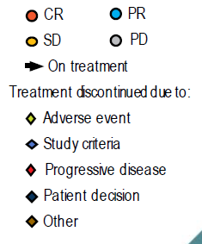
MEDIOLA Results - efficacy
Time to progression or treatment discontinuation
Olaparib + durvalumab + bevacizumab
Olaparib + durvalumab
CR
PR
DCR at 24 weeks: 28.1%
(90% CI 15.5–43.9)
Median PFS: 5.5 months
(95% CI 3.6–7.5)
SD
PD
On treatment
Treatment discontinued due to:
  Adverse event
  Study criteria
  Progressive disease
  Patient decision
  Other
DCR at 24 weeks: 77.4%
(90% CI 61.7–88.9)
Median PFS: 14.7 months
(95% CI 10.0–18.1)
24 weeks
24 weeks
0
100
200
300
400
500
600
0
100
200
300
400
500
Study day
Study day

Slide 41
MEDIOLA Exploratory analysis
Objective response rate (ORR)
100
Olap + durva + bev
ORR | 87.1%
95% CI | 70.2 – 96.4
Median DOR | 11.1 months
IQR | 7.4 – 16.4
Olap + durva
ORR | 34.4%
95% CI | 18.6 – 53.2
Median DOR | 6.9 months
IQR | 5.4 – 11.1
80
60
40
20
Best % change in
target lesion size
0
-20
-40
-60
-80
Confirmed ORR= 77.4% (95%Cl 58.9-90.4)
Confirmed ORR= 31.3% (95% Cl 16.1-50.0)
-100
 | Olaparib + durvalumab + bevacizumab |  | Olaparib + durvalumab
Genomic instability status (GIS)* subgroup | ORR (95% Cl), % | n/N patients | ORR (95% Cl), % | n/N patients
GIS-positive | 100 (69.2-100) | 10/10 | 50 (18.7-81.3) | 5/10
GIS-negative | 75 (34.9-96.8) | 6/8 | 16.7 (0.4-64.1) | 1/6
GIS-unknown | 84.6 (54.6-98.1) | 11/13 | 31.3 (11.0-58.7) | 5/16
Triplet cohort demonstrates GIS-independent, high ORR

Slide 42
MEDIOLA Safety Profiles
Patients with AE*, n (%) | Olap + durva + bev (N=31) | Olap + durva (N=32)
Nausea | 22 (71) | 28 (88)
Fatigue | 16 (52) | 16 (50)
Anaemia | 15 (48) | 13 (41)
Diarrhoea | 12 (39) | 14 (44)
Constipation | 9 (29) | 7 (22)
Vomiting | 15 (48) | 4 (13)
Decreased appetite | 11 (35) | 9 (28)
Headache | 11 (35) | 7 (22)
Abdominal pain | 8 (26) | 6 (19)
Arthralgia | 8 (26) | 8 (25)
Urinary tract infection | 9 (29) | 5 (16)
Blood creatinine increased | 5 (16) | 7 (22)
Hypothyroidism | 2 (6) | 5 (16)
Dysgeusia | 4 (13) | 6 (19)
AST increased | 5 (16) | 2 (6)
Myalgia | 3 (10) | 7 (22)
Rash | 5 (16) | 3 (19)
Back pain | 3 (10) | 6 (19)
Hypertension | 8 (26) | 1 (3)
Pruritus | 2 (6) | 5 (16)
Asthenia | 1 (3) | 7 (22)
Stomatitis | 5 (16) | 1 (3)
Weight decreased | 5 (16) | 3 (9)
Proteinuria | 7 (23) | 0
Epistaxis | 6 (19) | 0
Dysphonia | 5 (16) | 0
Patients with AE grade ≥3†, N (%) | Olap + durva + bev (N=31) | Olap + durva (N=32)
Anemia | 4 (13) | 7 (22)
Hypertension | 4 (13) | 1 (3)
Lipase increased | 2 (6) | 2 (6)
Fatigue | 2 (6) | 1 (3)
White blood cell count decreased | 2 (6) | 0
Neutropenia | 0 | 2 (6)
AE leading to discontinuation of ≥1 study treatment | 5 (16) | 2 (16)
 | Anemia Lethargy Intestinal perforation Chronic kidney disease Proteinuria | Renal impairment Lipase increased

Slide 43
Conclusions
Triplet combination of olaparib, durvalumab and bevacizumab showed promising efficacy as treatment in the absence of chemotherapy for women with germline BRCA wild type platinum - sensitive relapsed advanced ovarian cancer, with 77% disease control rate at 24 weeks and median PFS of 15 months
Exploratory analysis suggests high ORR in triplet cohort not driven by differences in genomic instability status (GIS); ORR was ≥75% in the GIS+, GIS− and GIS unknown subgroups
Safety profile of combination of olaparib plus durvalumab with/ without bevacizumab was consistent with known safety profiles expected for the single agents
Combination of olaparib, durvalumab and bevacizumab now being tested as part of first-line maintenance treatment in the Phase 3 study, DUO-O (NCT 03737643)

Slide 44
PARP inhibition in ovarian cancer
Pivotal phase 2 trial of pamiparib in advanced ovarian cancer

Slide 45
Study design
Phase 1/2 open-label, multicenter study assessing safety and antitumor activity of pamiparib in adults (≥18 years), Chinese patients with advanced ovarian cancer whose disease progressed despite standard therapy, or for which there is no standard therapy
Phase 1
Phase 2
Study Population
High grade, non-mucinous, epithelial OC (including fallopian or primary peritoneal cancer) and ECOG performance status of 0-1
Known deleterious/suspected deleterious gBRCAmut with ≥ 2 lines of standard chemotherapy, and currently experiencing relapsed disease/discontinued most recent standard treatment due to unacceptable toxicity
Exclusions: Untreated/active brain metastases or received prior treatment within 14 days of initiating study
A protocol amendment (PA) initiated a more proactive dose modification algorithm and close hematology monitoring; a pre- and post-PA safety analysis was conducted
20mg BID
Advanced platinum-sensitive
ovarian cancer (PSOC)*
N=80 evaluable patients
40mg BID
60mg BID
RP2D 60mg BID
Advanced platinum-resistant
ovarian cancer (PROC)**
N=20 evaluable patients
Pamiparib 60 mg administered PO BID on Day 1 of Cycle 1 (21-day cycle) and continuously in all subsequent cycles until disease progression, toxicity, or patient withdrawal
*Defined as disease progression occurring ≥6 months after last platinum treatment
**Defined as disease progression that occurred <6 months after last platinum treatment

Slide 46
Endpoints and assessments
Primary endpoint
Objective response rate (ORR) based on independent review committee (IRC) per Response Evaluation Criteria in Solid Tumors (RECIST) v1.1
Secondary endpoints
Duration of response (DOR) and progression-free survival (PFS) by IRC and investigator review
Disease control rate and clinical benefit rate by IRC and investigator review
ORR by investigator review
Overall survival (OS)
CA-125 response rate per Gynecologic Cancer Intergroup criteria
Pamiparib safety/tolerability profile
Assessments
Tumor imaging and CA-125 testing: every 6 weeks after 1st dose of pamiparib for 1st 18 weeks, every 9 weeks for remaining period in 1st year, and every 12 weeks from 2nd year onward
Safety and tolerability assessments: based on monitoring of AEs, as well as on vital signs, electrocardiograms, physical examinations, and clinical laboratory result
Statistical Methods: Antitumor activity per RECIST v1.1 was assessed in all efficacy-evaluable patients
Safety and tolerability: Evaluated in all patients who received ≥1 dose of pamiparib

Slide 47
Results – antitumor activity
Tumor response by patient cohort in the efficacy-evaluable population by IRC and investigator assessment based on RECIST v1.1
 |  | IRC Assessment |  | Investigator assessment
 |  | PSOC (N=82) | PROC (N=19) | PSOC (N=82) | PROC (N=19)
Best overall response, N (%) | Compete response (CR) | 8 (9.8) | 0 (0.0) | 5 (6.1) | 0 (0.0)
 | Partial response (PR) | 45 (54.9) | 6 (31.6) | 46 (56.1) | 5 (26.3)
 | Stable disease (SD) | 25 (30.5) | 12 (63.2) | 28 (34.1) | 10 (52.6)
 | Progressive disease (PD) | 4 (4.9) | 1 (5.3) | 3 (3.7) | 3 (15.8)
 | Not estimable | 0 (0.0) | 0 (0.0) | 0 (0.0) | 1 (5.3)
Objective response rate (ORR), % (95% CI) |  | 64.6 (53.3-74.9) | 31.6 (12.6-56.6) | 62.2 (50.8-72.7) | 26.3 (9.1-51.2)
Disease control rate (DCR), % (95% CI) |  | 95.1 (88.0-98.7) | 94.7 (74.0-99.9) | 96.3 (89.7-99.2) | 78.9 (54.4-93.9)
Cinical benefit rate (CBR) ≥24 weeks, % (95% CI) |  | 74.4 (63.6-83.4) | 52.6 (28.9-75.6) | 72.0 (60.9-81.3) | 52.6 (28.9-75.6)
Median time to response, months (min, max) |  | 1.7 (1.3, 6.3) | 1.4 (1.2, 1.4) | 2.7 (1.2, 8.3) | 1.3 (1.2, 4.2)
ORR in PSOC 64.6% by IRC (62.2% by investigator assessment) and 31.6% in PROC (26.3% by investigator assessment)
ORR and CR rate per RECIST v1.1 similar between IRC and investigator assessment
CA-125 response rate 79.7% (95% CI, 68.8-88.2) in PSOC patients and 38.1% (95% CI, 18.1-61.6) in PROC patients

Slide 48
Results - reduction in target lesions from baseline
Best change in sum of target lesion diameters by confirmed best overall response of the efficacy-evaluable population* per RECIST v1.1
In both cohorts, most patients had a reduction in target lesions from baseline
A. PSOC (Cohort 1)
B.. PROC (Cohort 2)
20
40
10
30
0
20
-10
10
0
-20
-10
-30
-20
Sum of Target Lesion Diameters (%)
Sum of Target Lesion Diameters (%)
-40
-30
-50
-40
-60
-50
-70
-60
Complete response (N=8)
Partial response (N=45)
Stable disease (N=25)
Progressive disease (N=4)
-70
-80
-80
Partial response (N=45)
Stable disease (N=25)
Progressive disease (N=4)
-90
-90
-100
-100
*Patients were considered efficacy-evaluable if they had measurable disease at baseline per RECIST v1.1 and had ≥1 postbaseline tumor assessment, unless treatment had been discontinued due to clinical progression or death prior to tumor assessment.

Slide 49
Results – ORR in PSOC patients
IRC assessed objective response rates (RECIST v1.1) by baseline characteristics in PSOC patients
Primary endpoint of ORR in PSOC patients was generally consistent across all subgroups
Response/Patients (N) |  |  |  | ORR (95% CI)
Age | <65 years ≥65 years | 46/72 7/10 |  | 63.9 (51.7, 74.9) 70.0 (34.8, 93.3)
ECOG performance status | 0 1 | 23/36 30/46 |  | 63.9 (46.2, 79.2) 65.2 (49.8, 78.6)
Prior systemic chemotherapy lines | 2 3 ≥4 | 34/48 9/16 10/18 |  | 70.8 (55.9, 83.0) 56.3 (29.9, 80.2) 55.6 (30.8, 78.5)
Time to progression to last platinum-based therapy | 6-12 months ≥12 months | 33/56 20/26 |  | 58.9 (45.0, 71.9) 76.9 (56.4, 91.0)
BRCA mutation type | BRCA1 BRCA2 | 45/72 8/10 |  | 62.5 (50.3, 73.6) 80.0 (44.4, 97.5)
Target lesion diameter per IRC at study entry | <50 mm ≥50 mm | 25/41 28/41 |  | 61.0 (44.5, 75.8) 68.3 (51.9, 81.9)
CA-125 atstudy entry | <70 kU/L ≥70 kU/L | 8/15 45/67 |  | 53.3 (26.6, 78.7) 67.2 (54.6, 78.2)
0
10
20
30
40
50
60
70
80
90
100

Slide 50
Results - duration of response and progression-free survival in PSOC patients
Duration of response and progression free survival in PSOC patients by IRC assessment per RECIST v1.1
Median duration of response was 14.5 months (95% CI, 11.1-NE)
Median progression-free survival was 15.2 months
(95% CI, 10.35-NE)
Duration of Response in Efficacy-Evaluable Population
Progression-Free Survival in Safety Population
100
100
75
75
50
50
Progression-Free Survival (%)
Progression-Free Survival (%)
25
25
0
0
0
5
10
15
20
0
1
2
3
4
5
6
7
8
9
10
11
12
13
14
15
16
17
18
19
20
Duration of Response (months)
Duration of Response (months)
No. at risk (N)
PSOC | 53 | 34 | 12 | 2 | 0
No. at risk (N)
PSOC | 90 | 88 | 78 | 72 | 72 | 62 | 57 | 41 | 41 | 32 | 31 | 22 | 22 | 12 | 12 | 12 | 3 | 3 | 1 | 0 | 0

Slide 51
Results – safety and tolerability
Summary of most common TEAEs
Median treatment duration 8.3 months (range, 0.1-19.3 months) in PSOC patients and 4.1 months (range, 0.1-19.9 months) in PROC patients
Across both PSOC and PROC cohorts, the most frequently reported AEs of any grade were GI disorders and hematologic toxicities
In the post-protocol amendment (PA) subgroup, the percentage of patients who experienced grade ≥3 hematologic AEs was lower vs the pre-PA subgroup
No patient in the post-PA subgroup experienced a hematologic AE that led to treatment discontinuation
Decreased neutrophil count
Decreased
WBC count
Vomiting

Slide 52
Conclusions
Statistically and clinically meaningful and durable response observed in patients with PSOC
Clinically meaningful and durable response observed in patients with PROC
Pamiparib 60 mg PO BID demonstrated a generally tolerated and acceptable safety profile
Overall safety profile generally consistent between patients with PSOC and PROC
Similar to other PARP inhibitors, hematologic toxicities were the most significant safety events observed
Hematological toxicities were manageable and could be better managed with a more proactive modification plan and closer hematologic monitoring
No myelodysplastic syndrome reported
No significant complications (e.g. grade ≥3 hemorrhage, fever, or infection) potentially related to hematologic toxicity reported

Slide 53
NORA
PARPi maintainance in OC: Niraparib

Slide 54
NORA Study design
Individualized starting dose of niraparib in Chinese patients with platinum-sensitive recurrent ovarian cancer (PSROC): A randomized, double-blind, placebo-controlled, phase 3 trial
Main inclusion criteria
Platinum-sensitive, recurrent OC
High-grade serous or high grade predominantly serous histology or known to have gBRCAmut
Completed at least 2 previous lines
of platinum-containing therapy
Partial or complete response to the last platinum-based chemotherapy
Niraparib*
(N=160)
Until disease progression
or toxicity
R
2:1
Placebo
(N=80)
Stratification factors
gBRCA mutation: Yes or No
Response to last chemotherapy: complete or partial response
Time to progression after penultimate platinum-based regimen: 6-12 vs >12 months
Primary endpoint
Progression-free survival (PFS) by BICR
Primary analysis of PFS in ITT population
Statistical assumption: PFS hazard ratio of 0.54,
two-sided type I error of .05, power >90%
Secondary endpoint
Safety
Chemotherapy-free interval (CFI)
Time to first subsequent therapy (TFST)
Overall survival (OS)
* Individual dosing - adopted in protocol amendment
Body weight ≥77 kg and platelets ≥150,000/𝜇L started with 300 mg QD Body weight <77 kg and/or platelets <150,000/𝜇L started with 200 mg QD

Slide 55
NORA Primary endpoint
PFS (BICR) in ITT population
1.0
68% reduction of hazard for relapse or death with niraparib
 | Niraparib (N=177) | Placebo (N=88)
Median PFS
Months (95% CI) | 18.3 (10.9–NE) | 5.4 (3.7–5.7)
Hazard ratio (95% CI) | 0.32 （0.23-0.45）
p-value¹ | <0.0001
0.8
0.6
Cumulative probability of progression-free
survival,%
0.4
0.2
Niraparib
Placebo
Censored observation
¹ p-value is from stratified log-rank test.
0.0
0
3
6
9
12
15
18
21
24
Time (months)
Niraparib
Placebo
177
88
160
63
116
28
100
18
70
11
43
8
25
8
8
2
0
0
Niraparib resulted in significantly longer mPFS than placebo in ITT population of all-comer patients

Slide 56
PFS (BICR) in pre-specified subgroups
 | Niraparib Events / N | Placebo Events / N | Hazard Ratio (95% CI)
Subgroup
Overall | 80/177 | 66/88 | 0.32 (0.23,0.46)
Age, year 18-64 ≥65 | 63/152 17/25 | 57/76 9/12 | 0.30 (0.21,0.44) 0.65 (0.29,1.46)
Time to progression after penultimate therapy, months 6-12 ≥12 | 29/56 51/121 | 25/28 41/60 | 0.31 (0.17,0.55) 0.33 (0.22,0.51)
Best response to platinum Complete response Partial response | 28/86 52/90 | 32/47 34/41 | 0.26 (0.15,0.46) 0.33 (0.21,0.52)
Germline BRCA mutation status Positive Negative | 24/64 56/112 | 28/35 38/53 | 0.22 (0.12,0.39 0.40 (0.26,0.61)
0.01
0.1
1
10
100
Niraparib better
Placebo better

Slide 57
PFS (BICR) in biomarker subgroups
gBRCAmut subgroups
Non-gBRCAmut subgroups
 | Niraparib (N=65) | Placebo (N=35)
mPFS, mo (95% CI) | NR (11.0-NE) | 5.5 (3.7-6.9)
HR (95% CI) | 0.22 (0.12-0.39)
p-value* | p<0.0001
 | Niraparib (N=112) | Placebo (N=53)
mPFS, mo (95% CI) | 11.1 (7.5-NE) | 3.9 (3.7-6.9)
HR (95% CI) | 0.40 (0.26-0.61)
p-value* | p<0.0001
1.0
1.0
0.8
0.8
0.6
0.6
Cumulative probability of progression-free
survival,%
Cumulative probability of progression-free
survival,%
0.4
0.4
0.2
Niraparib
Placebo
Censored observation
0.2
Niraparib
Placebo
Censored observation
0.0
0.0
0
3
6
9
12
15
18
21
24
0
3
6
9
12
15
18
21
24
Time (months)
Time (months)
Niraparib
Placebo
65
35
61
27
51
11
43
5
29
3
18
2
9
2
1
1
0
0
Niraparib
Placebo
112
53
99
36
65
17
57
13
41
8
25
6
16
6
7
1
0
0
Niraparib provided clinical benefit regardless of gBRCA mutation status
* p-value is from stratified log-rank test, descriptive only

Slide 58
Secondary efficacy endpoints: CFI and TFST
Chemo-free interval (CFI)
Time to first subsequent therapy (TFST)
 | Niraparib (N=177) | Placebo (N=88)
mPFS, mo (95% CI) | 18.5 (15.3-NE) | 9.7 (7.9-10.8)
HR (95% CI) | 0.34 (0.24-0.48)
p-value* | p<0.0001
 | Niraparib (N=117) | Placebo (N=88)
mPFS, mo (95% CI) | 16.7 (12.7-NE) | 7.7 (6.6-9.0)
HR (95% CI) | 0.35 (0.25-0.50)
p-value* | p<0.0001
1.0
1.0
0.8
0.8
0.6
0.6
Cumulative probability of being chemotherapy
free,%
Cumulative probability of being chemotherapy
free,%
0.4
0.4
0.2
Niraparib
Placebo
Censored observation
0.2
Niraparib
Placebo
Censored observation
0.0
0.0
0
3
6
9
12
15
18
21
24
27
30
0
3
6
9
12
15
18
21
24
27
Time (months)
Time (months)
Niraparib
Placebo
177
88
177
87
163
65
141
40
113
21
72
12
42
8
15
6
4
2
1
0
0
Niraparib
Placebo
177
88
173
80
152
54
126
32
100
15
56
11
30
8
11
2
2
0
0
Platinum
<8 weeks
Niraparib
Chemo
Chemotherapy-free Interval
TFST

Slide 59
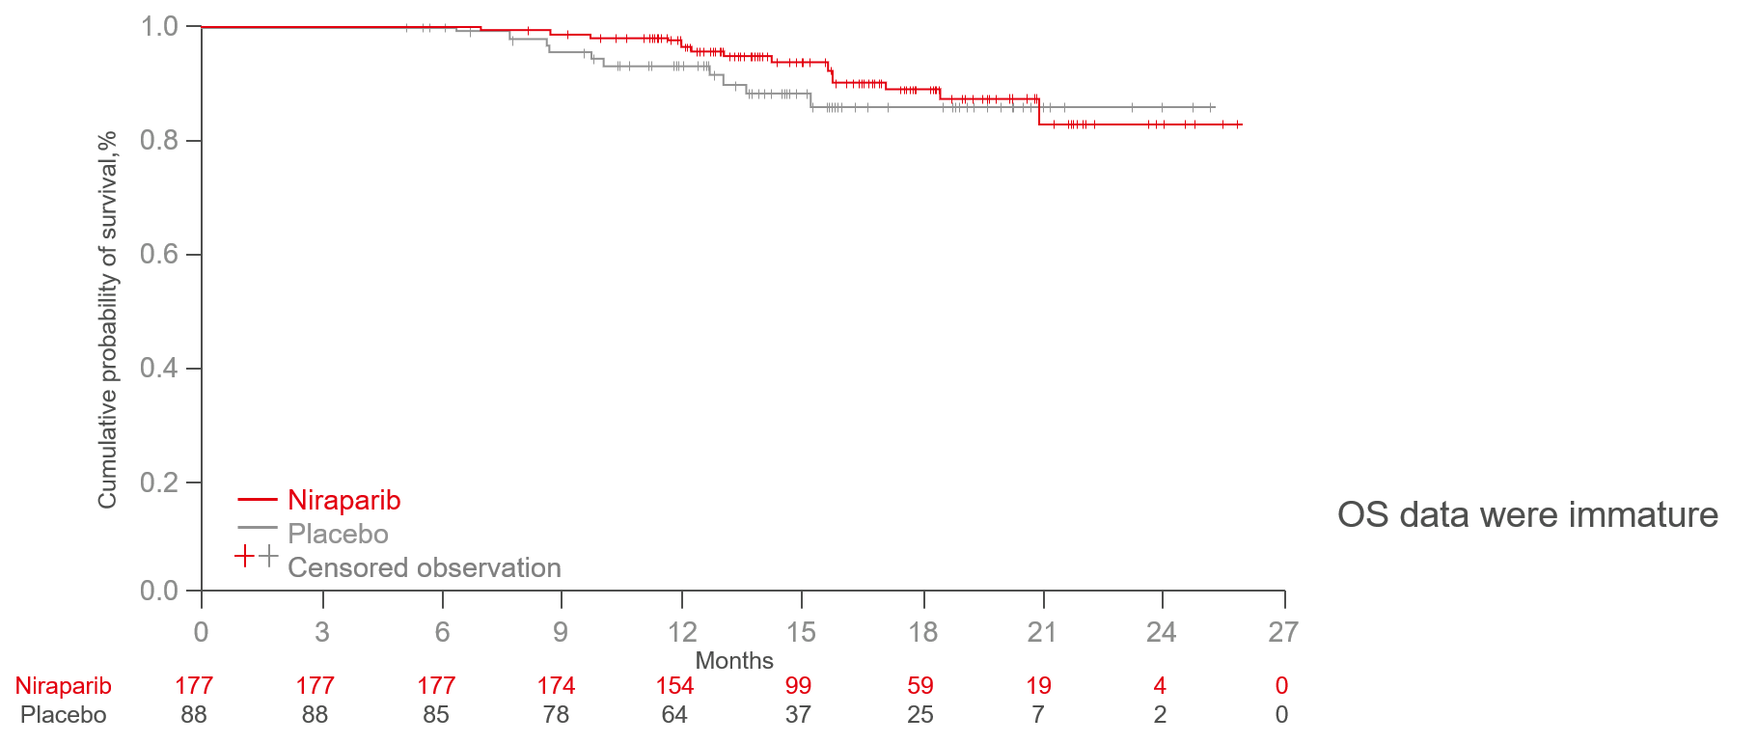
Secondary efficacy endpoint: OS
 | Niraparib (=177) | Placebo (n=88)
mOS, months (95%CI) | NR(NE-NE) | NR(NE-NE)
HR (95% CI) | 0.64 (0.29-1.42)
p-value* | p=0.267
 | Niraparib (N=177) | Placebo (N=88)
Events, n (%) | 16 (9.0) | 10 (11.4)
Censored, n (%) | 161 (91.0) | 78 (88.6)
(N=177)
(N=88)
Time (months)

Slide 60
Safety and tolerability
Summary of adverse events
Treatment emergent adverse events (TEAE) N (%) | Niraparib (N=177) | Placebo (N=88)
Any TEAE | 177 (100) | 84 (95.5)
≥Grade 3 | 90 (50.8) | 17(19.3)
Any treatment-related TEAE | 176 (99.4) | 77 (87.5)
≥Grade 3 | 79 (44.6) | 10 (11.4)
Any serious TEAE | 31(17.5) | 10 (11.4)
Any related serious TEAEs | 23 (13) | 4 (4.5)
Any TEAEs leading to dose reduction | 106 (59.9) | 12 (13.6)
Any TEAEs leading to treatment discontinuation | 7 (4) | 5 (5.7)
Any TEAEs leading to death* | 0 | 1 (1.1)
Niraparib generally well tolerated, no new safety signals observed
Most AEs managed with dose modification
TEAEs leading to discontinuation low (4%)
* The death case in placebo arm was a patient with secondary primary cancer (gastric cancer), which was considered as unrelated death. After the primary data cut-off, one case of treatment-related, fatal acute leukaemia (classification undefined) was reported in the niraparib group.

Slide 61
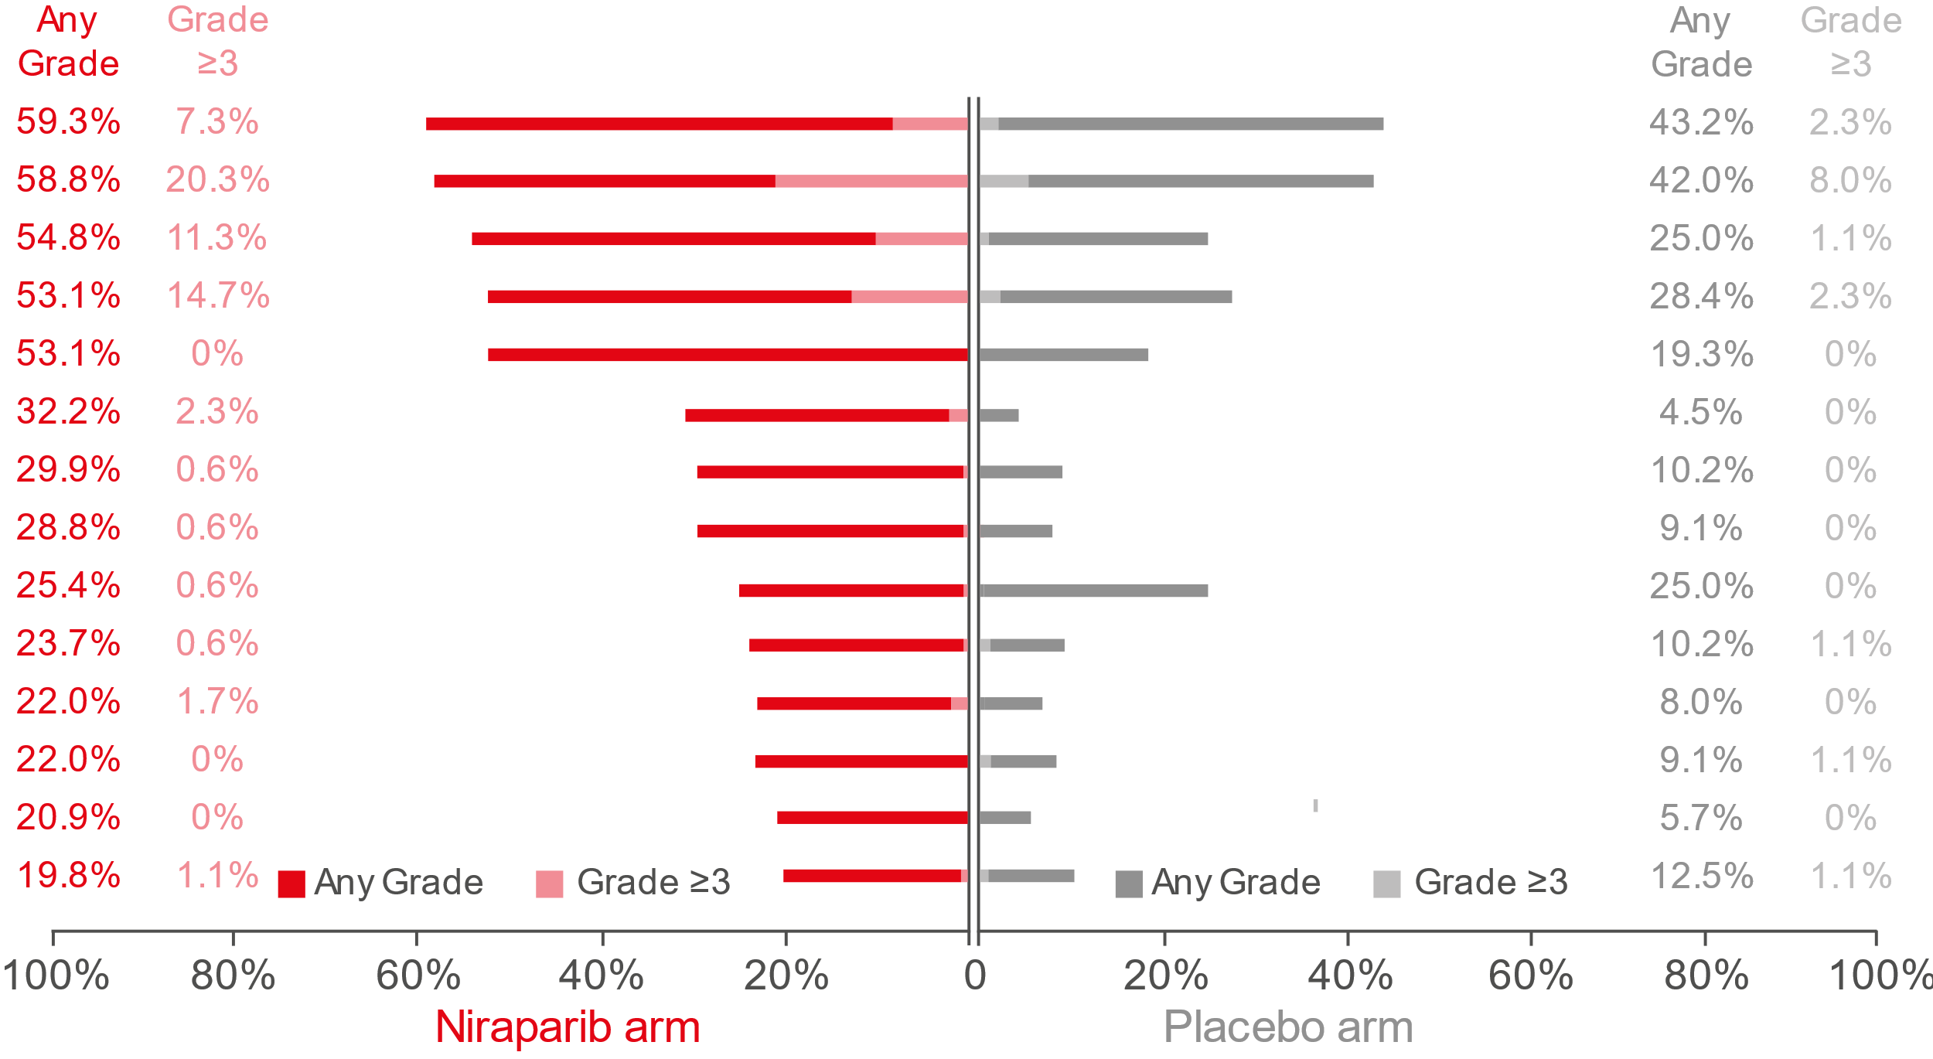
Summary of adverse events
Any grade in >10% of patients in either arm and/or grade ≥3 in patients overall
White blood cell count decreased*
Neutrophil count decreased*
Platelet count decreased
Anaemia
Nausea
Vomiting
Constipation
Insomnia
Asthenia
Alanine transaminase increased
Gamma-glutamyltransferase increased
Weight decreased
Upper respiratory tract infection
Aspartate aminotransferase increased
*The category of white blood cell decreased includes reports of white blood cell decreased and leukopenia. In the niraparib group, among 13 patients who experienced ≥Grade 3 white blood cell count decreased, 11 patients also had ≥Grade 3 neutrophil count decreased reported with overlapping duration. In the placebo group, two patients who experienced ≥Grade 3 white blood cell count decreased also reported ≥Grade 3 neutrophil count decreased with overlapping duration.

Slide 62
NORA Conclusions
First fully powered phase 3 randomized clinical trial evaluating a PARP inhibitor in Chinese patients with OC
Primary endpoint met, demonstrating that platinum-based chemotherapy and niraparib administered with an ISD regimen significantly improves CR and PR in patients with recurrent epithelial ovarian, fallopian tube or primary peritoneal cancer
  PFS in overall population: HR 0.32 (p<0.0001)
  PFS in gBRCAmut subgroup: HR 0.22 (p<0.0001)
  PFS in non-gBRCAmut subgroup: HR 0.40 (p<0.0001)
Prospective evaluation of ISD in NORA validated the NOVA retrospective analysis. ISD of Niraparib demonstrated consistent PFS benefit vs NOVA* with improved safety profile, especially hematological toxicities
ISD of niraparib is safe and should be considered standard clinical practice for maintenance for patients with OC
*NOVA trial: 300mg niraparib

Slide 63
Other solid tumors

Slide 64
LEAP-005
PARPi + PD-1i in previously treated advanced solid tumors: Lenvatinib plus pembrolizumab

Slide 65
LEAP-005 Study design
Phase 2 study of lenvatinib plus pembrolizumab in patients with previously treated advanced solid tumors
Key Inclusion/Exclusion
≥18 years of age
Histologically/cytologically advanced solid tumorª
  Triple negative breast (2L/3L)
  Ovarian (4L)
  Gastric (3L)
  Colorectal (non/MSI H/pMMR) (3L)
  Biliary tract (2L)
  Glioblastoma multiforme (2L)
Measurable disease (RECIST v1.1)
ECOG PS 0-1
Tissue for PD-L1 assessment^{b}
Pembrolizumab
200 mg IV Q3W +
Lenvatinib 20 mg
orally QD
Up to 35 cycles^{d}
30-Day safety FU + survival status
N=30^{c}
Evaluation^{e}
Primary endpoints: ORR (RECIST v1.1 or RANO, BICR^{)f,} safety/tolerability
Key secondary endpoints: DCR, DOR, PFS (RECIST v1.1 or RANO, BICR)^{f}
Response assessed Q9W^{g} until week 54; then Q12W until week 102; then Q24W thereafter
ªNumbers in parentheses indicate line of therapy. ^{b}PD-L1 status assessed centrally using PD L1 IHC 22C3 pharmDx assay (Agilent Technologies, Carpinteria , CA, USA). ^{c}Initial planned enrollment per cohort. ^{d}With investigator and sponsor approval, patients with disease progression before completing 35 cycles could remain on treatment if they were experiencing clinical benefit without intolerable toxicity; patients experiencing clinical benefit could continue lenvatinib treatment beyond 35 cycles. ^{e}In interim analysis, if adequate ORR determined, cohort expansion to 100 patients ^{f}Response assessed per RECIST v1.1, RANO (for glioblastoma), or iRECIST . ^{g}For glioblastoma cohort, response was assessed Q6W until week 18, then Q9W until week 54.

Slide 66
Antitumor activity: Women’s cancers
Objective response rate
Confirmed objective responses, RECIST v1.1 by BICR
 | 2L/3L TNBC (N=31) | 4L Ovarian (N=31)
ORR, % (95% CI) | 29.0 (14.2-48.0) | 32.3 (16.7-51.4)
DCR,ª % (95% CI) | 58.1 (39.1-75.5) | 74.2 (55.4-88.1)
Best overall response, N (%)
CR | 1 (3) | 1 (3)
PR | 8 (26) | 9 (29)
SD | 9 (29) | 13 (42)
Non-CR/Non-PD | 0 | 1 (3)
PD | 8 (26) | 5 (16)
Non-evaluable^{b} | 1 (3) | 0
No assessment^{c} | 4 (13) | 2 (6)
DOR, | NR | NR
median (range), mo | (0.0+ to 8.4+) | (1.5+ to 7.9+)
ªDefined as best overall response of CR, PR or SD. ^{b}Patient had post-baseline imaging and best overall response was determined to be nonevaluable per RECIST v1.1. ^{c}Patient had no post-baseline imaging. Data cutoff date: April 10, 2020.

Slide 67
Antitumor activity: GI cancers
Objective response rate
Confirmed objective responses, RECIST v1.1 by BICR
 | 3L Gastric (N=31) | 3L CRC (N=32) | 2L BTC (N=31)
ORR, % (95% CI) | 9.7 (2.0-25.8) | 21.9 (9.3-40.0) | 9.7 (2.0-25.8)
DCR,ª % (95% CI) | 48.4 (30.2-66.9) | 46.9 (29.1-65.3) | 67.7 (48.6-83.3)
Best overall response, n (%)
CR | 1 (3) | 0 | 0
PR | 2 (6) | 7 (22) | 3 (10)
SD | 12 (39) | 8 (25) | 18 (58)
Non-CR/Non-PD | 0 | 0 | 0
PD | 11 (35) | 12 (38) | 7 (23)
Non-evaluable^{b} | 0 | 1 (3) | 2 (6)
No assessment^{c} | 5 (16) | 4 (13) | 1 (3)
DOR, | NR | NR | 5.3
median (range), mo | (2.1+ to 2.3+) | (2.1+ to 10.4+) | (2.1+ to 6.2)
ªDefined as best overall response of CR, PR or SD. ^{b}Patient had post-baseline imaging and the best overall response was determined to be nonevaluable per RECIST v1.1. ^{c}Patienthad no post-baseline imaging. Data cutoff date: April 10, 2020.

Slide 68
Antitumor activity: Glioblastoma
Objective response rate
Confirmed objective responses, RANO by BICR
 | 2L GBM (N=31)
ORR, % (95% CI) | 16.1 (5.5-33.7)
DCR,ª % (95% CI) | 58.1 (39.1-75.5)
Best overall response, n (%)
CR | 0
PR | 5 (16)
SD | 13 (42)
Non-CR/Non-PD | 0
PD | 11 (35)
Non-evaluable^{b} | 1 (3)
No assessment^{c} | 1 (3)
DOR, | 3.2
median (range), mo | (2.5 to 4.9+)
ªDefined as best overall response of CR, PR or SD. ^{b}Patient had post-baseline imaging and the best overall response was determined to be nonevaluable per RECIST v1.1. ^{c}Patienthad no post-baseline imaging. Data cutoff date: April 10, 2020.

Slide 69
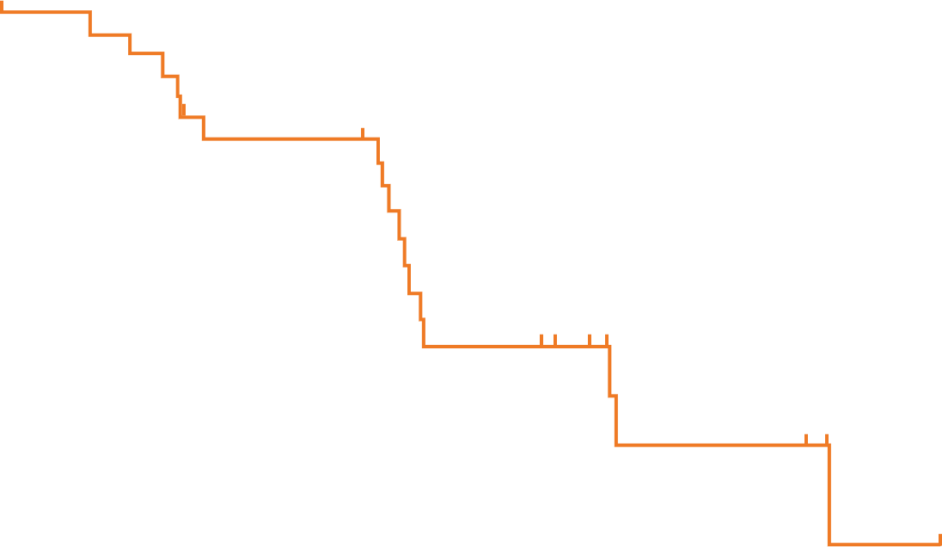
Progression-free survival: Women’s cancers
RECIST v1.1 by BICR
2L/3L TNBC Cohort
4L Ovarian Cohort
100
6-month rate
48.9%
100
6-month rate
47.1%
90
90
80
Median
(95% CI), mo
4.2 (1.9-NR)
80
Median
(95% CI), mo
4.4 (4.0-8.5)
70
Pts with Event
55%
70
Pts with Event
55%
60
60
50
PFS, %
50
PFS, %
40
40
30
30
20
20
10
10
0
0
0
3
6
9
12
0
3
6
9
12
Time (months)
Time (months)
No. at risk
31 | 15 | 8 | 2 | 0
No. at risk
31 | 23 | 9 | 1 | 0

Slide 70
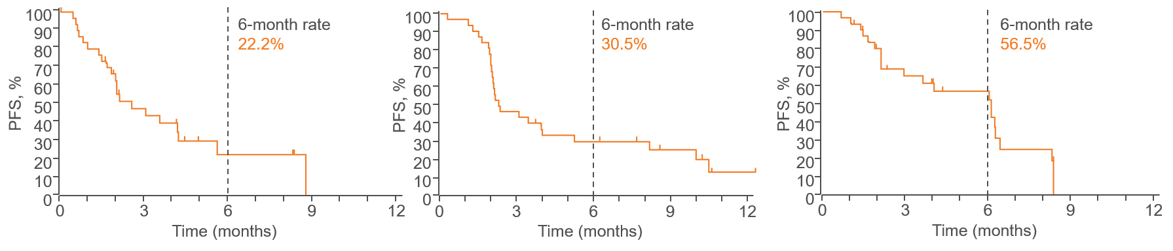
Progression-free survival: GI cancers
RECIST v1.1 by BICR
3L Gastric
3L CRC
2L BTC
Pts with Event | Median (95% CI), mo
68% | 2.5 (1.8−4.2)
Pts with Event | Median (95% CI), mo
78% | 2.3 (2.0−5.2)
Pts with Event | Median (95% CI), mo
65% | 6.1 (2.1−6.4)
No. at risk
31 | 12 | 3 | 0 | 0
No. at risk
32 | 15 | 9 | 5 | 1
No. at risk
31 | 16 | 12 | 0 | 0

Slide 71
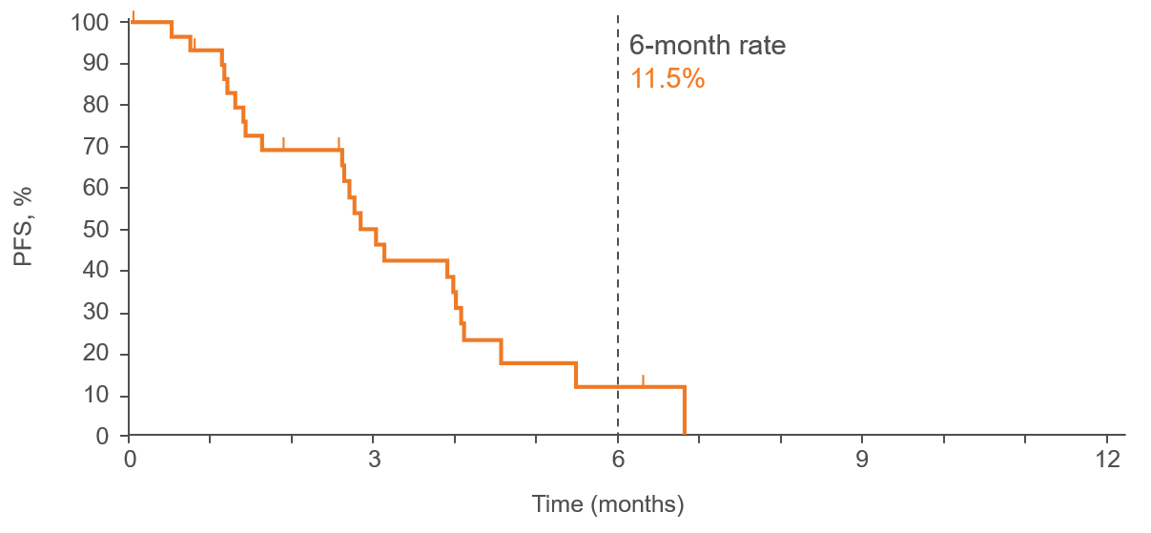
Progression-free survival: Glioblastoma
RANO by BICR
3L Gastric
Pts with Event | Median (95% CI), mo
77% | 2.8 (1.6−4.0)
No. at risk
31 | 13 | 2 | 0 | 0

Slide 72
Safety and tolerability
Summary of safety data
N (%) | 2L/3L TNBC (N=31) | 4L Ovarian (N=31) | 3L Gastric (N=31) | 3L CRC (N=32) | 2L BTC (N=31) | 2L GBM (N=31)
Treatment-related AEs | 30 (97) | 29 (94) | 28 (90) | 32 (100) | 30 (97) | 29 (94)
Grade 3-5 | 17 (55) | 21 (68) | 13 (42) | 16 (50) | 15 (48) | 11 (35)
Led to death | 1 (3)ª | 1 (3)ª | 1 (3)ª | 1 (3)ª | 0 (0) | 1 (3)ª
Lead to discontinuation | 3 (10) | 4 (13) | 2 (6) | 3 (9) | 2 (6) | 2 (6)
Lenvatinib^{b} | 24 (77) | 28 (90) | 18 (58) | 24 (75) | 23 (74) | 23 (74)
Immune-mediated Aes | 15 (48) | 15 (48) | 8 (26) | 14 (44) | 14 (45) | 9 (29)
Grade 3-5 | 1 (3) | 1 (3) | 1 (3) | 2 (6) | 2 (6) | 1 (3)
Infusion reactions | 1 (3) | 1 (3) | 0 | 0 | 1 (3) | 0
Grade 3-5 | 0 | 1 (3) | 0 | 0 | 0 | 0
One or more TRAE in most patients in each cohort
Grade 3-5 TRAEs in ~50% of patients in each cohort (although 68% in ovarian and 35% in GBM)
ªTreatment related AEs leading to death (n = 1 each): TNBC, subarachnoid hemorrhage; Ovarian, hypovolemic shock; Gastric, hemorrhage; CRC, intestinal perforation; GBM, pneumonitis. ^{b}Clinically significant treatment related AEs for lenvatinib. Data cutoff date: April 10, 2020.

Slide 73
Safety and tolerability
Treatment related AEs occurring in ≥20% of overall study population
N (%) | 2L/3L TNBC (N=31) | 4L Ovarian (N=31) | 3L Gastric (N=31) | 3L CRC (N=32) | 2L BTC (N=31) | 2L GBM (N=31)
Hypertension | 13 (42) | 17 (55) | 6 (19) | 14 (45) | 13 (42) | 10 (32)
Fatigue | 9 (29) | 13 (42) | 8 (26) | 9 (29) | 10 (32) | 6 (19)
Diarrhea | 7 (23) | 12 (39) | 8 (26) | 9 (29) | 10 (32) | 4 (13)
Decreased appetite | 8 (26) | 12 (39) | 6 (19) | 10 (32) | 7 (23) | 4 (13)
Hypothyroidism | 8 (26) | 13 (42) | 5 (16) | 9 (29) | 9 (29) | 8 (26)
Nausea | 8 (26) | 8 (26) | 6 (19) | 6 (19) | 10 (32) | 3 (10)

Slide 74
LEAP-005 Conclusions
In this interim analysis, prespecified futility efficacy criteria for cohort expansion were met or exceeded and toxicity was manageable in all cohorts
LEAP-005 will continue to assess the efficacy and safety of lenvatinib plus pembrolizumab in patients with previously treated advanced solid tumors in expanded cohorts of 100 patients each

Slide 75
PD-L1i plus PD-1i in urothelial carcinoma
BGB-A333 + Tislelizumab

Slide 76
Study design
Phase 1/2 study of BGB-A333, an anti-PD-L1 monoclonal antibody, in combination with anti-PD-1 antibody tislelizumab in patients with urothelial carcinoma (BGB-900-101)
Phase 1A (N=15) BGB-A333
Dose escalation
Phase 2B (N=12)
Dose expansion
Simultaneous PD-L1 and PD-1 blockade hypothesized to produce synergistic antitumor effects due to potential distinct modes of action
Patients in Phase 2B with locally advanced or metastatic UC who had progressed after ≥1 platinum-containing previous regimen received BGB-A333 (anti-PD-L1) 1350mg IV Q3W + tislelizumab (anti-PD-1) 200mg IV Q3W
As of 26th July 2020 (data cutoff), 12 patients (median age 69.5 years, 92% male) were enrolled in phase 2B
  Median duration of treatment was 6.2 months
  Ten patients (83%) had 1 prior systemic therapy
  Median study follow-up was 10 months
450 mg IV Q3W
Urothelial carcinoma
BGB-A333
1350 mg IV
+
tislelizumab
200 mg IV Q3W
900 mg IV Q3W
1350 mg IV Q3W
1800 mg IV Q3W
Phase 1B (N=12)
Dose confirmation
BGB-A333 1350mg IV
+ Tislelizumab
200mg IV Q3W

Slide 77
Results - efficacy
Combination treatment associated with durable clinical responseª
>
20
PD
PD
>
10
>
0
×
-10
SD
×
-20
SD
Complete response
Partial response
Stable disease
Progressive disease
Treatment ongoing
Discontinued
-30
×
Best Response in
Target Lesion (%)
-40
SD
×
-50
*
×
-60
CR
×
-70
*
×
>
-80
CR
SD
×
-90
*
CR
×
-100
PR
PR
×
*
0
10
20
30
40
50
60
70
Confirmed responses | PD-L1 high^{b} (N=6) | PD-L1 low^{b} (N=6) | Total (N=12)
CR | 2 | 1 | 3
PR | 2 | 0 | 2
SD | 2 | 2 | 4
PD | 0 | 2 | 2
NE | 0 | 1 | 1
ORR, % (95%CI) | 67 (22.3, 95.70 | 17 (0.42, 64.1) | 42 (15.2, 72.3)
DCR, % (95%CI) | 100 (54.1, 100.0) | 50 (11.8, 88.2) | 75 (42.8, 94.5)
Time since Treatment Initiation (Weeks)
Median DOR 9.1 months (95% CI: 6.0-9.6)

Slide 78
Results - efficacy
PFS, overall
PFS, by PD-L1 expression status
Median PFS 6.1 months overall
Median PFS 10.0 months in PD-L1 high population
Median PFS 4.1 months in PD-L1 low population
100
 | Events (%) | Median (95% CI)
UC Cohort | 10 (83.3) | 6.1 (1.9, 11.0)
100
 | Events (%) | Median (95% CI)
PD-L1 High* | 4 (66.7) | 10.0 (4.0, 11.0)
PD-L1 Low* | 6 (100.0) | 4.1 (1.2, 11.5)
90
90
80
Censored
80
70
70
Censored
60
60
50
Progression-Free Survival Probability (%)
50
Progression-Free Survival Probability (%)
40
40
30
30
20
20
10
10
0
0
1
2
3
4
5
6
7
8
9
10
11
12
0
0
1
2
3
4
5
6
7
8
9
10
11
12
Months After First Dose
Months
Patients at Risk (N)
UC Cohort | 12 | 12 | 10 | 9 | 8 | 8 | 8 | 5 | 5 | 4 | 3 | 2 | 0
Patients at Risk (N)
PD-L1 High | 6 | 6 | 6 | 6 | 5 | 5 | 5 | 4 | 4 | 3 | 2 | 1 | 0
PD-L1 Low | 6 | 6 | 4 | 3 | 3 | 3 | 3 | 1 | 1 | 1 | 1 | 1 | 0

Slide 79
Results – safety and tolerability
BGB-A33 + tislelizumab safety profileª
Any grade TRAEs occurring in ≥2 patients
Fatigue was the most commonly reported TRAE across the study
AE profile consistent with profiles observed during dose escalation and dose confirmation across multiple tumor types
No patients in phase 2B had a fatal TRAE
Two patients in phase 2B experienced 4 immune-related AEs (grade 3 endocrine disorders, grade 3 hypophysitis, grade 2 musculoskeletal and connective tissue disorder, grade 2 myositis)

Slide 80
Conclusions
Preliminary antitumor activity observed in patients with locally advanced/ metastatic UC receiving BGB-A333 in combination with tislelizumab
  Confirmed ORR 42% (5/12 patients), with 3 patients achieving complete responses and 2 achieving partial response
  Responses were durable (median DOR 9.1 months)
  Both ORR and PFS consistent with better efficacy in PD-L1 high population vs PD-L1 low population
BGB-A333 in combination with tislelizumab generally well tolerated in patients with locally advanced/ metastatic UC (N=12)
  Reported TRAEs generally of mild or moderate severity
These data provide insights into combining tislelizumab, a clinical stage anti-PD-1 antibody, with anti-PD-1 antibodies

Slide 81
PARP inhibiton + temozolamide
In biomarker-positive patients with locally advanced or metastatic solid tumors

Slide 82
Study design
Clinical benefit in biomarker-positive patients with locally advanced or metastatic solid tumors treated with the PARP1/2 inhibitor pamiparib in combination with low-dose (LD) temozolomide (TMZ)
Days
Low-dose TMZ PO QD
Pamiparib PO 60 mg BID
1
7
28
1
14
28
TMZ per label dosing: 75 mg/m² (continuous): 150 and 200 mg/m² (pulse) BSA equivalent assumes and average BSA=1.73 m²
TMZ (dose equivalents)
Flate dose | BSA equivalent
20mg | 11.5mg/m²
40mg | 23mg/m²
80mg | 46mg/m²
120mg | 69mg/m²
Arm A (pulse)
TMZ 40mg PO QD
TMZ 40mg** PO QD
TMZ 60mg* PO QD
TMZ 80mg PO QD
RP2D=60 mg pamiparib D1-28 + 60 mg TMZ D1-7
TMZ 100mg* PO QD
TMZ 120mg PO QD
The study (BGB-290-103) enrolled a total of 114 patients in a dose-escalation and dose-expansion
Majority of patients were white (75%) and heavily pretreated (median 3 prior therapies, range 1-10)
Median study follow-up time of 8.4 months (range 0.3-30.0)
Arm B (continuous)
TMZ 20mg PO QD
TMZ 40mg PO QD
Days
Low-dose TMZ PO QD
Pamiparib PO 60 mg BID
1
28
MTD
MAD
*
**
Intermediate cohorts
Intermediate schedule
Cohort 1: OVCA HRD+
Cohort 2: TNBC HRD+
Cohort 3: mCRPC HRD+
Cohort 4: ES-SCLC
Cohort 5: GC/GEJ

Slide 83
Retrospective biomarker analysis
Samples from dose-escalation and dose-expansion patients were included in the analysis
Myriad myChoice HRD test performed in archival tissue sample obtained at baseline
  Genomic instability score (GIS, formerly HRD score) based on large-scale transitions, telomeric allelic imbalance, and loss of heterozygosity
  GIS+ defined as GIS score ≥33
ctDNA NGS DNA-Seq performed in blood samples obtained at baseline
  Focus on 16 core DNA damage response (DDR) genes:
  ATM, ATR, BARD1, BRCA1, BRCA2, BRIP1, CHEK1, CHECK2, CDK12, FANCL, PALB2, PP2R2A, RAD51B, RAD51C, RAD51D, RAD54L
  DDR+ defined as ≥1 mutation in one of 16 DDR genes
Correlation of DDR/GIS status with overall response rate (ORR) and disease control rate (DCR)

Slide 84
TNBC
Cholangiocarcinoma
Cholangiocarcinoma
Fallopian tube
OVCA
Cholangiocarcinoma
Metanoma
Cervical cancer
TNBC
GC
Adrenal cancer
HCC
Sq NSCLC
Gallbladder
GC
Prostate
Head and neck
Sq NSCLC
GC
SCLC
GC
OVCA
Non-sq NSCLC
Prostate
GC
Pheochromocytoma
Prostate
Pancreatic cancer
Pancreatic cancer
OVCA
OVCA
Leiomyosarcoma
TNBC
Urothelial Kidney
Results - efficacy
GIS+ patients had better ORR and DCR than GIS- patients, irrespective of BRCA mutation status
ORR
 | BRCA1/2mut (N=7) | BRCA1/2wt (N=27) | Total (N=34)
GIS+ | 100% (5/5) (90% CI, 0.55-1.00) | 66.7% (4/6) (90% CI, 0.27-0.94) | 81.8% (9/11) (90% CI, 0.53-0.97)
GIS- | 50.0% (1/2) (90% CI, 0.03-0.97) | 9.5% (2/21) 90% CI, 0.02-0.27) | 13.0% (3/23) (90% CI, 0.04-0.30)
80
60
N=34*; GIS+ frequency=32%
40
20
0
Best objective response
Change in Tumor Size from Baseline (%)
PR
SD
PD
Ongoing treatment
-20
-40
DCR
 | BRCA1/2mut (N=7) | BRCA1/2wt (N=27) | Total (N=34)
GIS+ | 100% (5/5) (90 CI, 0.55-1.00) | 83.3% (5/6) (90% CI, 0.42-0.99) | 90.9% (10/11) (90% CI, 0.64-1.00)
GIS- | 50% (1/2) (90%CI, 0.03-0.97) | 57.1% (12/21) (90% CI, 0.37-0.75) | 56.5% (13/23) (90% CI, 0.38-0.74)
-60
GIS status
-80
GIS <33
GIS ≥33
-100
BRCA status
GIS
BRCA1
BRCA2
Wild-type
Germline
Somatic
Germline & somatic
Unknown
*Patients with postbaseline tumor assessments and Myriad myChoice results.
**The gBRCA1 mutation reported for the nonsquamous NSCLC patient was non-pathogenic.
GIS (formerly HRD score) measures LST+TAI+LOH; GIS+ = GIS score ≥33

Slide 85
Results
DDR+ patients had better ORR than DDR- patients, but responses were associated with BRCA mutations
Urothelial
Prostate
OVCA
Prostate
Pancreatic
TNBC
TNBC
Peritoneal
sqNSCLC
OVCA
Duodenal
Pancreatic
GC
Prostate
SCLC
TNBC
SCLC
SCLC
GC
SCLC
GC
SCLC
ORR
 | BRCA1/2mut (N=14) | BRCA1/2wt (N=72) | Total (N=86)
DDR+ | 38.5% (5/13) (90% CI, 0.17-0.65) | 11.1% (1/9) (90% CI, 0.06-0.43) | 27.3% (6/22) (90% CI, 0.12-0.47)
DDR- | 100% (1/1) (90% CI, 0.05-1.00) | 12.7% (8/63) (90% CI, 0.06-0.22) | 14.1 (9/64) (90% CI, 0.08-0.23)
N=86*; DDR+ frequency=26%
Response | Responders |  |  |  |  |  | Nonresponders
 | PR | PR | PR | PR | PR | PR | SD | SD | SD | SD | SD | SD | PD | PD | PD | PD | PD | PD | PD | PD | PD | PD
Treatment (months) | 4.1 | 7.4 | 22.1 | 4.2 | 3.7 | 14.7 | 17.0 | 5.5 | 1.4 | 0.6 | 1.8 | 5.5 | 2.6 | 0.5 | 0.2 | 2.0 | 1.8 | 1.3 | 1.7 | 0.5 | 2.1 | 1.8
BRCA2
CHEK2
BRCA1
ATM
PALB2
CHEK1
ATR
RAD54L
DCR
 | BRCA1/2mut (N=14) | BRCA1/2wt (N=72) | Total (N=86)
DDR+ | 61.5% (8/13) (90% CI, 0.35-0.83 | 44.4% (4/9) (90% CI, 0.17-0.75) | 54.5% (12/22) (90% CI, 0.35-0.73)
DDR- | 100.0% (1/1) (90% CI, 0.05-1.00) | 65.1% (41/63) (90% CI, 0.54-0.75) | 65.6% (42/64) (90% CI, 0.55-0.76)
*Patients with postbaseline tumor assessments and ctDNA data.
DDR panel: ATM, ATR, BARD1, BRCA1, BRCA2, BRIP1, CHEK1, CHEK2, CDK12, FANCL, PALB2,
PP2R2A, RAD51B, RAD51C, RAD51D, RAD54L
DDR+ = ≥1 mutation in one of 16 DDR genes 5 patients were GIS+ and DDR+

Slide 86
Conclusions
In this limited subset of patients treated with pamiparib in combination with different doses of low dose (LD) temozolomide (TMZ), GIS+ patients derived superior benefit, irrespective of BRCA1/2 mutation status, compared with DDR+, GIS- and DDR- patients
Responses in the DDR+ subpopulation were primarily associated with BRCA1/2 mutations
GIS status, a global measure of genomic instability, appears to be a robust biomarker for prediction of response to pamiparib + LD TMZ
As demonstrated previously, DDR mutations other than BRCA1/2 have limited utility in predicting response to PARP inhibitors
A new cohort (cohort 6) is currently evaluating antitumor activity of Pamiparib + LD TMZ in patients with GIS+ NSCLC, head and neck, esophageal, and soft tissue sarcoma tumors

Slide 87
Abbreviations
AE: Adverse event
BID: Twice daily
CI: Confidence interval
CR: Complete response
DCR: Disease control rate
DDR: DNA damage response
DOR: Duration of response
ECOG: Eastern Cooperative Oncology Group
GIS: Genomic instability score
HR: Hazard ratio
IRC: Independent review committee
IRC: Independent Review Committee
LD: Low dose
NSCLC: Non-small cell lung cancer
nsq-NSCLC: non-squamous non-small cell lung cancer
ORR: Objective response rate
OS: Overall survival
PARP: Poly (ADP-ribose) polymerase
PD: Progressive disease
PD-1: Programmed cell death protein-1
PD-L1: Programmed death-ligand 1
PFS: Progression free survival
PO: Orally
PR: Partial response
Q3W: Every 3 weeks
QoL: Quality of life
R: Randomized
RECIST: Response Evaluation Criteria in Solid Tumors
SAE: Severe adverse event
TEAE: Treatment emergent adverse event
TMZ: Temozolamide
TRAE: Treatment related adverse event
4

Slide 88
ESMO 2020 (Virtual)
Congress Report
Solid tumors:
PD-1/PD-L1 inhibition and PARP inhibition
Focus on GI and ovarian cancers

