Slide 1
ASCO/EHA/ICML
2023
Congress Report
Emerging treatments for B-cell malignancies

Slide 2
Congress dates
ASCO Annual Meeting 2023: June 2nd – June 5th
EHA2023 Hybrid Congress: June 8th – June 11th
17-ICML: June 13th – June 7th

Slide 3
Contents (i)
Slide numbers | Study | Abstract number | Presenter
8-13 | Zanubrutinib (zanu) vs bendamustine + rituximab (BR) in patients (pts) with treatment-naïve chronic lymphocytic leukemia/small lymphocytic lymphoma (CLL/SLL): Extended follow-up of the SEQUOIA study | EHA: P639 ICML:154 | Talha Munir Mazyar Shadman
14-22 | Time-limited venetoclax and ibrutinib for patients with relapsed/refractory CLL who have undetectable MRD – 4-year follow-up from the randomized phase II VISION/HO141 trial | EHA: S148 | Arnon Kater
23-30 | A phase 2 study of zanubrutinib in previously treated B-cell malignancies intolerant to ibrutinib and/or acalabrutinib: Preliminary results for patients with CLL/SLL | ICML: 345 | Mazyar Shadman
31-39 | Ibrutinib versus placebo in patients with asymptomatic, treatment-naïve early stage CLL: final results of the phase 3, double-blind, placebo-controlled CLL12 trial | EHA: S200 ICML: 24 | Petra Langerbeins
40-48 | Venetoclax-Obinutuzumab for previously untreated chronic lymphocytic leukemia: 6-year results of the randomized CLL14 study | EHA: S145 IMCL: 25 | Othman Al-Sawaf
49-55 | Genomic evolution and resistance to pirtobrutinib in covalent BTK-inhibitor pre-treated chronic lymphocytic leukemia patients: results from the phase I/II BRUIN study | EHA: S146 ICML:116 | Jennifer Brown Krish Patel
56-64 | MURANO: Final 7 year follow up and retreatment analysis in venetoclax-rituximab (VenR)-treated patients with relapsed/refractory chronic lymphocytic leukemia (R/R CLL) | ICML: 156 | John Seymour
65-72 | Long-term follow-up of multicenter phase II trial of zanubrutinib, obinutuzumab, and venetoclax (BOVen) in previously untreated patients with CLL/SLL | ICML: 153 | Jacob Soumerai
73-81 | Fixed-duration ibrutinib + venetoclax in chronic lymphocytic leukemia (CLL)/small lymphocytic lymphoma (SLL): 4-y follow-up from the FD cohort of the phase 2 CAPTIVATE study | ICML: 155 | Paolo Ghia
82-89 | 5-Year (Y) Follow-up of a Phase 2 Study of Ibrutinib Plus Fludarabine, Cyclophosphamide, Rituximab (iFCR) as Initial Therapy for Younger CLL Patients (Pts) | ICML: 152 | Inhye Ahn

Slide 4
Contents (ii)
Slide numbers | Study | Abstract number | Presenter
90-96 | Health-related quality of life in patients (pts) with Waldenström Macroglobulinemia (WM) treated with zanubrutinib (ZANU) vs ibrutinib (IBR): Results from the phase 3 ASPEN trial long-term follow-up | EHA: P1679 | Alessandra Tedeschi
97-103 | Efficacy of Pirtobrutinib, a highly selective, non-covalent BTK inhibitor in relapsed/refractory Waldenström macroglobulinemia: results from the phase 1/2 BRUIN study | EHA: P1108 | Lydia Scarfò
104-113 | First interim analysis of a phase 1 study of zanubrutinib (zanu) plus lenalidomide (len) in patients (pts) with relapsed/refractory (R/R) diffuse large B-cell lymphoma (DLBCL) | ASCO: 7557 EHA: P1136 ICML: 442 | Huilai Zhang
114-122 | Long-term efficacy and safety of zanubrutinib (zanu) in patients (pts) with relapsed/refractory (R/R) marginal zone lymphoma (MZL): Final analysis of the MAGNOLIA (BGB-3111-214) trial | EHA: P1084 ICML: 284 | Stephen Opat Judith Trotman
123-130 | Zanubrutinib plus obinutuzumab versus obinutuzumab in patients with relapsed/refractory follicular lymphoma: Updated analysis of the ROSEWOOD study | ASCO: 7545 EHA: P1080 ICML: 81 | Christopher R. Flowers Judith Trotman Pier Luigi Zinzani
131-137 | A phase II investigator-initiated study of acalabrutinib, lenalidomide and rituximab (aR2) in patients with previously untreated high tumor burden follicular lymphoma | EHA: P1092 | Paolo Strati
138-146 | Epcoritamab with rituximab + lenalidomide provides durable responses in patients with high-risk follicular lymphoma regardless of POD24 status. | ASCO: 7506 EHA: S222 | Anna Sureda
147-155 | Mosunetuzumab demonstrates durable responses in patients with relapsed/refractory follicular lymphoma and ≥2 prior therapies: updated analysis of a pivotal Phase II study | ICML: 83 | Laurie H. Sehn
156-163 | Rituximab and Ibrutinib Combination Is Safe and Effective in Untreated Splenic and Nodal Marginal Zone Lymphomas: Planned Subset Analysis of the IELSG47/MALIBU Phase II Study | ICML: 65 | Catherine Thieblemont

Slide 5
Contents (iii)
Slide numbers | Study | Abstract number | Presenter
164-172 | Ibrutinib plus BR or R-CHOP in previously treated patients with follicular or marginal zone lymphoma: the phase 3 SELENE Study | ICML: LBA2 | Loretta J. Nastoupil
173-180 | Pirtobrutinib in covalent BTK-inhibitor pre-treated mantle cell lymphoma: Updated results and subgroup analysis from the phase 1/2 BRUIN study with >3 years follow-up from start of enrollment | ASCO: 7513 EHA: P1087 ICML: 102 | Catherine C. Coombs Wojciech Jurczak Chan Yoon Cheah
181-187 | A phase 1 study evaluating the safety, tolerability, pharmacokinetics, and preliminary antitumor activity of Bcl-2 inhibitor BGB-11417 in adult patients with mature B-cell malignancies | ASCO: 7558 EHA: P626 | Caixia Li
188-195 | Updated safety and efficacy results of zanubrutinib in patients with B-cell malignancies who are intolerant of ibrutinib and/or acalabrutinib | EHA: P633 | Mazyar Shadman
196-201 | A first-in-human phase 1 study of oral LOXO-338, a selective Bcl2 inhibitor, in patients with advanced hematologic malignancies | EHA: P636 | Michal Kwiatek
202-209 | Characterization of zanubrutinib safety/tolerability profile and comparison with ibrutinib profile in patients with B-cell malignancies: post hoc analysis of a large clinical trial safety database | EHA: P631 | Jennifer R. Brown
210-217 | Updated analysis of BELLWAVE-001: A Phase 1/2 open-label dose-expansion study of the efficacy and safety of nemtabrutinib for the treatment of B-cell malignancies | EHA: P628 | Jennifer Woyach
218-225 | Long-term safety with ≥12 months of pirtobrutinib in relapsed/refractory (R/R) B-cell malignancies | ASCO: 64 EHA: P618 | Catherine C. Coombs Wojciech Jurczak
226-233 | Bruton tyrosine kinase (BTK) protein degrader BGB-16673 is less apt to cause, and able to overcome variable BTK resistance mutations compared to other BTK inhibitors (BTKi) | EHA: P1239 | Xiaoyu Feng
234-240 | BGB-16673, a BTK degrader, overcomes on-target resistance from BTK inhibitors and presents sustainable long-term tumor regression in lymphoma xenograft models | EHA: P1219 | Haitao Wang

Slide 6
SEQUOIA
Zanubrutinib vs bendamustine + rituximab
in TN CLL/SLL: Extended follow-up

Slide 7
SEQUOIA: Study design
A Phase III, open-label, randomized study of zanubrutinib compared with bendamustine plus rituximab in patients with previously untreated CLL/SLL
Arm A: zanubrutinib
160 mg bid until PD, intolerable toxicity, or end of study
(n=241)
Assessments
Response assessments were conducted every 12 weeks from start of cycle 1 for 96 weeks and then every 24 weeks until PD
CR/CRi confirmed via bone marrow biopsy
AEs documented until PD or start of next CLL therapy
Statistical analysis
Efficacy endpoints analyzed using ITT analysis and the per-protocol analysis set
Safety was assessed in all pts who received ≥1 dose of treatment
Outcomes
PFS assessed by INV
OS in cohorts 1 and 2
PFS 2^{c}
Clinical outcomes (correlated with baseline prognostic and predictive markers)
Safety
Open label
Cohort 1
without del(17p) by
central FISH
R
1:1
Key eligibility criteria
Untreated CLL/SLL
Met iwCLL criteria for treatment
≥65 y or ≥18 y of age and unsuitable for treatment with FCRª
Anticoagulation and CYP3A inhibitors allowed
Arm B: bendamustine
(90 mg/m² D1 and D2) + rituximab (375 mg/m² C1, then 500 mg/m² C2-C6) for 6 cycles
(n=238)
Stratification factors
Age, Binet stage, IGHV status, geographic region
Patients who had centrally confirmed PD could cross over to receive zanubrutinib
Cohort 2
with del(17p)
Arm C: zanubrutinib
160 mg bid until PD, intolerable toxicity, or end of study
(n=111)^{b}

Slide 8
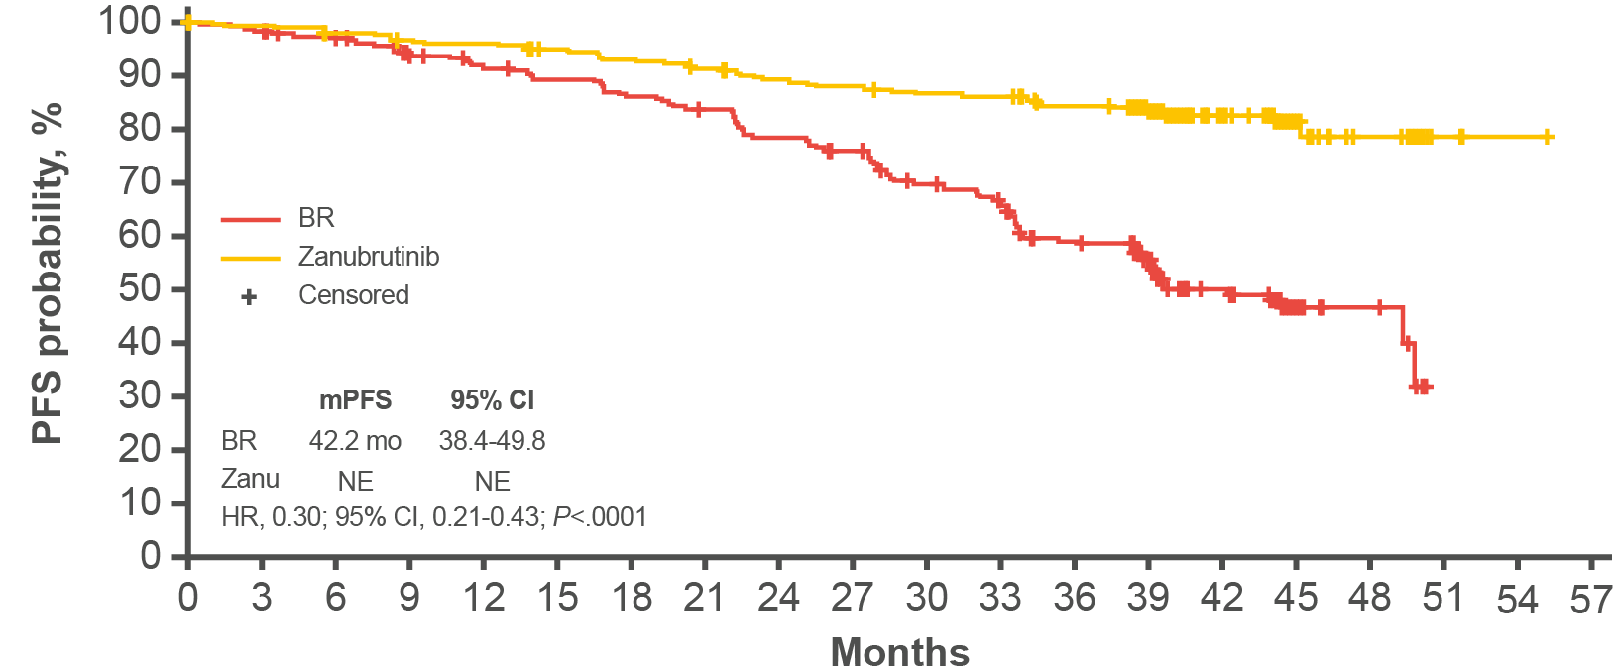
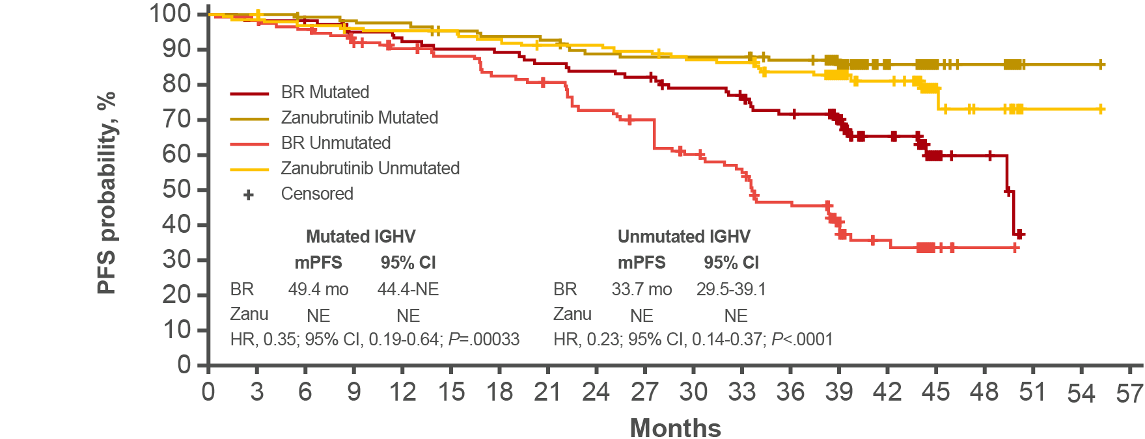
Progression-free survival (cohort 1)
PFS overall populationª
PFS mutated and unmutated IGHV and overall populationª
No. of patients
BR | 238 | 218 | 212 | 201 | 192 | 187 | 180 | 174 | 163 | 157 | 141 | 133 | 113 | 82 | 50 | 18 | 8 | 0
Zanu | 241 | 238 | 234 | 230 | 228 | 224 | 219 | 214 | 208 | 205 | 201 | 200 | 190 | 131 | 93 | 33 | 23 | 4 | 3 | 0
No. of patients
BR mutated | 110 | 101 | 99 | 94 | 91 | 89 | 88 | 85 | 83 | 81 | 76 | 73 | 67 | 53 | 31 | 14 | 7 | 0
Zanu mutated | 109 | 109 | 107 | 106 | 105 | 101 | 99 | 98 | 93 | 92 | 92 | 92 | 89 | 63 | 43 | 18 | 13 | 1 | 1 | 0
BR unmutated | 121 | 110 | 107 | 101 | 95 | 92 | 86 | 83 | 75 | 71 | 60 | 55 | 43 | 26 | 17 | 4 | 1 | 0
Zanu unmutated | 125 | 122 | 120 | 118 | 117 | 117 | 114 | 111 | 111 | 109 | 105 | 104 | 97 | 65 | 47 | 14 | 9 | 2 | 2 | 0
In cohort 1, median PFS was not reached in patients who received zanubrutinib; in patients who received BR, median PFS was 42.2 months
  Estimated 42-month PFS rates with zanubrutinib and BR were 82.4% and 50.0%, respectively
PFS was significantly improved with zanubrutinib vs BR in patients with mutated IGHV (2-sided P=.00033) and unmutated IGHV

Slide 9
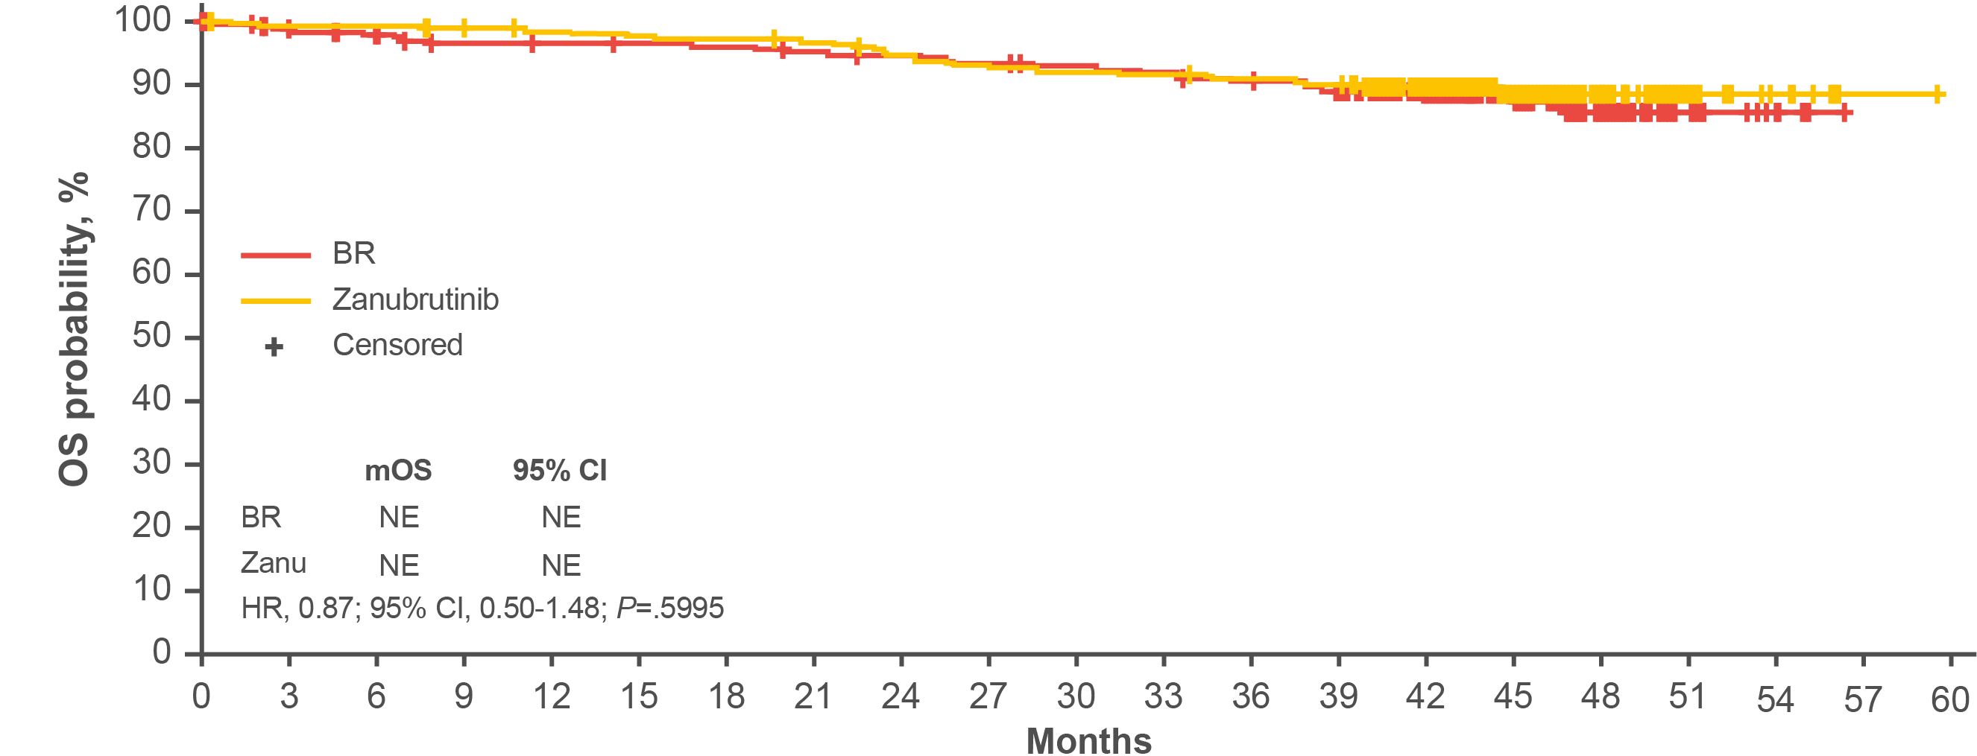
Overall survival (cohort 1)
OS overall population
Median OS was not reached in either group; the estimated 42-month OS rates were 89.4% and 88.3%, respectively
No. of patients
BR | 238 | 222 | 217 | 212 | 211 | 210 | 209 | 206 | 204 | 201 | 198 | 196 | 192 | 186 | 135 | 80 | 36 | 13 | 5 | 0
Zanu | 241 | 238 | 238 | 235 | 233 | 231 | 230 | 228 | 222 | 218 | 216 | 215 | 212 | 210 | 158 | 85 | 36 | 14 | 5 | 1 | 0

Slide 10
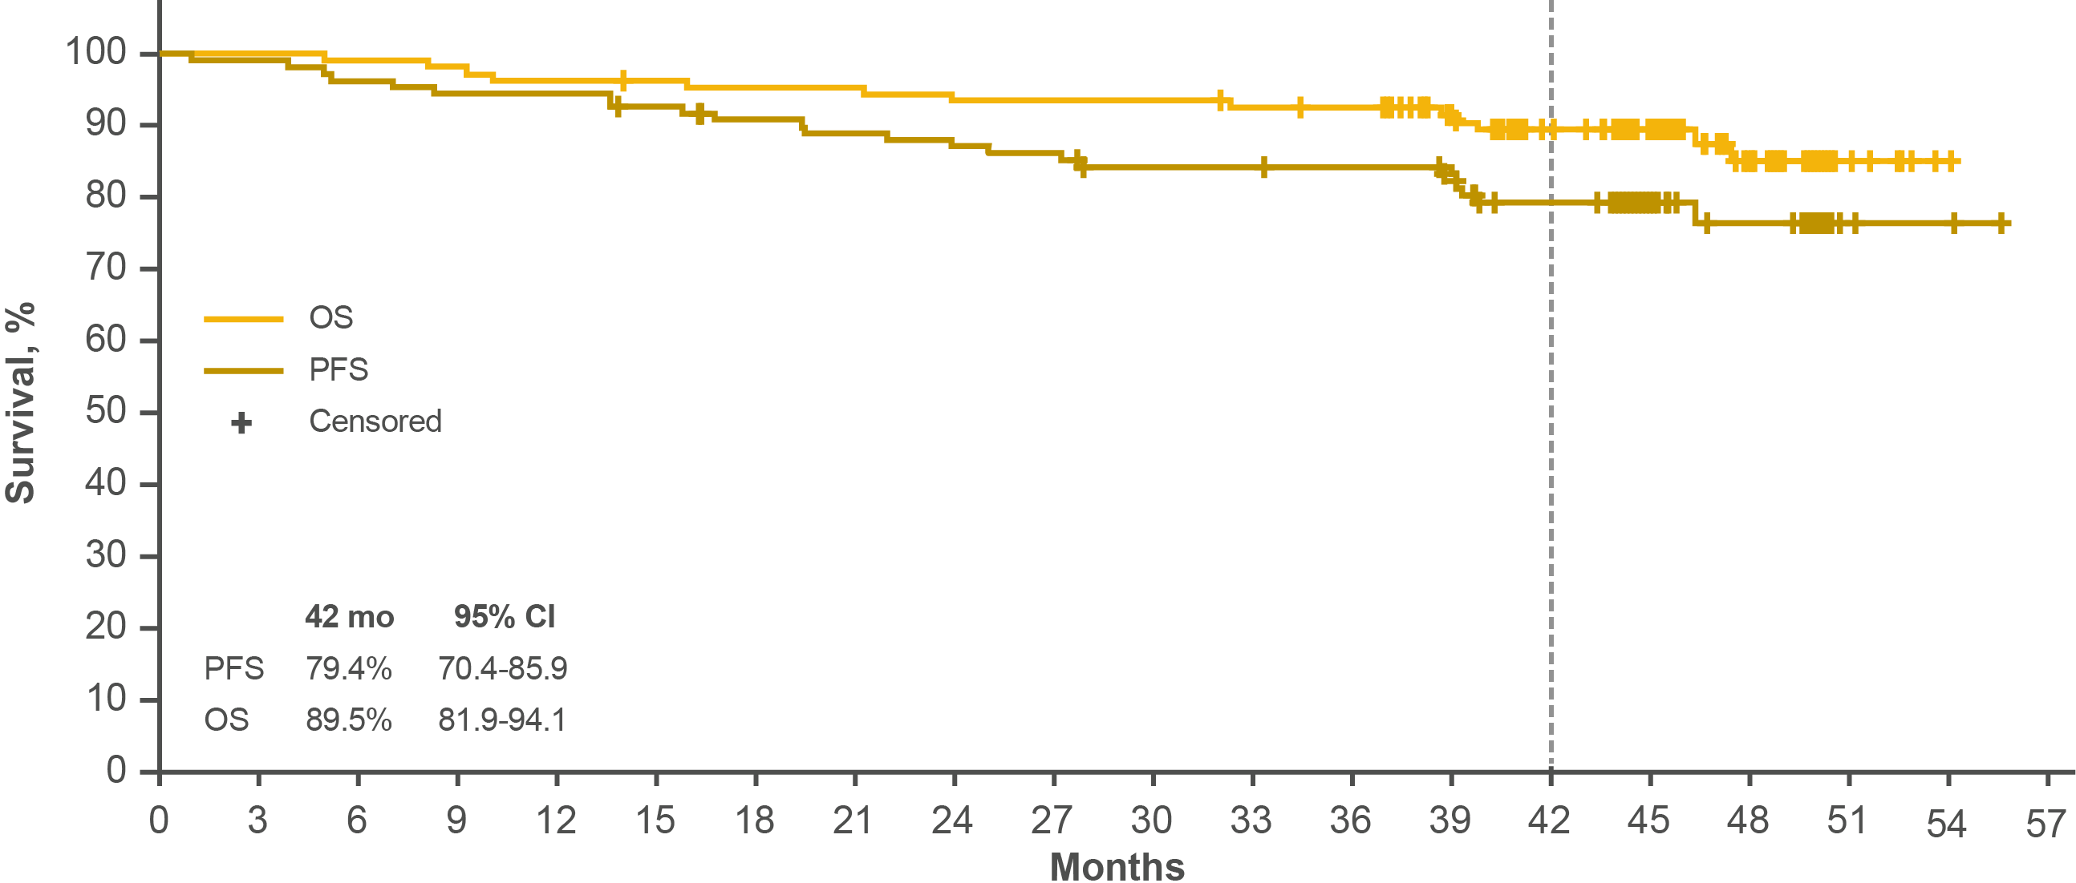
PFS and OS (cohort 2)
Median PFS and OS were not reached; the estimated 42-month rates were 79.4% and 89.5%, respectively
No. of patients
OS | 110 | 110 | 109 | 108 | 106 | 105 | 104 | 104 | 102 | 102 | 102 | 100 | 99 | 87 | 72 | 52 | 33 | 9 | 1 | 0
PFS | 110 | 109 | 106 | 104 | 104 | 101 | 98 | 96 | 94 | 93 | 89 | 89 | 88 | 85 | 75 | 32 | 26 | 3 | 2 | 0

Slide 11
Adverse events of interest
 | Patients without del(17p) |  |  |  | Patients with del(17p)
 | Arm A: zanubrutinib (n=240)ª |  | Arm B: BR (n=227)^{b} |  | Arm C: zanubrutinib (n=111)
AEIs, n(%) | Any grade | Grade ≥ 3 | Any grade | Grade ≥ 3 | Any grade | Grade ≥ 3
Infections | 175 (72.9) | 57 (23.8) | 142 (62.6) | 50 (22.0) | 89 (80.2) | 30 (27.0)
Bleeding | 117 (48.8) | 14 (5.8) | 28 (12.3) | 4 (1.8) | 64 (57.7) | 6 (5.4)
Other malignancies | 45 (18.8) | 22 (9.2) | 28 (12.3) | 11 (4.8) | 27 (24.3) | 8 (7.2)
Hypertension | 42 (17.5) | 22 (9.2) | 31 (13.7) | 15 (6.6) | 15 (13.5) | 7 (6.3)
Diarrhea | 41 (17.1) | 4 (1.7) | 32 (14.1) | 5 (2.2) | 22 (19.8) | 1 (0.9)
Neutropenia | 40 (16.7) | 30 (12.5) | 129 (56.8) | 116 (51.1) | 21 (18.9) | 18 (16.2)
Arthralgia | 37 (15.4) | 2 (0.8) | 23 (0.1) | 1 (0.4) | 26 (23.4) | 1 (0.9)
Anemia | 17 (7.1) | 1 (0.4) | 47 (20.7) | 5 (2.2) | 7 (6.3) | 0 (0)
Thrombocytopenia | 15 (6.3) | 5 (2.1) | 41 (18.1) | 18 (7.9) | 9 (8.1) | 2 (1.8)
Atrial fibrillation/flutter | 12 (5.0) | 3 (1.3) | 6 (2.6) | 3 (1.3) | 7 (6.3) | 5 (4.5)
Myalgia | 9 (3.8) | 0 (0) | 4 (1.8) | 0 (0) | 8 (7.2) | 1 (0.9)
Opportunistic infection | 6 (2.5) | 1 (0.4) | 4 (1.8) | 3 (1.3) | 1 (0.9) | 1 (0.9)

Slide 12
Exposure-adjusted incidence rate
Summary of EAIRsª for select AEIs
 | Patients without del(17p) |  | Patients with del(17p)
 | Arm A: Zanubrutinib (n=240)^{b} | Arm B: BR (n=227)^{c} | Arm C: zanubrutinib (n=111)
Atrial fibrillation and flutter | 0.13 | 0.08 | 0.15
Hemorrhage | 2.02 | 0.40 | 2.73
Major hemorrhage | 0.20 | 0.05 | 0.20
Hypertension | 0.49 | 0.45 | 0.35
Exposure-adjusted incidence rates for hypertension were similar between arms and lower than previously reported

Slide 13
Conclusions
The extended follow-up in the SEQUOIA study showed that the efficacy of zanubrutinib was maintained in previously untreated patients with CLL/SLL without del(17p) and that PFS rates were similar in patients with and without del(17p); OS rates were high in all arms of the trial
Additionally, patients with mutated IGHV who received zanubrutinib demonstrated significant improvements in PFS with extended follow-up vs those who received BR; patients with unmutated IGHV who received zanubrutinib maintained the PFS benefit vs patients who received BR that was observed at the interim analysis
Zanubrutinib was well tolerated over this extended treatment period and aligned with the known profile of BTK inhibitors; atrial fibrillation events remained low
The results of this extended follow-up in the SEQUOIA study support the use of zanubrutinib as a valuable first-line treatment option for elderly patients with CLL/SLL and those with del(17p)

Slide 14
VISION/HO141 trial
Time-limited venetoclax and ibrutinib in patients with R/R CLL who have undetectable MRD: 4-year follow-up

Slide 15
VISION/H0141: Study design
A Phase II trial of ibrutinib plus venetoclax in R/R CLL: Long-term clinical outcome and MRD-kinetics
Primary outcome
Month 27 = 1 year post randomization
Long-term follow-up
Month 51 = 3 years post randomization
Induction
Randomization MRD negative patients
Maintenance (also for MRD pos)
Arm A
Ibrutinib until progression/toxicity
Ibrutinib
R
1:2
Venetoclax
Observation until event
Ibrutinib until progression/toxicity
Arm B
Venetoclax
12 mo
2 months
15 months
Criteria for reinitiating treatment:
CLL progression
according to iwCLL
or
MRD above 10⁻³ | and | At least 1 month later: MRD above 10⁻²
Primary analysis, when the last patient reached 27 months, showed a favorable benefit-risk profile of MRD based on cessation and reduction:
  Primary endpoint was reached: PFS at 12 months post stopping therapy in arm B = 98%¹
Long-term clinical outcome and MRD kinetics with a median follow-up of 50.8 months presented here

Slide 16
MRD and iwCLL responses
MRD and iwCLL responses at end of first year of I-V treatment
N=225
72 patients (32%) achieved uMRD and at least PR
After 15 Cycles of Venetoclax-Ibrutinib

Slide 17
PFS and TTNT
PFS by group
TTNT by group
Arm A
Month 51 | TTNT
Arm A | 92%
Arm B | 96%
Non-randomized | 88%
Arm B
Month 51 | PFS
Arm A | 92%
Arm B | 81%
Non-randomized | 75%
non-randomized
non-randomized
Arm A
Arm B
No. of patients
Arm A | 24 | 24 | 24 | 24 | 17 | 1
Arm B | 48 | 48 | 47 | 46 | 33 | 3
non-randomized | 153 | 139 | 135 | 127 | 87 | 3
No. of patients
Arm A | 24 | 24 | 24 | 24 | 24 | 24 | 23
Arm B | 48 | 48 | 48 | 47 | 47 | 47 | 47
non-randomized | 153 | 141 | 133 | 131 | 130 | 128 | 125
End of C15

Slide 18
Overall survival by group
Arm A
Arm B
non- randomized
At 4 years month 51 | PFS
Arm A | 96%
Arm B | 92%
Non-randomized | 84%
No. of patients
Arm A | 24 | 24 | 24 | 24 | 18 | 1
Arm B | 48 | 48 | 47 | 47 | 35 | 3
non-randomized | 153 | 140 | 137 | 134 | 97 | 4

Slide 19
MRD responses
MRD responses from randomization + 3 years (month 51)
Non randomized (N=116)
36 (31%) =
3 deaths
19 toxicities (16%)
2 progression
2 refusal
10 other reasons
Arm A: uMRD randomized to continued ibrutinib (N=24)
13 (54%) =
1 deaths
6 toxicities (25%)
1 progression
2 refusal
3 other reasons
Arm B: uMRD randomized to observation (N=48)
8 (17%) =
2 deaths
1 toxicity (2%)
1 progression
4 other reasons

Slide 20
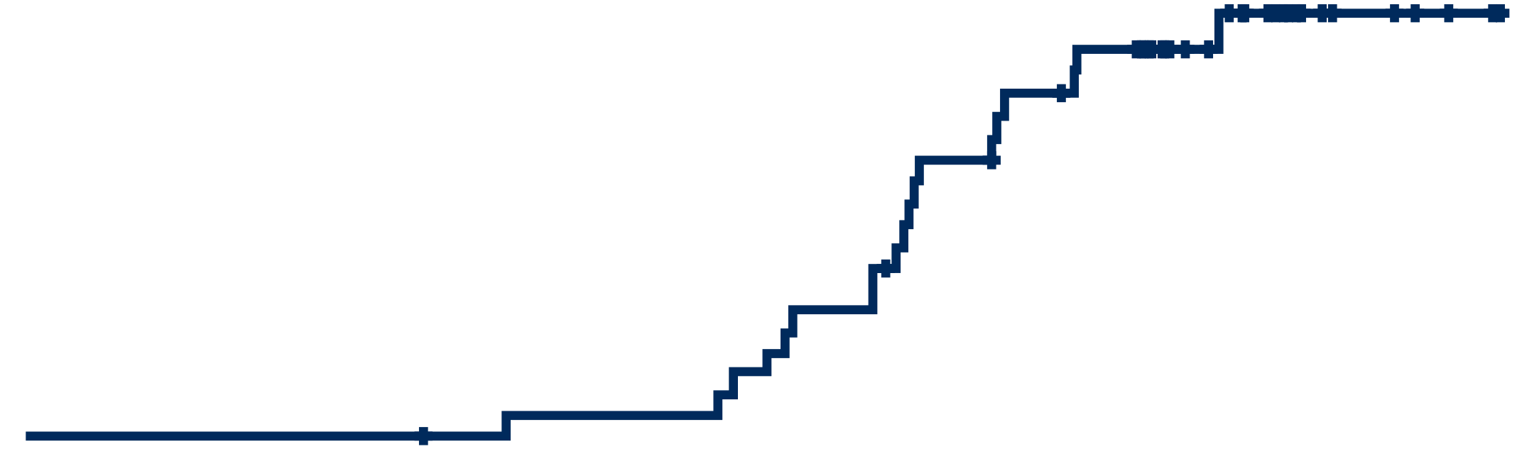
Treatment reinitiation in arm B
Treatment reinitiation in arm B
MRD responses to treatment reinitiation
1.00
C15 start observation N=48
N=19
After 12 cycles of re- treatment by VEN+IBR
100
dMRD2 11% (2/19)
0.75
10
1
dMRD3 21% (4/19)
0.50
0.1
Month 27
uMRD4 47% (9/19)
0.25
0.01
N 48
F 19
0.001
0.00
0.0001
Over 3 years after start of observation: 19/48 (40%) patients had MRD conversion (≥MRD2) and reinitiated treatment
Median time to MRD conversion – 24 months after start of observation (range 6-35)
MRD relapsed patients enriched for TP53 aberrations and genomic complexity (≥3 aberrations)
From 19 retreated patients
  15 progression-free
  1 progressive disease
  1 death
  2 other off protocol (toxicity, other reason)

Slide 21
Adverse events
Adverse events by group at randomization + 3 years (month 51)
The highest number of adverse events occurred in patients that were non-randomized
Percentage of AE in arm B retreated for MRD relapse (n=19)

Slide 22
Conclusions
At 50.8 months of follow-up:
After ibrutinib cessation:
  MRD relapse in 40%, median time to MRD relapse 24 months of observation
  A second uMRD response upon treatment in 47%, only 1 (5%) progression
  Overall toxicity lowest in treatment cessation arm
  For patients achieving uMRD after 15 cycles of treatment, treatment cessation with MRD guided reinitiation is a feasible approach

Slide 23
Zanubrutinib in previously treated
B-cell malignancies intolerant to ibrutinib and/or acalabrutinib
Preliminary results for patients with CLL/SLL

Slide 24
Zanubrutinib in CLL/SLL intolerant to ibrutinib and/or acalabrutinib: Study design
A Phase II, multicenter, single-arm study in patients with previously treated CLL/SLL intolerant to prior treatment with ibrutinib and/or acalabrutinib
Eligible patients
Age ≥18 years and received ≥4 weeks ibrutinib and/or acalabrutinib
Diagnosed with CLL/SLL requiring treatment according to iwCLL prior to initiation of ibrutinib or acalabrutinib
Ibrutinib and/or acalabrutinib intolerant
ECOG PS 0-2
Cohort 1
Intolerant of only ibrutinib
Zanubrutinib
160 mg BID
or
320 mg QD
Treatment until disease progression or unacceptable toxicityª
Cohort 2
Intolerant of acalabrutinib ± ibrutinib
Primary endpoint: Safety of zanubrutinib compared with ibrutinib and/or acalabrutinib intolerance AE profile
Secondary endpoints: ORR by INV, DCR by INV, DoR, time to first response, time to best overall response, PFS by INV, HRQoL
Exploratory endpoints: Improvements in response in patients with previous response to ibrutinib and/or acalabrutinib

Slide 25
Ibrutinib intolerance events
With zanubrutinib, 65 out of 95 ibrutinib intolerance AEs (68.4%) did not recur
32 (61.5%) of 52 patients with ibrutinib intolerance did not experience recurrence of any of other intolerance events
  No intolerance AEs occurred at a higher severity
  Of those that did recur, 22 of 30 ibrutinib intolerance events AEs (73.3%) recurred at a lower grade
  One patient discontinued treatment due to an ibrutinib intolerance

Slide 26
Acalabrutinib-intolerance events
With zanubrutinib, 15 out of 21 acalabrutinib intolerance AEs (71.4%) did not recur
12 (70.6%) of 17 patients with acalabrutinib intolerance did not experience recurrence of any of other intolerance events
  No intolerance AEs occurred at a higher severity
  Of those that did recur, 2 of 6 acalabrutinib intolerance events AEs (33.3%) recurred at a lower grade
  One patient discontinued treatment due to an acalabrutinib intolerance

Slide 27
Treatment-emergent adverse events
n (%) | Ibrutinib intolerant (n=44) | Acalabrutinib intolerantª (n=17) | Total (N=61)
Any TEAE | 42 (95.5) | 15 (88.2) | 57 (93.4)
Grade ≥3 TEAEs | 24 (54.5) | 7 (41.2) | 31 (50.8)
Serious TEAEs | 12 (27.3) | 4 (23.5) | 16 (26.2)
TEAEs leading to death | 1 (2.3) | 0 | 1 (1.6)
TEAEs leading to treatment discontinuation | 4 (9.1) | 1 (5.9) | 5 (8.2)
TEAEs leading to dose interruption | 22 (50.0) | 8 (47.1) | 30 (49.2)
TEAEs leading to dose reduction | 12 (27.3) | 3 (17.6) | 15 (24.6)
Fifty-seven patients (93.4%) reported ≥1 treatment-emergent AE (TEAE) while taking zanubrutinib
Grade ≥3 TEAEs were reported in 50.8% of patients, with the most common being neutropenia (11.5%), COVID-19 (6.6%) and pneumonia (6.6%)
One patient experienced a TEAE leading to death (COVID-19 pneumonia)

Slide 28
Treatment-emergent adverse event
TEAEs occurring in ≥15% of total patient population
TEAE, % | Ibrutinib intolerant (n=44) | Acalabrutinib intolerantª (n=17) | Total (N=61)
Fatigue | 14 (31.8) | 4 (23.5) | 18 (29.5)
COVID-19 | 13 (29.5) | 1 (5.9) | 14 (23.0)
Contusion | 10 (22.7) | 3 (17.6) | 13 (21.3)
Diarrhea | 8 (18.2) | 4 (23.5) | 12 (19.7)
Arthralgia | 8 (18.2) | 2 (11.8) | 10 (16.4)
Cough | 5 (11.4) | 5 (29.4) | 10 (16.4)
Myalgia | 7 (15.9) | 3 (17.6) | 10 (16.4)

Slide 29
Investigator-assessed responses
 | Ibrutinib intolerant | Acalabrutinib intolerantª | Total
ORR and DCR
n | 43 | 14 | 57
DCR, n (%) (95% CI)^{b} | 41 (95.3) (84.2-99.4) | 13 (92.9) (66.1-99.8) | 54 (94.7) (85.4-98.9)
ORR, n (%) (95% CI)^{c} | 31 (72.1) (56.3-84.7) | 10 (71.4) (41.9-91.6) | 41 (71.9) (58.5-83.0)
Best overall response, n (%)
CR | 1 (2.3) | 0 | 1 (1.8)
PR | 25 (58.1) | 8 (57.1) | 33 (57.9)
PR with lymphocytosis | 5 (11.6) | 2 (14.3) | 7 (12.3)
SD | 10 (23.3) | 3 (21.4) | 13 (22.8)
PD | 1 (2.3) | 1 (7.1) | 2 (3.5)
Not done^{d} | 1 (2.3) | 0 | 1 (1.8)
Time to best overall response
n | 31 | 10 | 41
Median (range), months | 5.7 (2.6-28.1) | 2.9 (2.7-8.4) | 5.6 (2.6-28.1)
PFS^{e}
n | 44 | 17 | 61
12-month event-free rate, % (95% Cl) | 90.3 (76.3-96.3) | 74.3 (24.5-93.9) | 88.3 (75.7-94.6)
DoR^{e}
n | 31 | 10 | 41
12-month event-free rate, % (95% Cl) | 89.2 (70.1-96.4) | 80.0 (20.4-96.9) | 88.0 (70.8-95.3)
In 57 evaluable patients, the DCR was 94.7% and the ORR was 71.9%
The 12-month PFS rate
was 88.3%
(95% CI, 75.7%-94.6%)

Slide 30
Conclusions
AEs that previously caused patients with CLL/SLL to discontinue ibrutinib or acalabrutinib treatment were unlikely to recur with zanubrutinib; recurrences were mostly at a lower severity
Disease was controlled in 95% of patients, suggesting that patients with CLL/SLL who were intolerant of ibrutinib or acalabrutinib are likely to receive clinical benefit from switching to zanubrutinib
These data suggest that zanubrutinib is a viable treatment option for patients with CLL/SLL who are intolerant of ibrutinib or acalabrutinib

Slide 31
CLL12
Ibrutinib versus placebo in early TN CLL:
final results

Slide 32
CLL12: Study design
A randomized, multicenter, Phase 3 trial to compare the efficacy and safety of ibrutinib vs. placebo in previously untreated Binet stage A CLL patients with risk of early disease progression
648 patients with CLL
Binet stage A
Asymptomatic
Treatment-naïve
All screened to determine the risk of progression
del(17p)
del(11q)
thymidine kinase
𝛃 macroglobulin
IGHV
ECOG PS
sex
age
152 patients
no risk
152 patients watch and wait
Risk assessment
363 patients
increased risk
182 patients ibrutinib
181 patients placebo
vs
420 [mg/d] until symptomatic disease progression
Primary endpoint analysis demonstrated superior EFS for the ibrutinib group¹
Overall survival was not analyzed due to a lacking number of events
The final analysis is performed at a median observation time of 69.3 (0 – 93.4) months
FPI
APR-2014
EOS
JUL-2022

Slide 33
Adverse events
Adverse events (patient level)
Adverse events of clinical interest (patient level)
 | Ibrutinib n=170 | Placebo n=168 | Watch & wait n=152
Max. CTC grade, n (%) CTC grades 1-5 CTC grades 3-5 | 169 (99.4) 122 (71.8) | 167 (99.4) 111 (66.1)
Marked as serious AE, n (%) | 241 (9.9) | 222 (14.9)
Second malignancy, n (%) CTC grades 1-5 CTC grade 5 | 22 (12.9) 2 (1.2) | 36 (21.4) 5 (3) | 15 (9.9) 2 (1.3)
 | Ibrutinib n=170 | Placebo n=168
Max. CTC grade, n (%) CTC grades 1-5 CTC grades 5 | 136 (80) 4 (2.4) | 88 (52.4) 1. (0.6)
Bleeding Cardiac arrhythmias Cardiac event other than arrhythmia Diarrhea Hypertensive disorders | 62 (36.5) 38 (22.4) 30 (17.6) 69 (40.6) 33 (19.4) | 25 (14.9) 16 (9.5) 26 (15.5) 48 (28.6) 14 (8.3)
The rate of CTC grade 1-5 AEs is slightly higher in the ibrutinib cohort, whereas the rate of serious AEs was slightly higher in the placebo group
The rate of bleeding events in the ibrutinib arm was 36.5% compared to 14.9% in the placebo arm
The rate of cardiac arrhythmias was 22.4% in the ibrutinib arm compared to 9.5% in the placebo arm

Slide 34
Treatment
 | Ibrutinib N=170 | Placebo N=168
No. of cycles, median (range) | 39 (1-99) | 27.5 (1-97)
Early treatment discontinuation, N (%) | 105 (61.8) | 136 (81)
Progressive disease | 5 (4.8) | 66 (48.5)
Adverse event | 76 (72.4) | 39 (28.7)
Death | 1 (1) | 1 (0.7)
Withdrawal/non-compliance | 14 (13.3) | 24 (17.6)
Other | 9 (8.6) | 6 (4.4)
The most common reason for treatment discontinuation were adverse events in the ibrutinib arm and progressive disease in the placebo arm

Slide 35
Response to treatment
Best response | Ibrutinib | Placebo
All patients [FAS], N | 182 | 181
Response, N (%) CR PR SD Missing | 3 (1.6) 129 (70.9) 36 (19.8) 14 (7.7) | 0 8 (5) 155 (85.6) 17 (9.4)
Overall response rate, N (%) | 132 (72.5) | 9 (5)
The overall response rate in the ibrutinib arm was 72.5%

Slide 36
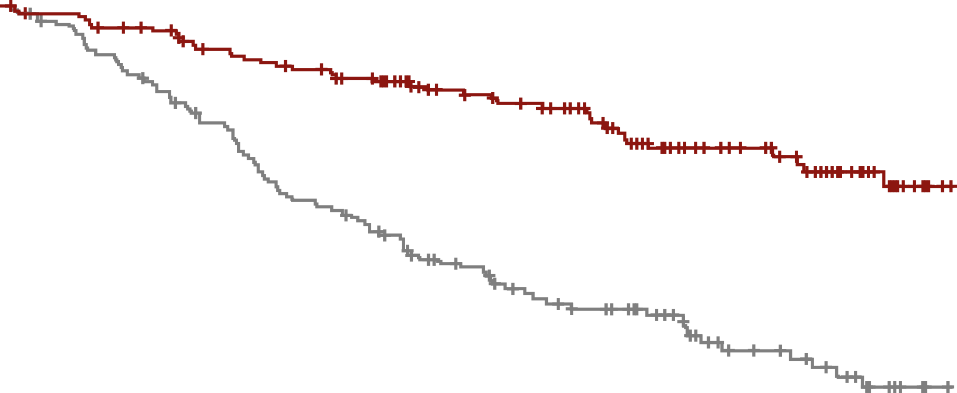
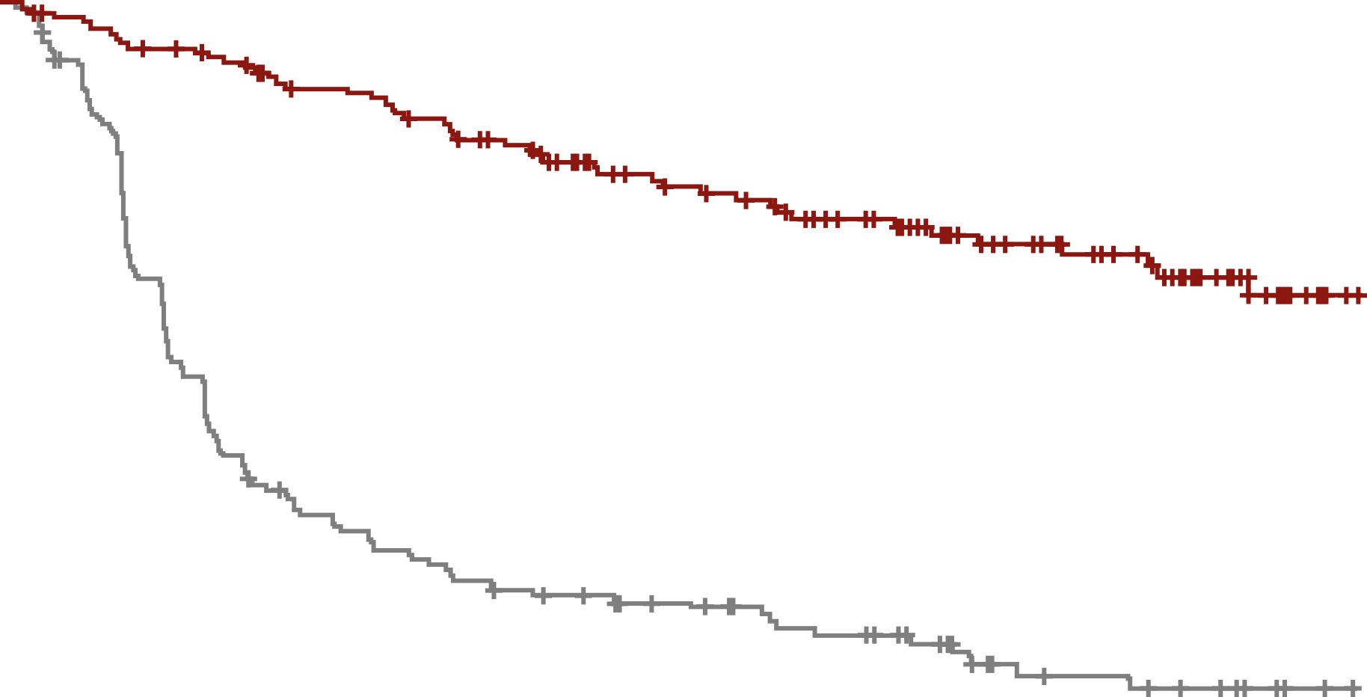
EFS and PFS
EFS until PD or death
PFS until PD or death
P < 0.001 (HR 0.276, 95% CI 0.188-0.407)
P < 0.001 (HR 0.174, 95% CI 0.122-0.246)
EFS | Pts, N | Events, N (%) | Median months | 1-year survival, % | 2-year survival, % | 3-year survival, % | 4-year survival, % | 5-year survival, %
All patients [ITT] | 363 | 132 (36.4)
Ibrutinib | 182 | 39 (21.4) | NR | 96.4 | 90.9 | 87.7 | 84.1 | 78.2
Placebo | 181 | 93 (51.4) | 51.6 | 88.9 | 74.5 | 61.2 | 52.2 | 48.0
PFS | Pts, N | Events, N (%) | Median months | 1-year survival, % | 2-year survival, % | 3-year survival, % | 4-year survival, % | 5-year survival, %
All patients [ITT] | 363 | 179 (49.3)
Ibrutinib | 182 | 47 (25.8) | NR | 94.7 | 89.1 | 82.2 | 77.1 | 73.9
Placebo | 181 | 132 (72.9) | 14.0 | 56.5 | 36.4 | 29.1 | 27.0 | 23.7

Slide 37
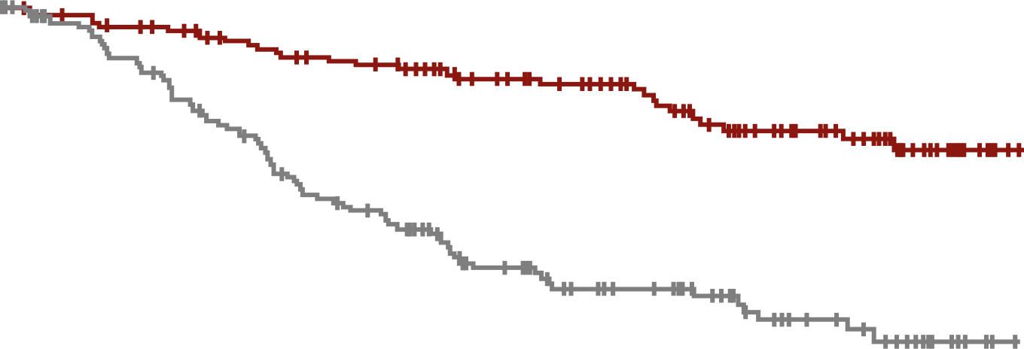
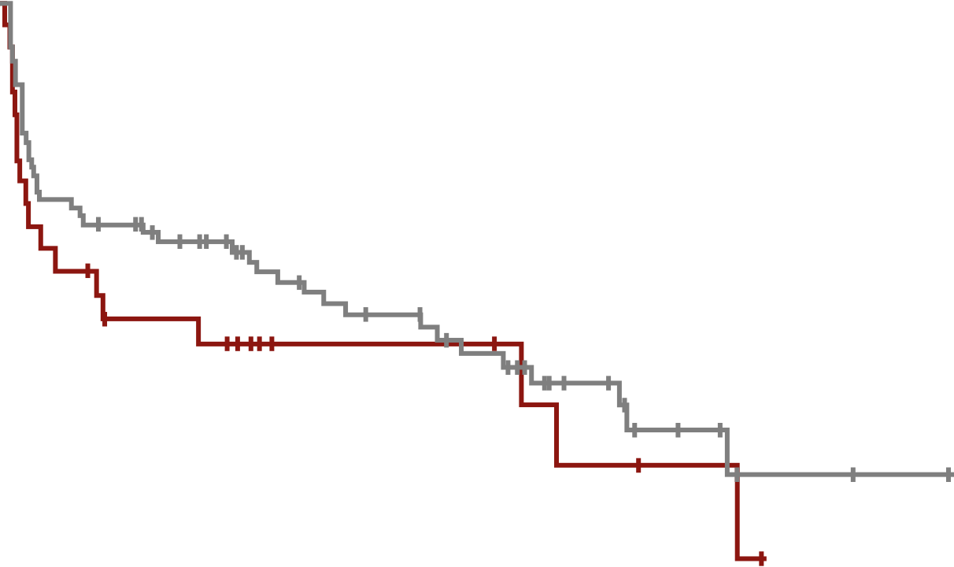
TTNT and PFS2
Time to next treatment
PFS2 from start of subsequent treatment
P < 0.001 (HR 0.244, 95% CI 0.156-0.380)
COX regression (HR 1.471, 95% CI 0.840-2.576)
TTNT | Pts, N | Events, N (%) | Median months | 1-year survival, % | 2-year survival, % | 3-year survival, % | 4-year survival, % | 5-year survival, %
All patients [ITT] | 363 | 108 (29.8)
Ibrutinib | 182 | 29 (15.9) | NR | 97.0 | 93.3 | 90.8 | 88.6 | 84.1
Placebo | 181 | 79 (43.6) | 68.5 | 91.8 | 76.9 | 64.2 | 58.0 | 54.6
PFS2 | Pts, N | Events, N (%) | Median months | 1-year survival, % | 2-year survival, % | 3-year survival, % | 4-year survival, % | 5-year survival, %
All patients [ITT] | 108 | 62 (57.4)
Ibrutinib | 29 | 18 (62.1) | 16.6 | 51.3 | 47.3 | 47.3 | 28.4 | 28.4
Placebo | 79 | 44 (55.7) | 35.1 | 64.5 | 56.9 | 49.9 | 41.3 | 34.1

Slide 38
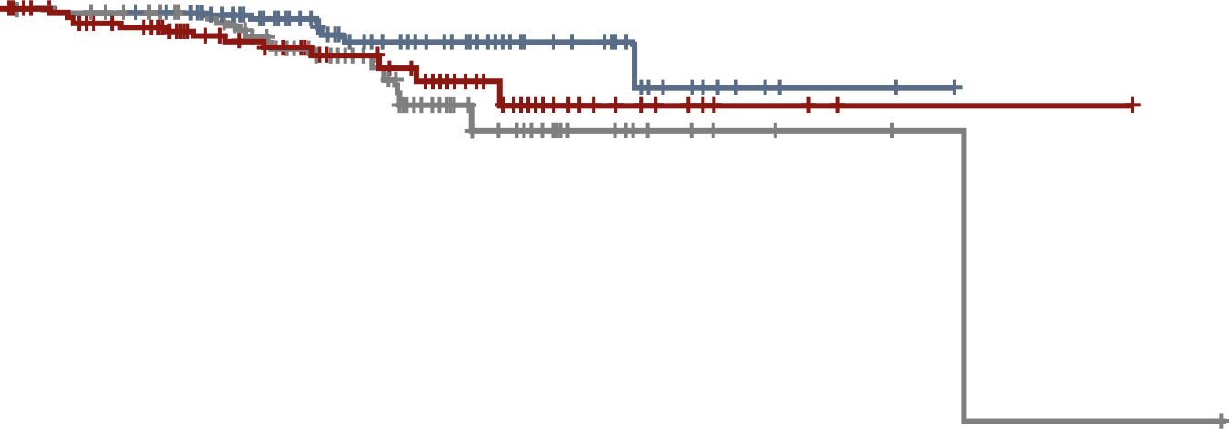
Overall survival
OS
OS from diagnosis
P = 0.562 (HR 0.791, 95% CI 0.358-1.748)
OS | Pts, N | Events, N (%) | Median months | 1-year survival, % | 2-year survival, % | 3-year survival, % | 4-year survival, % | 5-year survival, %
All patients [ITT] | 363 | 26 (7.2)
Ibrutinib | 182 | 12 (6.6) | NR | 98.8 | 97.6 | 97.0 | 94.1 | 93.3
Placebo | 181 | 14 (7.7) | NR | 100.0 | 100.0 | 98.8 | 96.0 | 93.6
OS | Pts, N | Events, N (%) | Median months | 2-year survival, % | 4-year survival, % | 6-year survival, % | 8-year survival, % | 10-year survival, %
All patients [ITT] | 515 | 32 (6.2)
Ibrutinib | 182 | 12 (6.6) | NR | 98.2 | 97.0 | 94.7 | 93.6 | 89.8
Placebo | 181 | 14 (7.7) | 258.0 | 100.0 | 100.0 | 96.4 | 93.5 | 86.5
Watch & wait | 152 | 6 (3.9) | NR | 99.3 | 99.3 | 98.6 | 95.3 | 95.3

Slide 39
Conclusions
The CLL12 study demonstrates that in patients with early stage CLL;
  ibrutinib is associated with relevant cardiovascular toxicity and increased susceptibility to bleeding
  EFS, PFS and TTNT are significantly longer for patients in the ibrutinib group
  ibrutinib does not prolong survival as compared to placebo
  Median survival is > 20 years for patients in the placebo group

Slide 40
CLL14
Venetoclax plus obinutuzumab in TN CLL:
6 year follow up

Slide 41
CLL14: Study design
Prospective, open-label, multicenter, randomized Phase III study of venetoclax plus obinutuzumab vs chlorambucil plus obinutuzumab in TN CLL and coexisting medical conditions: 6 year follow-up
Venetoclax plus
Obinutuzumab (n=216)
6 cycles
Venetoclax 400 mg QD
(initiated day 22, dose ramp
50 mg -400 mg over 5 weeks)¹
Venetoclax
(n=216)
6 cycles
Venetoclax 400 mg QD¹
Key eligibility criteria
Age ≥18 years
Documented TN CLL requiring treatment according to iwCLL criteria
One of (or both):
  CIRS score greater than > 6
  CrCl of 30-69 mL/min¹
Arm A
Follow-up Phase:
Primary endpoint: Progression-free survival
Key secondary endpoints:
DoR, MRD, OS
Patients with CLL with preexisting conditions
N=432
R
1:1
Chlorambucil plus Obinutuzumab (n=216)
6 cycles
Chlorambucil 0.5 mg/kg
body weight
(days 1 and 15 of each cycle)¹
Chlorambucil
(n=216)
6 cycles
Chlorambucil 0.5 mg/kg body weight (days 1 and 15 of each cycle)¹
Arm B

Slide 42
Baseline characteristics
Characteristic | Venetoclax-obinutuzumab N=216 | Chlorambucil-obinutuzumab N=216
Median age | 72 years | 71 years
Binet stage
A | 21% | 20%
B | 35% | 37%
C | 44% | 43%
Median total CIRS score | 9 (0 - 23) | 8 (1 -28)
Median estimated CrCl | 65.2 ml/min | 67.4 ml/min
TLS risk category
Low | 13% | 12%
Intermediate | 64% | 68%
High | 22% | 20%
Characteristic | Venetoclax-obinutuzumab N=216 | Chlorambucil-obinutuzumab N=216
IGHV mutational status
Unmutated | 61% | 59%
Mutated | 38% | 40%
Not evaluable | 1% | 1%
del(17p) and/or TP53 mutation | 12% | 12%
Cytogenetic subgroups
Deletion in 17p | 8% | 7%
Deletion in 11q | 17% | 18%
Trisomy in 12 | 17% | 19%
No abnormalities | 24% | 20%
Deletion in 13q alone | 34% | 36%

Slide 43
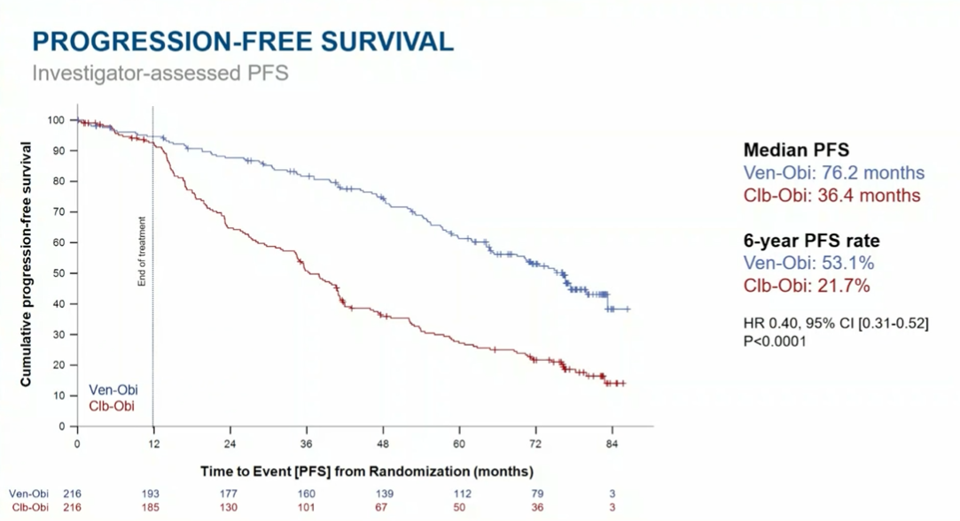
Progression-free survival
Investigator-assessed PFS
Median PFS
Ven-Obi: 76.2 months
Clb-Obi: 36.4 months
6-year PFS rate
Ven-Obi: 53.1%
Clb-Obi: 21.7%
HR 0.40, 95% CI (0.31-0.52) P<0.0001
End of treatment
Ven-Obi | 216 | 193 | 177 | 160 | 139 | 112 | 79 | 3
Clb-Obi | 216 | 185 | 130 | 101 | 67 | 50 | 36 | 3

Slide 44
Progression-free survival by subgroup
Investigator-assessed PFS by IGHV status
Investigator-assessed PFS by TP53 status
Ven-Obi & IGHV^{mut}
Ven-Obi & IGHV^{unmut}
Clb-Obi & IGHV^{mut}
Clb-Obi & IGHV^{unmut}
Ven-Obi & TP53^{del/mut}
Ven-Obi & none
Clb-Obi & TP53^{del/mut}
Clb-Obi & none
Ven-Obi IGHV^{mut}
Ven-Obi IGHV^{unmut}
Clb-Obi IGHV^{mut}
Clb-Obi IGHV^{unmut}
76 | 68 | 64 | 60 | 57 | 49 | 39 | 2
121 | 110 | 101 | 90 | 73 | 57 | 37 | 1
83 | 76 | 66 | 57 | 42 | 35 | 28 | 2
123 | 101 | 59 | 41 | 22 | 13 | 8 | 1
Ven-Obi TP53^{del/mut}
Ven-Obi no TP53^{del/mut}
Clb-Obi TP53^{del/mut}
Clb-Obi no TP53^{del/mut}
25 | 21 | 17 | 15 | 13 | 8 | 4 | 0
184 | 168 | 157 | 142 | 123 | 101 | 73 | 3
24 | 19 | 10 | 9 | 5 | 4 | 3 | 0
184 | 160 | 117 | 90 | 60 | 45 | 33 | 3
Median PFS
Ven-Obi IGHV^{mut}: NR
Ven-Obi IGHV^{unmut}: 64.8 m
HR 0.38, 95% CI (0.23-0.61) P<0.001
Clb-Obi IGHV^{mut}: 62.2 m
Clb-Obi IGHV^{unmut}: 26.9 m
HR 0.33, 95% CI (0.23-0.47) P<0.001
Median PFS
Ven-Obi no TP53^{del/mut}: 76.6 m
Ven-Obi TP53^{del/mut}: 51.9 m
HR 2.29, 95% CI (1.37-3.83) P=0.001
Clb-Obi no TP53^{del/mut}: 38.9 m
Clb-Obi TP53^{del/mut}: 20.8 m
HR 1.66, 95% CI (1.05-2.63) P=0.03

Slide 45
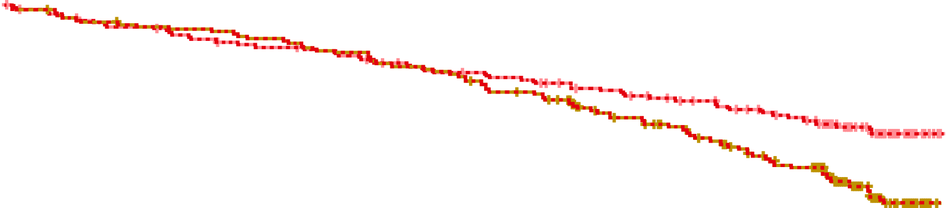
Overall survival
Investigator-assessed OS
Median OS
Ven-Obi: not reached
Clb-Obi: not reached
6-year OS rate
Ven-Obi: 78.7%
Clb-Obi: 69.2%
HR 0.69, 95% CI (0.48-1.01) P=0.052
Ven-Obi: 48 deaths, 9 (18.8% ) CLL-related
Clb-Obi: 70 deaths, 26 (37.1% ) CLL-related
Ven-Obi
Clb-Obi
216 | 198 | 189 | 182 | 173 | 160 | 144 | 23
216 | 201 | 194 | 181 | 167 | 144 | 118 | 16

Slide 46
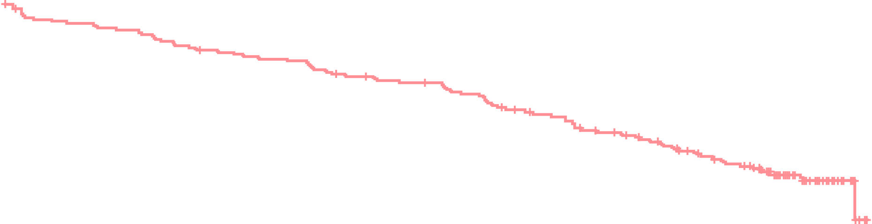
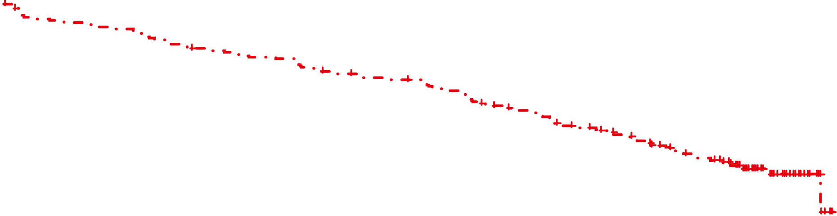
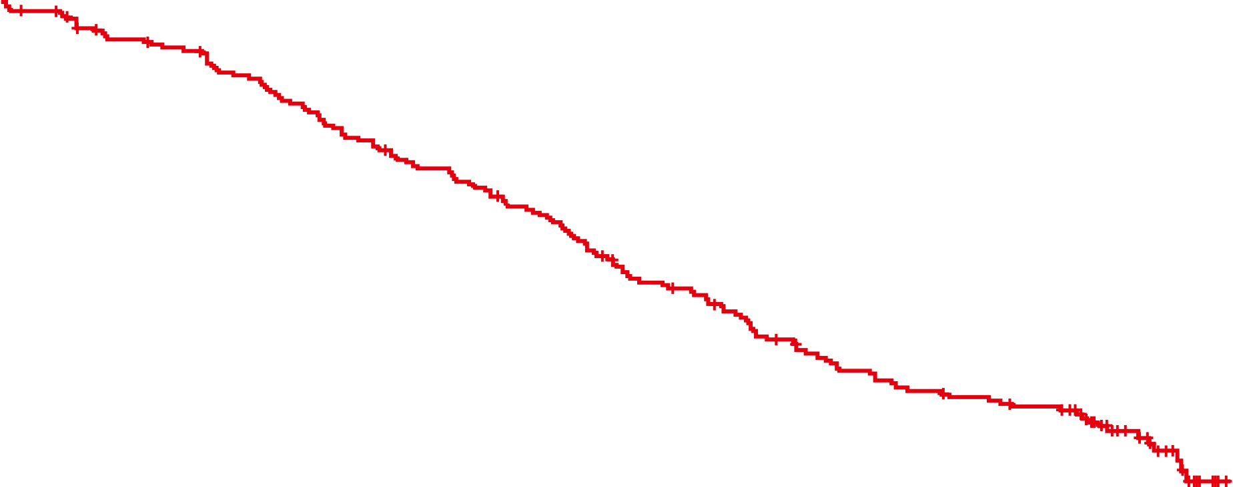
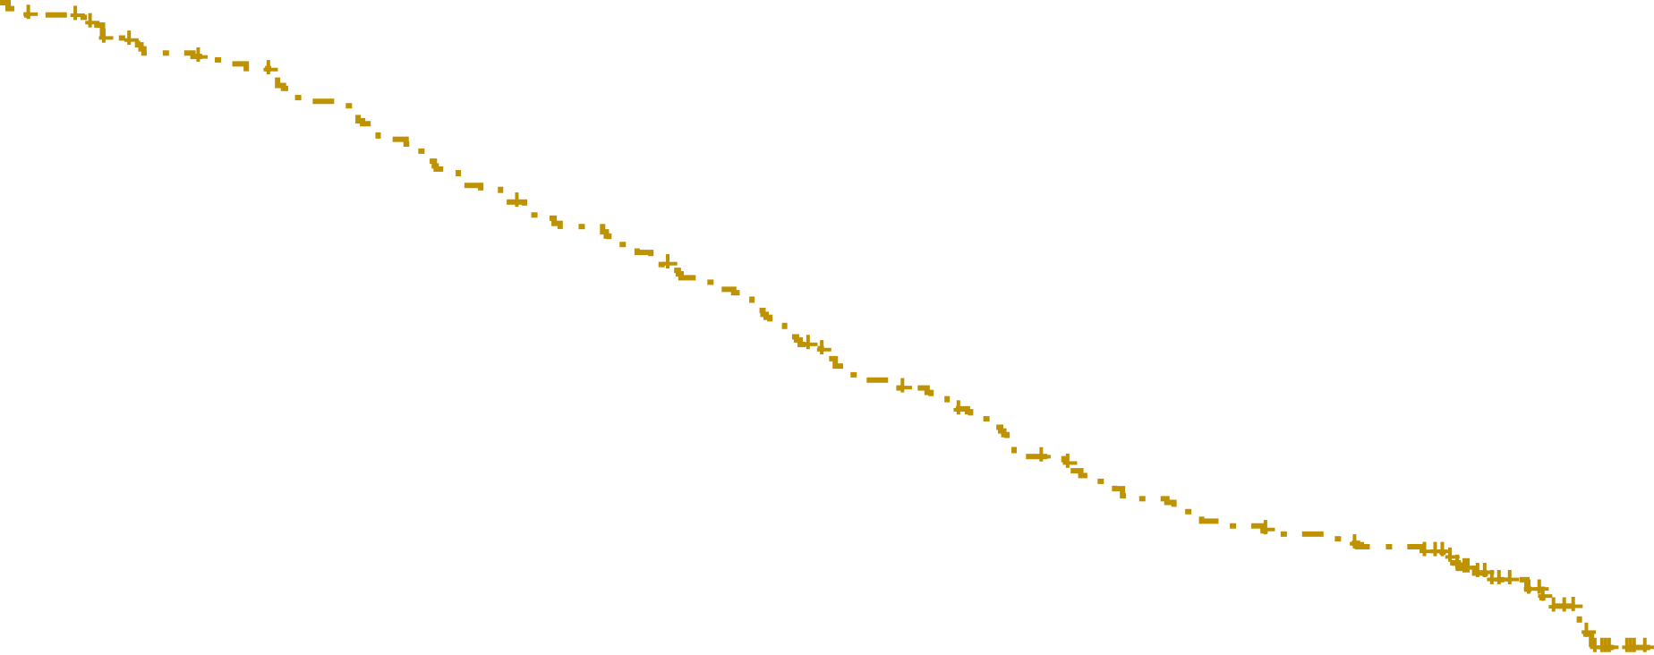
Time to next treatment
Defined as time to death or next-antileukemic treatment
Median TTNT
Ven-Obi: not reached
Clb-Obi: 52.9 m
6-year TTNT rate
Ven-Obi: 65.2%
Clb-Obi: 37.1%
Next anti-leukemic therapy:
Ven-Obi: 67 PDs
- 39 NLT
Clb-Obi: 141 PDs
- 103 NLT
HR 0.44, 95% CI (0.33-0.58) P<0.0001
No protocol-defined post-protocol care
Most patients received targeted therapy in 2L
Ven-Obi
Clb-Obi
216 | 195 | 183 | 172 | 161 | 140 | 118 | 20
216 | 194 | 166 | 140 | 111 | 83 | 70 | 10

Slide 47
Safety
Most frequent ≥ grade 3 AEs
Second primary malignancies
 | Venetoclax-obinutuzumab (N=212) |  | Chlorambucil-obinutuzumab (N=214)
 | During treatment | After treatment | During treatment | After treatment
Neutropenia | 51.9% | 3.8% | 47.2% | 1.9%
Thrombocytopenia | 14.2% | 0.5% | 15.0% | 0.0%
Anemia | 7.5% | 1.9% | 6.1% | 0.5%
Febrile neutropenia | 4.2% | 0.9% | 3.3% | 0.5%
Leukopenia | 2.4% | 0.0% | 4.7% | 0.0%
Pneunomia | 3.8% | 3.3% | 3.7% | 1.4%
Infusion-related reaction | 9.0% | 0.0% | 9.8% | 0.5%
Tumour lysis syndrome | 1.4% | 0.0% | 3.3% | 0.0%
 | VenetocIax-obinutuzumab (N=212) | ChlorambuciI-obinutuzumab (N=214)
Overall total number of events Excluding non-melanoma skin cancers | 31 | 20
Number of patients with ≥1 SPM | 30 (14.2%) | 18 (8.4%)
Melanoma | 8 (3.8%) | 4 (1.9%)
Solid organ tumours | 17 (8.0%) | 11 (5.1%)
Hematological malignancies | 3 (1.4%) | 2 (0.9%)
Other | 2 (0.9%) | 1 (0.5%)
Low rates of post-treatment toxicity in these fixed-duration therapies
No statistical difference in the number of SMPs between Ven-Obi and Clb-Obi
Rates of SMPs currently viewed to have no clinical implications by investigators

Slide 48
Conclusions
53.1% of patients treated with fixed-duration venetoclax-obinutuzumab remain without PFS event five years after treatment cessation
Over 60% have not required a second-line treatment
End-of-treatment MRD status significantly correlated with PFS and OS
Benefit observed across all subgroups, including TP53^{del/mut} and IGHV^{unmut}
No new safety signals, secondary malignancy rate under continued observation

Slide 49
BRUIN
Genomic evolution and resistance to pirtobrutinib in cBTKi pre-treated CLL

Slide 50
BRUIN: Study design and methods
Genomic analysis in the CLL cohort of the Phase 1/2 BRUIN study of pirtobrutinib in patients
with B-cell malignancies
CLL pirtobrutinib monotherapy cohortª
N=311
CLL treated with prior cBTKi
n=279
CLL with PD on pirtobrutinib
n=111
PD with available longitudinal samples
n=49
32 cBTKi-naïve patients
168 patients without PD at data cutoff date
62 patients with pending NGS data at baseline or PD
NGS of paired baseline and progression PBMC samples from 49 cBTKi pre-treated CLL patients who progressed on pirtobrutinib
Targeted NGS (5% VAF Limit of Detection) gene list (all exons, 74 genes): BTK, PLCG2, TP53…
Manual inspection (1% VAF cutoff) of acquired BTK mutations at corresponding baseline sample

Slide 51
Baseline genomics and efficacy
100
50
Best SPD change (%)
0
*
-50
-100
Prior cBTKi-resistant
Prior ibrutinib
Prior acalabrutinib
Prior zanubrutinib
84%
90%
20%
2%
At baseline
BTK
PLCG2
TP53
ATM
NOTCH1
SF3B1
51%
10%
49%
27%
20%
18%
Mut. at baseline
Single
Multiple
The most common mutations at baseline were in BTK (51%), TP53 (49%), ATM (27%), NOTCH1 (20%), SF3B1 (18%), and PLCG2 (10%)
A total of 31 BTK mutations in 25 patients were detected at baseline: C481S (n=23), C481R (n=4), C481Y (n=2), C481F (n=1), T474I (n=1)
Pirtobrutinib efficacy was observed regardless of type of prior cBTKi and baseline BTK mutational status
ORR for the resistant population (N=49) was 80% (95% CI 66-90%), comparable to the 82% ORR (95% CI 77-86%) in the overall population (N=279)

Slide 52
Genomics at progression
Acquired resistance (n=49)
Acquired mutations (n=82)
Baseline
Gatekeeper (T474)
22%
C481S/R/Y/F
30
Kinase-impaired
(L528) 11%
T4741
PH
TH
SH3
SH3
Kinase
# BTK mutations
V416L
A428D
Y545N
Kinase other
9%
C481
S/Y/R
D539G/H
C481
4%
L528W
T4741/F/L/Y
18
BTK
Non-BTK
No mutation detected
BTK
SF3B1
TP53
Acquired
PLCG2
BCL2
Other
71% (35/49) of patients had at least one acquired mutation at progression, while 29% (14/49) of patients had no mutation detected in this NGS targeted gene panel, suggesting alternative mechanisms of resistance
A total of 82 acquired mutations were found in 35 patients, including mutations in BTK (45%), TP53 (11%), SF3B1 (6%), PLCG2 (5%) and BCL2 (4%)
Acquired resistance to pirtobrutinib mostly converged around on-target BTK mutations (non-C481), the majority of which were on the T474 gatekeeper residue or a kinase-impaired mutation on the L528

Slide 53
Acquired BTK mutations
All (68)
BTK C481 (33)
BTK T474 (19)
BTK L528 (9)
BTK Other (7)
100
100
100
100
100
80
80
80
80
80
60
60
60
60
60
VAF (%)
VAF (%)
VAF (%)
VAF (%)
VAF (%)
40
40
40
40
40
20
20
20
20
20
Mutation detected
At baseline
At progression (PD)
Shared
0
0
0
0
0
Baseline
PD
Baseline
PD
Baseline
PD
Baseline
PD
Baseline
PD
ORR (%)
31/36 (86%)
23/25 (92%)
16/18 (89%)
8/9 (89%)
5/6 (83%)
Decrease/clearance of most C481 clones observed at progression on pirtobrutinib in 92% (22/24) patientsª
BTK C481R/S/Y, T474, L528, and other mutations arose at/near progression (n=27 patients^{b})
The majority of BTK acquired mutations were T474, L528
ORR were similar across groups regardless of the acquired BTK mutation

Slide 54
Baseline BTK mutations at low VAFs
Baseline
C481S/R/Y/F
30
T474I
PH
TH
SH3
SH3
Kinase
# BTK mutations
Y545N
A428D
C481
T474
L528
A428
L528W
28
Ibrutinib 31/44 (70%)
4
2
1
T474I/L
6
Acalabrutinib 8/10 (80%)
4
4
Baseline (Low VAF)
Acalabrutinib 1/1 (100%)
1
#BTK mutations detected at baseline according to prior cBTKi
9/37 (24%) acquired non-C481 BTK mutations at PD (median VAF at PD: 40% [range, 9-84]) pre-existed at baseline at low VAFs (1-3%)ª
Low-VAF baseline BTK mutations mimicked the ones identified at progression and predominantly occurred at the T474 and L528 residues
These patients had similar responses to pirtobrutinib (6/8, 75% ORR [95% CI, 35-97], median time on pirtobrutinib of 11.2 months [range 3.9-14.5 m]) and included patients that received prior ibrutinib (n=4), acalabrutinib (n=3), and ibrutinib + acalabrutinib (n=1)

Slide 55
Conclusions
Patients who progressed on pirtobrutinib showed clearance of BTK C481 clones and some developed non-C481 clones, particularly gatekeeper T474 and kinase-impaired L528W mutations, as well as other less frequent mutations in the kinase domain
Approximately half of patients did not acquire BTK mutations and 29% did not acquire any mutations in this targeted panel, suggesting alternate resistance mechanisms
Several non-C481 BTK mutations were shown to be pre-existing at baseline at low VAF, suggesting emergence on prior cBTKi
Importantly, these baseline and acquired kinase domain BTK mutations did not preclude pirtobrutinib efficacy

Slide 56
MURANO
Venetoclax-rituximab (VenR) in R/R CLL:
7-year follow-up and retreatment analysis

Slide 57
MURANO: Study design
A Phase III, open-label, randomized study in R/R CLL to evaluate the benefit of venetoclax plus rituximab compared with bendamustine plus rituximab
Main study
Substudy
Ven
5-week ramp-up
20-400 mg
VenR combination
therapy (n=194)
Venetoclax
400 mg orally once daily
Rituximab
375 mg/m² C1D1
500 mg/m2 C2–6, D1
Venetoclax monotherapy
Venetoclax 400 mg orally once daily
R/R CLL (N=389)
Stratified by:
del(17p) by local labs
Responsiveness to prior therapy
Geographic region
Subsequent retreatment with VenR
or
crossover from BR to VenR following PDª
R
1:1
BR (n=195)
Bendamustine
70 mg/m2 C1–6, D1, D2
Rituximab
375 mg/m² C1D1
500 mg/m² C2–6, D1
Start
5 weeks
C1
6 months
C6 (EOCT)
max 2 years from C1D1
C24 (EOCT)
7 years’
follow-up

Slide 58
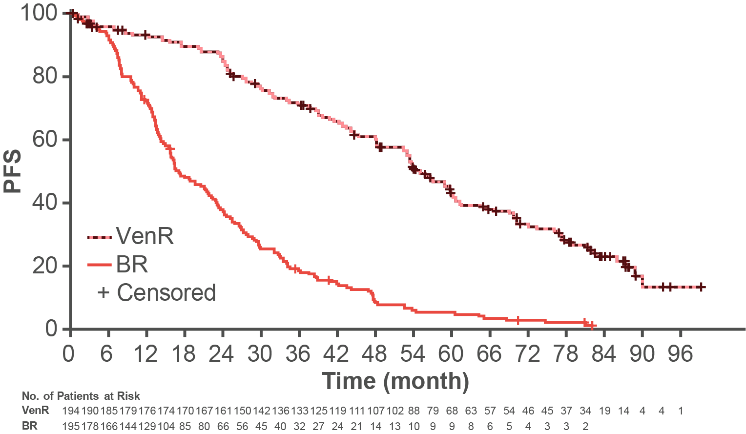
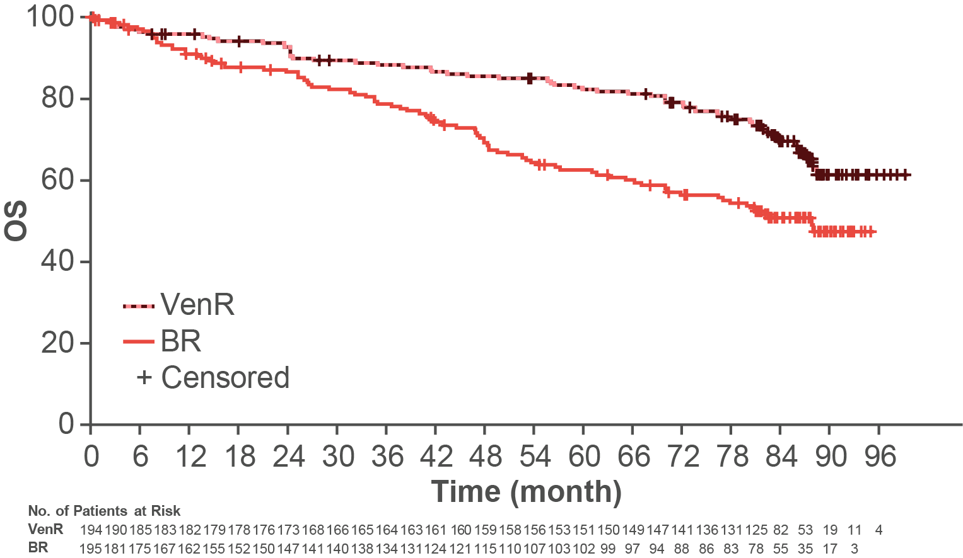
PFS and OS
PFS
OS
 | Median PFS (95% CI), months | HRª | 7-year PFS (%)
VenR (n=194) | 54.7 (52.3-59.9) | 0.23 (0.18-0.29) Stratified P-value <0.0001^{b} | 23.0
BR (n=195) | 17.0 (15.5-21.7) |  | NE
 | Median OS (95% CI), months | HR^{c} | 7-year OS (%)
VenR (n=194) | NE | 0.53 (0.37-0.74) Stratified P-value <0.0002^{b} | 69.6
BR (n=195) | 87.8 (70.1-NE) |  | 51.0
Median follow up for efficacy (range) was 86.8 months (0.3–99.2) for VenR and 84.4 months (0.0−95.0) for BR
No new safety signals were identified since the 5-year data cut,¹ with all patients outside of the AE reporting window^{b}

Slide 59
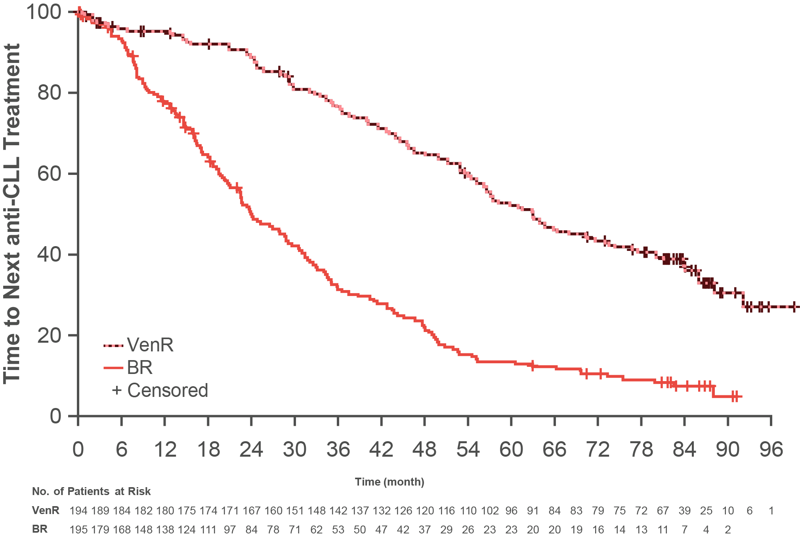
TTNT
 | Median TTNT (95% CI), months | HRª (95% CI)
VenR | 63.0 (56.1-73.6) | 0.30 (0.23-0.39) Stratified P-value <0.0001^{b}
BR | 24.0 (20.7-29.5)
Overall, 95 (49.0%) VenR-treated patients and 131 (67.2%) BR-treated patients received subsequent anti-leukemic treatment

Slide 60
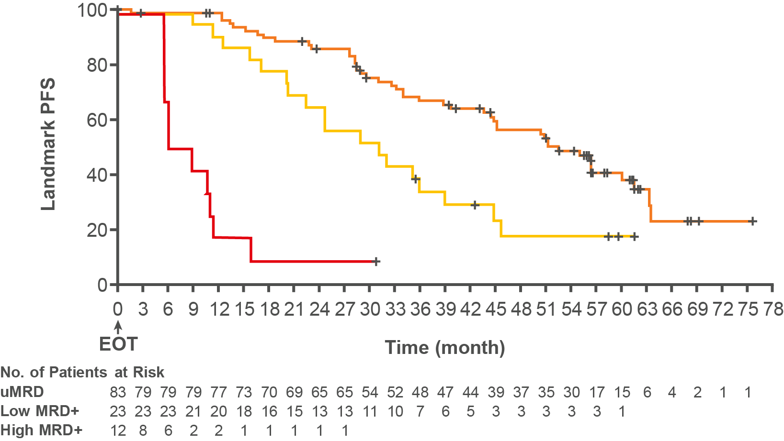
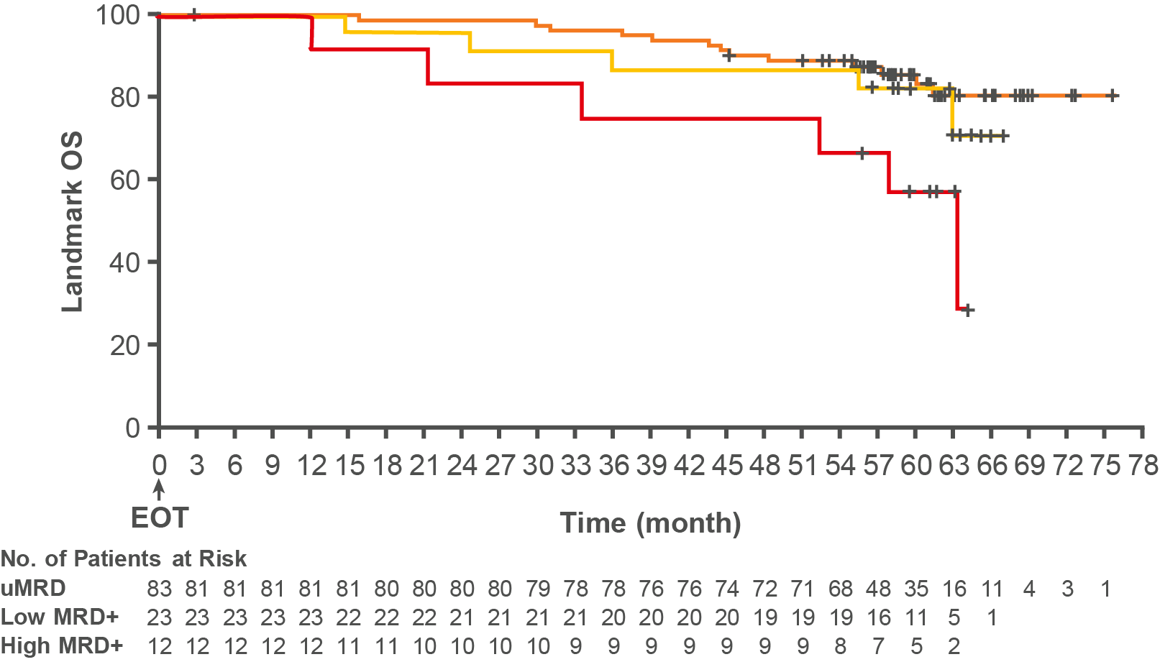
PFS and OS by MRD
PFS by MRD
OS by MRD
–– uMRD
–– LowMRD+
–– High MRD+
+ Censored
–– uMRD
–– LowMRD+
–– High MRD+
+ Censored
Patients who completed 2 years of Ven without PDª | Median PFS since EOT (95% CI), months | HR (95% CI); P-value^{b}
uMRD (n=83) | 52.5 (44.5-61.5)
Low MRD (n=23) | 29.3 (20.2-37.5) | vs uMRD: 3.46 (1.75-6.86); <0.0001
High MRD+ (n=12) | 4.6 (2.8-8.3) | vs uMRD: 17.22 (5.70-52.00); <0.0001
Patients who completed 2 years of Ven without PDª | Median OS since EOT (95% CI), months | HR (95% CI); P-value^{b}
uMRD (n=83) | NE (NE-NE)
Low MRD (n=23) | NE (62.7-NE) | vs uMRD: 1.07 (0.34-3.35); NS
High MRD+ (n=12) | 63.1 (51.5-NE) | vs uMRD: 2.39 (0.73-7.80); NS
Achievement of uMRD was associated with prolonged PFS in VenR-treated patients

Slide 61
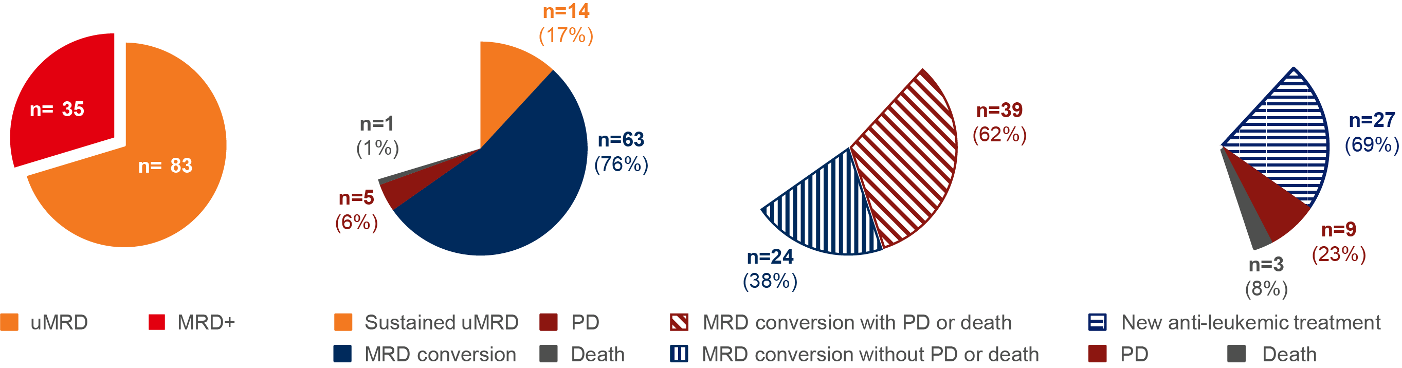
MRD conversion
MRD status at EOT (n=118)
MRD conversion after EOT
PDª among patients with MRD conversion
Next treatment among patients with PDª
Most patients who received 2 full years of VenR treatment had uMRD at EOT; generally MRD conversion with subsequent PD did not occur until
~ 4 years post EOT
Next treatment
or death
MRD conversion
Conversion to PD
Approximately 24 months
Median time to conversion:
19.4 months (95% CI: 8.7-28.0)
Median time from conversion to PD: 28.3 months (95% CI: 23.2-35.0)
Median time from PD to next treatment or death: 4.5 months (95% CI: 3.3-6.4)
C1D1
EOT
~4-year timeframe

Slide 62
uMRD and mutation status
VenR-treated patients, n (%) | TP53ª (n=192)^{b} |  | IGHV^{c} (n=176)^{b}
 | Wildtype (n=144) | Mutated (n=48) | Wildtype (n=53) | Mutated (n=123)
Patients with sustained uMRD (n=14) | 13/144 (9.0) | 1/48 (2.1) | 7/53 (13.2) | 6/123 (4.9)
Patients without sustained uMRD (n=180) | 131/144 (91.0) | 47/48 (97.9) | 46/53 (86.8) | 117/123 (95.1)
Favorable baseline characteristics were over-represented among patients with enduring uMRD
Among the 14 patients with sustained uMRD after EOT, median number of prior therapies was 1 (1-3)
Among the small group of patients with favorable disease biology there is a portion (7/43[16.3%]) who have long term enduring uMRD following 2 years of VenR

Slide 63
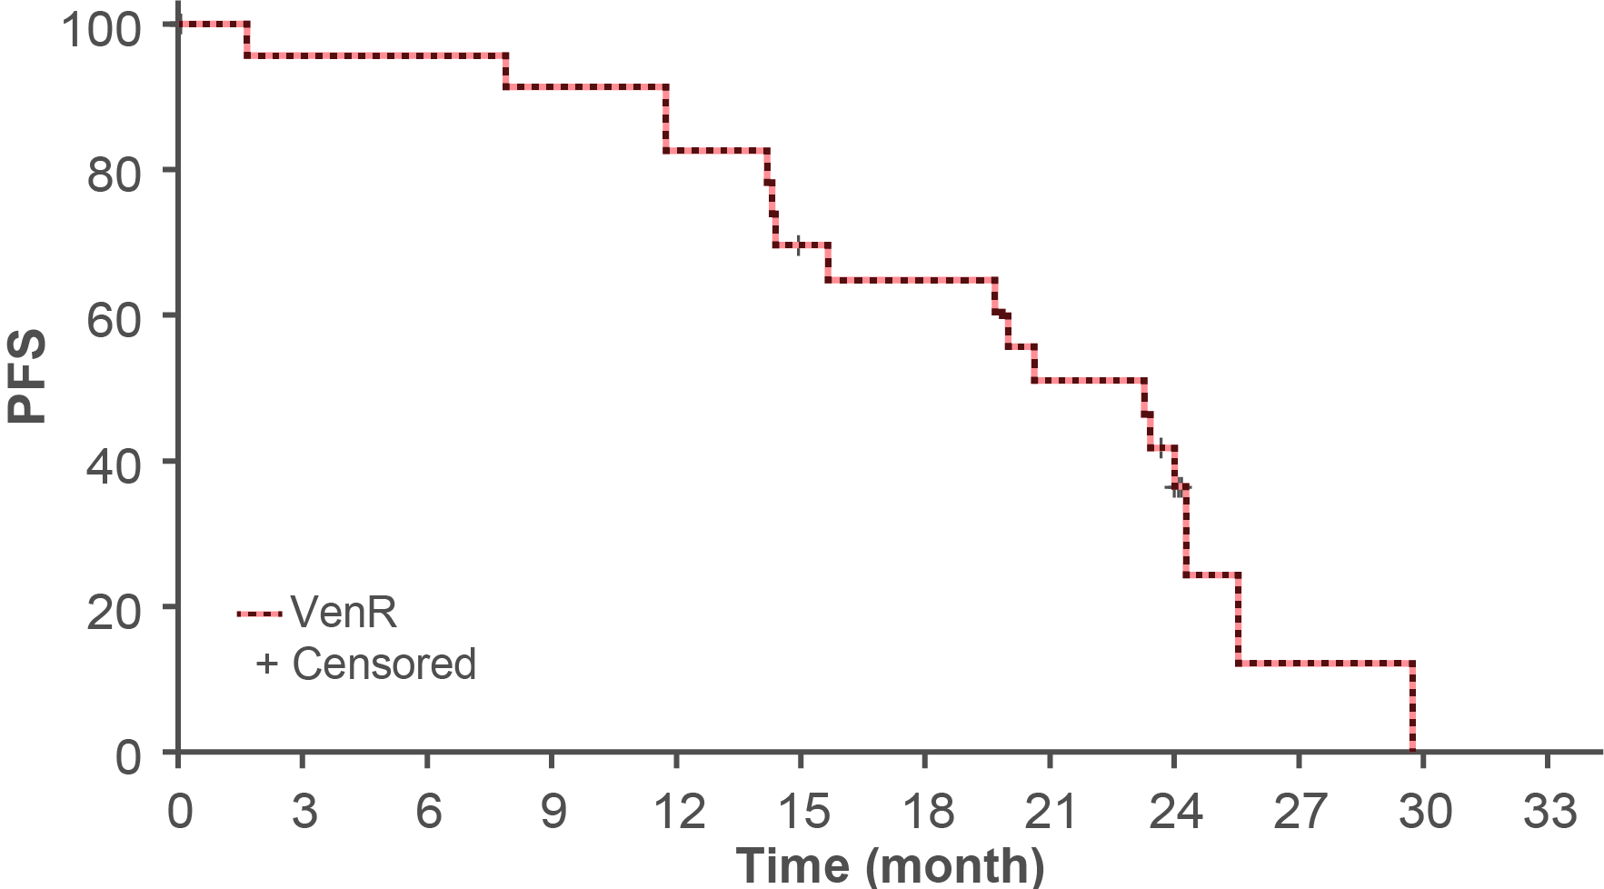
Efficacy: VenR retreatment
PFS
Efficacy summary
Amongst VenR-retreated patients, median follow up (range) was 33.4 months (2.7–44.0)
  Best ORR was high at 72.0%; CR rate was 24%
  8 patients (32%) achieved uMRD at the retreatment EOCT; all were MRD+ at EOT
  Median PFS (95% CI) was 23.3 months
  (15.6–24.3)
  Median OS was not reached
No. of patients
VenR | 25 | 22 | 22 | 21 | 19 | 15 | 14 | 11 | 7 | 1

Slide 64
Conclusions
In this final long-term analysis of the MURANO trial, PFS and OS benefits for 2-year fixed treatment with VenR over BR were sustained
A longer TTNT with VenR was observed vs BR
Achievement of uMRD was associated with prolonged PFS in VenR-treated patients
In patients retreated with VenR in the substudy, best ORR was high and uMRD was still attainable in this high-risk population
Retreatment with VenR is a viable option for pretreated patients, based on ORR and uMRD findings
Overall, these data continue to support the use of fixed-duration VenR in R/R CLL

Slide 65
Phase II trial of zanubrutinib, obinutuzumab, and venetoclax (BOVen) in TN CLL/SLL
Long-term follow-up

Slide 66
BOVen in TN CLL: Study design
Phase II trial of zanubrutinib, obinutuzumab, and venetoclax (BOVen) in previously untreated patients with CLL/SLL
Key eligibility criteria
Previously untreated CLL/SLL
Requires treatment
(iwCLL guidelines)
ECOG 0-2
ANC ≥1,000, PLT count ≥75
(unless due to CLL)
Coumadin and dual antiplatelet excluded
Venetoclax: Ramp-up to target 400 mg QD
Zanubrutinib 160 mg BID
Obinutuzumab 1000 mg on C1 (D1-2, 8, 15) and C2-8 day 1
C1
C2
C3
C4
C5
C6
C7
C8
C9 – C24
(if applicable)
Treatment duration / MRD-directed treatment discontinuation criteria
Treatment duration: Min 8 months to Max 24 months (including 2-month doublet lead-in prior to venetoclax)
Peripheral blood MRD (flow cytometry) assessed every 2 cycles
  If PB uMRD <10⁻⁴ (flow), then BM MRD assessment within 14 days
  If PB and BM uMRD <10⁻⁴ (flow), then repeat PB MRD assessment after 2 additional cycles
  If PB x 2 (consecutively) and BM uMRD <10⁻⁴ (primary endpoint), treatment is discontinued

Slide 67
Adverse events (all-cause)
Any grade AEs in >10% pts | Grade 1-2 (%) | Grade 3 (%) | Grade 4 (%)
Platelet count decreased | 25 (48%) | 4 (8%) | -
Fatigue | 28 (54%) | 1 (2%) | -
Neutrophil count decreased | 16 (31%) | 5 (10%) | 7 (13%)
Diarrhea | 23 (44%) | 1 (2%) | -
Bruising | 23 (44%) | - | -
Cough | 20 (38%) | - | -
Infusion-related reaction | 17 (33%) | 1 (2%) | 1 (2%)
Nausea | 18 (35%) | - | -
Anemia | 18 (35%) | - | -
Constipation | 17 (33%) | - | -
Arthralgias | 13 (25%) | - | -
Rash, maculopapular | 10 (19%) | 2 (4%) | -
Nasal congestion | 12 (23%) | - | -
GERD | 11 (21%) | - | -
Insomnia | 11 (21%) | - | -
Myalgia | 10 (19%) | - | -
Abdominal pain | 10 (19%) | - | -
Dyspnea | 10 (19%) | - | -
Headache | 8 (15%) | 1 (2%) | -
Dizziness | 9 (17%) | - | -
AST increased | 9 (17%) | - | -
Any grade of AEs in >10% pts | Grade 1-2 (%) | Grade 3 (%) | Grade 4 (%)
Sinusitis | 9 (17%) | - | -
ALK phosphatase increased | 7 (13%) | 1 (2%) | -
Anxiety | 8 (15%) | - | -
Sore throat | 8 (15%) | - | -
Hypocalcemia | 8 (15%) | - | -
Dry skin | 7 (13%) | - | -
Postnasal drip | 7 (13%) | - | -
Back pain | 7 (13%) | - | -
Weight loss | 7 (13%) | - | -
Edema, limbs | 6 (12%) | - | -
Non-cardiac chest pain | 6 (12%) | - | -
Hypertension | 6 (12%) | - | -
Grade >3 AEs in >2 pts | Grade 3 (%) | Grade 4 (%) | Grade 5 (%)
Neutrophil count decreased | 5 (10%) | 7 (13%) | -
Platelet count decreased | 4 (8%) | - | -
Lung infection | 3 (6%) | - | -
Infusion-related reaction | 1 (2%) | 1 ( 2%) | -
Rash, maculopapular | 2 (4%) | - | -
Skin infection | 2 (4%) | - | -
Additional grade >3 AEs occuring in 1 patient each are as follows: One grade 5 AE occurred in a patient with intracranial hemorrhage on cycle 1 day 1. Grade 3 AEs were febrile neutropenia, fatigue, diarrhea, headache, alkaline phosphatase increased, mucositis oral, hypophosphatemia, bilirrubin increased, heart failure, purpura, rash, gallbladder obstruction, left Achilles partial tear, and invasive mammary carcinoma (1 patient each).
No laboratory or clinical tumor lysis syndrome (Howard criteria)

Slide 68
MRD
96%
48/50
92%
46/50
96% (48/50) uMRD in PB
92% (46/50) uMRD in both PB and BM
All met prespecified MRD endpoint/ treatment discontinuation criterion and stopped therapy after median of 10 mo (IQR 8-12 mo)
77.6%
38/49
53.1%
26/49
26%
13/50
uMRD = MRD <10⁻⁴
(14-color flow cytometry)
LOD: 10⁻⁴
Cutoff: uMRD if <10⁻⁴
2%
1/50
One patient, initially ascertained as uMRD in peripheral blood at 8 mo, had subsequent serial testing which confirmed MRD positivity at the threshold of detection, so the patient was excluded from the proportion of patients achieving uMRD.
BM, bone marrow; EOT, end of treatment; IQR, interquartile range; LOD, limit of detection; mo, months; MRD, minimal residual disease; PB, peripheral blood; uMRD, undetectable MRD.
Soumerai JD, et al. Abstract 153 presented at 17-ICML.

Slide 69
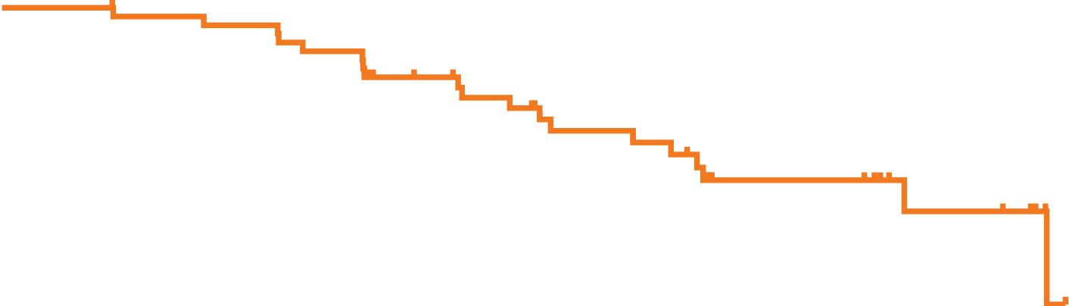
PFS and uMRD
PFS in all pts (n=50)
MRD-free survival in BM uMRD pts (n=46)
Percent uMRD-FC (<10⁻⁴)
Median PFS – not reached (range, 4.1-45.1+)
Time 0 = Treatment start
Calculated from Treatment Start until PD/ death or last follow-up (patients entering retreatment based on MRD criteria without iwCLL PD were censored)
Median MRD-free survival – 29.8 mo (range, 3.6-35.1+)
Time 0 = EOT in uMRD <10⁻⁴ (flow)
Calculated from EOT until date of detectable MRD ≥10⁻⁴ or last confirmed uMRD <10⁻⁴ (flow)
BOVen with uMRD-directed treatment duration resulted in durable PFS and uMRD

Slide 70
ΔMRD400 and uMRD
ΔMRD400 | BM uMRD within 8 mo | Time to BM uMRD | Time on therapy
Achieved (n=21) | 100% (21/21) | 6 mo (IQR 6-6) | 8 mo (IQR 8-10)
Failed (n=14) | 21% (3/14) | 11 mo (IQR 10-15.5) | 13 mo (IQR 12-17.5)
ΔMRD400 at C5D1 predicted early uMRD in the bone marrow and shorter duration of therapy ΔMRD is decreased in PB MRD (immunosequencing) at C5D1 (1 mo of venetoclax at target dose) 400-fold reduction optimal cutoff for predicting uMRD at <10⁻⁴ within 8 mo (Youden Index)
ΔMRD400 | Del(17p) / TP53^{mut} (n=5) | IGHV unmutated (n=25)
Achieved | 4 (80%) | 15 (60%)
Failed | 1 (20%) | 10 (40%)
ΔMRD400 does not appear to track with traditional risk factors (e.g., TP53 or IGHV)

Slide 71


MRD-free survival
MRD-free survival: ΔMRD400-evaluable and EOT PB uMRD (n=34)
ΔMRD400 achieved and
EOT PB uMRD (n=21)
Percent uMRD-FC (<10⁻⁴)
ΔMRD400 failed and
EOT PB uMRD (n=13)
ΔMRD400 | n | Time on therapy (median) | MRD-free survival (median)
Achieved | 21 | 8 months P<0.001 | Not reached | HR 4.02 (95%CI 1.37-11.81)
Failed | 13 | 13 months | 18.1 months | Log-rank P=0.003
ΔMRD400 was associated with longer MRD-free survival despite shorter time on therapy

Slide 72
Conclusions
BOVen was well tolerated with no additional safety signals with long-term follow-up
BOVen achieved frequent uMRD (<10⁻⁴) in peripheral blood (96%) and bone marrow (92%)
Median duration therapy was 10 months (IQR 8-12) including 2-month lead in
Long term follow-up with durable progression-free survival
MRD-free survival (<10⁻⁴) was 29.8 months
  MRD-free survival was longer among those who achieved ∆MRD400 (NR vs 18.1 mo, log-rank P=0.003) despite fewer cycles of therapy (8 vs 3 cycles, P<0.001)
Next: Phase II trial BOVen with ∆MRD400-directed therapy in TN CLL (24 vs 10 mo)
  Hypothesis: longer duration therapy for patients who fail to achieve ∆MRD400 will further improve uMRD duration in these patients

Slide 73
CAPTIVATE
Fixed-duration ibrutinib+venetoclax for
1L treatment of CLL/SLL: 4-year follow-up

Slide 74
CAPTIVATE: Study design
International, multicenter, Phase II study evaluating first-line treatment with the ibrutinib + venetoclax combination in patients with CLL/SLL.
Eligible patients
(N=159)
Previously untreated CLL/SLL
Active disease requiring treatment per iwCLL criteria²
Aged ≤70 years
ECOG PS 0-2
End of fixed-duration treatment
Upon progression, patients can be retreated with single-agent ibrutinib (or fixed-duration ibrutinib + venetoclax if they had response of >2 years)
Ibrutinib lead-in
Ibrutinib 420 mg QD (3 cyclesª)
Ibrutinib + venetoclax
Ibrutinib 420 mg QD + venetoclax 5-week ramp-up³ to 400 mg QD (12 cyclesª)
Follow-up
Endpoints
CR rate, including CRi, per investigator assessment
ORR
DOR
uMRD rates (<10⁻⁴ by flow cytometry)
PFS
OS
Safety
The data presented here are focused on the FD cohort¹
The primary analysis reported an ORR of 96%, a best uMRD rate of 77% in PB, and a 24-mo PFS of 95%

Slide 75
Complete response rate
CR rate over time
Best ORR was 96%
Median DoR was not reached for responding patients (n=153)
Median duration of CR was not reached (n=93); the 36-month landmark estimate for durable CR was 80% (95% CI 69-87)
Patients, %
2/23
8/22
6/20
49/82
40/81
32/75
80/148
69/145
60/136
del(17p)/TP53 mutated

Slide 76



uMRD
uMRD rate in peripheral blood
In the overall population, 21% of patients had uMRD in PB at 36 months post-treatment
⁻⁴
⁻⁴
ª

Slide 77
Progression-free survival
Fixed-duration ibrutinib + venetoclax continues to provide durable and high PFS rates
Treatment
period
All patients
uIGHV
del(17p)/TP53
 | del(17p)/TP53 mutation n=27 | Unmutated IGHV n=89 | All treated patients N=159
4-year PFS rate, % (95% CI) | 63 (41-79) | 73 (62-81) | 79 (71-84)
No. of patients
del(17p)/TP53 mutation | 27 | 26 | 26 | 21 | 21 | 19 | 19 | 14 | 13
Unmutated IGHV | 89 | 85 | 85 | 79 | 79 | 73 | 72 | 59 | 58
All treated patients | 159 | 153 | 152 | 144 | 143 | 132 | 130 | 115 | 111

Slide 78
Overall survival
All patients
FD ibrutinib + venetoclax continues to provide durable and high OS rates in the overall population and in patients with high-risk genomic features
Median TTNT was not reached (n=28; range
1-53 months)
Landmark estimate of the proportion of patients who had not started a next treatment at 4 years was 84% (95% CI 77-89)
uIGHV
del(17p)/TP53
Treatment
period
 | del(17p)/TP53 mutation n=27 | Unmutated IGHV n=89 | All treated patients N=159
4-year OS rate, % (95% CI) | 96 (76-99) | 97 (90-99) | 98ª (94-99)
No. of patients
del(17p)/TP53 mutation | 27 | 26 | 26 | 25 | 25 | 25 | 25 | 25 | 24
Unmutated IGHV | 89 | 86 | 86 | 84 | 84 | 83 | 83 | 82 | 79
All treated patients | 159 | 155 | 154 | 151 | 150 | 149 | 149 | 148 | 143

Slide 79
Retreatment
Patient | Baseline high-risk featuresª |  |  |  | Response to FD ibr + venª |  | Reponse to retreatment with ibr
 | del(17p) | TP53 mutated | uIGHV | Complex karyotype | PFS (months) | Best response | Best response
1 2 3 4 5 6 7 8 9 10 11 12 13 14 15 16 17 | No No No No No No No No Yes Yes No No No No No No Yes | No No No No No No No No No No No No No No No No Yes | Yes Yes Yes Yes Yes Yes Yes Yes No Yes Yes No No No Yes Yes Yes | Unknown No No No Yes No Yes Yes No Yes No No Yes Yes Yes No Yes | 38.6 20.3 19.4 44.2 38.6 27.4 38.6 27.6 28.5 16.6 36.5 27.4 22.0 30.4 38.6 39.6 48.8 | CR PR PR CR CR PR PR CR CRi PR CR PR PR PR CR PR PR | CR PR PR PR PR PR PR PR PR PR PR PR PR PR PRL SD PD^{b}
To date, 19 patients who have progressed after completing FD ibrutinib + venetoclax have initiated retreatment with ibrutinib
The median retreatment duration is 11.1 (range
0-38.6) months
Response data are available for 17 of these patients^{b}

Slide 80
Safety
Characteristics | Patients retreated with ibrutinib n=19
Patients with any TEAE, n (%) | 15 (79)
Grade 3-4 | 2 (11)
Any AE leading to ibrutinib discontinuation, n (%) | 0
Any AE leading to ibrutinib dose reduction, n (%) | 0
Any serious AE, n (%) | 1 (5)
Grade 3-4 | 0
Fatal AE | 0
All patients have completed FD treatment. Safety data on serious AEs considered related to study treatment and second malignancies continued to be collected
  1 serious AE of prostate cancer occurred during this additional year of follow-up
Among the 19 patients who have initiated retreatment with ibrutinib, there have been no AEs leading to dose reduction or discontinuation

Slide 81
Conclusions
Ibrutinib + venetoclax represents an efficacious, all-oral, once-daily, chemotherapy-free fixed duration regimen that continues to provide clinically meaningful benefits and deep, durable responses in previously untreated patients with CLL/SLL
The safety profile is manageable and unchanged from that previously reported. No dose reductions or discontinuations due to AEs have occurred among patients who have initiated retreatment
Retreatment with single-agent ibrutinib has yielded promising responses in these initial patients with CLL progression after completing fixed duration ibrutinib + venetoclax

Slide 82
Phase 2 study of iFCR as 1L therapy for younger CLL patients
5-year follow-up

Slide 83
Study design
Phase 2 study of iFCR as initial therapy in young and fit CLL patients
I-M 2Y+
Eligible patients
(N=85)
Previously untreated CLL
Age ≤65 years
ECOG PS 0-1
Ibrutinib 7-day lead-in
iFCR
(up to 6 cycles)
Ibrutinib maintenance
(I-M)ª
(2 years)
Off Ibrutinib
Ibrutinib retreatment
(N=6)
Part 1 (iFCR): primary endpoint
CR rates with uMRD in BM^{b}
Part 2 (I-M): primary endpoint
uMRD rates^{c}
Secondary endpoints
ORR
PFS
OS
Safety
Pharmacokinetics

Slide 84
Safety
Common AEs (>30%) | Grade, N |  | Grade, N |  |  | Grade ≥3, N (%) | Total, N (%)
 | 1 | 2 | 3 | 4 | 5 |  | N (%)
Hematologic AEs
Neutropenia | 12 | 11 | 15 | 19 | 0 | 34 (40) | 57 (67)
Leukopenia | 16 | 11 | 22 | 5 | 0 | 27 (32) | 54 (64)
Anemia | 26 | 18 | 9 | 0 | 0 | 9 (11) | 53 (62)
Thrombocytopenia | 21 | 24 | 23 | 4 | 0 | 27 (32) | 72 (85)
Non-hematologic AEs
Nausea | 52 | 10 | 1 | 0 | 0 | 1 (1) | 63 (74)
Hyperglycemia | 35 | 17 | 7 | 0 | 0 | 7 (8) | 59 (69)
Fatigue | 44 | 12 | 0 | 0 | 0 | 0 (0) | 56 (66)
Bruising | 43 | 6 | 0 | 0 | 0 | 0 (0) | 49 (58)
Diarrhea | 29 | 3 | 3 | 0 | 0 | 3 (4) | 35 (41)
Arthralgia | 23 | 11 | 0 | 0 | 0 | 0 (0) | 34 (40)
Hypocalcemia | 28 | 3 | 1 | 0 | 0 | 1 (1) | 32 (38)
Constipation | 29 | 3 | 3 | 0 | 0 | 3 (4) | 31 (36)
Cough | 25 | 6 | 0 | 0 | 0 | 0 (0) | 31 (36)
Hyponatremia | 29 | 0 | 1 | 1 | 0 | 2 (2) | 31 (36)
Aspartate aminotransferase increased | 22 | 4 | 2 | 2 | 0 | 4 (5) | 30 (35)
Rash, acneiform | 18 | 9 | 1 | 0 | 0 | 1 (1) | 28 (33)
Upper respiratory infection | 10 | 18 | 0 | 0 | 0 | 0 (0) | 28 (33)
Hypertension | 6 | 14 | 6 | 0 | 0 | 6 (7) | 26 (31)
AEs of special interest | Grade, N |  |  |  |  | Total, N (%)
 | 1 | 2 | 3 | 4 | 5
Sudden cardiac death (during 2Y I-M) | 0 | 0 | 0 | 0 | 1 | 1 (1)
Atrial fibrillation | 4 | 1 | 2 | 0 | 0 | 7 (8)
Hypertension | 6 | 14 | 6 | 0 | 0 | 26 (31)
Bruising | 43 | 6 | 0 | 0 | 0 | 49 (58)
Hematoma | 1 | 0 | 0 | 0 | 0 | 1 (1)
Febrile neutropenia | 0 | 0 | 9 | 1 | 0 | 10 (12)
Second malignancy or hematologic disorderª | 3 | 4 | 2 | 2 | 0 | 11 (13)

Slide 85
Progression-free survival
PFS by IGHV mutation status
PFS by continuation of Ibr beyond 2Y+
Mutated
Discontinued after 2Y I-M
1.00
1.00
0.75
Unmutated
0.75
Continued after 2Y I-M
0.50
0.50
0.25
P = 0.36
0.25
P = 0.78
0.00
0.00
0
12
24
36
48
60
72
84
96
0
12
24
36
48
60
Time in month since registration
Time in month since registration
No. of patients
Mutated | 34 | 33 | 32 | 31 | 28 | 20 | 7 | 5 | 0
Unmutated | 45 | 45 | 43 | 42 | 39 | 26 | 15 | 9 | 0
No. of patients
Mutated | 20 | 20 | 19 | 10 | 6 | 3
Unmutated | 34 | 34 | 33 | 16 | 11 | 0
Median follow-up of 63 months (range 6.8-95.8)
No significant PFS difference based on IGHV status
5-year PFS: 94% (95% CI 89-100%)
5-year OS: 99% (95% CI 96-100%)

Slide 86
MRD in PB
69 patients had serial MRD data
Patients who were off study or did not reach the timepoints were considered unevaluable
At the last follow-up, 64% of evaluable patients maintained PB-uMRD
13 (25%) patients developed MRD conversion in PB, mostly during treatment cessation
N patients on study
 | 66 | 69 | 57 | 68 | 57 | 68 | 56 | 56 | 56 | 53

Slide 87
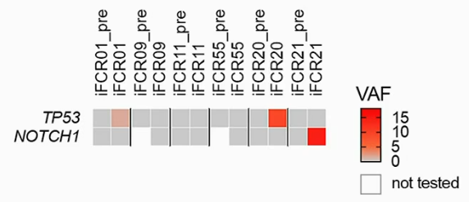
Targeted NGS at MRD conversion
TP53 and NOTCH1 at pre-treatment
vs MRD conversion
BTK/PLCG2 mutations and
other CLL driver genes
90-gene targeted NGS panel, including BTK, PLCG2 and other CLL driver genes
6 patients with available PB sample at MRD conversion
Re-emergent clones lacked BTK mutation
iFCR01_pre
iFCR01
iFCR09_pre
iFCR09
iFCR11_pre
iFCR11
iFCR55_pre
iFCR55
iFCR20_pre
iFCR20
iFCR21_pre
iFCR21
iFCR01
iFCR09
iFCR11
iFCR55
iFCR20
iFCR21
VAF
VAF
TP53
NOTCH1
15
BTK
PLCG2
ATM
SF3B1
BRAF
BCOR
BRCC3
XPO1
FBXW7
MYD88
15
10
10
5
5
0
0
not tested

Slide 88
Retreatment with ibrutinib
Ibrutinib retreatment
iFCR
Ibrutinib maintenance
Off drug
1
9
24
26
11
55
0
25
50
75
100
Months from initiation of study therapy
Detectable MRD
uMRD4
CLL progression
6 patients with MRD conversion (2 with CLL progression) received ibrutinib retreatment
Median time on retreatment: 34 months
4 of 6 patients responded to retreatment (3 PR, 1 unconfirmed CR)
2 patients had stable disease (CLL progression at 32 and 23 months on retreatment)
MRD growth stabilized but was not eradicated during retreatment

Slide 89
Conclusions
With 5 years of follow-up, iFCR with 2Y I-M achieved durably deep response in a population of
85 young, fit CLL patients with diverse prognostic markers
  5-year PFS: 94%
  No significant PFS difference by IGHV status
Safety
  1 sudden cardiac death, 7 (8%) atrial fibrillation
  11 (13%) second malignancy (most commonly skin cancer, 1 MDS, 1 CCUS)
13 patients (15%) developed MRD conversion
6 patients (7%) received retreatment with ibrutinib (median 34 months on retreatment)
  Re-emergent clones lacked BTK mutation and retained sensitivity to ibrutinib
Consistent with data from iFCG & Filo (Jain, 2021 Leukemia; Michallet 2023 Blood Adv)
These data provide rationale to further investigate BTKi plus FC-anti-CD20 mAb-based regimens
in young, fit CLL patients in randomized studies

Slide 90
ASPEN
Long-term follow-up:
HRQoL in WM patients treated
with zanubrutinib and ibrutinib

Slide 91
ASPEN: Study design (Cohort 1)
Open-label, multicenter, randomized Phase 3 study of zanubrutinib vs ibrutinib in adult patients with WM
Eligible patients
Histologic diagnosis of WM
Meeting ≥1 criterion for treatment initiation¹
If treatment naïveª, must be considered unsuitable for standard chemoimmunotherapy
No prior BTK inhibitors
Zanubrutinib
(n=102)
160 mg BID until PD
Key HRQoL endpoints
Global health status (GHS)
Physical functioning
Role functioning
Symptoms: fatigue, diarrhea, nausea/vomiting
Arm A
Cohort 1
Patients with MYD88^{MUT} WM
N=201 (164 R/R)
R
1:1
Arm B
Ibrutinib
(n=99)
420 mg QD until PD
Stratification factors
CXCR4 status (CXCR4^{MUT} vs CXCR4^{WT}/missing)
Number of prior lines of therapy (0 vs 1-3 vs >3)

Slide 92
Changes in PROs from baseline for the ITT population
GHS/QoL
Physical Functioning
Role Functioning
20
15
20
15
10
15
10
10
LS mean change (95% CI)
LS mean change (95% CI)
LS mean change (95% CI)
Improvement
Improvement
Improvement
5
5
5
0
0
0
-5
4
7
13
25
-5
4
7
13
25
-5
4
7
13
25
Cycle
Cycle
Cycle
No. of patients
Zanubrutinib | 88 | 87 | 81 |  | 71
Ibrutinib | 70 | 70 | 69 |  | 59
EMTD (95% CI) | -2.35 (-8.53, 3.84) P=.4549 | -0.65 (-6.10, 4.80) P=.8134 | -2.37 (-7.58, 2.84) P=.3701 |  | -1.07 (-7.11, 4.97) P=.7277
No. of patients
Zanubrutinib | 87 | 87 | 83 |  | 73
Ibrutinib | 70 | 70 | 70 |  | 60
EMTD (95% CI) | -0.18 (-5.37, 5.00) P=.9449 | 1.76 (-3.59, 7.11) P=.5164 | -2.80 (-8.09, 2.48) P=.2968 |  | 0.53 (-4.23, 5.29) P=.8252
No. of patients
Zanubrutinib | 87 | 87 | 83 |  | 72
Ibrutinib | 70 | 71 | 70 |  | 61
EMTD (95% CI) | -2.85 (-10.36, 4.67) P=.4562 | -1.81 (-9.27, 5.65) P=.6334 | 1.53 (-5.80, 8.86) P=.6808 |  | 3.05 (-3.73, 9.83) P=.3762
In GHS and functional PRO endpoints, both arms experienced improvements. Differences between the two arms were not significant.

Slide 93
Changes in PROs from baseline for the ITT population
Fatigue
Diarrhea
Nausea/vomiting
5
10
10
0
5
5
-5
LS mean change (95% CI)
LS mean change (95% CI)
LS mean change (95% CI)
Improvement
Improvement
Improvement
-10
0
0
-15
-5
-5
-20
-25
4
7
13
25
-10
4
7
13
25
-10
4
7
13
25
Cycle
Cycle
Cycle
No. of patients
Zanubrutinib | 87 | 87 | 83 |  | 73
Ibrutinib | 71 | 71 | 70 |  | 61
EMTD (95% CI) | -1.76 (-8.14, 4.62) P=.5871 | 0.34 (-5.52, 6.20) P=.9086 | 1.10 (-4.81, 7.01) P=.7134 |  | -0.05 (-6.34, 6.24) P=.9883
No. of patients
Zanubrutinib | 88 | 87 | 82 |  | 72
Ibrutinib | 70 | 70 | 69 |  | 59
EMTD (95% CI) | -7.26 (-12.62, -1.90) P=.0082 | -4.90 (-10.63, 0.84) P=.0937 | -3.37 (-8.67, 1.93) P=.2115 |  | 0.57 (-4.76, 5.91) P=.8319
No. of patients
Zanubrutinib | 87 | 87 | 83 |  | 73
Ibrutinib | 71 | 71 | 70 |  | 61
EMTD (95% CI) | -5.57 (-9.49, 1.66) P=.0055 | 0.80 (-1.62, 3.21) P=.5153 | -1.52 (-3.85, 0.81) P=.1996 |  | -0.33 (-3.13, 2.47) P=.8187
Diarrhea and nausea/vomiting symptom scores were stable from baseline through all key clinical cycles in the zanubrutinib arm, whereas patients receiving ibrutinib experienced initial worsening of diarrhea and nausea/vomiting from baseline
  Treatment differences for diarrhea and nausea/vomiting were clinically meaningful at Cycle 4

Slide 94
Changes in PROs from baseline for patients achieving a VGPRª by Cycle 25
GHS/QoL
Physical functioning
Role functioning
35
20
30
30
15
25
25
10
20
20
15
LS mean change (95% CI)
LS mean change (95% CI)
LS mean change (95% CI)
Improvement
Improvement
Improvement
15
5
10
0
5
5
0
-5
0
-5
4
7
13
25
-5
4
7
13
25
-5
4
7
13
25
Cycle
Cycle
Cycle
No. of patients
Zanubrutinib | 26 | 28 | 28 |  | 24
Ibrutinib | 13 | 14 | 13 |  | 11
EMTD (95% CI) | 4.63 (-11.52, 20.79) P=.5656 | 9.39 (-3.70, 22.47) P=.1552 | 1.30 (-8.69, 11.29) P=.7942 |  | 3.79 (-9.96, 17.53) P=.5809
No. of patients
Zanubrutinib | 26 | 28 | 28 |  | 25
Ibrutinib | 12 | 13 | 13 |  | 11
EMTD (95% CI) | 4.16 (-7.96, 16.27) P=.4925 | 10.42 (0.57, 20.28) P=.0387 | 2.90 (-7.64, 13.44) P=.5814 |  | 10.45 (0.12, 20.79) P=.0476
No. of patients
Zanubrutinib | 26 | 28 | 28 |  | 24
Ibrutinib | 13 | 14 | 13 |  | 11
EMTD (95% CI) | 1.47 (-13.00, 15.93) P=.8389 | 8.59 (-6.50, 23.69) P=.2570 | 11.54 (-1.94, 25.01) P=.0914 |  | 8.67 (-5.51, 22.86) P=.2240
In general, patients receiving zanubrutinib experienced greater functional improvements than patients receiving ibrutinib
  Treatment differences for physical functioning were clinically meaningful at Cycle 7 and again at Cycle 25

Slide 95
Changes in PROs from baseline for patients achieving a VGPRª by Cycle 25
Fatigue
Diarrhea
Nausea/vomiting
5
30
20
0
25
15
-5
20
-10
15
10
LS mean change (95% CI)
10
LS mean change (95% CI)
LS mean change (95% CI)
Improvement
Improvement
Improvement
-15
5
5
-20
0
0
-25
-5
-5
-30
-10
-35
4
7
13
25
-5
4
7
13
25
-10
4
7
13
25
Cycle
Cycle
Cycle
No. of patients
Zanubrutinib | 26 | 28 | 28 |  | 25
Ibrutinib | 13 | 14 | 13 |  | 11
EMTD (95% CI) | -2.85 (-17.57, 11.88) P=.6982 | -11.76 (-22.24, -1.28) P=.0288 | -6.37 (-16.93, 4.20) P=.2304 |  | -13.53 (-25.00, -2.06) P=.0220
No. of patients
Zanubrutinib | 26 | 28 | 28 |  | 24
Ibrutinib | 13 | 14 | 13 |  | 11
EMTD (95% CI) | -19.83 (-33.43, -6.24) P=.0053 | -11.29 (-23.63, 1.06) P=.0721 | -1.52 (-13.97, 10.92) P=.8060 |  | -5.12 (-13.51, 3.27) P=.2245
No. of patients
Zanubrutinib | 26 | 28 | 28 |  | 25
Ibrutinib | 13 | 14 | 13 |  | 11
EMTD (95% CI) | -10.98 (-22.21, 0.24) P=.0549 | -1.60 (-4.39, 1.18) P=.2515 | -1.15 (-4.36, 2.06) P=.4738 |  | -0.25 (-9.06, 8.56) P=.9549
Patients receiving zanubrutinib experienced greater symptomatic improvements than patients receiving ibrutinib
  Treatment differences for diarrhea and nausea/vomiting were clinically meaningful by Cycle 4, while differences for fatigue were clinically meaningful at Cycle 7 and again at Cycle 25

Slide 96
Conclusions
In the ASPEN trial, treatment with zanubrutinib was associated with greater improvements in HRQoL vs ibrutinib in patients with WM and MYD88 mutations
  In earlier cycles of treatment, clinically meaningful differences were observed in diarrhea and nausea/vomiting in the ITT population and among patients who achieved VGPR by Cycle 25
  In patients who achieved VGPR by Cycle 25, clinically meaningful differences in physical functioning and fatigue were achieved in early-term treatment and continued to the end of treatment
The improved HRQoL seen with zanubrutinib among patients who achieved VGPR by Cycle 25 is consistent with the shorter median time to VGPR in the zanubrutinib arm and suggests that when disease is controlled to a similar extent, patients fare better in overall HRQoL when treated with zanubrutinib vs ibrutinib
Given the improved long-term safety of zanubrutinib vs ibrutinib and deep, early, durable responses in patients in the ASPEN trial, the HRQoL results support the use of zanubrutinib as an effective option for BTK-inhibitor therapy in patients with WM

Slide 97
Phase
1/2 BRUIN Study
Efficacy of pirtobrutinib in R/R WM

Slide 98
BRUIN: study design
This is an open-label, multi-center Phase 1/2 study of oral pirtobrutinib in patients with CLL/SLL and NHL who have failed or are intolerant to standard of care.
Phase 1 Escalation + Expansion (25 to 300 mg QD)
Phase 2 (200 mg QD)
N=773
Phase 1 3+3 design
28-day cycles
Intra-patient dose escalation allowed
Cohort expansion permitted at doses deemed safe
Eligibility
Age ≥18
ECOG 0-2
Active disease and in need of treatment
Previously treated
Key endpoints
Safety/tolerability
Determine MTD and recommended Phase 2 dose
pharmacokinetics
Efficacy according to ORR and DOR (IWWM6/Modified IWWM6) as assessed by investigator
Safety population
CLL/SLL
n=317
MCL
n=166
WM
n=80
Otherª
n=210
Efficacy population
WM
n=80
Prior cBTKi
n=63
cBTKi
naïve
n=17

Slide 99
Efficacy
Response Evaluable WM Patients | Prior cBTKi n=63 | cBTKi Naïve n=17
Major Response Rateª, % (95% CI) | 66.7 (53.7-78.0) | 88.2 (63.6-98.5)
CR + VGPR Rate, % (95% CI) | 23.8 (14.0-36.2) | 29.4 (10.3-56.0)
Best Response
VGPR, n (%) | 15 (23.8) | 5 (29.4)
PR, n (%) | 27 (42.9) | 10 (58.8)
MR, n (%) | 9 (14.3) | 0 (0)
SD, n (%) | 9 (14.3) | 2 (11.8)
Prior cBTKi discontinuation for progression
Prior cBTKi discontinuation for toxicity/other
cBTKi naïve
* Bcl-2 Inhibitor
# MYD88 Negative
#
*
*
#
#
#
#
#
*
*
#

Slide 100
Major response rate by subgroup
 | Responders/patients |  | Major response rate, % (95% CI)
All patients | 57/80 |  | 71.3 (60.0-80.8)
Age at enrollment
< 65 | 20/28 |  | 71.4 (51.3-86.8)
>65 | 37/52 |  | 71.2 (56.9-829)
Sex
Male | 38/52 |  | 73.1 (59.0-84.4)
Female | 19/28 |  | 67.9 (47.6-84.1)
ECOG PS
0 | 29/43 |  | 67.4 (51.5-80.9)
1/2 | 28/37 |  | 75.7 (58.8-88.2)
IPSS category
Low Risk | 10/14 |  | 71.4 (41.9-91.6)
Intermediate Risk | 37/52 |  | 71.2 (56.9-82.9)
High Risk | 9/12 |  | 75.0 (42.8-94.5)
MYD88 genotype
Positive | 43/61 |  | 70.5 (57.4-81.5)
Negative | 6/7 |  | 85.7 (42.1-99.6)
Prior therapy
cBTKi naïve | 15/17 |  | 88.2 (63.6-98.5)
cBTKi pretreated | 42/63 |  | 66.7 (53.7-78.0)
CIT + cBTKi | 34/50 |  | 68.0 (53.3-80.5)
Reason for discontinuation from any prior cBTKi
Disease Progression | 26/41 |  | 63.4 (46.9-77.9)
Toxicity/Other | 15/21 |  | 71.4 (47 8-88.7)
0
25
50
75
100

Slide 101
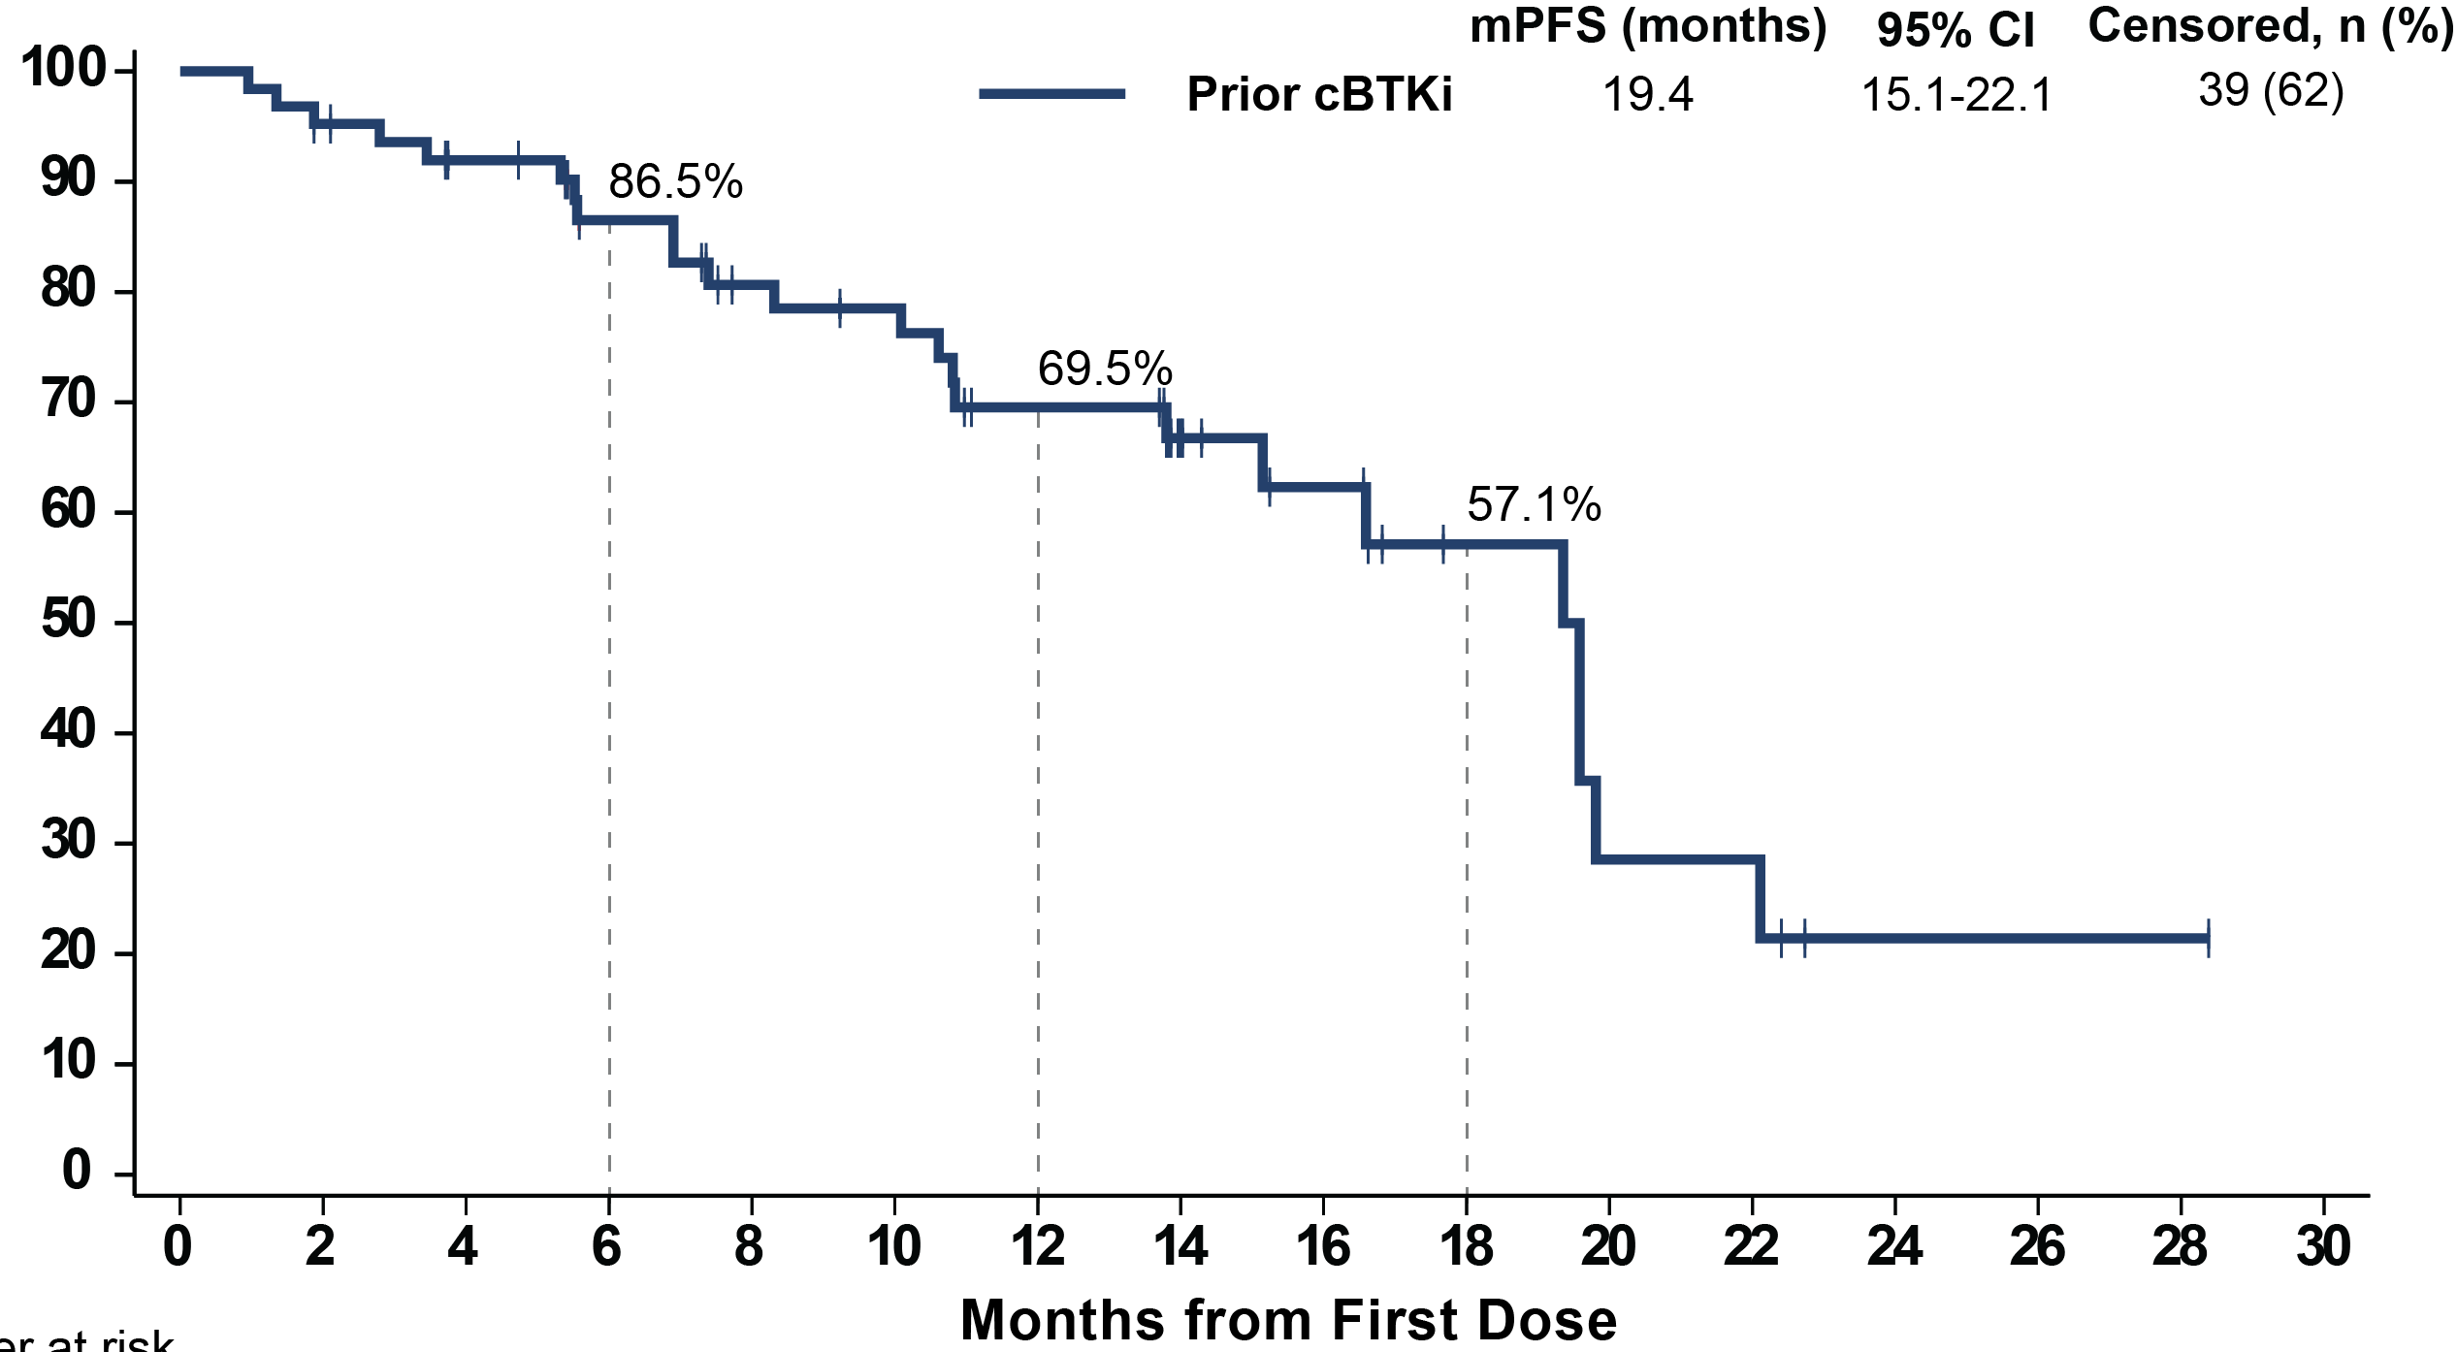
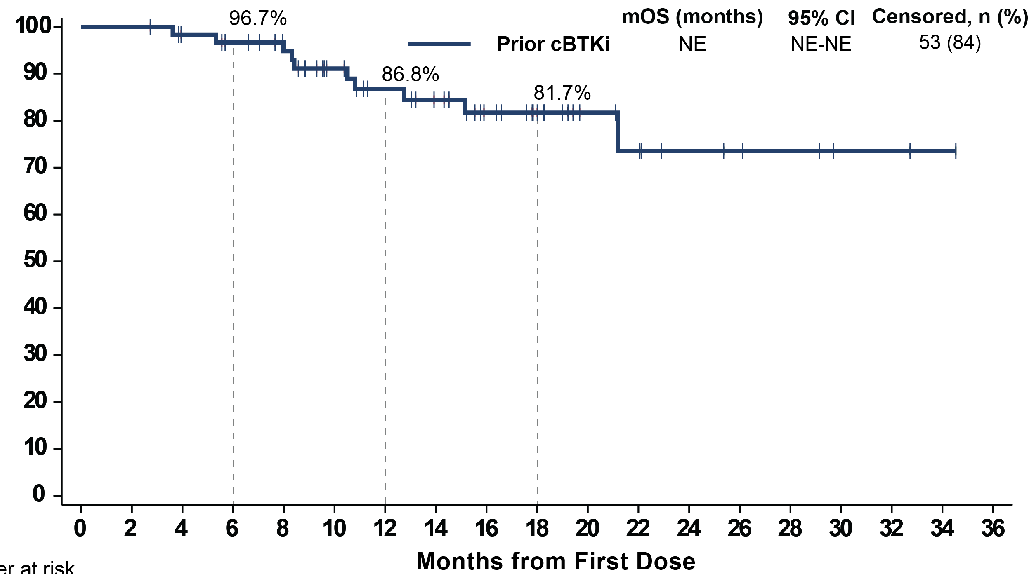
PFS and OS
PFS
OS
PFS probability, %
OS probability, %
Months from first dose
Months from first dose
No. of patients
Prior cBTKI | 63 | 59 | 53 | 45 | 38 | 35 | 27 | 18 | 13 | 8 | 4 | 4 | 1 | 1 | 1 | 0
No. of patients
Prior cBTKI | 63 | 63 | 59 | 56 | 51 | 43 | 37 | 33 | 24 | 19 | 11 | 9 | 6 | 5 | 4 | 2 | 2 | 1 | 0
The median follow-up for PFS and OS in patients who received prior cBTKi was 14 and 16 months, respectively
55.6% (35/63) of patients who received prior cBTKi remain on pirtobrutinib

Slide 102
Adverse events
 | All Doses and Patients (N=773)
 | Treatment-emergent AEs, (≥15%), % |  | Treatment-related AEs, %
AEs | Any grade | Grade ≥3 | Any grade | Grade ≥3
Fatigue | 28.7% | 2.1% | 9.3% | 0.8%
Diarrhea | 24.2% | 0.9% | 9.3% | 0.4%
Neutropeniaª | 24.2% | 20.4% | 14.7% | 11.5%
Contusion | 19.4% | 0.0% | 12.8% | 0.0%
Cough | 17.5% | 0.1% | 2.3% | 0.0%
COVID-19 | 16.7% | 2.7% | 1.3% | 0.0%
Nausea | 16.2% | 0.1% | 4.7% | 0.1%
Dyspnea | 15.5% | 1.0% | 3.0% | 0.1%
Anemia | 15.4% | 8.8% | 5.2% | 2.1%
AEs of Special Interest^{b} | Any grade | Grade ≥3 | Any grade | Grade ≥3
Bruising^{c} | 23.7% | 0.0% | 15.1% | 0.0%
Rash^{d} | 12.7% | 0.5% | 6.0% | 0.4%
Arthralgia | 14.4% | 0.6% | 3.5% | 0.0%
Hemorrhage/Hematoma^{e} | 11.4% | 1.8% | 4.0% | 0.6%
Hypertension | 9.2% | 2.3% | 3.4% | 0.6%
Atrial fibrillation/flutter^{f,g} | 2.8% | 1.2% | 0.8% | 0.1%
Median time on treatment for the overall safety population was 9.6 months
Discontinuations due to treatment-related AEs occurred in 2.6% (n=20) of all patients
Dose reductions due to treatment-related AEs occurred in 4.5% (n=35) of all patients
Overall and WM safety profiles are generally consistent^{h}

Slide 103
Conclusions
Pirtobrutinib demonstrated promising efficacy in this cohort of heavily pretreated relapsed/refractory WM patients, including among patients who received prior CIT and cBTKi
  Major response rate among prior CIT + cBTKi patients was 68%
The depth of response observed, as identified by the favorable VGPR rate, is notable in the subset of patients with prior cBTKi therapy
  Major response rate and VGPR rate among prior cBTKi patients was 67% and 24%, respectively
Pirtobrutinib continues to be well tolerated with low rates of grade ≥3 AEs and discontinuation due to drug-related toxicity
  Low rates of cBTKi associated AEs were observed with pirtobrutinib

Slide 104
Zanubrutinib plus lenalidomide in R/R DLBCL
First interim analysis

Slide 105
Zanubrutinib plus lenalidomide in R/R DLBCL: Study design
Phase 1, open-label, dose-escalation/expansion study of zanubrutinib plus lenalidomide in Chinese patients with R/R DLBCL (BGB-3111-110)
Key eligibility criteria
Age ≥18 years with histologically confirmed DLBCL
R/R disease with ≥1 prior line of adequate systemic therapy
Ineligibility for HDT/SCT if not received previously
ECOG PS of 0-2
Part 1
Dose escalation
RPD2D
Part 2
Dose expansion
Zanubrutinib and lenalidomide were given continuously until PD or intolerable toxicity
Zanubrutinib and lenalidomide were given continuously until PD or intolerable toxicity
Zanubrutinib dose | Lenalidomide dose
160 mg BID | Dose level 1: 15 mg QD d 1-21 per 28-d cycle
160 mg BID | Dose level 2: 20 mg QD d 1-21 per 28-d cycle
160 mg BID | Dose level 3: 25 mg QD d 1-21 per 28-d cycle
Zanubrutinib dose:
160 mg BID
Lenalidomide dose:
RP2D
(25 mg QD, d 1-21 per 28-d cycle)
Part 1: Primary endpoints
Safety
RP2D of lenalidomide in the combination
Part 2: Primary endpoints
ORR

Slide 106
Disease response
Disease response by investigator based on the Lugano 2014 classification
The ORR was 45.7%
(95% CI, 30.9%-61.0) and the CR rate 23.9%
At RP2D, the ORR was 56.7% (95% CI, 37.4%-74.5%) and the CR rate 30.0% in all patients
Patients, %
 | Part 1, dose level 1 (n=6) | Part 1, dose level 2 (n=10) | Part 1, dose level 3/RP2D (n=11) | Part 2/RP2D (n=19) | RP2D combine (n=30) | Total (N=46)
ORR (95% CI), %ª | 16.7 (0.4-64.1) | 30.0 (6.7-65.2) | 90.9 (58.7-99.8) | 36.8 (16.3-61.6) | 56.7 (37.4-74.5) | 45.7 (30.9-61.0)
CR rate (95% CI), %^{b} | 16.7 (0.4-64.1) | 10.0 (0.3-44.5) | 45.5 (16.7-76.6) | 21.1 (6.1-45.6) | 30.0 (14.7-49.4) | 23.9 (12.6-38.8)

Slide 107
Disease response by subtype
At RP2D, the ORR was 60.9% (95% CI, 38.5%-80.3%; CR, 34.8%) in patients with non-GCB disease and 50.0% (95% CI, 11.8%-88.2%;
CR, 16.7%) in patients
with GCB disease
Patients, %
 | RP2D combined (n=30) |  | Total (N=46)
 | GCB (n=6) | Non-GCB (n=23) | GCB (n=12) | Non-GCB (n=32)
ORR (95% CI), %ª | 50.0 (11.8-88.2) | 60.9 (38.5-80.3) | 50 (21.1-78.9) | 46.9 (29.1-65.3)
CR rate (95% CI), %^{b} | 16.7 (0.4-64.1) | 34.8 (16.4-57.3) | 16.7 (2.1-48.4) | 28.1 (13.7-46.7)

Slide 108
Treatment duration with response
Swimlane plot of treatment duration with response per overall assessment by investigator
Zanubrutinib 160 mg BID
+ lenalidomide 15 mg QD
At data cutoff, 16 of the 21 responders were still progression free, with the longest PFS of >20.8 months observed in a patient receiving dose level 1
Zanubrutinib 160 mg BID
+ lenalidomide 20 mg QD
Part 1
Zanubrutinib 160 mg BID
+ lenalidomide 25 mg QD
Zanubrutinib 160 mg BID
+ lenalidomide 25 mg QD
CR
Part 2
PR
Part 1, dose level 1
SD
Part 1, dose level 2
PD
Part 1, dose level 3/RP2D
NE
Part 2/RP2D
Ongoing treatment
Death
0
1
2
3
4
5
6
7
8
9
10
11
12
13
14
15
16
17
18
19
20
21
22
23
24
25
26
Months since first dose

Slide 109
Duration of responseª
Median DoR follow-up, months^{b}
DoR, months^{b}
 | Median (95% CI) | Range
Part 1, dose level 1 (n=6) | NE (NE-NE) | 18.04+ to 18.04
Part 1, dose level 2 (n=10) | NE (5.55-NE) | 5.55 to 8.34+
Part 1, dose level 3/RP2D (n=11) | NE (3.02-NE) | 0.03+ to 8.54+
Part 2/RP2D (n=19) | NE (2.76-NE) | 0.03+ to 2.92+
RP2D combined (n=30) | NE (3.02-NE) | 0.03+ to 8.54+
Total (N=46) | NE (3.02-NE) | 0.03+ to 18.04+
DoR event-free rate, %^{c}
Overall, the median DoR was not reached, and the 6-month event-free rate was 63.5% (95% CI, 32.8%-83.0%)
At RP2D, DoR was not reached, and the 6-month event-free rate was 59.4% (95% CI, 23.8%-82.8%)
RP2D combined (n=30)
All patients (n=46)

Slide 110
Progression-free survivalª
Median PFS follow-up, months^{b}
PFS, months^{c}
 | Median (95% CI) | Range
Part 1, dose level 1 (n=6) | 2.79 (0.43-NE) | 0.03+ to 20.80+
Part 1, dose level 2 (n=10) | 2.89 (2.69-NE) | 2.69 to 14.72+
Part 1, dose level 3/RP2D (n=11) | NE (5.49-NE) | 2.83+ to 11.43+
Part 2/RP2D (n=19) | 2.79 (2.53-NE) | 0.03+ to 5.62+
RP2D combined (n=30) | 5.52 (2.79-NE) | 0.03+ to 11.43+
Total (N=46) | 5.49 (2.79-8.28) | 0.03+ to 20.80+
PFS event-free rate, %^{d}
Overall, median PFS was 5.5 months (95% CI, 2.8-8.3 months), with a 9-month event-free rate of 31.1% (95% CI, 16.4%-47.0%)
At RP2D, the median PFS was 5.5 months (95% CI, 2.8 months-not evaluable [NE]), with a 9-month event-free rate of 37.4% (95% CI, 17.6%-57.4%)
RP2D combined (n=30)
All patients (n=46)

Slide 111
Treatment-emergent adverse events
 | Part 1 Zanubrutinib 160 mg BID |  |  | Part 1 Zanubrutinib 160 mg BID
Preferred term, n (%) | Lenalidomide 15 mg QD (dose level 1) (n=6) | Lenalidomide 20 mg QD (dose level 2) (n=10) | Lenalidomide 25 mg QD (dose level 3; RP2D) (n=11) | Lenalidomide 25 mg QD RP2D) (n=19) | RP2D combined (n=30) | Total (N=46)
Patients with ≥1 TEAEª | 6 (100.0) | 10 (100.0) | 11 (100.0) | 19 (100.0) | 30 (100.0) | 46 (100.0)
Neutrophil count decreased | 2 (33.3) | 6 (60.0) | 10 (90.9) | 14 (73.7) | 24 (80.0) | 32 (69.6)
White blood cell count decreased | 3 (50.0) | 6 (60.0) | 9 (81.8) | 13 (68.4) | 22 (73.3) | 31 (67.4)
Platelet count decreased | 1 (16.7) | 7 (70.0) | 7 (63.6) | 8 (42.1) | 15 (50.0) | 23 (50.0)
Anemia | 2 (33.3) | 5 (50.0) | 7 (63.6) | 5 (26.3) | 12 (40.0) | 19 (41.3)
Lymphocyte count decreased | 4 (66.7) | 5 (50.0) | 5 (45.5) | 2 (10.5) | 7 (23.3) | 16 (34.8)
Hypokalemia | 2 (33.3) | 3 (30.0) | 4 (36.4) | 6 (31.6) | 10 (33.3) | 15 (32.6)
ALT increased | 0 | 2 (20.0) | 5 (45.5) | 7 (36.8) | 12 (40.0) | 14 (30.4)
AST increased | 0 | 4 (40.0) | 5 (45.5) | 5 (26.3) | 10 (33.3) | 14 (30.4)
Rash | 2 (33.3) | 4 (40.0) | 2 (18.2) | 5 (26.3) | 7 (23.3) | 13 (28.3)
𝛄-Glutamyltransferase increased | 1 (16.7) | 1 (10.0) | 4 (36.4) | 6 (31.6) | 10 (33.3) | 12 (26.1)
Hypoalbuminemia | 1 (16.7) | 4 (40.0) | 3 (27.3) | 2 (10.5) | 5 (16.7) | 10 (21.7)
Pneumonia | 0 | 2 (20.0) | 4 (36.4) | 4 (21.1) | 8 (26.7) | 10 (21.7)
Serious | 0 | 3 (30.0) | 3 (27.3) | 5 (26.3) | 8 (26.7) | 11 (23.9)
Leading to death | 0 | 1 (10.0) | 0 | 1 (5.3) | 1 (3.3) | 2 (4.3)
Leading to treatment discontinuation | 0 | 2 (20.0) | 1 (9.1) | 1 (5.3) | 2 (6.7) | 4 (8.7)
Leading to dose modification | 3 (50.0) | 6 (60.0) | 7 (63.6) | 10 (52.6) | 17 (56.7) | 26 (56.6)
Leading to dose interruption | 3 (50.0) | 6 (60.0) | 6 (54.5) | 8 (42.1) | 14 (46.7) | 23 (50.0)
Leading to dose reduction | 0 | 0 | 3 (27.3) | 2 (10.5) | 5 (16.7) | 5 (10.9)

Slide 112
Grade ≥3 TEAEs
 | Part 1 Zanubrutinib 160 mg BID |  |  | Part 2 Zanubrutinib 160 mg BID
Preferred term, n (%) | Lenalidomide 15 mg QD(dose level 1) (n=6) | Lenalidomide 20 mg QD (dose level 2) (n=10) | Lenalidomide 25 mg QD (dose level 3; RP2D) (n=11) | Lenalidomide 25 mg QD RP2D) (n=19) | RP2D combined (n=30) | Total (N=46)
Grade ≥3 TEAEª | 4 (66.7) | 6 (60.0) | 8 (72.7) | 10 (52.6) | 18 (60.0) | 28 (60.9)
Neutrophil count decreased | 2 (33.3) | 6 (60.0) | 6 (54.5) | 7 (36.8) | 13 (43.3) | 21 (45.7)
White blood cell count decreased | 0 | 4 (40.0) | 4 (36.4) | 3 (15.8) | 7 (23.3) | 11 (23.9)
Lymphocyte count decreased | 2 (33.3) | 1 (10.0) | 1 (9.1) | 1 (5.3) | 2 (6.7) | 5 (10.9)
Pneumonia | 0 | 1 (10.0) | 1 (9.1) | 3 (15.8) | 4 (13.3) | 5 (10.9)
Platelet count decreased | 0 | 2 (20.0) | 2 (18.2) | 0 | 2 (6.7) | 4 (8.7)
Anemia | 0 | 2 (20.0) | 0 | 1 (5.3) | 1 (3.3) | 3 (6.5)
Hypokalemia | 0 | 0 | 2 (18.2) | 1 (5.3) | 3 (10.0) | 3 (6.5)
Neutropenia | 0 | 0 | 2 (18.2) | 0 | 2 (6.7) | 2 (4.3)
Grade ≥3 TEAEs occurred in 60.9% of patients, were most commonly hematologic toxicities, and were generally manageable across all dose levels
At RP2D, grade ≥3 TEAEs occurred in 60.0% of patients, most commonly neutrophil count decreased (43.3%), white blood cell count decreased (23.3%), and pneumonia (13.3%); 1 patient (3.3%) had febrile neutropenia (grade 3) but recovered within 2 days
Two TEAEs (cardiopulmonary failure, pneumonia) leading to death were reported; both were unrelated to treatment

Slide 113
Conclusions
The zanubrutinib 160 mg twice daily plus lenalidomide 25 mg once daily combination demonstrated an acceptable safety profile and promising efficacy in patients with R/R DLBCL
Further evaluation of the combination in a larger sample is planned in future analyses

Slide 114
MAGNOLIA
Zanubrutinib in R/R MZL: Final analysis

Slide 115
MAGNOLIA: Study design
Long-term efficacy and safety of zanubrutinib in patients with R/R MZL
Key eligibility criteria
Age ≥18 years
Confirmed R/R MZL diagnosis
Have previously received ≥1 CD20-directed regimen
ECOG PS of 0, 1, or 2
Follow-up Phase:
Primary endpoint: ORR by IRC using Lugano classification¹
Key secondary endpoints:
ORR by INV, PFS, OS, DoR, safety
Zanubrutinib monotherapy (N=68)
160 mg BID

Slide 116
Best overall response by IRC and INV assessment
 | (N=66)ª
 | IRC |  | INV
Efficacy | PET and/or CT (primary endpoint)^{b} | CT only (sensitivity analysis)^{f} | PET and/or CT
ORR, n (%) | 45 (68) | 44 (67) | 50 (76)
[95% CI] | [55.6-79.1] | [54.0-77.8] | [63.6-85.5]
P-value | <.0001^{c}
Best response, n (%)
CR | 17 (26) | 16 (24) | 19 (29)
PR | 28 (42) | 28 (42) | 31 (47)
SD | 14 (21)^{d,e} | 16 (24) | 10 (15)
PD | 6 (9) | 5 (8) | 5 (8)
Discontinued study prior to first assessment, n (%) | 1 (1) | 1 (1) | 1 (1)
Time to response, median (range), months | 2.8 (1.7-11.1) | 3.0 (1.8-22.2) | 2.8 (1.7-16.6)
After a median follow-up of 28 months, ORR by IRC was 68%; ORR by INV was 76%
26% of patients had a CR by IRC, and 29% had a CR by INV; the median time to response was approximately 3 months

Slide 117
Best overall response by IRC and MZL subtypes
The ORR was high in all MZL subtypes, with the highest ORR seen in patients with nodal MZL (76%) and the highest CR in patients with extranodal MZL (40%)
Best response, %
ª
ORR, % | 64 | 76 | 67 | 50 | 68

Slide 118
Progression-free survival and duration of response
PFS by IRC
DoR by IRC
PFS rate at 24 months:
Overall
MALT
NMZL
SMZL
71%
77%
73%
64%
DOR rate at 24 months:
Overall
MALT
NMZL
SMZL
–– MALT
–– NMZL
–– SMZL
+ Censored
–– MALT
–– NMZL
–– SMZL
+ Censored
73%
75%
78%
NE
No. of patients
MALT | 25 | 23 | 22 | 21 | 21 | 20 | 18 | 18 | 18 | 18 | 17 | 17 | 16 | 16 | 16 | 14 | 14 | 14 | 14 | 14 | 14 | 14 | 14 | 13 | 12
NMZL | 25 | 25 | 25 | 24 | 24 | 23 | 21 | 21 | 21 | 20 | 20 | 20 | 20 | 20 | 20 | 20 | 19 | 15 | 15 | 15 | 15 | 15 | 15 | 15 | 15
SMZL | 12 | 12 | 12 | 11 | 11 | 11 | 8 | 7 | 7 | 7 | 7 | 7 | 7 | 7 | 7 | 7 | 7 | 7 | 6 | 6 | 6 | 6 | 6 | 4 | 4
No. of patients
MALT | 16 | 16 | 16 | 16 | 16 | 16 | 16 | 15 | 15 | 14 | 14 | 14 | 13 | 13 | 13 | 13 | 13 | 13 | 13 | 13 | 12 | 11 | 11 | 9 | 8
NMZL | 19 | 19 | 19 | 18 | 17 | 17 | 17 | 17 | 17 | 17 | 17 | 17 | 17 | 17 | 17 | 16 | 13 | 13 | 13 | 13 | 13 | 12 | 11 | 7 | 6
SMZL | 8 | 8 | 8 | 6 | 6 | 6 | 6 | 6 | 6 | 6 | 6 | 6 | 6 | 6 | 5 | 5 | 5 | 4 | 4 | 4 | 2 | 2 | 1 | 0
At a follow-up of 24 months, PFS rate by IRC was 71%
At a follow-up of 24 months, DoR rate by IRC was 73%

Slide 119
Overall survival
At a follow-up of 24 months, OS rate by IRC was 86%
Patients in the MALT and SMZL subtypes recorded the highest OS
OS rate at 24 months:
Overall
MALT
NMZL
SMZL
–– MALT
–– NMZL
–– SMZL
+ Censored
86%
92%
80%
92%
No. of patients
MALT | 25 | 25 | 24 | 23 | 23 | 23 | 23 | 23 | 23 | 23 | 23 | 23 | 23 | 23 | 23 | 23 | 23 | 21 | 21 | 21 | 21 | 21 | 21 | 21 | 21
NMZL | 25 | 25 | 25 | 25 | 25 | 25 | 25 | 25 | 25 | 25 | 25 | 24 | 24 | 24 | 24 | 24 | 23 | 21 | 21 | 21 | 20 | 20 | 20 | 20 | 20
SMZL | 12 | 12 | 12 | 12 | 12 | 12 | 12 | 12 | 12 | 12 | 12 | 12 | 12 | 12 | 11 | 11 | 11 | 11 | 11 | 11 | 11 | 11 | 11 | 11 | 10

Slide 120
Safety summary
TEAEs in all patients, n (%) | N=68 | N=68
≥1 TEAE | 68 (100) | 68 (100)
Grade ≥3 | 33 (49) | 33 (49)
Serious | 30 (44) | 30 (44)
Leading to death | 5 (7)ª | 5 (7)a
Leading to dose interruption | 25 (37)^{b} | 25 (37)b
Leading to study drug discontinuation | 5 (7)^{c} | 5 (7)c
Leading to dose reduction | 0 | 0
TEAEs of clinical interest, n (%) | All grade | Grade ≥3
Infections | 38 (56) | 15 (22)^{d}
Hemorrhage | 28 (41) | 1 (1.5)^{e}
Cardiac
Hypertension | 3 (4)^{f} | 2 (3)
Atrial fibrillation/flutter | 2 (3)^{g} | 1 (1.5)
Ventricular extrasystole | 1 (1.5)^{h} | 0
Second primary malignancy | 5 (7)^{i} | 3 (4)

Slide 121
Cardiac TEAEs of clinical interest
 | MAGNOLIA | Pooled analysis B-cell malignanciesª
Cardiovascular disorders | Zanubrutinib (n=68) | Zanubrutinib (n=1550) | Ibrutinib (n=422)
Treatment duration, median, months | 24 | 26.64 | 19.96
Any cardiovascular medical history, n (%)
Atrial fibrillation/flutter | 8 (11.7) | 101 (6.5) | 26 (6.2)
Ventricular arrhythmia^{b} | 0 | 14 (0.9) | 1 (0.2)
Hypertension^{c} | 21 (30.9) | 669 (43.2) | 206 (48.8)
Any cardiovascular AE, n (%)
Atrial fibrillation/flutter | 2 (3) | 60 (3.9) | 60 (14.2)
 | EAIR: 0.13 vs 0.82 person-month (P<.0001) | EAIR: 0.13 vs 0.82 person-month (P<.0001)
Ventricular arrhythmia (grade ≥2)^{b} | 1 (1.5) | 11 (0.7) | 6 (1.4)
Hypertension^{c} | 3 (4) | 225 (14.5) | 85 (20.1)
Cardiac TEAEs were rare, with hypertension occurring in 4%, atrial fibrillation/flutter in 3%, and ventricular extrasystole in 1.5% of patients; the rate of cardiac TEAEs was comparable to that in a pooled safety analysis of zanubrutinib and lower than that reported for ibrutinib

Slide 122
Conclusions
At a median study follow-up of 28 months, zanubrutinib showed high response rates and durable disease control in R/R MZL
  There were responses in all MZL subtypes and in difficult-to-treat subgroups
Zanubrutinib was generally well tolerated
  Hypertension and atrial fibrillation/flutter were uncommon, comparable to those in the zanubrutinib pooled safety analyses, and lower than reported with ibrutinib
  No new safety signals were observed
These data support the use of zanubrutinib as treatment for patients with R/R MZL

Slide 123
ROSEWOOD
Zanubrutinib plus obinutuzumab
versus obinutuzumab in R/R FL

Slide 124
ROSEWOOD: Study design
Phase 2, open-label, randomized study of zanubrutinib combined with obinutuzumab compared with obinutuzumab monotherapy in R/R FL
Key eligibility criteria
Adults with grade 1-3a R/R FL
Previous treatment with ≥2 lines of therapy including an anti-CD20 antibody and an alkylating agent
Measurable disease
ECOG PS 0-2
Adequate organ function
No prior BTK inhibitor
Arm A
Zanubrutinibª plus
obinutuzumab^{b}
(n=145)
Until PD/unacceptable toxicity
Primary endpoint
ORR by IRC according to Lugano 2014 classification
Other endpoints
DoR by IRC^{c}
PFS by IRC^{c}
OS^{c}
TTNT
Safety (AEs)^{c}
R
2:1
Stratification factors
Number of prior lines of treatment
Rituximab-refractory status
Geographic region
Arm B
Obinutuzumab^{b} n=72
Option to cross over to combination if PD centrally confirmed or no response at 12 months

Slide 125
Efficacy outcomes
Endpoint | Zanubrutinib + obinutuzimab (n=145) | Obinutuzimab (n=72) | 2-sided P-value
ORR by IRC (95% CI), % | 69.0 (60.8-76.4) | 45.8 (34.0-58.0) | 0.0012
CR | 39.3 | 19.4 | 0.0035
PR | 29.7 | 26.4 | –
DoR by IRC
Median (95% CI), % | NE (25.3-NE) | 14.0 (9.2-25.1) | –
18-month DoR rate (95% CI), % | 69.3 (57.8-78.2) | 41.9 (22.6-60.1) | –
DoCR by IRC
Median (95% CI), mo | NE (26.5-NE) | 26.5 (2.7-NE) | –
18-month DoCR rate (95% CI), % | 87.4 (73.8-94.2) | 51.1 (21.0-74.9) | –
At the median study follow-up of 20.2 months, the difference in the ORR by IRC was 22.7%
(95% CI, 9.0%-36.5%) in favor of zanubrutinib plus obinutuzimab

Slide 126
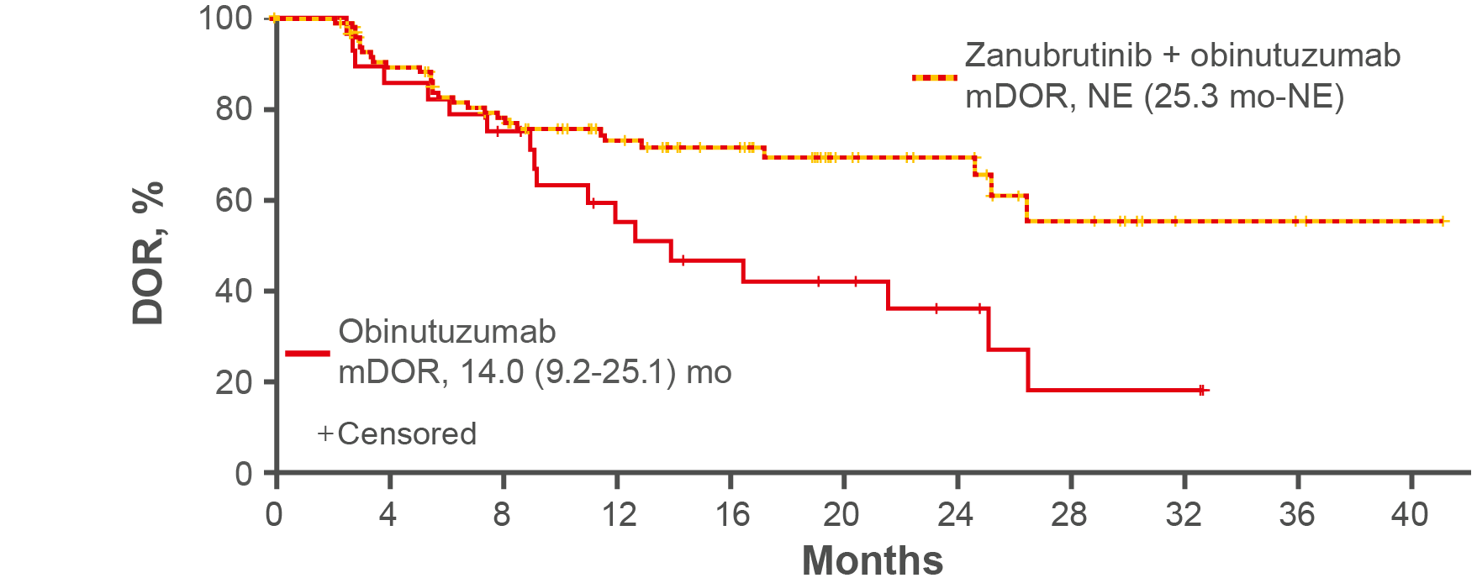
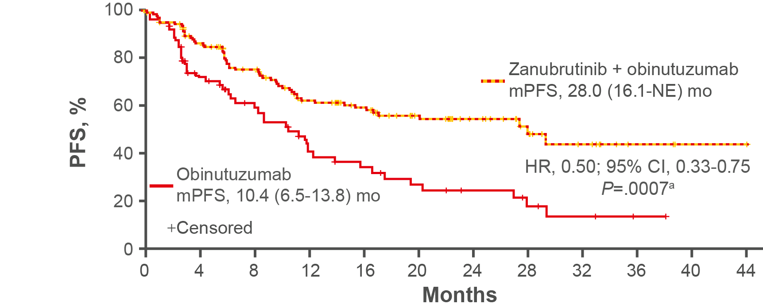
DoR and PFS
DoR by IRC
PFS by IRC
No. of patients
Zanubrutiniba + obinutuzumab | 100 | 97 | 82 | 73 | 68 | 59 | 51 | 43 | 40 | 33 | 23 | 21 | 19 | 12 | 10 | 7 | 3 | 3 | 2 | 1 | 1 | 0
Obinutuzumab | 33 | 29 | 24 | 23 | 20 | 16 | 13 | 11 | 10 | 9 | 8 | 6 | 5 | 3 | 2 | 2 | 2 | 0
No. of patients
Zanubrutiniba + obinutuzumab | 145 | 135 | 116 | 96 | 92 | 79 | 67 | 62 | 56 | 45 | 38 | 35 | 25 | 22 | 15 | 10 | 9 | 5 | 3 | 3 | 1 | 1 | 0
Obinutuzumab | 72 | 63 | 42 | 34 | 30 | 27 | 19 | 16 | 15 | 12 | 11 | 9 | 8 | 8 | 5 | 3 | 3 | 2 | 1 | 1 | 0
Median duration of response by IRC was 14.0 months with obinutuzimab and was not reached in the zanubrutinib plus obinutuzimab arm
Median PFS was longer with zanubrutinib plus obinutuzimab vs obunituzimab

Slide 127
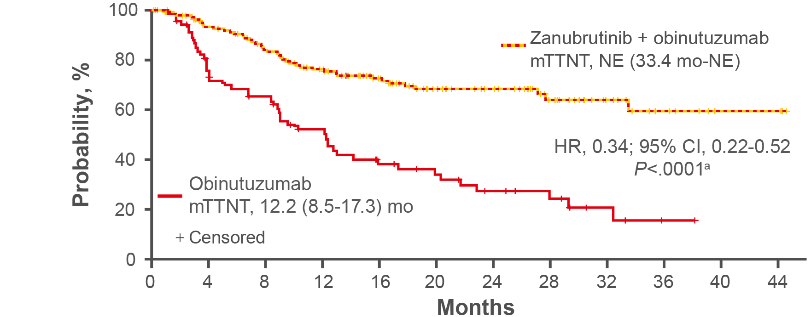
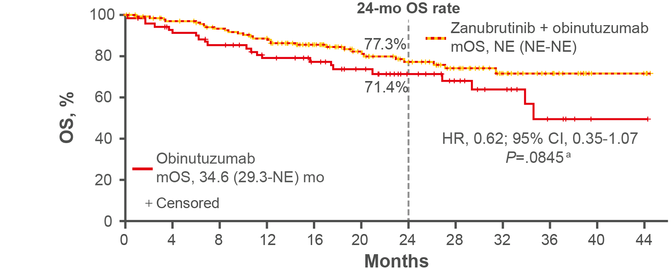
TTNT and OS
Time to next antilymphoma treatment
Overall survival
No. of patients
Zanubrutiniba + obinutuzumab | 145 | 137 | 125 | 118 | 107 | 98 | 91 | 80 | 71 | 62 | 53 | 47 | 44 | 40 | 29 | 22 | 17 | 12 | 10 | 6 | 3 | 3 | 3 | 0
Obinutuzumab | 72 | 65 | 49 | 44 | 41 | 32 | 30 | 24 | 20 | 18 | 16 | 13 | 11 | 9 | 8 | 5 | 4 | 2 | 1 | 1 | 0
No. of patients
Zanubrutiniba + obinutuzumab | 145 | 139 | 133 | 129 | 123 | 119 | 113 | 102 | 92 | 81 | 70 | 62 | 56 | 51 | 41 | 33 | 26 | 20 | 17 | 11 | 4 | 4 | 3 | 0
Obinutuzumab | 72 | 67 | 63 | 62 | 57 | 54 | 49 | 48 | 43 | 39 | 36 | 32 | 25 | 23 | 18 | 14 | 13 | 8 | 5 | 3 | 1 | 1 | 1 | 0
TTNT was prolonged with zanubrutinib plus Obinutuzumab
The estimated OS rate at 24 months was numerically higher with zanubrutinib plus obinutuzimab vs obinutuzimab

Slide 128
Treatment-emergent adverse events
Common nonhematologic TEAEs (any grade)
Selected grade ≥3 nonhematologic TEAEs
n (%) | Zanubrutinib + obinutuzimab (n=143) | Obinutuzimab (n=71)
Pneumonia | 14 (9.8) | 3 (4.2)
COVID-19 | 8 (5.6) | 2 (2.8)
COVID-19 pneumonia | 5 (3.5) | 2 (2.8)
Diarrhea | 4 (2.8) | 1 (1.4)
Febrile neutropenia | 3 (2.1) | 1 (1.4)
Atrial fibrillation | 2 (1.4) | 0 (0)
Infusion-related reaction | 1 (0.7) | 3 (4.2)
Hypertension | 1 (0.7) | 1 (1.4)
There were no unexpected safety findings with zanubrutinib plus obinutuzumab
  Among common nonhematologic treatment-emergent adverse events (TEAEs) of Obinutuzumab (>5% difference vs zanubrutinib plus obinutuzimab)

Slide 129
EAIRs for TEAEs of special interest
Incidences of atrial fibrillation and hypertension were low and similar in both treatment arms
Two patients in each arm reported major hemorrhage
Persons per 100 person-months

Slide 130
Conclusions
In the ROSEWOOD study, zanubrutinib plus obinutuzumab demonstrated meaningful efficacy and a manageable safety profile in heavily pretreated patients with R/R FL
This longer follow-up analysis provides evidence of the significant complete response rate, with longer
PFS and TTNT, with zanubrutinib plus obinutuzumab vs obinutuzumab – A consistent benefit was observed across key prespecified subgroups
The combination of zanubrutinib and obinutuzumab demonstrates a favorable risk-benefit profile and
may represent a potential novel combination therapy for patients with R/R FL
A phase 3 study of zanubrutinib plus obinutuzumab in patients who previously received ≥1 line of
systemic therapy is now underway (MAHOGANY; NCT05100862)

Slide 131
Acalabrutinib, lenalidomide, and rituximab
(aR2) in previously untreated FL
A Phase 2 investigator-initiated study

Slide 132
aR2 in FL: Study design
A Phase II Study of acalabrutinib, lenalidomide, and rituximab (aR2)
in patients with previously untreated FL
Inclusion Criteria
Adult patients with previously treated FL
Grade 1-3A
Stage 3-4
High tumor burden (per GELF criteria)
Acalabrutinib 100 mg PO BID
For 13 cycles
Cycle 1
Lenalidomide 20 mg PO D 1-21
Rituximab 375 mg/m² IV weekly X 4, then monthly
For 12 cycles
Cycle 2
Lugano criteria: PET/CT
(month 3, 6, 12, 18, 24,
then yearly)
Primary endpoint: best complete response rate

Slide 133
Treatment characteristics
Patients (N=24) | n (%); median [Range]
Cycles (n) | 13 (6-13)
Cycles delay | 15 (62.5)
Lenalidomide dose reduction | 6 (25)
Lenalidomide delay | 20 (83)
Lenalidomide discontinuation | 0 (0)
Acalabrutinib dose reduction | 2 (8)
Acalabrutinib delay | 17 (71)
Acalabrutinib discontinuation | 1 (4)
Rituximab omission | 3 (22.5)
Cycle delay was due to COVID-19 in 11 (46%) cases

Slide 134
Response to treatment
Patients (N=24) | n (%)
PET3 ORR | 24 (100)
PET3 CR | 15 (62.5)
PET6 ORR | 24 (100)
PET6 CR | 22 (92)
EOT ORR | 21 (87.5)
EOT CR | 20 (83)
Best response: CR | 22 (92)
PR | 2 (8)
SD | 0 (0)
PD | 0 (0)
ORR | 24 (100)
N=24
N=24
N=24
N=24

Slide 135
PFS and OS
PFS
OS
Proportion not
progressed/dead
Proportion alive
N
24
PD/dead
5
2-y PFS
79%
N
24
dead
5
2-y OS
92%
N | 24 | 24 | 24 | 23 | 22 | 20 | 17 | 11 | 4
N | 24 | 24 | 24 | 24 | 24 | 22 | 18 | 15 | 5
After a median follow-up of 22 months (95% CI 20-24 months), 4 patients had PD, including 2 who transformed at 5 and 7 months, while PR (both with pre-treatment bulky disease and SUVmax >17), and 1 who transformed at end of treatment, after initial CR
At data cutoff, 2 patients have died, 1 due to COVID19 (while in CR, at 14 months) and 1 due to transformed lymphoma (at 10 months), both 4 months after study discontinuation

Slide 136
Safety and tolerability
Patients (N=24) | Grade 1-2 | Grade 3-4
Neutropenia | 8 (33) | 14 (58)
ALT elevation | 7 (29) | 4 (17)
AST elevation | 6 (25) | 3 (12.5)
Infection | 8 (33) | 3 (12.5)
Anemia | 18 (75) | 2 (8)
Skin rash | 10 (42) | 2 (8)
Fatigue | 18 (75) | 1 (4)
Nausea | 6 (25) | 1 (4)
Infusion-related reaction | 5 (21) | 1 (4)
Peripheral neuropathy | 4 (17) | 1 (4)
Lymphopenia | 3 (12.5) | 1 (4)
Atrial fibrillation | 0 (0) | 1 (4)
Thrombocytopenia | 16 (67) | 0 (0)
Headache | 14 (58) | 0 (0)
Diarrhea | 10 (42) | 0 (0)
Pruritus | 7 (29) | 0 (0)
Arthralgia | 7 (29) | 0 (0)
Bruising | 6 (25) | 0 (0)
Myalgia | 6 (25) | 0 (0)
Dizziness | 5 (21) | 0 (0)
Dry skin | 4 (17) | 0 (0)
Sinus bradycardia | 3 (12.5) | 0 (0)
Dysgeusia | 2 (4) | 0 (0)
5 out of 8 grade 1-2 infections and 2 out of 3 grade 3-4 infections were related to COVID19
14 (58%) patients needed growth factor support, a median of 2 times
(range, 1-8)
One patient developed atrial fibrillation
None had severe bleeding

Slide 137
Conclusions
The results indicate that aR² is a safe and effective frontline non-chemotherapy regimen for FL patients, resulting in high CR rates
Considering the observed early achievement of CR, the study has been expanded to include 26 additional patients treated with only 6 cycles
Correlate analyses are planned to assess minimal residual disease status and effects on the immune microenvironment

Slide 138
Epcoritamab
SC plus R² in high risk FL
Including POD24 status

Slide 139
Epcoritamab SC plus R²: study design
A Phase 1b/2, open-label trial to assess the aafety and preliminary efficacy of epcoritamab SC in combination with rituximab and lenalidomide (R²) in adults with R/R FL
Key inclusion criteria
R/R CD20⁺ FL
  Grade 1, 2 or 3A
  Stage II-IV
Need for treatment based on symptoms or disease burden, as determined by GELF criteria
ECOG PS 0-2
Measurable disease by CT or MRI
Adequate organ function
Epcoritamab SC 48 mg (N=111)
High risk
Patients could be counted in ≥1 high-risk subgroup
POD24ª
(n=42)
Primary refractory^{b}
(n=38)
Refractory^{b} to prior anti-CD20 (n=48)
Double refractory^{b,c}
(n=37)
High FLIPI
(3-5; n=64)
POD24ª 2L^{d}
(n=23)
POD24ª 3L+^{e}
(n=19)
Non-high risk^{f}
(n=21)
First pooled analysis for epcoritamab SC + R² in R/R FL patients
Epcoritamab is a subcutaneously administered CD3xCD20 bispecific antibody developed using the DuoBody® platform
Data cutoff: January 31, 2023. Median follow-up: 11.4 mo
Primary objectives: Safety and antitumor activity^{g}

Slide 140
Safety profile
Safety summary
Treatment-emergent adverse events
 | Total N=111
Grade ≥3 TEAE, n (%) Related to epcoritamab SC | 84 (76) 45 (41)
ICANS, n (%)ª Median time to resolution, d (range)^{b} | 2 (2) 5.5 (4-7)
CTLS, n (%) | 0
Epcoritamab SC dose delay due to TEAE, n (%) Related to epcoritamab SC | 68 (61) 32 (29)
Epcoritamab SC discontinuation due to TEAE, n (%) Related to epcoritamab SC | 14 (13) 5 (5)
Fatal TEAE (all COVID19), n (%) | 4 (4)
Findings are consistent with previous reports

Slide 141
CRS
CRS summary
CRS events by dosing period
 | Total N=111
CRS, n(%)ª Grade 1 Grade 2 Grade 3 | 53 (48) 38 (34) 13 (12) 2 (2)
Median time to onset after full dose, d (range) | 2 (1-9)
CRS resolution, n (%) | 53 (100)
Median time to resolution, d (range)^{b} | 3 (1-23)
Treated with tocilizumab, n (%) | 14 (13)
Leading to epcoritamab SC discontinuation, n (%) | 0
Incidence, %
CRS occurrence was predictable
Majority of events were low grade
All events resolved
Cycle 1

Slide 142
Responses
Responseª | Efficacy evaluable for epcoritamab SC +R² (n=104) | Response to immediate prior therapy^{b} (n=104^{c})
Overall response CMR PMR | 98% 87% 12% | 85% 58% 27%
Stable disease | 1% | 5%
Progressive disease | 1% | 7%
High overall response and CMR rates observed with epcoritamab SC + R²
Epcoritamab SC + R² substantially improved overall response and CMR rates compared with immediate prior therapy

Slide 143
Antitumor activity
Antitumor activity in POD24
Tumor activity in subgroupsª
Response, % | Non-POD24 n=64 | POD24 n=40 | POD24 2L n=21 | POD24 3L+
ORR | 98 | 98 | 100 | 95
CMR | 94 | 75 | 86 | 63
Patients, %
High overall response and CMR rates regardless of POD24 status and line of therapy
High overall response and CMR rates regardless of subgroup

Slide 144
PFS
PFS – Overall and POD24
PFS – Other high-risk subgroups and non-high-risk
PFSª | Overall^{b} N=111 | POD24^{c} n=42 | POD24 2L^{d} n=23 | POD24 3L+^{e} n=19
9-mo, 12-mo estimates, % | 85, 78 | 77, 77 | 81, 81 | 72, 72
Primary refractory (n=38)^{f}
Refractory to anti-CD20 (n=48)^{f}
Double refractory (n=37)^{g}
High FLIPI (3-5) (n=64)^{h}
Non-high risk (n=21)^{i}
Overall (N=111)
POD24 (n=42)
No. of patients | No. of patients at risk
 | 111 | 96 | 70 | 44 | 17
 | 42 | 35 | 20 | 10 | 3
No. of patients | No. of patients at risk
 | 38 | 34 | 25 | 15 | 4
 | 48 | 41 | 31 | 19 | 7
 | 37 | 31 | 21 | 14 | 5
 | 64 | 54 | 41 | 29 | 11
 | 21 | 20 | 13 | 8 | 3
Epcoritamab SC +R² led to durable remissions, including POD24 patients
Epcoritamab SC +R² led to durable remissions in other high-risk and non high-risk populations

Slide 145
DoCR
DoCR – Overall and POD24
DoCR – Other high-risk subgroups and
Non-high risk
DoCRª | Overall^{b} n=90 | POD24^{c} n=30 | POD24 2L^{d} n=18 | POD24 3L+^{e} n=12
9-mo, 12-mo estimates, % | 89, 89 | 90, 90 | 85, 85 | 100, 100
Primary refractory (n=31)^{f}
Refractory to anti-CD20 (n=38)^{f}
Double refractory (n=28)^{g}
High FLIPI (3–5) (n=52)^{h}
Non-high risk (n=18)^{i}
Overall (n=90
POD24 (n=30)
No. of patients | No. of patients at risk
 | 90 | 76 | 56 | 35 | 13
 | 30 | 25 | 13 | 7 | 2
No. of patients | No. of patients at risk
 | 31 | 28 | 18 | 11 | 2
 | 38 | 34 | 22 | 15 | 5
 | 28 | 24 | 15 | 10 | 3
 | 52 | 43 | 35 | 24 | 10
 | 18 | 14 | 11 | 6 | 1
Epcoritamab SC + R² led to durable complete responses, including in POD24 patients
Epcoritamab SC + R² led to durable complete responses in other high-risk and non high-risk populations
Data cutoff: January 31, 2023. Definitions for all subgroups available in study design. ª DoCR is among complete responders in response-evaluable set. ^{b} Median follow-up: 11.4 mo (range, 2.1-22.1). ^{c} Median follow-up: 9.5 mo (range, 2.4+ to 19.4). ^{d} Median follow-up: 9.2 mo (range, 3.0-19.4). ^{e} Median follow-up: 9.5 mo (range, 2.4+ to 16.7). ^{f} Median follow-up: 10.4 mo (range, 3.0-19.4). ^{g} Median follow-up: 10.1 mo (range, 3.0-19.4). ^{h} Median follow-up: 12.5 mo (range, 2.1-22.1). ^{i} Median follow-up: 11.2 mo (range, 3.7-19.0).
DoCR, duration of complete response; FLIPI, Follicular Lymphoma International Prognostic Index; POD24, progression within 2 years of initiating 1L treatment that included chemoimmunotherapy; R², lenalidamide + rituximab; SC, subcutaneous.
Sureda A, et al. Abstract 7506 presented at ASCO 2023. Sureda A, et al. Abstract S222 presented at EHA2023.

Slide 146
Conclusions
Addition of epcoritamab SC to R² drives deep and durable remissions in R/R FL patients, including POD24 and other high-risk populations
  High overall response and CMR rates were observed regardless of POD24 or other high-risk features
Manageable safety profile with no new safety signals; consistent with previous reports
  CRS occurrence was predictable, and events were primarily low grade
Epcoritamab SC combination regimens are being studied in the ongoing randomized, Phase 3 EPCORE FL-1 trial (NCT05409066) as well as in a POD24 cohort in the EPCORE NHL-2 trial (NCT04663347)

Slide 147
Mosunetuzumab in R/R FL
Updated analysis

Slide 148
Mosunetuzumab in R/R FL: Study design
Phase II study of mosunetuzumab in R/R FL
Key inclusion criteria
R/R FL (grade 1-3a)
≥2 prior therapies, including an anti-CD20 antibody and an alkylating agent
ECOG PS 0-1
Mosunetuzumab administration
IV mosunetuzumab (21-day cycles) with step-up dosing in C1
Hospitalization for monitoring following mosunetuzumab infusion not required
Fixed-duration treatment: 8 cycles (CR after C8) / 17 cycles (PR/SD after C8)ª
As of July 8, 2022, 90 pts had received ≥1 dose of mosunetuzumab
D15
60 mg
D1
60 mg
D1
30 mg
D1
30 mg
D8
2 mg
D1
1 mg
C1
C2
C2
C8/C17
Primary endpoint: IRC-determined CR rate (as best response), by Cheson 2007 criteria²
CRS graded using ASTCT criteria²
Exploratory analyses assessed the association between TMTV at baseline, and clinical efficacy and safety
TMTV derived from PET images at study entry using artificial intelligence-based model³

Slide 149
Response
Pivotal Phase II study
Updated analysis
Efficacy endpoint | IRF, N (%)
CR¹ | 54 (60%)
ORR¹ | 72 (80%)
24-month DoCR rate: 63%²
54 (60%) pts achieved CR as best response
49 pts (54%) achieved CR at EOT
1 CR pt experienced PD in cycle 8
4 pts achieved CR after EOT due to delayed bone marrow confirmation of CR
Mosunetuzumab showed high rates of durable responses
A high number of patients achieved CR at EOTª
Longer follow-up data continue to demonstrate clinically meaningful outcomes

Slide 150

DoCR
 | n=49
Median, months (95% CI) | NE (23.2-NE)
24-month DoCR, % (95% CI) | 65 (39.0-90.5)
0.8
0.6
DoCR probability
Durable responses were observed in patients who achieved a CR at EOT
0.4
0.2
No. of patients | 49 | 48 | 46 | 41 | 40 | 36 | 34 | 30 | 27 | 21 | 19 | 10 | 5 | 4 | 4 | 2 | 2 | 2

Slide 151
PFS and OS at EOT
PFS in patients with a CR at EOT
OS in patients with a CR at EOT
1.0
1.0
PFS probability
0.8
OS probability
0.8
0.6
0.6
0.4
0.4
0.2
0.2
0.0
0.0
0
2
4
6
8
10
12
14
16
18
20
22
24
26
28
30
32
34
36
0
2
4
6
8
10
12
14
16
18
20
22
24
26
28
30
32
34
36
Time from first treatment, months
Time from first treatment, months
No. of patients | 49 | 49 | 48 | 47 | 46 | 43 | 39 | 39 | 34 | 28 | 27 | 26 | 15 | 9 | 4 | 4 | 2 | 2 | 1
No. of patients | 49 | 49 | 49 | 49 | 49 | 48 | 48 | 48 | 46 | 43 | 42 | 36 | 32 | 25 | 15 | 11 | 7 | 2 | 1
 | n=49
Median, months (95% CI) | NE (26.3-NE)
24-month PFS after first dose, % (95% CI) | 77 (63.3-91.0)
 | n=49
Median, months (95% CI) | NE (NE-NE)
24-month OS, % (95% CI) | 100 (100-100.0)

Slide 152
DoR
 | Early CRª (by month 3 assessment) n=33 | Late CR^{b} (after month 3 assessment) n=21 | PR as best response n=16
Median DoR, months (95% CI) 24-month DoR rate, % (95% CI) | NE (23.2-NE) 67.8 (43.5-92.0) | NE (22.8-NE) 66.1 (39.3-93) | 4.0 (2.5-6.7) NE
Median PFS, months (95% CI) 24-month PFS rate, % (95% CI) | NE (26.3-NE) 79.2 (64.1-94.2) | NE (24.0-NE) 65.1 (37.7-92.5) | 5.4 (4.1-11.8) NE
Median OS, months (95% CI) 24-month OS rate, % (95% CI) | NE (NE-NE) 100 (100-100) | NE (32.2-NE) 100 (100-100) | NE (NE-NE) 78.5 (56.9-100)
A similar DoR benefit was observed, regardless of timing to first CR
Median time to first CR: 3 months (range 1.0-19)
Median DoR: NE in patients with early or late CR
No association between timing of first CR and DoR

Slide 153
TMTV and BOR
Median, cm³ | 139.32 | 185.82 | 73.55 | 133.46 | 793.27
n | 50 | 14 | 9 | 8 | 1
No correlation was observed between baseline and TMTV
10000
1000
TMTV, cm³
100
10
Median baseline TMTV: 139cm³
(range: 0–4858; n=82)
1
CR
PR
SD
PD
NE
BOR by INV, with or without PET scan

Slide 154
CRS
CRS¹ by ASTCT criteria² | N=90
CRS (any grade), % Grade 1 Grade 2 Grade 3 Grade 4 | 44 26 17 1 1
Median time to CRS onset, hours (range) C1D1 C1D15 | 5.2 (1.2-24) 27 (0.1-391)
Median CRS duration, days (range) | 3 (1-29)
Corticosteroids for CRS management, % | 11
Tocilizumab for CRS management, % | 8
Events resolved, % | 100
FL patients with bone/bone marrow metabolic disease (n=24)
Grade ≥2 CRS
8 (33.3%)
No CRS or grade 1 CRS
16 (66.7%)
FL patients without bone/bone marrow metabolic disease (n=58)
8 (13.8%)
Grade ≥2 CRS
No CRS or grade 1 CRS
Grade ≥2 CRS was greater in patients with the presence of bone/bone marrow metabolic disease burdenª
CRS was primarily low grade and occurred during cycle 1
All CRS events resolved
50 (86.2%)

Slide 155
Conclusions
In this pivotal Phase II study, fixed-duration mosenetuzumab monotherapy demonstrated a high CR rate
at EOT in pts with R/R FL
Durable responses were observed in patients with a CR at EOT; a high proportion of patients remained event free at 2 years
In exploratory analyses, a similar DoR benefit was observed regardless of whether patients achieved an early or late CR
No correlation was observed between TMTV at baseline and BOR
CRS was predominantly low grade; grade ≥2 CRS events were more frequently observed in patients with bone/bone marrow metabolic disease burden versus those without

Slide 156
MALIBU
Rituximab and ibrutinib
untreated SMZL and NMZL

Slide 157
MALIBU: Study design
Phase II study of ibrutinib and rituximab in untreated marginal zone lymphomas
Key eligibility criteria
CD20+ MZL
Previously untreated and symptomatic
Ann Arbor II-IV; Ann Arbor I if not eligible for local therapy
≥1 measurable disease site
ECOG PS 0-2
Stratification
Rituximab 1/week x 4, 1/month x 4
Day 1, 8, 15, 22, 57, 85, 113, 141
375 mg/m² IV, then rituximab 1400 mg SC
EMZL, n=130
SMZL, n=30
Ibrutinib
560 mg/day continuously
from day 1 to day 730 (≈ 2 years)
NMZL, n=15
Induction
R-ibrutinib
Maintenance
ibrutinib only
Primary endpoints
CR rate at 12-monthsª
PFS at 5-year (co-primary)
Secondary endpoints
Safety
Efficacy CRR-24 mo; ORR-12 &
24 mo, DoR, DCR, EFS, OS, TTNT
Histological transformation rate
Prognostic role PET/CT scan
Central pathology review in France and Switzerland
Review of slides of PB and BM in SMZL (cytology) at baseline

Slide 158
Response
Response Summary
DoR
Response, n (%) | Response at 12 months |  |  | Best objective response
 | All n=34/45 | SMZL n=24/30 | NMZL n=10/15 | All n=43/45 | SMZL n=29/30 | NMZL n=14/15
Overall response rate | 33 (97) | 24 (100) | 9 (90) | 41 (95) | 28 (97) | 13 (93)
Complete response | 18 (53) | 10 (42) | 8 (80) | 22 (51) | 14 (48) | 8 (57)
Partial response | 15 (44) | 14 (58) | 1 (10) | 19 (44) | 14 (48) | 5 (36)
Stable disease | - | - | - | - | - | -
Progressive disease | 1 (3) | - | 1 (10) | - | - | -
SMZL
NMZL
Log rank=0.005
 | All n=41/43 | SMZL n=28/29 | NMZL n=13/14
Median DOR, months (IQR) | NR (22.3-NE) | NR | 22.3 (12-NE)
 | All n=43/45 | SMZL n=29/30 | NMZL n=14/15
Median time to best response, months (range) | 2.2 (1.1-20) | 2.7 (1.1-20) | 1.9 (1.2-12.8)
No. of patients | No. of patients at risk
 | 28 | 22 | 19 | 11 | 2 | 0
 | 13 | 11 | 8 | 7 | 2 | 0

Slide 159
PFS and OS
PFS
OS
NMZL
SMZL
SMZL
HR, 4.75 (95% CI, 1.2-18.5)
Log rank=0.0133
HR, 1.02 (95% CI, 0.09-11.3)
Log rank=0.988
NMZL
Whole cohort 2-yr PFS: 77% (95% CI: 59-88)
SMZL 2-yr PFS: 86% (95% CI: 62-95)
NMZL 2-yr PFS: 59% (95% CI: 27-81)
No. of patients | No. of patients at risk |  |  |  |  |  | Relapses | Deathsª
 | 30 | 28 | 28 | 21 | 7 | 0 | 1 | 2
 | 15 | 13 | 10 | 9 | 4 | 0 | 6 | 1
No. of patients | No. of patients at risk |  |  |  |  |  | Deathsª
 | 30 | 28 | 28 | 21 | 7 | 0 | 2
 | 15 | 13 | 11 | 9 | 4 | 0 | 1

Slide 160
Drug-related AEs
All patients SMZL + NMZL
No difference
between SMZL and NMZL
% of patients

Slide 161
AEs of specific interest
 | All |  | SMZL |  | NMZL
 | Any grade | Grade 3+ | Any grade | Grade 3+ | Any grade | Grade 3+
Neutropenia | 8 (17.8) | 8 (17.8) | 6 (20.0) | 6 (20.0) | 2 (13.3) | 2 (13.3)
Diarrhea | 4 (8.9) | 1 (2.2) | 4 (13.3) | 1 (3.3) | 0 (0) | 0 (0)
Hemorrhage | 3 (6.7) | 0 (0) | 2 (6.7) | 0 (0) | 1 (6.7) | 0 (0)
Infection | 1 (2.2) | 0 (0) | 1 (3.3) | 0 (0) | 0 (0) | 0 (0)
Cardiacª | 4 (8.9) | 2 (4.4) | 2 (6.7) | 1 (3.3) | 2 (13.3) | 1 (6.7)
Rash | 1 (2.2) | 1 (2.2) | 1 (3.3) | 1 (3.3) | 0 (0) | 0 (0)
4 infections are SAEs (3 COVID-19 all NDR, 1 strongyloidiasis NDR)
1 neutropenia is a SAE (DR rituximab)
2 cardiac events are SAEs (1 flutter NDR, 1 flutter DR rituximab)
1 hemorrhage is a SAE (hemolytic anemia NDR)

Slide 162
Discontinuation and reduction of treatment
Discontinuation, n=10
Death (COVID-19, stroke, car accident), n=3
Hemolytic anemia, n=1
Neutropenia, n=2
Infection (disseminated strongyloidiasis), n=1
Skin disorders, n=2
Atrial fibrillation, n=1
Dose reduction, n=13
Rituximab (1) = infusion-related reaction
Ibrutinib (12) = neutropenia (3), cardiac disorders (3), musculoskeletal pain (2), skin disorder (1), fatigue (1), edema (1), epigastralgia (1)

Slide 163
Conclusions
First report of R-ibrutinib in first-line MZL
R-ibrutinib showed promising activity in SMZL and NMZL cohorts
  12-mo ORR: 97%
  12-mo CRR: 53%
The 2-year PFS was 77% (95% CI: 59-88)
  SMZL: 2-year PFS: 86% (95% CI: 62-95)
  NMZL: 2-year PFS: 59% (95% CI: 27-81)
The toxicity profile was acceptable
  n=0, G3 hemorrhage
  n=2, G3 cardiac toxicities

Slide 164
SELENE
Ibrutinib plus BR or R-CHOP in
previously treated patients with FL or MZL

Slide 165
SELENE: Study design
Randomized, double-blind, placebo-controlled, Phase 3 study of ibrutinib plus BR or R-CHOP in previously treated patients with FL or MZL
Key eligibility criteria
R/R FL or MZL
≥1 measurable disease site
≥1 prior treatment with anti-CD20 CIT regimen
ECOG PS ≤1
Mar 2014 → Nov 2015ª
Primary endpoint
PFS (investigator-assessed)
Secondary endpoints
OS
CR rate
ORR
DoR
Patient-reported outcomes (FACT-Lym)
Safety
BR or R-CHOP^{b} + ibrutinib
Ibrutinib 560 mg QD until PD or unacceptable toxicity
n=202
N=403
R
1:1
BR or R-CHOP^{b} + placebo
Placebo QD until PD or unacceptable toxicity
n=201
Stratified by:
BR vs R-CHOP
Refractory vs relapsed disease
FL vs MZL
1 vs >1 prior LOT

Slide 166
Progression-free survival
100
Despite favorable median PFS with ibrutinib + CIT, the primary study endpoint was not met
ITT population: PFS at median follow-up of 84 months
  Ibrutinib + CIT: 40.5 months
  Placebo + CIT: 23.8 months
PFS with ibrutinib + CIT was consistent across subgroups
Progression-free survival, %
80
HR (95% CI): 0.81 (0.63-1.04); P = 0.0922
60
40
20
Patients, n
Events, n
Ibrutinib + CIT 202 119
Placebo + CIT 201 134
0
0
6
12
18
24
30
36
42
48
54
60
66
72
78
84
90
96
Time, months
No. of patients (no. treated) | No. of patients at risk
Ibrutinib + CIT | 202 (201) | 174 (149) | 147 (110) | 125 (93) | 108 (82) | 103 (77) | 96 (72) | 84 (62) | 81 (57) | 74 (52) | 69 (49) | 63 (46) | 61 (44) | 55 (39) | 34 (28) | 15 (12) | 0 (1)
Placebo + CIT | 201 (199) | 172 (167) | 144 (130) | 112 (99) | 88 (81) | 81 (69) | 74 (63) | 69 (58) | 65 (53) | 63 (48) | 62 (45) | 59 (44) | 57 (42) | 46 (38) | 32 (27) | 6 (7) | 0 (0)

Slide 167
PFS in patients with MZL
100
In 56 patients with MZL, median PFS by investigator assessment was prolonged in both arms
  Ibrutinib + CIT: not reached (95% CI, 49.25-NE)
  Placebo + CIT: 91.6 months (95% CI, 9.23-NE)
PFS by IRC, HR (95% CI): 0.52 (0.23-1.18); P=0.1118
Progression-free survival, %
80
60
40
HR (95% CI): 0.73 (0.31-1.68); P = 0.4505
20
Patients, n
Events, n
Ibrutinib + CIT 28 10
Placebo + CIT 28 12
0
0
6
12
18
24
30
36
42
48
54
60
66
72
78
84
90
96
Time, months
No. of patients | No. of patients at risk
Ibrutinib + CIT | 28 | 23 | 21 | 20 | 18 | 17 | 17 | 17 | 17 | 16 | 15 | 15 | 15 | 14 | 9 | 4 | 0
Placebo + CIT | 28 | 21 | 18 | 18 | 17 | 16 | 15 | 15 | 14 | 14 | 14 | 14 | 14 | 13 | 10 | 3 | 0

Slide 168
Duration of response
100
Median DoR in overall population
  Ibrutinib + CIT: 44.3 months (95% CI, 32.89-60.02)
  Placebo + CIT: 21.7 months (95% CI, 17.61-32.36)
Median DoR in the MZL subgroup
  Ibrutinib + CIT: not reached
  Placebo + CIT: 89.2 months
80
Patients, %
60
40
20
Ibrutinib + CIT
Placebo + CIT
0
0
6
12
18
24
30
36
42
48
54
60
66
72
78
84
90
96
Duration of response, months
No. of patients | No. of patients at risk
Ibrutinib + CIT | 185 | 160 | 128 | 112 | 105 | 101 | 92 | 84 | 79 | 73 | 67 | 63 | 58 | 40 | 17 | 5 | 0
Placebo + CIT | 182 | 160 | 123 | 96 | 85 | 74 | 72 | 66 | 63 | 62 | 59 | 57 | 50 | 30 | 12 | 0 | 0

Slide 169
OS
100
Median OS was not reached in either treatment arm
Estimated 7-year OS rates were similar between treatment arms
  Ibrutinib + CIT: 67.4%
  Placebo + CIT: 68.3%
Estimated 7-year OS rates in the MZL subgroup:
  Ibrutinib + CIT: 76.6%
  Placebo + CIT: 68.5%
  HR (95% CI): 0.69 (0.24-2.00); P=0.4964
Overall survival, %
80
60
40
HR (95% CI): 0.98 (0.69-1.40); P = 0.9115
20
Patients, n
Events, n
Ibrutinib + CIT 202 60
Placebo + CIT 201 61
0
0
6
12
18
24
30
36
42
48
54
60
66
72
78
84
90
96
Duration of response, months
No. of patients | No. of patients at risk
Ibrutinib + CIT | 202 | 193 | 180 | 168 | 163 | 157 | 151 | 140 | 139 | 135 | 129 | 125 | 120 | 112 | 68 | 26 | 1
Placebo + CIT | 201 | 191 | 172 | 170 | 164 | 157 | 149 | 144 | 140 | 135 | 133 | 132 | 130 | 115 | 69 | 24 | 1

Slide 170
Safety profile
Event, n (%) | Ibrutinib + CIT (n=201) | Placebo + CIT (n=199)
Any-grade TEAE | 199 (99.0) | 197 (99.0)
COVID-19-related | 12 (6.0) | 3 (1.5)
Treatment-related | 187 (93.0) | 160 (80.4)
TEAE leading to death | 13 (6.5) | 13 (6.5)
Grade ≥3 TEAE | 172 (85.6) | 150 (75.4)
Serious TEAE | 112 (55.7) | 74 (37.2)
COVID-19-related | 3 (1.5) | 0
Treatment-related | 70 (34.8) | 36 (18.1)
TEAE leading to dose reduction | 41 (20.4) | 21 (10.6)
TEAE leading to discontinuation | 62 (30.8) | 37 (18.6)
TEAEs of special interest | TEAEs of special interest
Infections and infestations | 158 (78.6) | 141 (70.9)
Major hemorrhage | 6 (3.0) | 2 (1.0)
Arthralgia | 28 (13.9) | 36 (18.1)
Hypertension | 19 (9.5) | 19 (9.5)
Atrial fibrillation | 13 (6.5) | 4 (2.0)
Ibrutinib + CIT was broadly well tolerated with no new safety signals

Slide 171
AEs
Most common all-grade AEs (occurring in >20% of patients)
Patients, %
The most common grade ≥3 AEs were: thrombocytopenia, neutropenia, anemia, and diarrhea
Grade ≥3 thrombocytopenia and anemia were more frequent in the ibrutinib + CIT arm than in the placebo + CIT arm (10.0% vs 5.0% and 11.4% vs 4.0%, respectively)
Rates of grade ≥3 neutropenia were similar in both arms (30.8% vs 31.2%)

Slide 172
Conclusions
In the SELENE study, the addition of ibrutinib to CIT in patients with R/R FL or MZL did not significantly improve PFS
  In patients with MZL, median PFS was prolonged in both arms compared with the overall study population
Duration of response was longer with ibrutinib + CIT compared with placebo + CIT
The overall safety profile of ibrutinib + CIT was consistent with the established safety profiles of both ibrutinib and BR/R-CHOP
  With 7 years of follow-up, no new safety signals were identified
  The addition of ibrutinib to CIT resulted in additive toxicity, but did not impact OS
Further analyses are needed to define specific FL/MZL subgroups that could potentially benefit from extended treatment with ibrutinib following CIT

Slide 173
BRUIN
Pirtobrutinib in cBTKi pre-treated MCL: updated results and subgroup analysis
with 2 years of survival follow-up

Slide 174
BRUIN: Study design
Phase 1/2 dose escalation + expansion study of pirtobrutinib in patients with B-cell malignancies.
The data presented here are focused on the MCL cohort
Safety population
Efficacy populations
Eligibility
Age ≥18 years
ECOG PS 0-2
Active disease and in need of treatment
Previously treated
CLL/SLL
n=317
Key endpoints
Safety/tolerability
Determine MTD and recommended Phase 2 dose
Pharmacokinetics
Efficacy according to ORR and DoR (Lugano) as assessed by IRC
cBTKi naïve
n=14
Phase 1 escalation + expansion
(25 to 300 mg QD)
N=773
MCL
n=166
Prior cBTKi
n=152
Primary analysis set (PAS)^{b} n=90
Otherª
n=290
Supplemental cohort
n=62
The data presented here are focused on the MCL cohort

Slide 175
Efficacy based on IRC assessment
*
Pre-treated MCL patients had an ORR of 56.7% (95% CI 45.8-67.1) and a CR rate of 18.9%
In cBTKi-naïve patients, ORR was 85.7% (95% CI 57.2-98.2) and CR rate was 42.9%
Prior cBTKi MCL Patients | n=90
Overall response rateª, % (95% CI) | 56.7% (45.8-67.1)
Best response^{b}
CR, n (%) | 17 (18.9)
PR, n (%) | 34 (37.8)
SD, n (%) | 16 (17.8)
PD, n (%) | 14 (15.6)
100
Prior cBTKi treated
cBTKi naïve
75
50
25
% change in the sum of products of
diameters from baseline
cBTKi-naïve MCL patients | n=14
Overall response rateª, % (95% CI) | 85.7% (57.2-98.2)
Best response^{c}
CR, n (%) | 6 (42.9)
PR, n (%) | 6 (42.9)
SD, n (%) | 0 (0.0)
PD, n (%) | 1 (7.1)
0
-25
-50
-75
-100

Slide 176
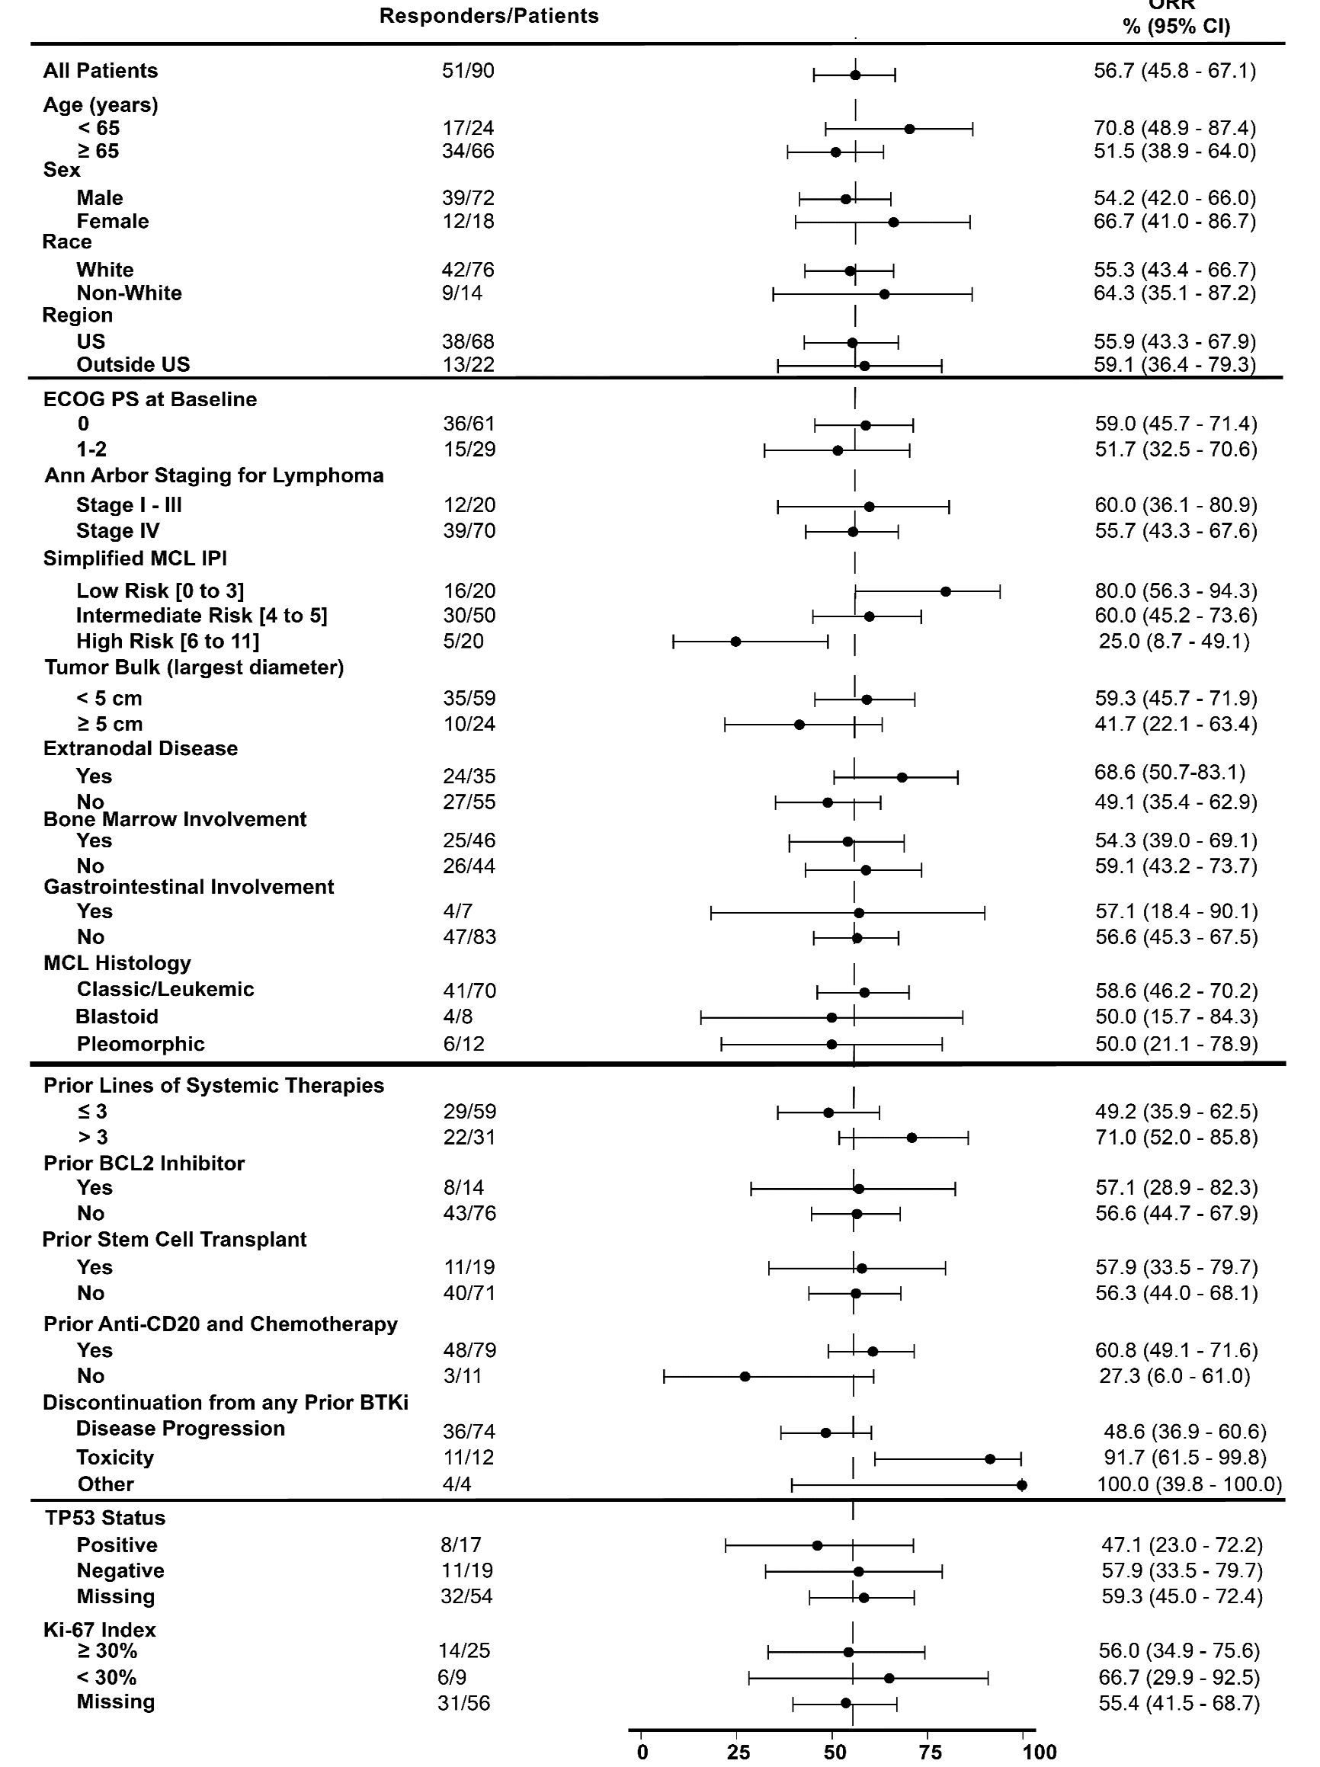
ORR in prior cBTKi MCL subgroups
Responders/patients |  | ORR % (95% CI)
Responders/patients |  | ORR % (95% CI)
ORR was consistently high across analysed subgroups
ORR was higher in patients who discontinued from a prior BTKi due to toxicity compared to those who discontinued because of disease progression
Patients with adverse biology, including TP53 mutations and high Ki-67, did not seem to have a significant difference in ORR
0
25
50
75
100
0
25
50
75
100

Slide 177
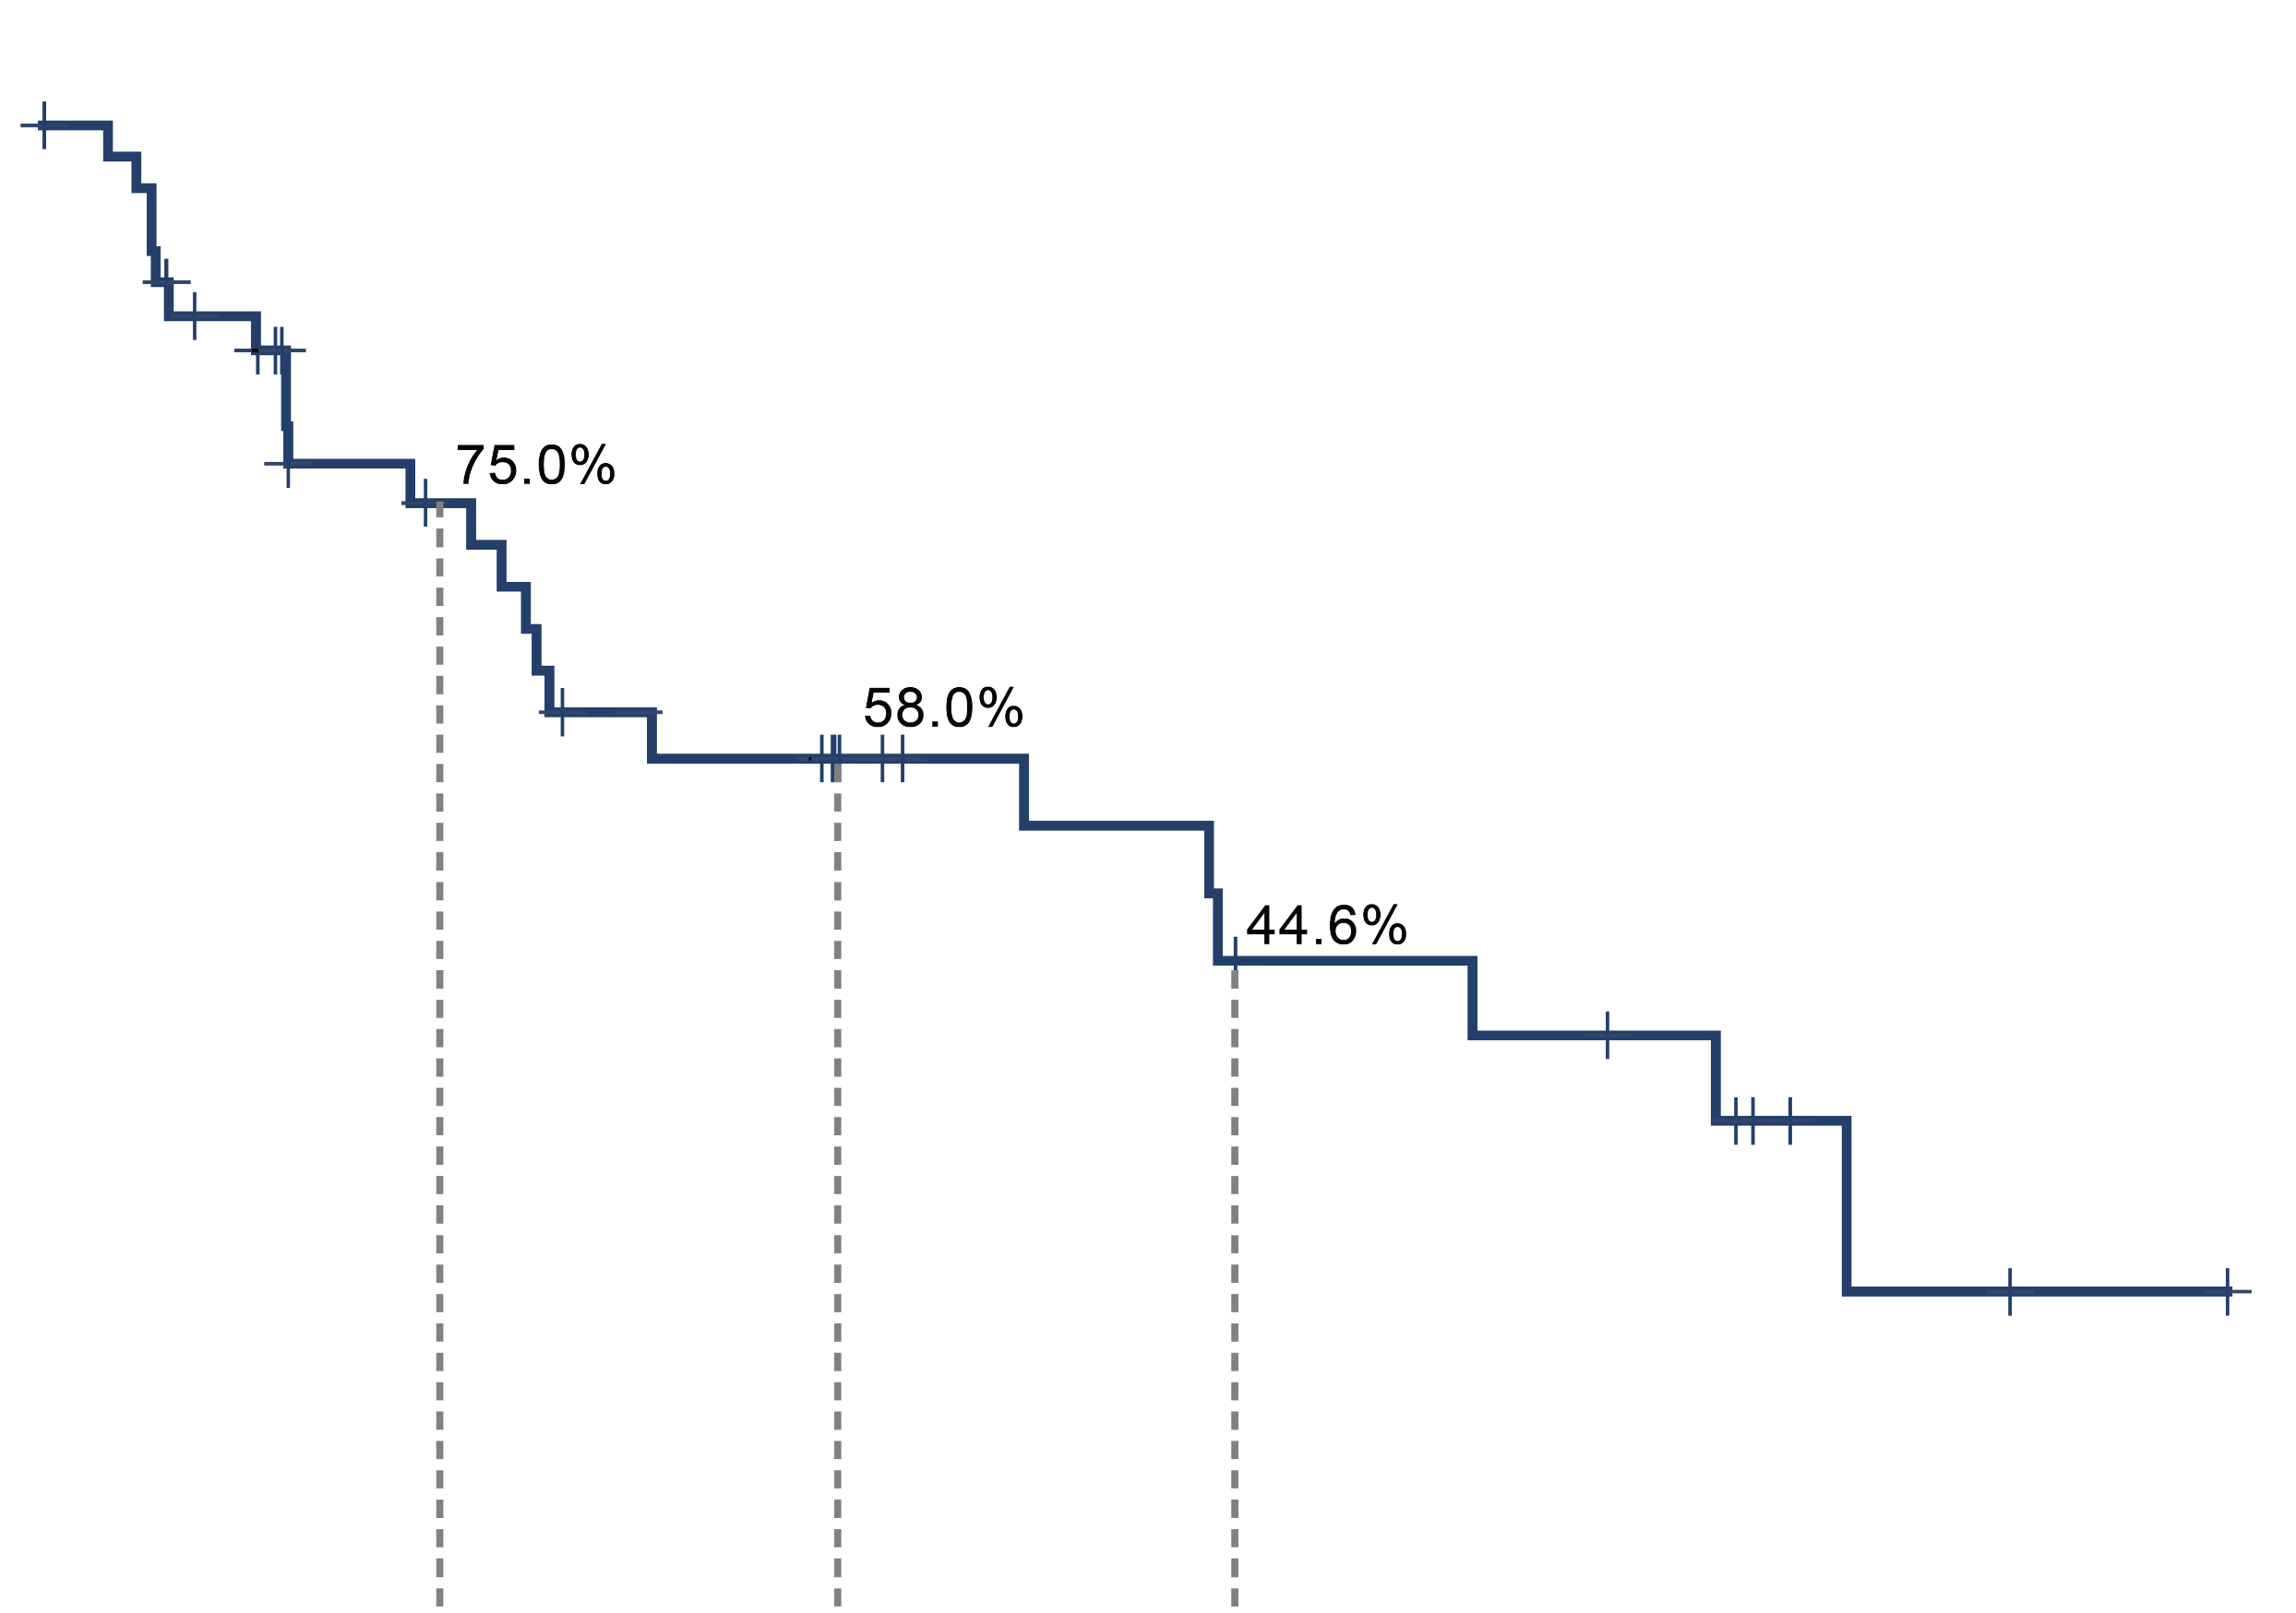
IRC-assessed DoR in pre-treated MCL patients
Median PFS was 7.4 (95% CI: 5.3-13.3) with a median follow-up of 13.8 months
Median OS was 23.5 (95% CI: 15.9-NE) with a median follow-up of 23.5 months
In the cBTKi-naïve cohort, median DoR, PFS, and OS were not reached
18-month DoR rate was 100% (95% CI: 100%)
18-month PFS rate was 92.3% (95% CI: 56.6-98.9%)
18-month OS rate was 92.3% (95% CI: 56.6-98.9%)
Median DOR: 17.6
95% CI: 7.3-27.2
Median follow-up: 12.7 months
Censored, n (%): 28 (55)
No. of patients
––––– | 51 | 39 | 30 | 27 | 21 | 19 | 16 | 13 | 12 | 10 | 9 | 8 | 7 | 4 | 2 | 1 | 1 | 0

Slide 178
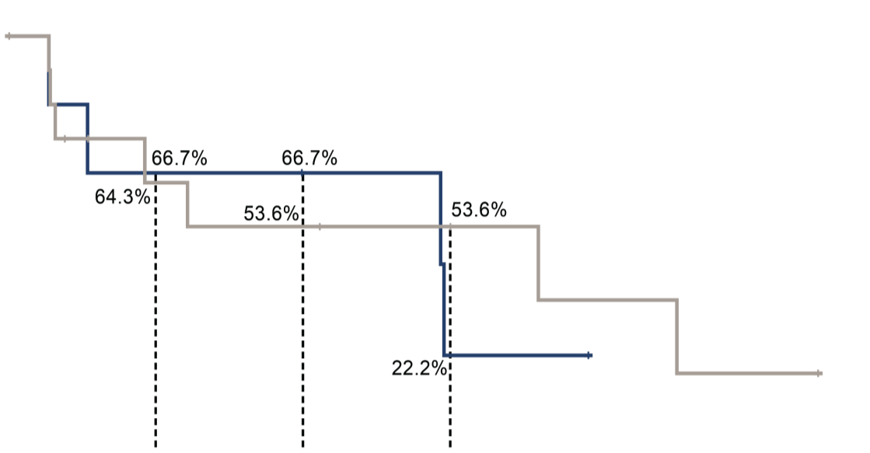
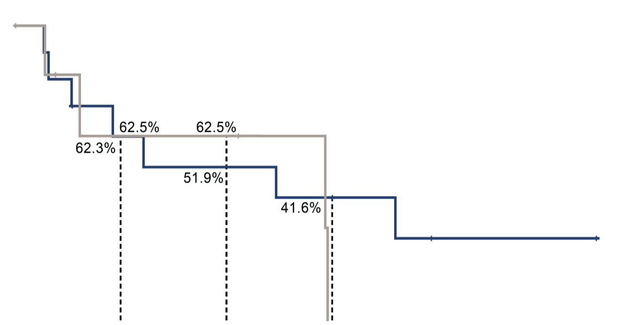
DoR in high-risk MCL subgroups
DoR by Ki-67 index
DoR by TP53 status
No. of patients
Ki-67 <30% | 6 | 5 | 4 | 4 | 4 | 4 | 3 | 3 | 3 | 1 | 1 | 1 | 0 | 0 | 0 | 0 | 0 | 0
Ki-67 ≥30% | 14 | 9 | 7 | 6 | 5 | 5 | 5 | 4 | 4 | 4 | 3 | 2 | 2 | 2 | 1 | 1 | 1 | 0
No. of patients
TP53 negative | 11 | 9 | 7 | 6 | 5 | 5 | 5 | 5 | 4 | 4 | 3 | 2 | 1 | 1 | 1 | 1 | 1 | 0
TP53 positive | 8 | 5 | 3 | 3 | 3 | 3 | 3 | 2 | 2 | 0 | 0 | 0 | 0 | 0 | 0 | 0 | 0 | 0
DoR did not appear to be affected by a high Ki-67 index (>30%) or TP53 mutations

Slide 179
Safety profile
MCL patients (n=166)ª
 | Treatment-emergent AEs (≥15%), % |  | Treatment-related AEs, %
Adverse event (AEs) | Any grade | Grade ≥3 | Any grade | Grade ≥3
Fatigue | 31.3 | 3.0 | 21.1 | 2.4
Diarrhea | 22.3 | 0.0 | 12.0 | 0.0
Dyspnea | 16.3 | 1.2 | 9.0 | 0.6
AEs of special interest^{b} | Any grade | Grade ≥3 | Any grade | Grade ≥3
Bruising^{c} | 16.3 | 0.0 | 11.4 | 0.0
Rash^{d} | 8.4 | 0.6 | 5.4 | 0.0
Arthralgia | 9.0 | 1.2 | 2.4 | 0.0
Hemorrhage/hematoma^{e} | 10.2 | 2.4 | 4.2 | 0.6
Hypertension | 3.6 | 0.0 | 1.8 | 0.0
Atrial fibrillation/flutter^{f,g} | 3.6 | 1.8 | 0.6 | 0.0
Median time on treatment for the MCL population was 5 months
Discontinuations^{h} due to TRAEs occurred in 3% (n=5) of MCL patients
Dose reductions due to TRAEs occurred in 6% (n=10) of MCL patients

Slide 180
Conclusions
Pirtobrutinib is approved in the USA to treat relapsed or refractory MCL after at least two lines of
systemic therapy including prior BTK inhibitor treatment
With a median survival follow-up time of ~2 years, pirtobrutinib continues to demonstrate promising
and durable efficacy in heavily pre-treated relapsed/refractory MCL patients who have been treated
with a prior cBTKi
  Consistently high overall response rates were observed in patients with high-risk disease features including blastoid/pleomorphic variants, elevated Ki-67 index, and TP53 mutations
Pirtobrutinib was well tolerated with low-rates of discontinuation due to drug-related toxicity
  Low rates of cBTKi-associated AEs were observed with pirtobrutinib
A randomized, global, Phase 3 trial comparing pirtobrutinib with investigator’s choice of cBTKi in
pre-treated BTKi-naïve MCL is ongoing (BRUIN MCL-321; NCT04662255)

Slide 181
Bcl-2 inhibitor
BGB-11417 in mature B-cell malignancies
A Phase I study

Slide 182
BGB-11417 in B-cell malignancies: Study design
Phase 1 study to evaluate the safety, tolerability, and antitumor activity of BGB-11417 in adults with B-cell malignancies
Eligible Patients
≥18 years old
Diagnosed with 1 of the following diseases
  Cohort A: R/R MZL, FL, DLBCL or TF- NHL
  Cohorts B & C:
  R/R CLL/SLL
  (iwCLL 2008 criteria)
Measurable disease by CT/MRI
Adequate organ function
Cohort A
R/R NHL
(FL, MZL, DLBCL
or TF-NHL)
N=6-36ª
Dose escalation
80 mg/d
160 mg/d
320 mg/d
640 mg/d
Weekly ramp-up for CLL/SLL and daily ramp-up for NHL schedule to reach target dose
RP2D
Cohort B
R/R CLL/SLL with
low tumor burden
N=6-36ª
Cohort C
R/R CLL/SLL with
high tumor burden
N=6-9ª
RP2D
RP2D
Primary endpoints:
RP2D and/or MTD, safety, tolerability, incidence and severity of TLS-relevant events
Secondary endpoints:
derived PK parameters and ORR of BGB-11417
monotherapy per disease-specific response assessment guidelines as determined by investigator
Exploratory endpoints:
preliminary antitumor activity per disease type, including TTR, DoR, PFS, OS; MRD in CLL/SLL cohort^{b}

Slide 183
Duration of treatment and best response (NHL)
80 mg
Of the 34 evaluable patients with NHL, 6 (17.6%) achieved a complete response (CR) or partial response (PR); both CRs occurred in patients with DLBCL in the 640 mg cohort
160 mg
320 mg
CR
640 mg
PR
DLBCL
SD
FL
PD
MZL
Ongoing treament
TF-NHL
Death
Reach target dose
0
1
2
3
4
5
6
7
8
9
10
11
12
13
14
15
16
17
18
Time since first dose, months

Slide 184
Duration of treatment and best response (CLL/SLL)
Of 23 evaluable patients with CLL/SLL, 13 (56.5%) had a PR or better
Of 9 minimal residual disease (MRD)-evaluable patients with CLL/SLL
(80 mg, n=5; 160 mg, n=4), 3 had undetectable MRD
with <1 CLL cell in 10⁴ leukocytes (uMRD4)
  One had blood and
  bone marrow uMRD4 after 4.5 months
  (80 mg cohort)
  Two had blood uMRD4 after 7.1 months
80 mg
160 mg
320 mg
CR
CRi
PR
SD
640 mg
PD
Ongoing treatment
SLL
Death
320 mgª
CLL
Reach target dose
0
1
2
3
4
5
6
7
8
9
10
11
12
13
14
15
16
Time since first dose, months

Slide 185
Treatment-emergent adverse events
Patients, n (%)ª | NHL (n=34) | CLL/SLL, low tumor burden (n=22) | CLL/SLL, high tumor burden (n=1) | All (N=57)
≥1 TEAE | 33 (97.1) | 22 (100.0) | 1 (100.0) | 56 (98.2)
Grade ≥3 TEAEs | 19 (55.9) | 14 (63.6) | 1 (100.0) | 34 (59.6)
Serious TEAEs | 6 (17.6) | 7 (31.8) | 1 (100.0) | 14 (24.6)
Leading to death | 1 (2.9) | 2 (9.1) | 0 | 3 (5.3)
Leading to treatment discontinuation | 0 | 1 (4.5) | 0 | 1 (1.8)
Leading to dose modification | 5 (14.7) | 10 (45.5) | 1 (100.0) | 16 (28.1)
≥1 treatment-related TEAEs | 29 (85.3) | 21 (95.5) | 1 (100.0) | 51 (89.5)
Grade ≥3 TEAEs | 14 (41.2) | 13 (59.1) | 1 (100.0) | 28 (49.1)
Serious TEAEs | 3 (8.8) | 4 (18.2) | 0 | 7 (12.3)
Leading to death | 0 | 2 (9.1) | 0 | 2 (3.5)
Leading to treatment discontinuation | 0 | 1 (4.5) | 0 | 1 (1.8)
Leading to dose modification | 4 (11.8) | 6 (27.3) | 0 | 10 (17.5)
Of all patients, 24.6% had serious treatment-emergent AEs (TEAEs) and 28.1% had TEAEs leading to treatment dose modification
TEAEs leading to treatment discontinuation or death were reported in 1.8% and 5.3% of all patients, respectively

Slide 186
Treatment-emergent adverse events
TEAEs with incidence ≥10%
Most TEAEs observed in this study were grade 1 or 2; the most common grade ≥3 was neutropenia (33.3%)
No clinical TLS occurred in any patient
Patients, %

Slide 187
Conclusions
These initial results from indicated that BGB-11417 monotherapy, at all tested doses up to 640 mg, was well tolerated without dose-dependent increases in toxicity
The risk of TLS was low and manageable in this study, with no clinical TLS observed
Initial antitumor activity of BGB-11417 monotherapy was promising; responses were observed in patients with R/R CLL/SLL at lower dose levels
Preliminary antitumor activity was observed in patients with NHL with BGB-11417 monotherapy; further expansion data are being generated

Slide 188
Zanubrutinib in B-cell malignancies who are intolerant of ibrutinib and/or acalabrutinib

Slide 189
Zanubrutinib in B-cell malignancies who are intolerant of ibrutinib and/or acalabrutinib: Study design
A Phase 2, multicenter, single-arm study of in patients with previously treated B-cell lymphoma intolerant of prior treatment with ibrutinib and/or acalabrutinib
Eligible patients
Previously treated patients with CLL/SLL, MCL, MZL, or WM intolerant of prior BTKi
ECOG PS ≤2
Cohort 1
Intolerant of only ibrutinib
n=57
Zanubrutinib
160 mg BID
or
320 mg QD
Treatment until PD, unacceptable toxicity, treatment consent withdrawal, or study terminationª
Cohort 2
Intolerant of acalabrutinib ± ibrutinib
n=25

Slide 190
Recurrence of ibrutinib intolerance events during zanubrutinib treatment
While receiving zanubrutinib, 84 of 124 (67.7%) ibrutinib intolerance events did not recur
Of those AEs that did recur during zanubrutinib treatment, none recurred
at a higher grade, and 30 of 40 (75.0%) ibrutinib intolerance events were lower grade
Ibrutinib-intolerance events
Did not recur
Recurred at lower grade
Recurred at same grade
Recurred at higher gradeª
Fatigue
Hypertension
Atrial fibrillation
Arthralgia
Rash
Hemorrhage
Stomatitis
Myalgia
Muscle spasms
Headache
Diarrhea
Constipation
Nausea
ALT increased
AST increased
Lymphedema
Neutropenia
Pain in extremity
Dizziness
Insomnia
Arthritis
Bone pain
Bronchitis
Embolism
Fungal infection
Heart rate irregular
Hypertransaminasemia
Keratitis
Malaise
Pericardial effusion
Pleural effusion
Pneumonia
Psoriasis
Pyrexia
Sinusitis
Supraventricular tachycardia
Vaginal infection
Ventricular arrythmia
Ventricular extrasytoles
Vertigo
Vomiting
Vulval abscess

Slide 191
Recurrence of acalabrutinib intolerance events during zanubrutinib treatment
Myalgia
Arthralgia
Headache
Diarrhea
Hemorrhage
Rash
Fatigue
Abdominal pain
Asthenia
Atrial fibrillation
Dyspepsia
GERD
Groin pain
Insomnia
Malaise
Musculoskeletal pain
Myocardial infarction
Nausea
Pain in extremity
Stomatitis
While receiving zanubrutinib 27 of 37 (73.0%) acalabrutinib intolerance events did not recur
Of those AEs that did recur during zanubrutinib treatment, none recurred
at a higher grade, and 4 of 10 (40.0%) acalabrutinib intolerance events were lower grade
Did not recur
Recurred at lower grade
Recurred at same grade
Recurred at higher gradeª
0 | 4 | 8 | 12 | 16
Number of events

Slide 192
Efficacy outcomes
Efficacy outcomes in efficacy-evaluable patients
 | Ibrutinib intolerant (n=56) | Acalabrutinib +/- ibrutinib intolerant (n=20) | Total (N=76)
DCR (SD or better), n (%) [95% CI] | 54 (96.4) [87.7-99.6] | 19 (95.0) [75.1-99.9] | 73 (96.1) [88.9-99.2]
ORR (better than SD), n (%) [95% CI] | 41 (73.2) [59.7-84.2] | 13 (65.0) [40.8-84.6] | 54 (71.1) [59.5-80.9]
CRª | 1 (1.8) | 0 (0) | 1 (1.3)
PR^{b} | 40 (71.4) | 13 (65.0) | 53 (69.7)
SD | 13 (23.2) | 6 (30.0) | 19 (25.0)
PD | 1 (1.8) | 1 (5.0) | 2 (2.6)
Time to BOR, median (range), months^{c} | 5.7 (2.6-28.1) | 3.0 (2.7-11.1) | 5.6 (2.6-28.1)
Time to first overall response, median (range), months^{c} | 3.0 (2.6-28.1) | 2.9 (2.7-11.1) | 3.0 (2.6-28.1)
Among the 76 efficacy-evaluable patients receiving zanubrutinib, ≥95% of patients across cohorts had controlled disease and 65% achieved a PR, thereby maintaining or improving response

Slide 193
Safety summary
 | Ibrutinib intolerant (n=57) | Acalabrutinib +/- ibrutinib intolerant (n=25) | Total (N=82)
Patients with ≥1 AE, n (%) | 55 (96.5) | 23 (92.0) | 78 (95.1)
Grade 3 or higher | 29 (50.9) | 8 (32.0) | 37 (45.1)
Serious | 15 (26.3) | 4 (16.0) | 19 (23.2)
Leading to treatment discontinuation | 5 (8.8) | 2 (8.0) | 7 (8.5)
Leading to dose interruption | 27 (47.4) | 11 (44.0) | 38 (46.3)
Leading to dose reductions | 14 (24.6) | 4 (16.0) | 18 (22.0)
Leading to death | 1 (1.8) | 0 (0) | 1 (1.2)
The safety profile observed during this longer follow-up was consistent with what has been previously reported for zanubrutinib
A total of 37 patients (45.1%) experienced grade ≥ 3 AEs, and 19 (23.2%) had serious AEs; 6 (7.3%) deaths occurred (1 due to AE)

Slide 194
AEs
Most common AEs (incidence ≥10% in all patients)
AEs, n (%) | Ibrutinib intolerant (n=57) | Acalabrutinib +/- ibrutinib intolerant (n=25) | Total (N=82)
Fatigue | 18 (31.6) | 6 (24.0) | 24 (29.3)
Contusion | 14 (24.6) | 4 (16.0) | 18 (22.0)
Arthralgia | 12 (21.1) | 5 (20.0) | 17 (20.7)
COVID-19 | 14 (24.6) | 3 (12.0) | 17 (20.7)
Diarrhea | 10 (17.5) | 7 (28.0) | 17 (20.7)
Myalgia | 10 (17.5) | 5 (20.0) | 15 (18.3)
Cough | 6 (10.5) | 6 (24.0) | 12 (14.6)
Dizziness | 9 (15.8) | 3 (12.0) | 12 (14.6)
Rash | 9 (15.8) | 3 (12.0) | 12 (14.6)
Hypertension | 5 (8.8) | 5 (20.0) | 10 (12.2)
Nausea | 9 (15.8) | 1 (4.0) | 10 (12.2)
Upper respiratory tract infection | 8 (14.0) | 2 (8.0) | 10 (12.2)
Constipation | 9 (15.8) | 0 (0) | 9 (11.0)
Headache | 6 (10.5) | 3 (12.0) | 9 (11.0)
Insomnia | 8 (14.0) | 1 (4.0) | 9 (11.0)
Urinary tract infection | 7 (12.3) | 2 (8.0) | 9 (11.0)

Slide 195
Conclusions
The median exposure to zanubrutinib was longer than the median exposure to the prior BTK inhibitor before discontinuation
In this longer-term analysis, 67.7% of ibrutinib intolerance events and 73.0% of acalabrutinib intolerance events did not recur
Zanubrutinib provided disease control in ≥95% of efficacy-evaluable patients who were responding to, but intolerant of, prior treatment with ibrutinib and/or acalabrutinib
These longer-term safety and efficacy outcomes suggest that patients who are intolerant of other BTK inhibitors can attain clinical benefit by switching to zanubrutinib
Study enrollment and follow-up are ongoing

Slide 196
LOXO-338 in patients with advanced hematologic malignancies
First-in-human phase 1 study in
CLL/SLL and NHL/WM

Slide 197
LOXO-338 in CLL/SLL and NHL/WM: Study design
A Phase 1 study of oral LOXO-338, a selective BCL2 inhibitor, in patients with advanced hematologic malignancies
Key eligibility criteria
Age ≥18 years
Confirmed CLL/SLL per 2018 iwCLL criteria, or other R/R B-cell NHL and WM per WHO criteria
  CLL, SLL or other R/R B-cell NHL: patients must have received prior therapy and must not have progressed on prior BCL2 inhibitor therapy
  WM: patients must have received prior therapy and must be BCL2 naïve
ECOG PS of 0-1
Dose escalation utilized an i3+3 design¹. A flat-dose schedule was used without a dose ramp
3-6 patients enrolled per dose for dose-limiting toxicity assessment in cycle 1 (28 days)
Intrapatient dose escalation was allowed
Tumor Lysis Syndrome prophylaxis was recommended, all patients were monitored for TLS
Phase 1 dose escalation
LOXO-338 (25 to 300 mg QD)
N=27
Safety/efficacy population
CLL/SLL
n=10
NHLª
15
WM
n=2

Slide 198
Patient and disease characteristics
Characteristic | CLL/SLL (n=10) | NHL/WMª (n=17) | Total (N=27)
Median age, years (range) | 72 (54-80) | 67 (48-82) | 69 (48-82)
Sex, n (%)
Male | 9 (90) | 7 (41) | 16 (59)
Female | 1 (10) | 10 (59) | 11 (41)
ECOG PS, n (%)
0 | 6 (60) | 6 (35) | 12 (44)
1 | 4 (40) | 11 (65) | 15 (56)
Race, n (%)
White | 9 (90) | 13 (77) | 22 (82)
Black or African American | 1 (10) | - | 1 (4)
Not reported | - | 4 (24) | 4 (15)
Median number of lines of prior systemic therapy (range) | 3 (2-4) | 3 (2-8) | 3 (2-8)
Prior therapy, n (%)
Radiotherapy | - | 5 (29) | 5 (19)
Prior BTK inhibitor therapy | 7 (70) | 11 (65) | 18 (67)
TLS risk categorization
Low | 6 (60) | 13 (77) | 19 (70)
Medium | 3 (30) | 2 (12) | 5 (19)
High | 1 (10) | 2 (12) | 3 (11)

Slide 199
TEAEs reported in ≥10% of all patients
 | All doses and patients (N=27)
 | Treatment-emergent AEs, n (%) |  | Treatment-related AEs, n (%)
Adverse event | Any grade | Grade ≥3 | Any grade | Grade ≥3
Fatigue | 6 (22) | - | - | -
Anemia | 4 (15) | 4 (15) | - | -
COVID-19 | 3 (11) | 1 (4) | - | -
Decreased appetite | 3 (11) | - | - | -
Diarrhea | 3 (11) | - | - | -
Nausea | 3 (11) | - | 1 (4) | -
Night sweats | 3 (11) | - | - | -
Rash | 3 (11) | - | - | -
Median time on treatment was 4.5 months
(range, 0.5-11)
No DLT was observed and MTD not reached
Tumor lysis syndrome was not observed
Other TRAEs were:
  increased amylase (n=1)
  erythema (n=1)
  herpes zoster (n=1)
  neuralgia (n=1)
  (grade 1-2)
  syncope (n=1) (grade 3)
No patient discontinued due to TRAEs

Slide 200
Treatment outcomes and efficacy
Treatment outcomes
Efficacy
Efficacy evaluable patientsª | CLL/SLL (n=10)^{b} | NHL/WM (n=17) | Total (N=27)
PR, n (%) | 3 (30)^{c} | 1 (6)^{d} | 4 (15)
SD, n (%) | 4 (40) | 10 (59) | 14 (52)
PD, n (%) | 2 (20) | 6 (35) | 8 (30)
Starting dose
CLL/SLL
50 mg
100 mg
200 mg
300 mg
PR
SD
FL
PD
Treatment ongoing
Intrapatient dose
escalation (IPDE).
No patient had change
in response following
IPDE
MCL
MZL
WM
0
1
2
3
4
5
6
7
8
9
10
11
12
Treatment duration, months

Slide 201
Conclusions
LOXO-338 demonstrated a favourable safety profile and was well tolerated at tested dose levels
Preliminary efficacy was observed with LOXO-338 monotherapy

Slide 202
Safety/tolerability of zanubrutinib in
B-cell malignancies
Post hoc analysis of a large
clinical trial safety database

Slide 203
Safety/tolerability of zanubrutinib: Pooled analysis methods
Updated pooled analysis that characterizes the overall safety/tolerability profile of zanubrutinib in 1550 patients from 10 clinical studies, including 2 that compared zanubrutinib head-to-head with ibrutinib
Clinical trial | NCT number | Phase | Disease state | Zanubrutinib dose | Location | No. of patients treated with zanubrutinib (N=1550)
BGB-3111-1002 | 03189524 | 1 | B-cell malignancies | 160 mg BID 320 mg QD | China | 44
BGB-3111-205 | 03206918 | 2 | R/R CLL/SLL | 160 mg BID | China | 91
BGB-3111-206 | 03206970 | 2 | R/R MCL | 160 mg BID | China | 86
BGB-3111-210 | 03332173 | 2 | WM | 160 mg BID | China | 44
BGB-3111-AU-003 | 02343120 | 1/2 | B-cell malignancies | 160 mg BID 40 mg QD 80 mg QD 160 mg QD 320 mg QD | Global | 373ª
BGB-3111-214 | 03846427 | 2 | MZL | 160 mg BID | Global | 68
BGB-3111-302 (ASPEN)^{b} | 03053440 | 3 | WM | 160 mg BID | Global | 129
BGB-3111-304 (SEQUOIA) | 03336333 | 3 | TN CLL/SLL | 160 mg BID | Global | 391
BGB-3111-305 (ALPINE)^{b} | 03734016 | 3 | R/R CLL/SLL | 160 mg BID | Global | 324
BGB-3111-LTE1 | 04170283 | 3 | B-cell malignancies | 160 mg BID | Global | 337^{c}
Patients with CLL/SLL, MCL, MZL, WM, FL, and other B-cell malignancies were included
ASPEN (cohort 1) and ALPINE compared zanubrutinib head-to-head with ibrutinib

Slide 204
Methods
Treatment-emergent adverse events (TEAEs) were summarized using MedDRA preferred terms
Adverse events of special interest (AESIs) were defined using grouped terms
  AESIs included anemia, atrial fibrillation/flutter, hemorrhage, hypertension, infections, neutropenia, second primary malignancies, and thrombocytopenia
Incidence rates of TEAEs, exposure-adjusted incidence rates (EAIRs), and prevalence of AESIs over time were assessed
EAIRs in units of persons per 100 person-months were calculated as follows:
  (Number of patients who experienced a TEAE of interest/total treatment exposure time in months for all patients) × 100
An EAIR of 0.5 persons per 100 person-months indicates that if 1000 patients were each treated for a month, 5 would be estimated to experience the TEAE of interest

Slide 205
Exposure, dose-adjustments and deaths
 | All zanubrutinib (N=1550) | ASPEN/ALPINEª
 |  | Zanubrutinib (n=425) | Ibrutinib (N=422)
Duration of treatment, median (range), months | 34.4 (0.1-90.0) | 32.6 (0.4-68.7) | 25.7 (0.1-59.3)
<12 months, n (%) | 280 (18.1) | 41 (9.6) | 78 (18.5)
12 to <24 months, n (%) | 235 (15.2) | 96 (22.6) | 106 (25.1)
24 to <36 months, n (%) | 338 (21.8) | 163 (38.4) | 131 (31.0)
≥36 months, n (%) | 697 (45.0) | 125 (29.4) | 107 (25.4)
Patients with ≥1 TEAE leading to, n (%)
Dose reduction | 156 (10.1) | 59 (13.9) | 81 (19.2)
Dose interruption | 791 (51.0) | 230 (54.1) | 249 (59.0)
Treatment discontinuation | 211 (13.6) | 60 (14.1) | 93 (22.0)
Treatment discontinuation due to cardiac TEAE | 16 (1.0) | 2 (0.5) | 18 (4.3)
Deaths, n (%)
Any TEAE | 113 (7.3) | 37 (8.7) | 43 (10.2)
Cardiac TEAE | 12 (0.8) | 1 (0.2) | 7 (1.7)
Median exposure was
34.4 months among all patients who received zanubrutinib;
45.0% received zanubrutinib
for ≥36 months
The most frequent TEAEs leading to dose modifications were infection events
In the pooled zanubrutinib population, deaths attributed to TEAEs occurred in 7.3% of patients; most (3.7%, n=57) were due to infections, including COVID-19-related TEAEs
Cardiac-related TEAEs leading
to death were lower with zanubrutinib than with ibrutinib (0.2% vs 1.7%) in the head-to-head trial populations

Slide 206
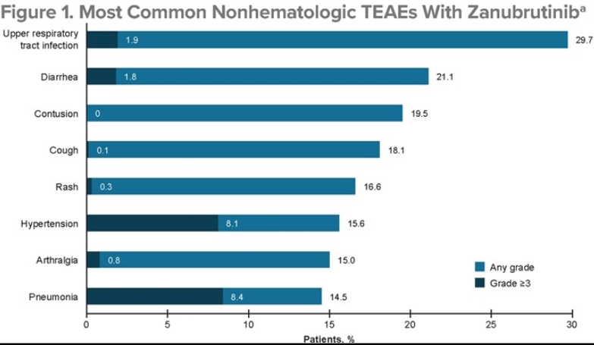
TEAS
Most common nonhematologic TEAEs with zanubrutinibª
The most common nonhematologic TEAEs in patients who received zanubrutinib were upper respiratory tract infection and diarrhea
No grade ≥3 TEAEs occurred in >10% of patients; the most common grade ≥3 TEAEs were pneumonia (8.4%) and hypertension (8.1%)
Serious AEs occurred in
49.2% of patients who received zanubrutinib
The only serious AE in ≥5% of patients in the pooled zanubrutinib population was pneumonia (8.2%)
29.7
21.1
19.5
18.1
16.6
15.6
15.0
14.5
Patients, %

Slide 207
EAIRs of AESIs
Cardiovascular EAIRs
Noncardiovascular EAIRs
Hypertension
Atrial fibrillation/ flutter
0.57ª
Infections
Hemorrhage
Neutropenia
Thrombo- cytopenia
Anemia
Second primary malignancies
6.01
0.82
5.40
6.64
P=.0098
1.08
2.49
3.00
0.15
3.00
0.20
0.64
P<.001
1.21
1.05
1.32
0.0
0.2
0.4
0.6
0.8
1.0
1.2
Persons per 100 person-months
0.59
◼︎ All zanubrutinib (N=1550)
◼︎ Zanubrutinib in ASPEN/ALPINE (n=425)^{b}
◼︎ Ibrutinib (N=422)^{b}
0.49
0.65
0.51
EAIRs of AESIs, including infections, with zanubrutinib were numerically lower than with ibrutinib in head-to-head comparisons of the ASPEN/ALPINE study populations, except for neutropenia
  EAIRs of atrial fibrillation and infections were significantly lower with zanubrutinib vs ibrutinib (P<.0001 and P=.0098, respectively)
  With the exception of ALPINE, EAIRs for hypertension with zanubrutinib were low (pooled EAIR <0.5 persons per 100 person-months) and consistent across studies
0.57
0.75
0.52
0.47
0.58
0.0
0.5
1.0
1.5
2.0
2.5
3.0
5.5
6.0
6.5
7.0
Persons per 100 person-months
◼︎ All zanubrutinib (N=1550)
◼︎ Zanubrutinib in ASPEN/ALPINE (n=425)^{b}
◼︎ Ibrutinib (N=422)^{b}

Slide 208
Prevalence of selected AESIs over time
15
Atrial fibrillation/flutter
25
Hypertension
The prevalence of AESIs tended to remain constant
or decrease over time with zanubrutinib
In head-to-head comparisons of the ASPEN/ALPINE study populations, hypertension tended to increase over time with ibrutinib, whereas it remained relatively stable with zanubrutinib
The prevalence of atrial fibrillation with zanubrutinib remained lower than with ibrutinib over time
Prevalence, %
20
10
Prevalence, %
15
5
10
5
0
≤12
>12 to 24
>24 to 36
>36
0
≤12
>12 to 24
>24 to 36
>36
Months
Months
50
Hemorrhage
30
Neutropenia
All zanubrutinib (N=1550)
Zanubrutinib in ASPEN/ALPINE (n=425)ª
Ibrutinib (N=422)ª
40
Prevalence, %
Prevalence, %
30
20
20
10
5
0
≤12
>12 to 24
>24 to 36
>36
0
≤12
>12 to 24
>24 to 36
>36
Months
Months
n= | 1550 | 1282 | 1040 | 698
n= | 425 | 384 | 288 | 125
n= | 422 | 348 | 240 | 107
n= | 1550 | 1282 | 1040 | 698
n= | 425 | 384 | 288 | 125
n= | 422 | 348 | 240 | 107

Slide 209
Conclusions
These pooled safety analyses showed that zanubrutinib is well tolerated in patients with B-cell malignancies, with TEAEs (upper respiratory tract infection, diarrhea, contusion) that were generally mild to moderate in severity
When comparing zanubrutinib vs ibrutinib in pooled head-to-head studies, rates of TEAEs or cardiac TEAEs leading to discontinuation were lower with zanubrutinib
  In pooled head-to-head comparisons, rates of death due to cardiac events were lower with zanubrutinib than ibrutinib (0.2% vs 1.7%), which is comparable to findings in the phase 3 ALPINE study
EAIRs for AESIs, especially for hypertension and atrial fibrillation/flutter, were lower with zanubrutinib than ibrutinib in head-to-head comparisons
In this pooled analysis, the EAIR for hypertension was largely influenced by data from ALPINE, which was an outlier from the rates observed in other studies of zanubrutinib
  Although hypertension rates were higher in ALPINE, cardiac events (eg, atrial fibrillation/flutter) were low and consistent with other zanubrutinib studies
The prevalence of AESIs tended to decrease over time, without the emergence of new safety signals
Due to the continuous dosing of BTKis in most B-cell malignancies, long-term tolerability and low treatment discontinuation rates with BTKis are important
These analyses support zanubrutinib as an appropriate long-term treatment option for patients with B-cell malignancies

Slide 210
BELLWAVE-001
Nemtabrutinib for the treatment of
B-Cell Malignancies

Slide 211
BELLWAVE-001: Study design
A Phase 1/2 open-label dose-expansion study of the efficacy and safety of nemtabrutinib for the treatment of B-cell malignancies
Expansion cohort
10-25 patients per cohort
Key Eligibility Criteria
Age 18 years
CLL/SLL with symptomatic disease
B-cell NHL with measurable disease
Relapsed or refractory disease after 2 prior therapies^{c}
WM with IgM level ≥2×ULN
ECOG PS 0-2
R/R CLL/SLL, C481S mutation (cohort A)ª
Until unacceptable toxicity, progression, withdrawal
CLL/SLL
R/R CLL/SLL, no C481S mutation (cohort B)^{b}
Nemtabrutinib RP2D
65 mg QD
RT
Endpoints
Primary: ORR per iwCLL criteria¹ in patients with CLL/SLL
Secondary: DoR, safety, and tolerability
Exploratory: PFS
FL
B-cell NHL
MCL
MZL
High-grade BCL
WM
R/R B-cell NHL, CLL/SLL, WM

Slide 212
ORR and BOR in patients with CLL
AF
 | CLL/SLL n=57 | Cohort A n=25 | Cohort B n=10 | Prior BTK and BCL2 inhibitors n=24 | BTK^{C481s} mutation n=36 | No IGHV mutation n=30 | del(17p) n=19
ORR, n (% [95% CI])ª | 32 (56 [42-69]) | 15 (60 [39-79]) | 4 (40 [12-74]) | 14 (58 [37-78]) | 21 (58 [41-75]) | 15 (50 [31-69]) | 10 (53 [29-76])
BOR, n (%)
CR | 2 (4) | 0 (0) | 1 (10) | 0 (0) | 1 (3) | 0 (0) | 1 (5)
PR | 15 (26) | 5 (20) | 2 (20) | 6 (25) | 11 (31) | 8 (27) | 2 (11)
PR-L | 15 (26) | 10 (40) | 1 (10) | 8 (33) | 9 (25) | 7 (23) | 7 (37)
SD | 16 (28) | 8 (32) | 4 (40) | 7 (29) | 10 (28) | 9 (30) | 4 (21)
PD | 1 (2) | 0 (0) | 1 (10) | 1 (4) | 0 (0) | 1 (3) | 1 (5)
NA | 8 (14) | 2 (8) | 1 (10) | 2 (8) | 5 (14) | 5 (17) | 4 (21)

Slide 213
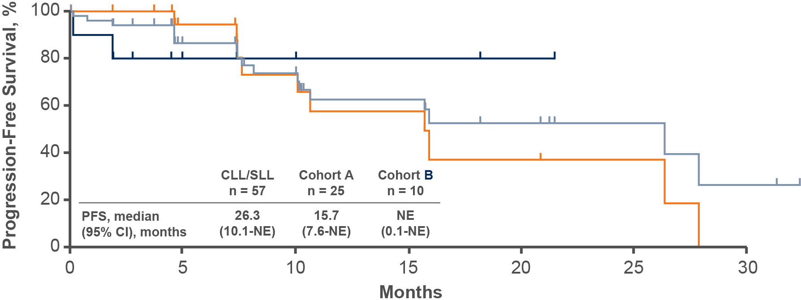
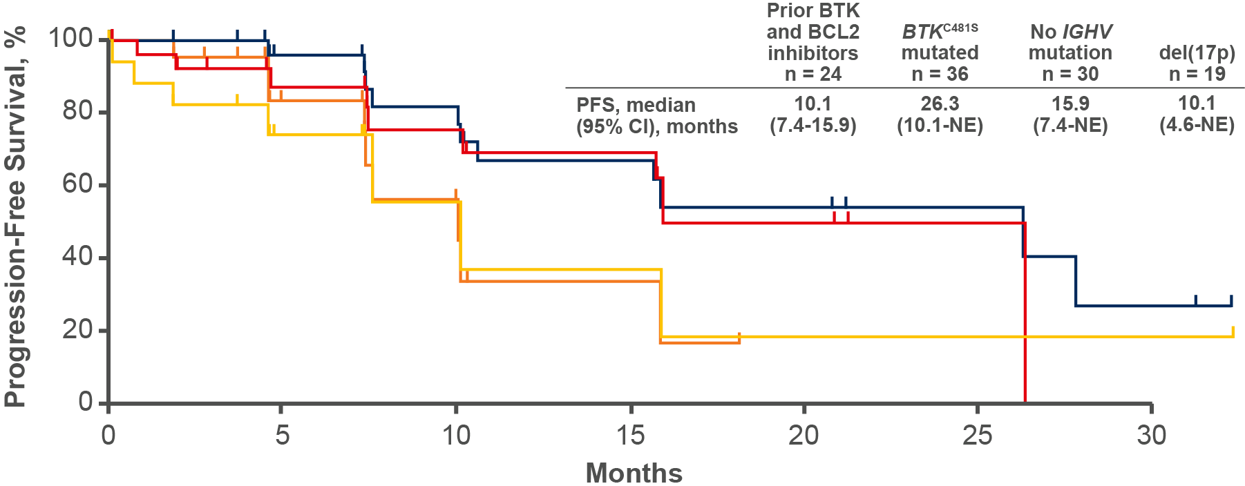
Progression-free survival
PFS in cohorts A and Bª
PFS in subgroups of patients with CLL/SLL
No. of patients
CLL/SLL | 57 | 30 | 21 | 15 | 8 | 4 | 0
Cohort A | 25 | 15 | 10 | 7 | 3 | 2 | 0
Cohort B | 10 | 4 | 2 | 2 | 1 | 0 | 0
No. of patients
Prior BTK and BCL2 inhibitors | 24 | 11 | 5 | 2 | 0 | 0 | 0
BTK^{C481S} mutated | 36 | 22 | 17 | 13 | 7 | 4 | 0
No IGHV mutation | 30 | 17 | 12 | 10 | 4 | 1 | 0
del(17p) | 19 | 6 | 3 | 2 | 1 | 1 | 0

Slide 214
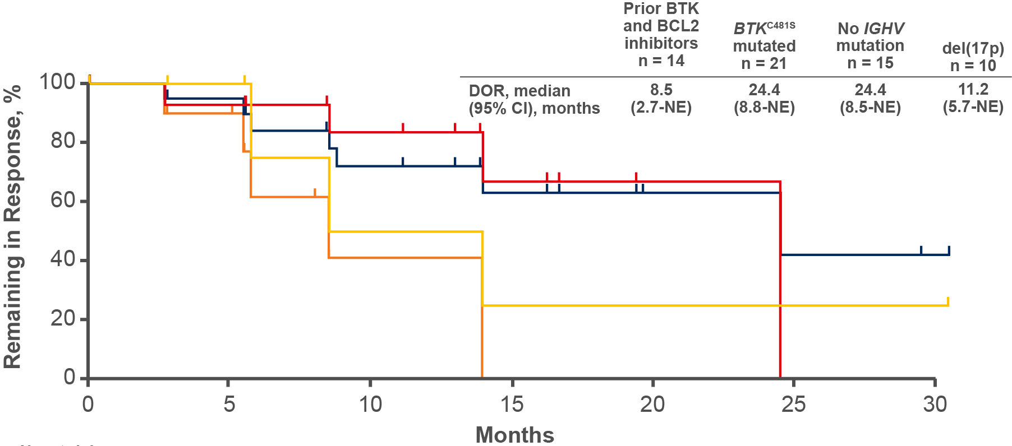
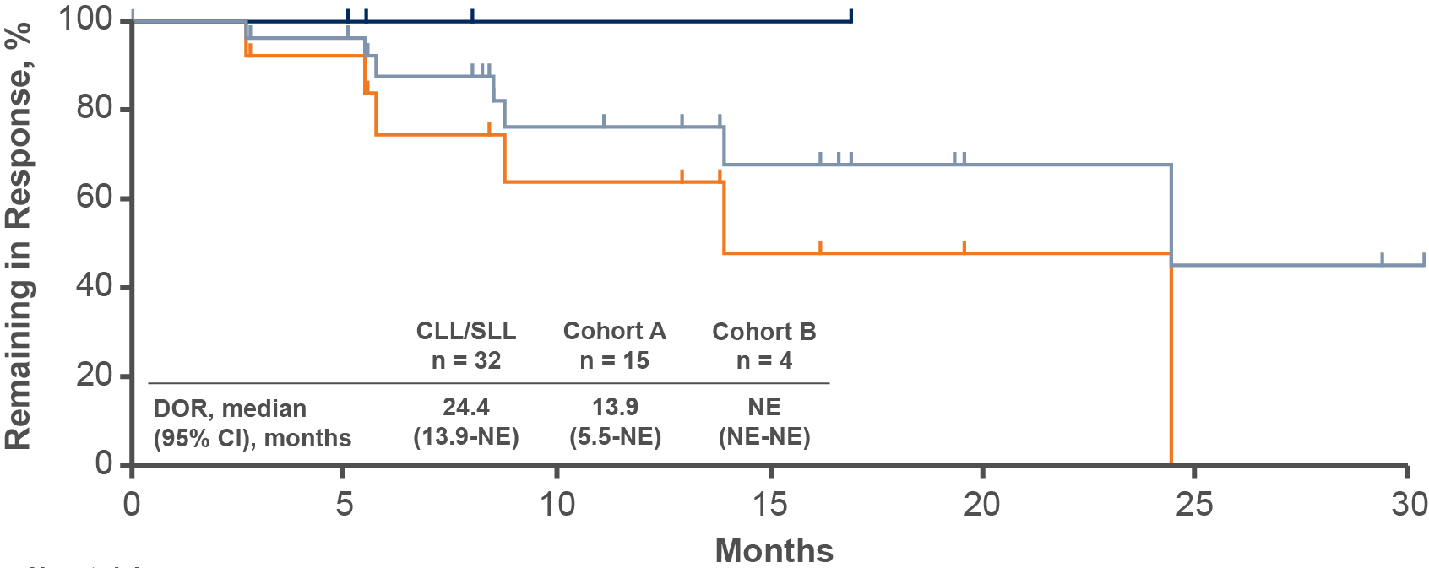
DoR
DoR in cohorts A and Bª
DoR in subgroups of patients with CLL/SLL
No. of patients
CLL/SLL | 32 | 25 | 13 | 8 | 3 | 2 | 0
Cohort A | 15 | 11 | 6 | 3 | 1 | 0 | 0
Cohort B | 4 | 4 | 1 | 1 | 0 | 0 | 0
No. of patients
Prior BTK and BCL2 inhibitors | 14 | 8 | 1 | 0 | 0 | 0 | 0
BTK^{C481S} mutated | 21 | 18 | 12 | 7 | 3 | 2 | 0
No IGHV mutation | 15 | 13 | 9 | 4 | 1 | 0 | 0
del(17p) | 10 | 5 | 2 | 1 | 1 | 1 | 0

Slide 215
Treatment-related adverse events
 | All patients at 65 mg QD (N=112)
 | All | Grade ≥3ª
Any treatment-related AEs | 82 (73) | 45 (40)
Treatment-related AEs ≥5%
Dysgeusia | 23 (21) | 0 (0)
Neutrophil count decreased | 22 (20) | 19 (17)
Fatigue | 14 (13) | 2 (2)
Platelet count decreased | 13 (12) | 5 (4)
Nausea | 13 (12) | 0 (0)
Hypertension | 11 (10) | 4 (4)
Diarrhea | 11 (10) | 2 (2)
Pyrexia | 9 (8) | 2 (2)
Constipation | 8 (7) | 0 (0)
Vomiting | 7 (6) | 0 (0)
Arthralgia | 6 (5) | 0 (0)
Dizziness | 6 (5) | 0 (0)
Rash maculopapular | 6 (5) | 3 (3)

Slide 216
Adverse events of special interest
AESI ≥5 patients | All patients at 65 mg QD N=112
Hypertension | 34 (30)
Arthralgia | 22 (20)
Rash maculopapular | 16 (14)
Pneumonia | 16 (14)
Rash | 14 (13)
Upper respiratory tract infection | 13 (12)
Cellulitis | 8 (7)
Urinary tract infection | 8 (7)
Sinusitis | 8 (7)
Sepsis | 6 (5)
Atrial fibrillation | 5 (4)
COVID-19 | 5 (4)
Oral candidiasis | 5 (4)
Rhinovirus infection | 5 (4)

Slide 217
Conclusions
Nemtabrutinib at the RP2D of 65 mg QD continued to show promising and durable antitumor activity with
a manageable AE profile in a R/R population of patients who had prior therapy with novel agents
The efficacy of nemtabrutinib was promising and warrants further investigation in the subgroup of patients with CLL/SLL previously treated with BTK and BCL2 inhibitors

Slide 218
BRUIN
Pirtobrutinib in R/R B-cell malignancies:
long-term safety analysis

Slide 219
BRUIN: Study design
Phase 1/2 dose escalation + expansion study of pirtobrutinib in patients with R/R B-cell malignancies.
Patients who received ≥12 months of treatment were included in a post-hoc safety analysis
Eligibility
Age ≥18
ECOG PS 0-2
Active disease and in need of treatment
Previously treated
Eligibility permitted with:
  Cardiac comorbidities including prior atrial fibrillationª
  Ongoing anti-coagulation/anti-platelet treatment^{b}
Key endpoints Phase 1/2 BRUIN study
Safety/tolerability
Determine MTD and recommended Phase 2 dose
Pharmacokinetics
Efficacy according to ORR and DoR (Lugano) as assessed by investigator
Phase 1 escalation + expansion
(25 to 300 mg QD)
Overall safety population
N=773
≥12 months treatment
N=326
Clinical safety analysis in long-term patients
Median time to onset, dose reduction, discontinuation, and EAIRs were determined for TEAEs that occurred in ≥15% of patients and select AESIs associated with BTKi.
Phase 2
(200 mg QD)

Slide 220
Treatment-emergent adverse events
 | ≥12 months treatment (N=326) |  | All patients (N=773)
Treatment-emergent AEs (≥15%) | Any grade TEAE, % | Grade ≥3 TEAE, % | Any grade TEAE, % | Grade ≥3 TEAE, %
Fatigue | 32.2 | 1.2 | 28.7 | 2.1
Diarrhea | 30.7 | 1.2 | 24.2 | 0.9
Neutropeniaª | 29.8 | 23.9 | 25.0 | 20.3
Covid-19 | 28.5 | 4.3 | 16.7 | 2.7
Contusion | 25.8 | 0 | 19.4 | 0
Cough | 24.5 | 0 | 17.5 | 0.1
Back pain | 20.9 | 0.9 | 12.7 | 0.5
Headache | 18.4 | 0.6 | 13.1 | 0.5
Upper respiratory tract infection | 18.1 | 0 | 9.8 | 0.1
Nausea | 17.5 | 0.3 | 16.2 | 0.1
Dyspnea | 17.2 | 0.6 | 15.5 | 1.0
Abdominal pain | 16.3 | 0.9 | 13.1 | 1.0
Constipation | 16.3 | 0 | 13.6 | 0.3

Slide 221
Adverse events of special interestª
All patients (n=773)
Long-term patients (n=326)
Among the patients with ≥12 months treatment:
Most TEAEs and AEs of special interest were low grade and did not lead to dose reduction or discontinuation
42% of the patients with treatment-emergent hypertension had a pre-existing medical history of hypertension
In total, across all TEAEs, dose reduction or discontinuation occurred in 23 (7%) and 11 (3%) patients, respectively
With additional treatment, the rates of selected AEs of special interest did not show clinically meaningful increases, particularly grade ≥3
Bruising^{b}
Arthralgia
Rash^{c}
Hemorrhage/Hematoma^{d}
Hypertension
◼︎ Any grade
◼︎ Grade ≥3
Atrial fibrillation/flutter^{e}
50
40
30
20
10
0
10
20
30
40
50
Percentage

Slide 222
Time to first occurrence of TEAEs and AESIs
Median (min, max)
The median times for first occurrence of most common and select TEAEs were generally within the first
12 months of treatment initiation
Fatigue
5.1 (0.0, 28.9)
Diarrhea
4.2 (0.0, 27.6)
COVID-19
14.3 (0.0, 35.5)
Contusion
2.1 (0.0, 35.0)
Cough
8.1 (0.1, 28.3)
Back pain
5.5 (0.0, 32.9)
Treatment-emergent AEs
Headache
6.6 (0.0, 29.3)
Upper respiratory tract infection
9.5 (0.3, 27.0)
Nausea
2.1 (0.0, 26.3)
Dyspnea
6.0 (0.0, 24.7)
Neutrophil count decreased
6.4 (0.0, 31.3)
Abdominal pain
9.7 (0.1, 29.3)
Constipation
5.3 (0.0, 27.2)
Bruising^{b}
1.9 (0.0, 28.3)
Arthralgia
7.4 (0.0, 34.2)
AEs of
special interestª
Rash^{c}
2.4 (0.0, 28.6)
Hemmorhage/Hematoma^{d}
5.8 (0.0, 24.6)
Hypertension
6.9 (0.0, 22.5)
Atrial fibrillation/flutter^{e}
10.2 (1.3, 24.8)
0
10
20
30
40
Time to first occurence of AE, months

Slide 223
EAIRsª for AESIs
AEs of special interest^{b} | ≥12 months treatment (N=326) |  | All patients (N=773)
 | TEAE incidence rate | TRAE incidence rate | TEAE incidence rate | TRAE incidence rate
Bruising^{c} | 1.99 | 1.21 | 2.69 | 1.55
Arthralgia | 1.16 | 0.23 | 1.41 | 0.31
Rash^{d} | 1.27 | 0.44 | 1.11 | 0.55
Hemorrhage/ hematoma^{e} | 0.87 | 0.30 | 1.07 | 0.36
Hypertension | 0.85 | 0.23 | 0.87 | 0.30
Atrial fibrillation/ flutter^{f} | 0.13 | 0.04 | 0.25 | 0.07
Prolonged treatment with pirtobrutinib did not lead to an increase in EAIRs of most TEAEs or TRAEs of special interest

Slide 224
Treatment modifications due to TRAEs
 | ≥12 months treatment (N=326) | All patients (N=773)
Median time on treatment, months (IQR) | 19.4 (16.0, 25.4) | 9.6 (3.5, 18.1)
Discontinuations due to TRAEs, n (%) | 4 (1.2) | 20 (2.6)
Dose reductions due to TRAEs, n (%) | 18 (5.5) | 35 (4.5)
Among the patients who received ≥12 months treatment:
Median time on treatment was 19.4 months, with 231 (71%) patients remaining on pirtobrutinib at data cutoff
4 (1%) patients discontinued due to a TRAE (platelet count decreased, COVID-19 pneumonia, neutropenia, pneumonitis)
1 patient experienced a fatal TRAE (COVID-19 pneumonia)
Treatment discontinuation and dose reduction rates were similar between the overall safety population and for patients who received ≥12 months treatment

Slide 225
Conclusions
In this post-hoc safety analysis in patients who received pirtobrutinib for ≥12 months:
  The safety and tolerability profile observed was similar to previously published safety analyses on all patients enrolled regardless of follow-up
  With continued therapy, low incidence of grade ≥3 AEs and few dose modifications were observed
Prolonged pirtobrutinib therapy continues to demonstrate a safety profile amenable to long-term administration at the recommended dose without evidence of new or worsening toxicity signals

Slide 226
Preclinical study of BTK protein degrader, BGB-16673
Resistance mutations analysis

Slide 227
BGB-16673 CDAC mechanism of action
A
Ternary complex formation
BGB-16673 is an orally available chimeric degradation activating compound (CDAC) with demonstrated preclinical BTK degradation activity
BGB-16673
Ub
E2
BTK
E3
B
Polyubiquitination
E2
BTK
E3
Ub
Ub
Ub
Ub
E2
E3
BTK
Ub
Ub
Ub
Ub
C
Target degradation

Slide 228
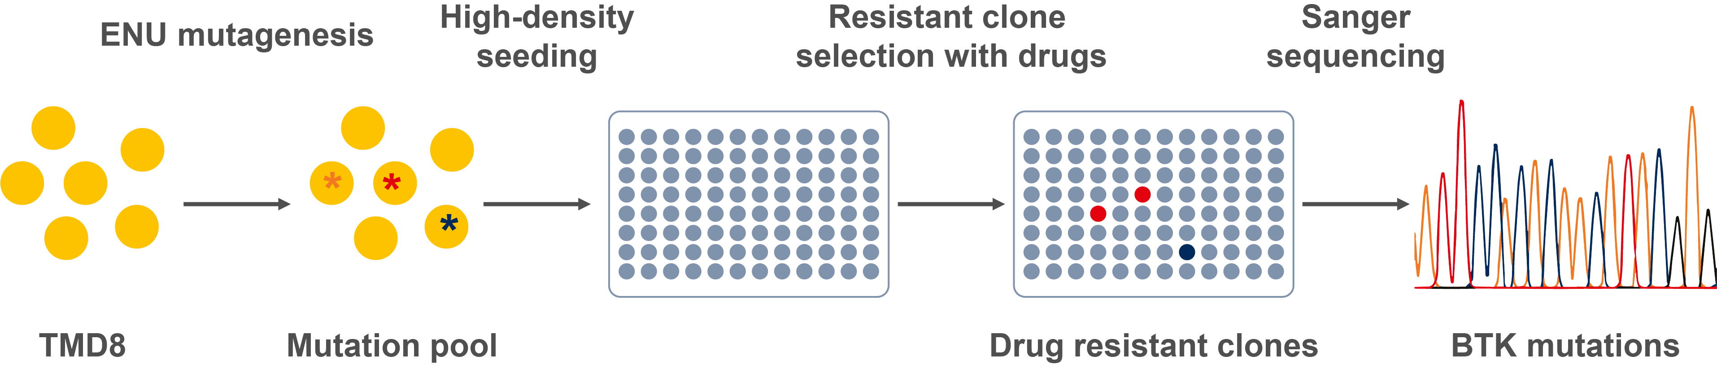
ENU mutagenesis screen: procedure
a
ENU mutagenesis screens were used to characterize the profile and tendency of BGB-16673 to cause on-target BTK resistance mutations as compared with non-covalent BTKi

Slide 229
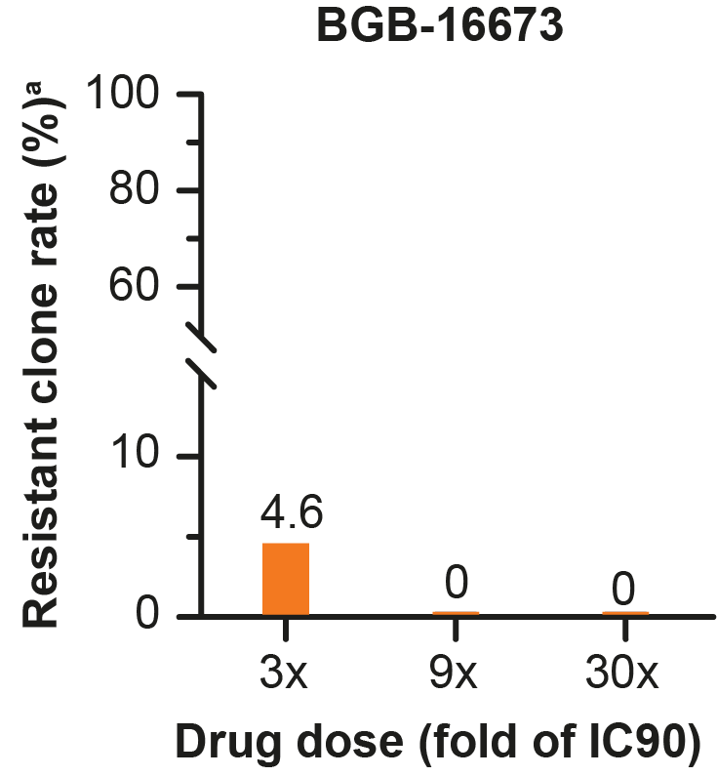
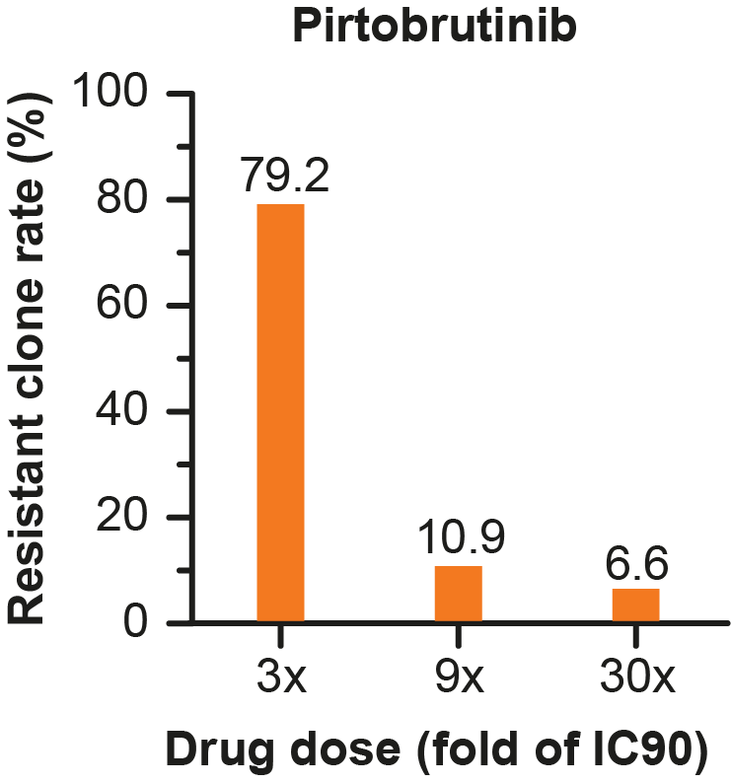
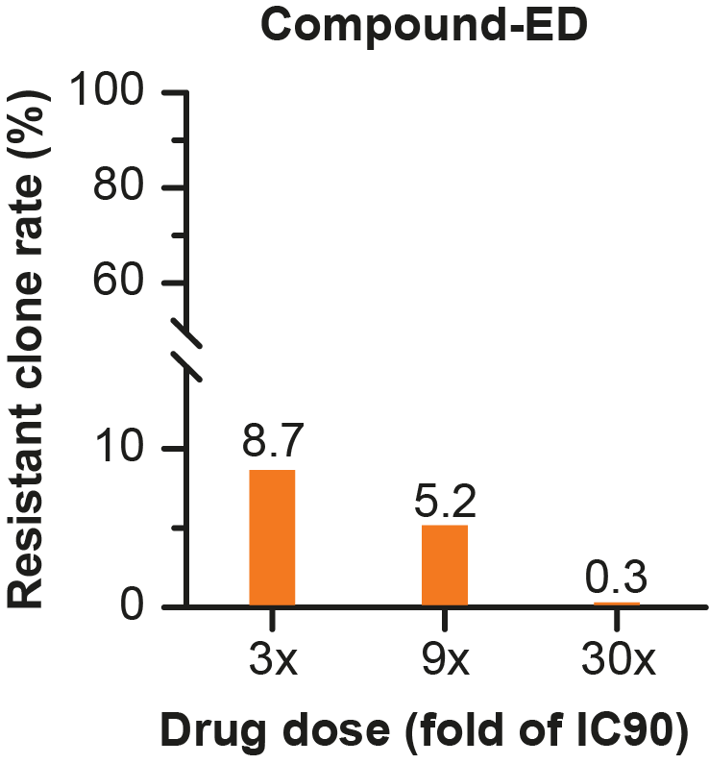
Resistant clone rates and BTK mutation frequencies
In ENU mutagenesis screens, fewer resistant clones and lower BTK mutation frequency were seen with BTK CDAC treatment as compared to non-covalent BTKi treatment
Drug dose (fold of IC₉₀)
Drug dose (fold of IC₉₀)
Drug dose (fold of IC₉₀)
Compound | BGB-16673 (BTK CDAC) | Compound-ED (E3 dead non-covalent control) | Pirtobrutinib (non-covalent inhibitor)
BTK mutation frequency^{b}, % | 12.7 (7/55) | 100 (80/80) | 100 (144/144)

Slide 230
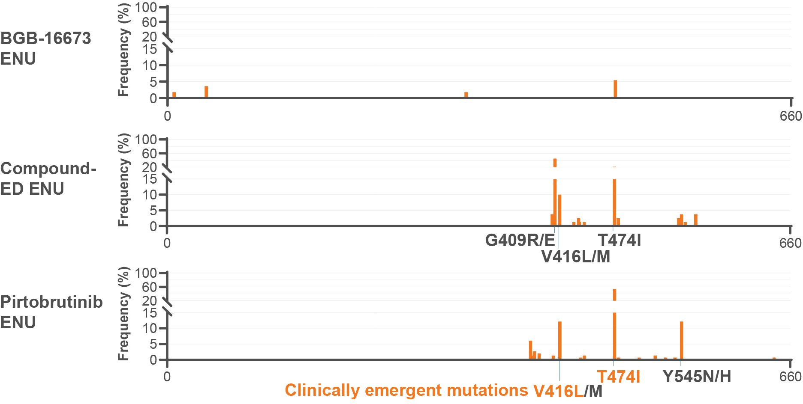
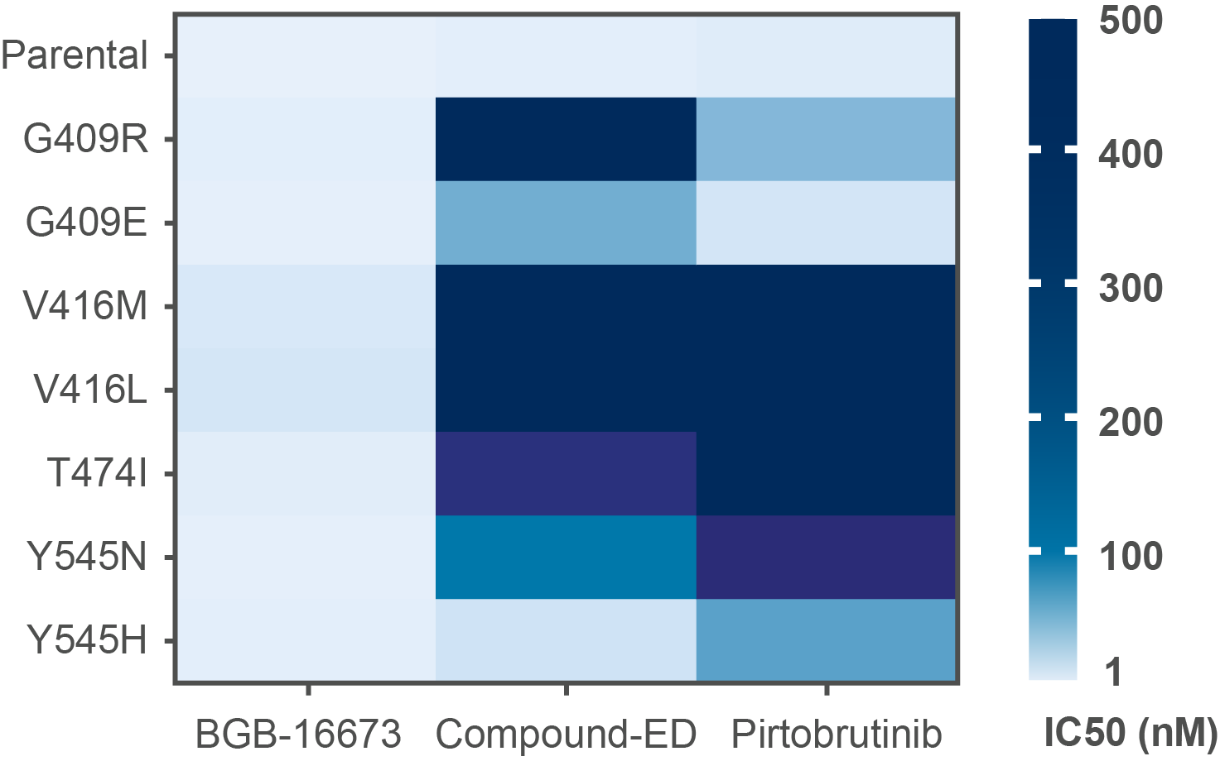
BTK mutation spectrums
BTK cDNA sequencing analysis
Average IC₅₀ in ENU clones with the same BTK mutation
IC₅₀ (nM)
v
BGB-16673 appears to have a unique BTK resistance mutation profile vs pirtobrutinib. Much fewer BTK mutants appeared in BGB-16673 resistant clones
No BTK mutations with frequency >10% were observed in the BGB-16673 arm. In comparison, more clones resistant to pirtobrutinib had mutations in BTK
BGB-16673 was more potent against BTK mutations derived from compound-ED and pirtobrutinib screens

Slide 231
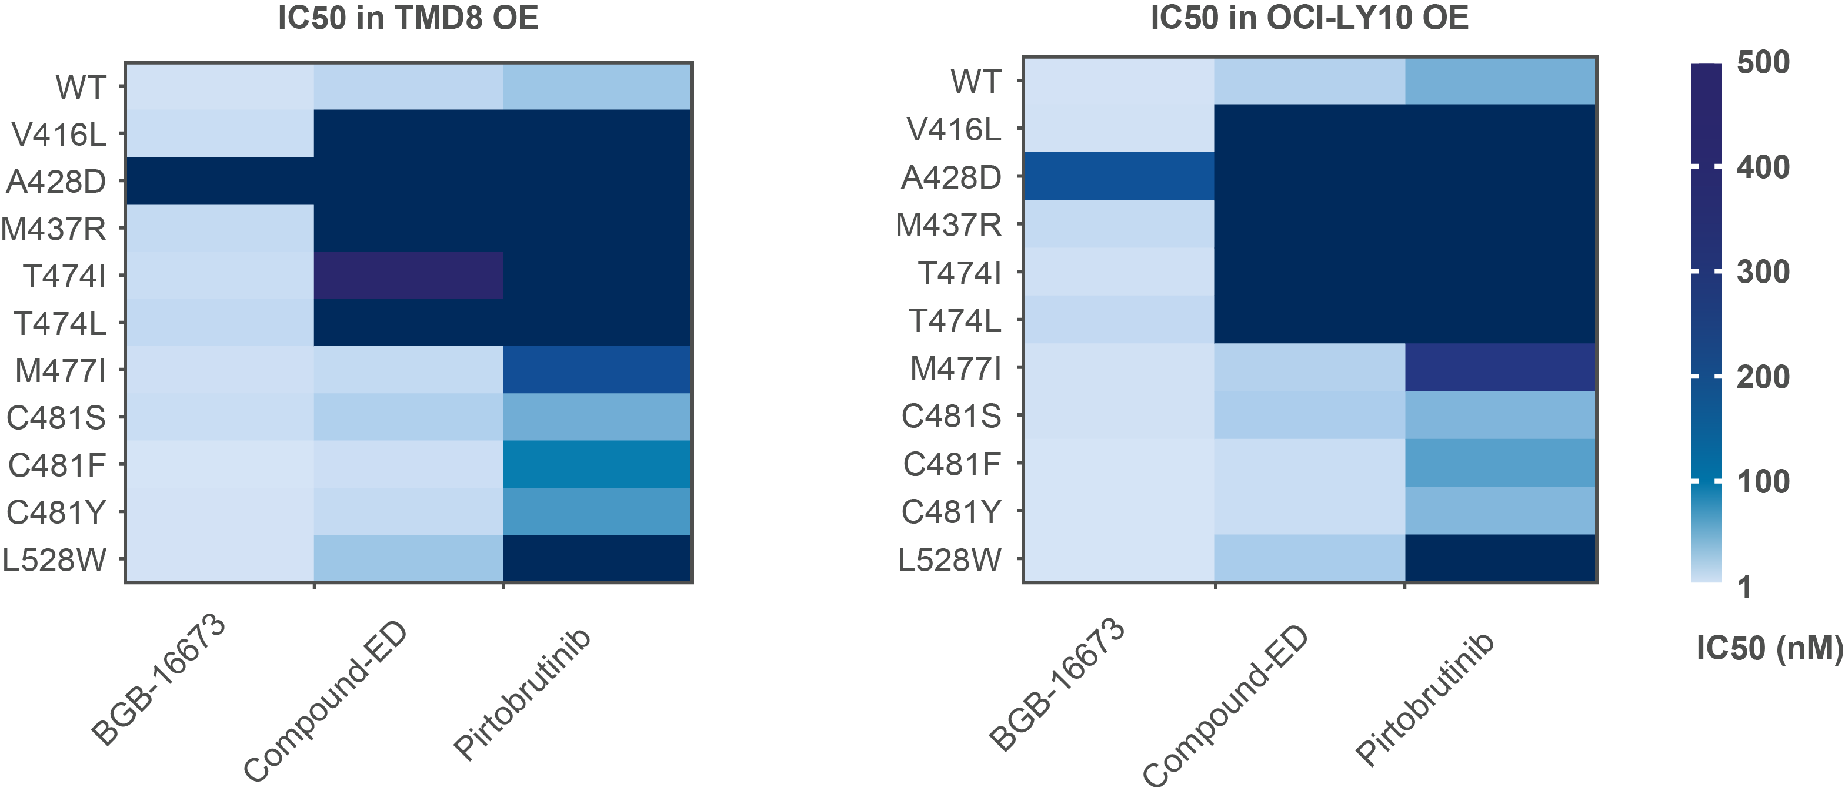
Average IC₅₀ in BTK-mutant overexpression cell lines
IC₅₀ in TMD8 OE
IC₅₀ in OCI-LY10 OE
BGB-16673 could overcome all BTK resistance mutations from both covalent and non-covalent BTKi trials, except A428D which was tested to be resistant to all BTKis
IC₅₀ (nM)
v

Slide 232
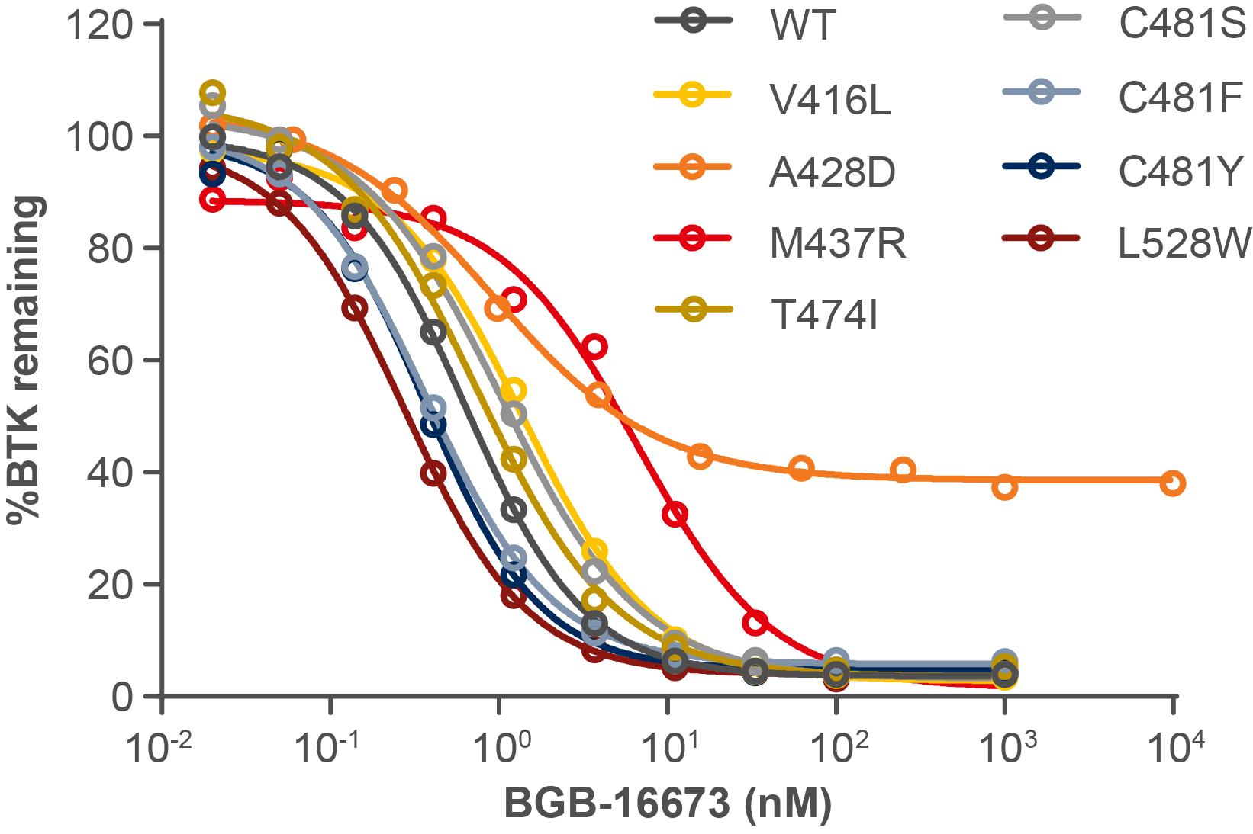
Degradation of BTK mutants by BGB-16673
BTK degradation was evaluated in TMD8 overexpression cell lines by HTRF assay
BGB-16673 could degrade BTK in the presence of clinically-relevant resistance mutations
% BTK remaining
v
BGB-16673 treatment time | Degradation | WT | V416L | A428D | M437R | T474I | C481S | C481F | C481Y | L528W
24 h | DC50, nM | 0.7 | 1.4 | 4.1 | 6.8 | 0.8 | 1.1 | 0.4 | 0.4 | 0.3
 | Dmax, % | 96 | 97 | 62 | 98 | 95 | 96 | 94 | 95 | 96

Slide 233
Conclusions
Relative to BTKis, the BTK CDAC BGB-16673 is less apt to cause on-target resistance mutations and demonstrated a unique BTK resistance mutation profile
BGB-16673 could overcome a wide variety of BTK resistance mutations derived from both ENU mutagenesis screens and relapsed patients
These findings suggest that BGB-16673 is a promising novel BTK degrader that could benefit patients who develop BTKi on-target resistance mutations
Further studies exploring the dominant BGB-16673 resistance mechanisms not reliant on BTK are in progress

Slide 234
Preclinical study of BTK protein degrader, BGB-16673
Overcoming resistance from BTKis

Slide 235
Background
Frequently acquired BTK resistant mutations at cysteine 481 and other mutations limit long-term clinical benefit of BTKis
Agents which could tackle resistance mutations from both covalent and non-covalent BTKis may provide novel treatment options
BGB-16673 is an orally available BTK-targeting chimeric degradation activation (BTK-CDAC) compound designed to degrade wildtype BTK and multiple mutant forms
Here, the capability of BGB-16673 to overcome commonly observed on-target mutations from BTKis was investigated in cell lines and mouse xenograft models. Additionally, mouse xenograft models were used to examine whether BGB-16673 is superior to BTKis in suppressing tumor growth and metastasis

Slide 236
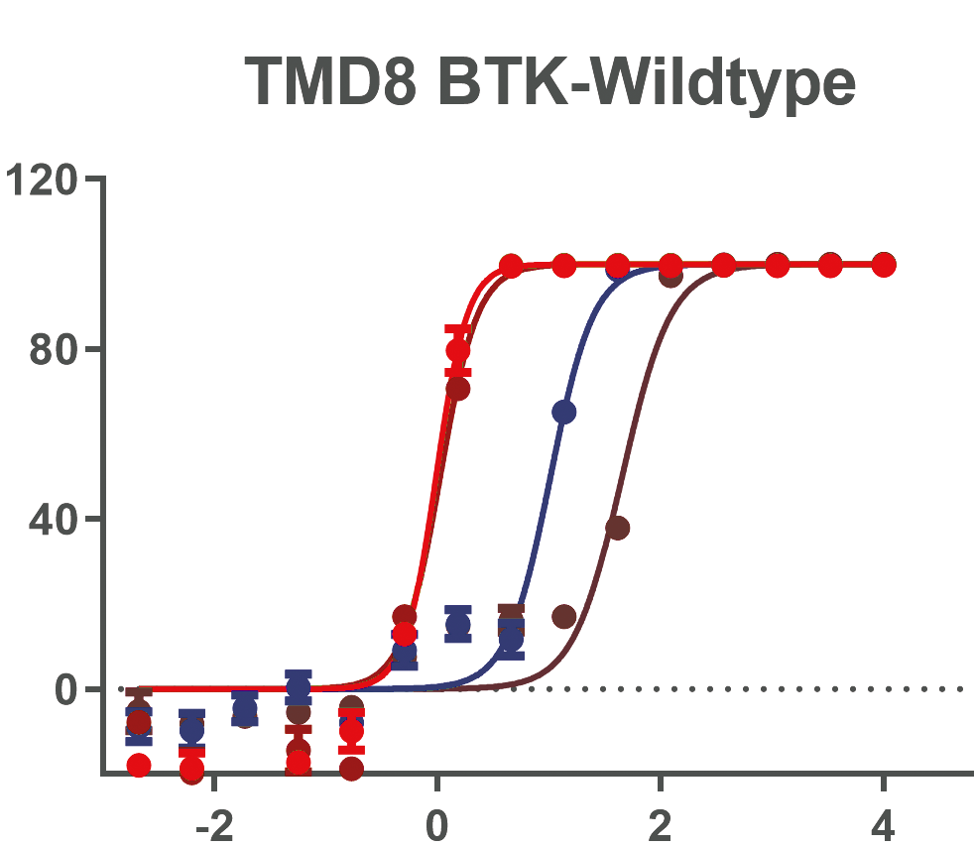
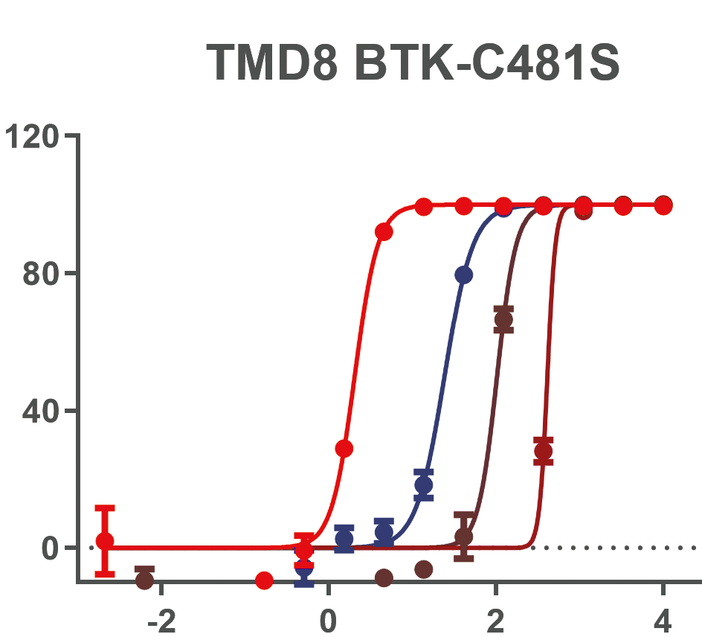





BGB-16673 potency in vitro
TMD8 lymphoma cells expressing WT or mutant BTK were incubated for 5 days with different concentrations of BGB-16673 and BTKis, and cell viability was measured by CTG assay
TMD8 cells with different BTK formats | IC_{50,} nM
 | BGB- 16673 | lbrutinib | Pirtobrutinib | ARQ- 531
WT | 0.9707 | 1.053 | 10.30 | 45.12
C481S | 2.041 | ~411.0 | 24.28 | 103.0
C481F | 0.5327 | 296.1 | 54.44 | 9.425
C481Y | 0.1803 | 161.3 | 15.95 | 9.627
T474I | 1.849 | 3.720 | 1515 | 150.6
L528W | 0.168 | 226.2 | 3940 | 95.11
Proliferation inhibition, %
Proliferation inhibition, %
Proliferation inhibition, %
Log concentration (nM)
Log concentration (nM)
Log concentration (nM)
Proliferation inhibition, %
Proliferation inhibition, %
Proliferation inhibition, %
Log concentration (nM)
Log concentration (nM)
Log concentration (nM)
BGB-16673 exhibits high potency (single-digit nM IC₅₀) in cancer cells expressing clinically-relevant BTK mutants resistant to covalent and non-covalent BTKis

Slide 237
BGB-16673 antitumor activity in mouse xenograft models
NCG mice were subcutaneously injected with WT or mutant BTK-expressing TMD8 lymphoma cells
TMD8 BTK-Wildtype
Groups | TGI (% at day 11) | P
BGB-16673, 6 mpk | 72 | <0.0001
BGB-16673, 20 mpk | 104 | <0.0001
TMD8 BTK-C481S
Groups | TGI (% at day 11) | P
BGB-16673, 6 mpk | 65 | <0.0001
BGB-16673, 20 mpk | 108 | <0.0001
BGB-16673 drives complete tumor regression of lymphoma xenograft models expressing WT or BTK mutations resistant to covalent and non-covalent inhibitors
–– Vehicle
–– BGB-16673, 6 mpk, QD
–– BGB-16673, 20 mpk, QD
–– Vehicle
–– BGB-16673, 6 mpk, QD
–– BGB-16673, 20 mpk, QD
TMD8 BTK-T474I
Groups | TGI (% at day 17) | P
BGB-16673, 20 mpk | 96 | <0.0001
BGB-16673, 30 mpk | 106 | <0.0001
Pirtobrutinib, 50 mpk | 42 | 0.02
TMD8 BTK-L528W
Groups | TGI (% at day 9) | P
BGB-16673, 6 mpk | 96 | <0.0001
BGB-16673, 20 mpk | 97 | <0.0001
Pirtobrutinib, 50 mpk | 43 | 0.006
–– Vehicle
–– BGB-16673, 20 mpk, QD
–– BGB-16673, 30 mpk, QD
–– Pirtobrutinib, 50 mpk BID
–– Vehicle
–– BGB-16673, 6 mpk, QD
–– BGB-16673, 20 mpk, QD
–– Pirtobrutinib, 50 mpk BID

Slide 238
Duration of response in mouse xenograft models
3000
TMD8 BTK-wildtype tumor growth
BGB-16673 presents longer duration of response than BTKis in BTK WT and C481S mutant-expressing lymphoma xenograft models
2000
Tumor volume,
mm³ mean ± SEM
–– Vehicle
–– BGB-16673, 6 mpk, QD
–– BGB-16673, 10 mpk, QD
–– BGB-16673, 20 mpk, QD
–– Ibrutinib, 100 mpk, QD
–– Pirtobrutinib, 30 mpk, BID
–– Pirtobrutinib, 50 mpk, BID
1000
400
200
0
0
0
20
40
60
80
Treatment days
Day 75
3000
TMD8 BTK-C481S tumor growth
2000
Tumor volume,
mm³ mean ± SEM
–– Vehicle
–– BGB-16673, 10 mpk, QD
–– BGB-16673, 20 mpk, QD
–– BGB-16673, 30 mpk, QD
–– Ibrutinib, 100 mpk, QD
–– Pirtobrutinib, 30 mpk, BID
–– Pirtobrutinib, 50 mpk, BID
1000
400
200
0
0
0
20
40
60
80
Treatment days
Day 69

Slide 239





Survival rates and tumor infiltration
Groups | TMD8 BTK-Wildtype
 | TGI (% at day 12) | P (day 12 vs pirtobrutinib 50 mpk) | Survival rate (day 70 survived/total) | Day 70 CR/survived | Splenomegaly mice (day 70 Spl./survived)
BGB-16673, 6 mpk | 99 | 0.2847 | 1/8 | 1/1 | 1/1
BGB-16673, 10 mpk | 100 | 0.1289 | 8/8 | 8/8 | 6/8
BGB-16673, 20 mpk | 101 | 0.0596 | 8/8 | 8/8 | 1/8
Ibrutinib, 100 mpk | 99 | 0.2491 | 1/8 | 0/1 | 1/1
Pirtobrutinib, 30 mpk | 94 | 0.573 | 1/8 | 1/1 | 1/1
Pirtobrutinib, 50 mpk | 97 | – | 6/8 | 5/6 | 6/6
Groups | TMD8 BTK-C481S
 | TGI (% at day 14) | P (day 14 vs pirtobrutinib 50 mpk) | Survival rate (day 69 survived/total) | Day 69 CR/survived | Splenomegaly mice (day 69 Spl./survived)
BGB-16673, 10 mpk | 104 | 0.5235 | 0/8 | 0 | NA
BGB-16673, 20 mpk | 106 | 0.0697 | 7/8 | 5/7 | 3/7
BGB-16673, 30 mpk | 106 | 0.0223 | 8/8 | 8/8 | 2/8
Ibrutinib, 100 mpk | 10 | <0.0001 | 0/8 | 0 | NA
Pirtobrutinib, 30 mpk | 103 | 0.5764 | 3/8 | 2/3 | 3/3
Pirtobrutinib, 50 mpk | 103 | - | 7/8 | 5/7 | 7/7
BGB-16673 has better survival rates and less metastatic tumor infiltration in spleens than BTKis in long-term treatment in BTK WT and C481S mutant-expressing lymphoma xenograft models

Slide 240
Conclusions
BGB-16673 is a potent degrader against tumors expressing wildtype and clinical-relevant BTK mutations
BGB-16673 exhibits longer duration of response and less metastatic infiltration to the spleen than ibrutinib and pirtobrutinib in mouse xenograft models

