Slide 1
ASH 2023
Congress Report
BTKi and Bcl2i in CLL

Slide 2
Contents (i)
Slide numbers | Study | Abstract Number | Presenter
4-12 | Extended follow-up of ALPINE randomized Phase 3 study confirms sustained superior progression-free survival of zanubrutinib versus ibrutinib for treatment of relapsed/refractory chronic lymphocytic leukemia and small lymphocytic lymphoma (R/R CLL/SLL) | 202 | Jennifer Brown
13-21 | Acquired Mutations in Patients (Pts) with Relapsed/Refractory (R/R) Chronic Lymphocytic Leukemia (CLL) That Progressed in the ALPINE Study | 1890 | Jennifer Brown
22-28 | Extended Follow-up and Resistance Mutations in CLL Patients Treated with Acalabrutinib | 1891 | Clare Sun
29-37 | Broad superiority of zanubrutinib (zanu) over bendamustine + rituximab (BR) across multiple high-risk factors: Biomarker subgroup analysis in the Phase 3 SEQUOIA study in patients with treatment-naive (TN) chronic lymphocytic leukemia (CLL)/small lymphocytic lymphoma (SLL) without del(17p) | 1902 | Linlin Xu
38-45 | Pirtobrutinib in Post-cBTKi CLL/SLL: ~30 Months Follow-up and Subgroup Analysis With/Without Prior BCL2i from the Phase 1/2 BRUIN Study | 325 | Jennifer A. Woyach
46-53 | Fixed-Duration Pirtobrutinib Combined with Venetoclax ± Rituximab in Relapsed/Refractory Chronic Lymphocytic Leukemia: Updated Results, Including MRD Data, from the BRUIN Phase 1b Study | 3269 | Lindsey E. Roeker

Slide 3
Contents (ii)
Slide numbers | Study | Abstract Number | Presenter
54-63 | Ibrutinib Plus Venetoclax with MRD-Directed Duration of Treatment Is Superior to FCR and Is a New Standard of Care for Previously Untreated CLL: Report of the Phase III UK NCRI FLAIR Study | 631 | Peter Hillmen
64-73 | Acalabrutinib ± Obinutuzumab Vs Obinutuzumab + Chlorambucil in Treatment-Naive Chronic Lymphocytic Leukemia: 6-Year Follow-up of ELEVATE-TN | 636 | Jeff P. Sharman
74-81 | Combination treatment with sonrotoclax (BGB-11417), a second-generation Bcl2 inhibitor, and zanubrutinib, a Bruton tyrosine kinase (BTK) inhibitor, is well tolerated and achieves deep responses in patients with treatment-naïve chronic lymphocytic leukemia/small lymphocytic lymphoma (TN-CLL/SLL): Data from an ongoing Phase 1/2 study | 327 | Constantine S. Tam
82-88 | Updated Efficacy and Safety Results of Lisaftoclax (APG-2575) in Patients (Pts) with Heavily Pretreated Chronic Lymphocytic Leukemia (CLL): Pooled Analyses of Two Clinical Trials | 1900 | Keshu Zhou
89-95 | Preliminary results from BGB-16673-101, a first-in-human study of the Bruton’s tyrosine kinase (BTK) degrader BGB-16673 in patients (pts) with relapsed or refractory (R/R) B-cell malignancies | 4401 | John Seymour
96-104 | A First-in-Human Phase 1 Trial of NX-2127, a First-in-Class Bruton's Tyrosine Kinase (BTK) Dual-Targeted Protein Degrader with Immunomodulatory Activity, in Patients with Relapsed/Refractory B Cell Malignancies | 4463 | Alexey Danilov

Slide 4
ALPINE
Zanubrutinib vs ibrutinib in R/R CLL:
Extended follow-up

Slide 5
ALPINE study design
A randomized Phase 3 study of zanubrutinib compared with ibrutinib in patients with R/R CLL/SLL
R/R CLL/SLL with ≥ 1 prior treatment
(N=652)
Key inclusion criteria
R/R to ≥1 prior systemic therapy for CLL/SLL
Measurable lymphadenopathy by CT or MRI
Requires treatment per iwCLL
Key exclusion criteria
Prior BTK inhibitor therapy
Treatment with warfarin or other vitamin K antagonists
Patient disposition at extended follow-up
Zanubrutinib
160 mg BID
Randomised (N=652)
Zanubrutinib (n=327)
Ibrutinib (n=325)
R
1:1
Not treated (n=3)
Not treated (n=1)
Ibrutinib
420 mg QD
Discontinued (N=130)
AE (n=69)
PD (n=51)
Withdrawal by patient (n=7)
Lost to follow-up/other (n=3)
Discontinued (N=172)
AE (n=88)
PD (n=62)
Withdrawal by patient (n=15)
Physician decision (n=6)
Lost to follow-up/other (n=1)
Treatment until disease progression or unacceptable toxicity
Stratification factors:
Age, geographic region, refractoriness, del(17p)/TP53
Treatment ongoing (n=194, 59%)
Median follow-up: 40.3 months
Treatment ongoing (n=152, 47%)
Median follow-up: 38.7 months

Slide 6
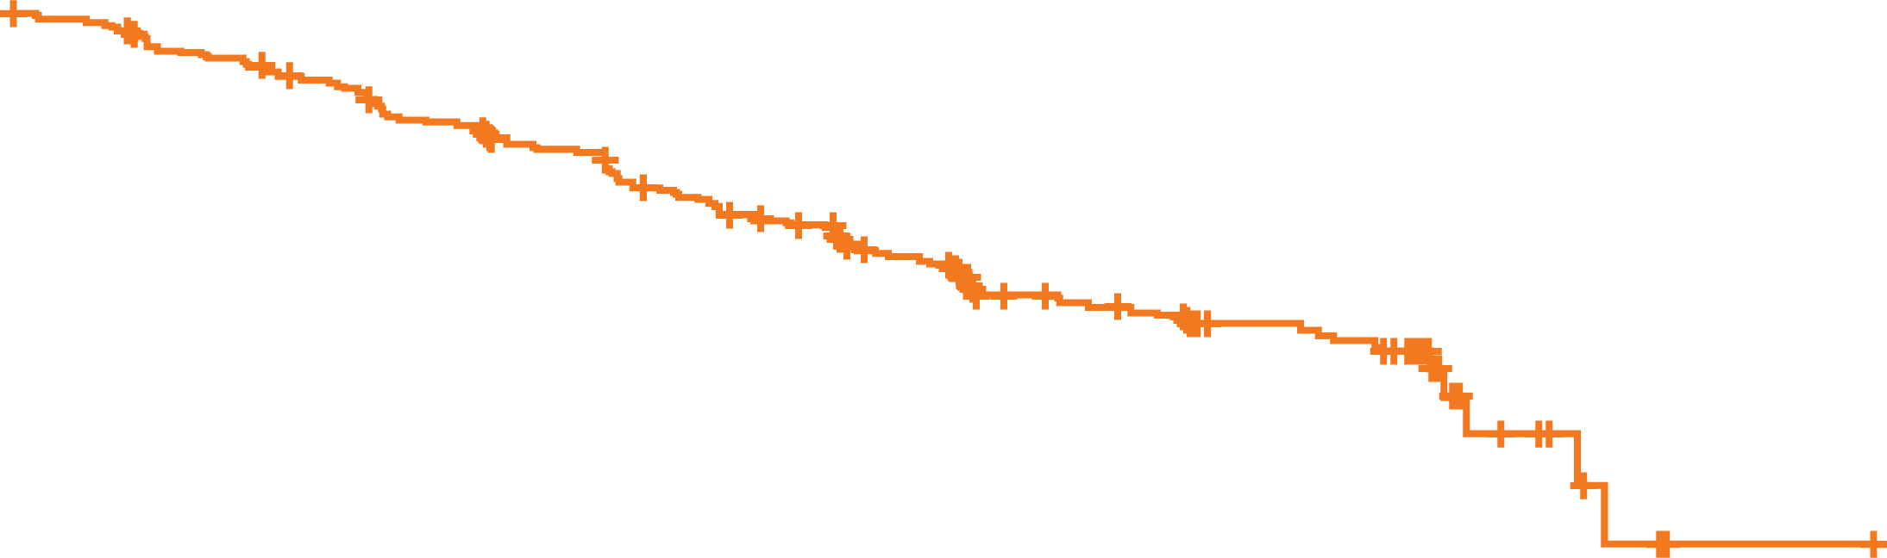
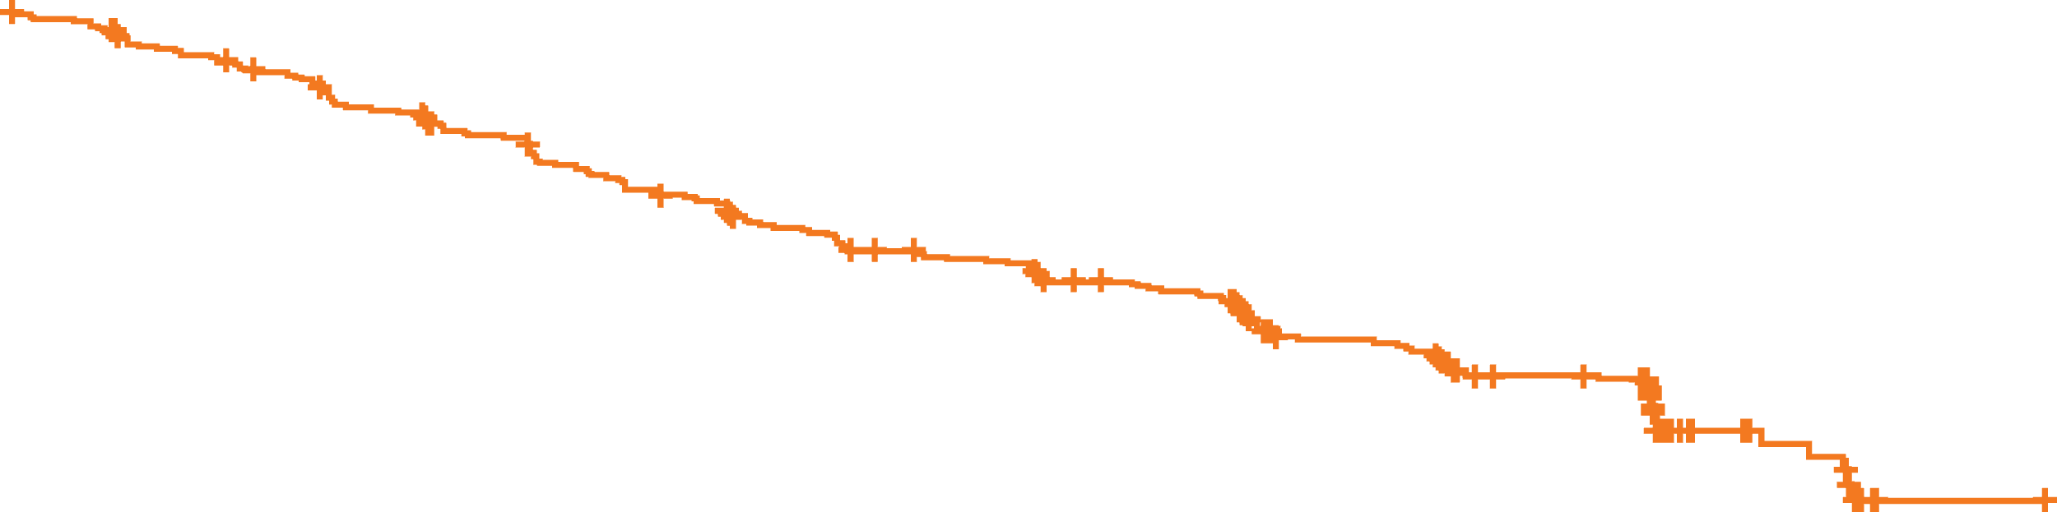
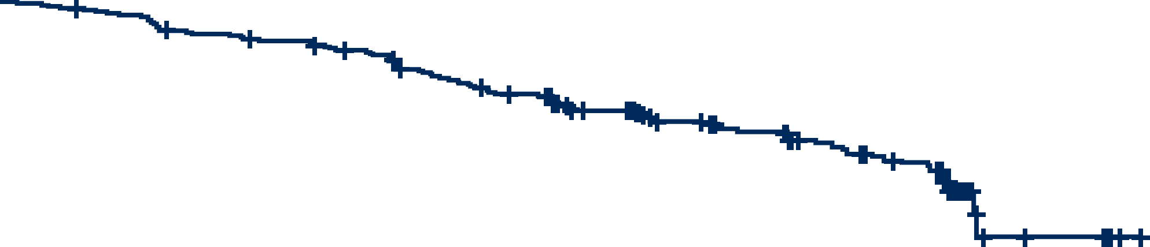
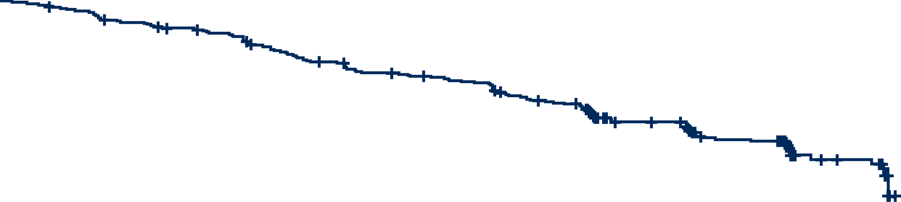
Progression-free survival probability
PFS at 29.6 months follow-up¹
PFS at 39.0 months follow-up (extended follow-up)
78.4%
64.9%
PFS events, n (%)
Zanubrutinib | 87 (26.6)
Ibrutinib | 118 (36.3)
65.9%
PFS events, n (%)
Zanubrutinib | 130 (39.8)
Ibrutinib | 159 (48.9)
54.8%
Hazard ratio (95% CI)=0.65 (0.49-0.86)
Two-sided P=0.0024
Hazard ratio (95% CI)=0.68 (0.53-0.86)
Two-sided P=0.0011
No. at risk
Zanubrutinib | 327 | 316 | 303 | 297 | 290 | 274 | 260 | 221 | 165 | 158 | 122 | 111 | 12 | 2 | 0
Ibrutinib | 325 | 306 | 293 | 273 | 259 | 241 | 227 | 186 | 128 | 121 | 97 | 87 | 9 | 1 | 1 | 0
No. at risk
Zanubrutinib | 327 | 315 | 302 | 295 | 287 | 272 | 258 | 247 | 242 | 236 | 217 | 206 | 151 | 124 | 118 | 42 | 38 | 0 | 0 | 0
Ibrutinib | 325 | 305 | 293 | 273 | 258 | 242 | 229 | 212 | 200 | 194 | 182 | 171 | 116 | 92 | 88 | 28 | 22 | 1 | 1 | 0
Previous report demonstrated zanubrutinib is clinically and statistically superior to ibrutinib
Zanubrutinib sustains PFS benefit over ibrutinib at extended follow-up

Slide 7
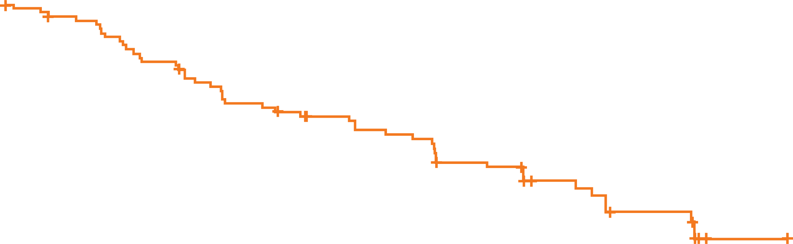
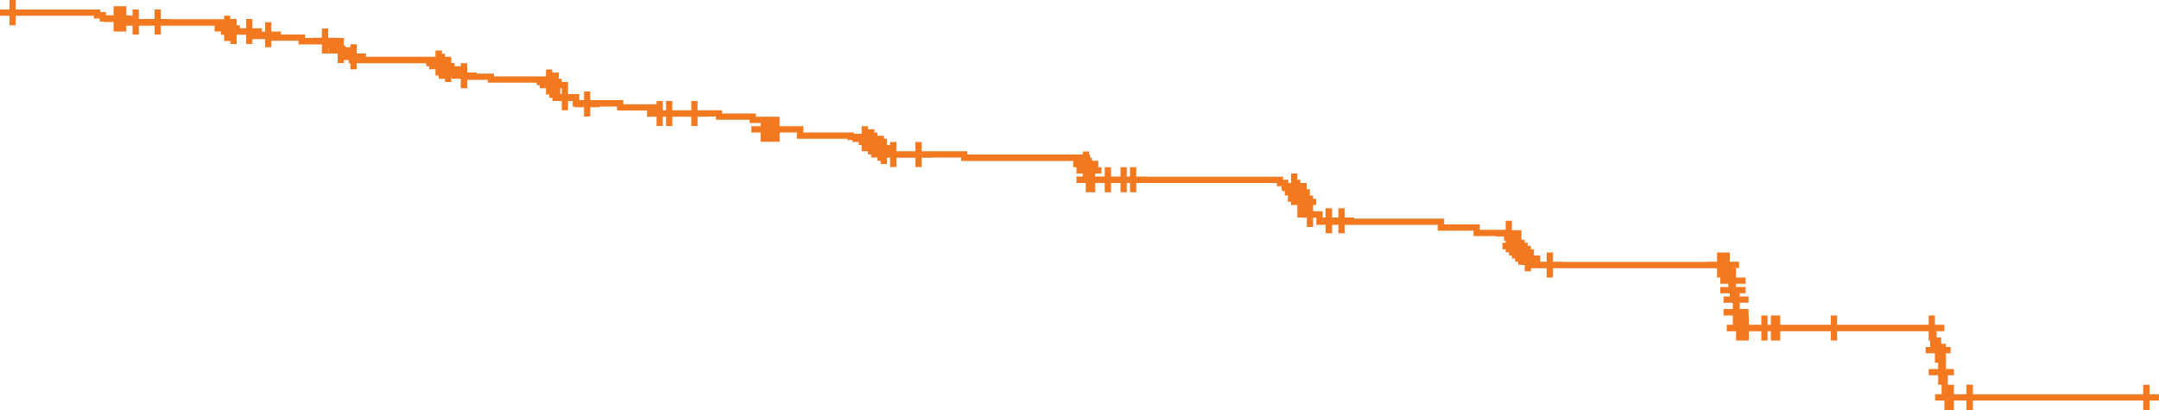
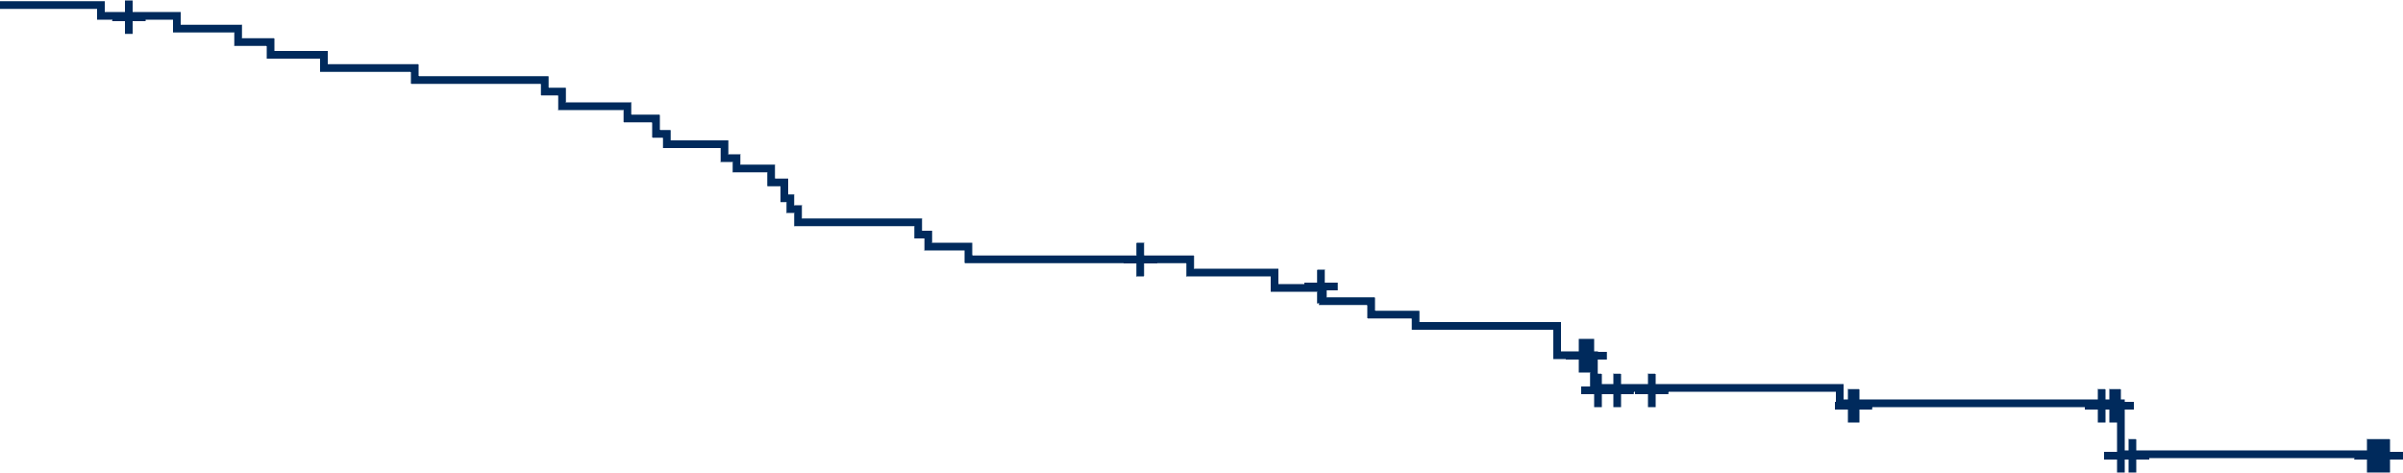
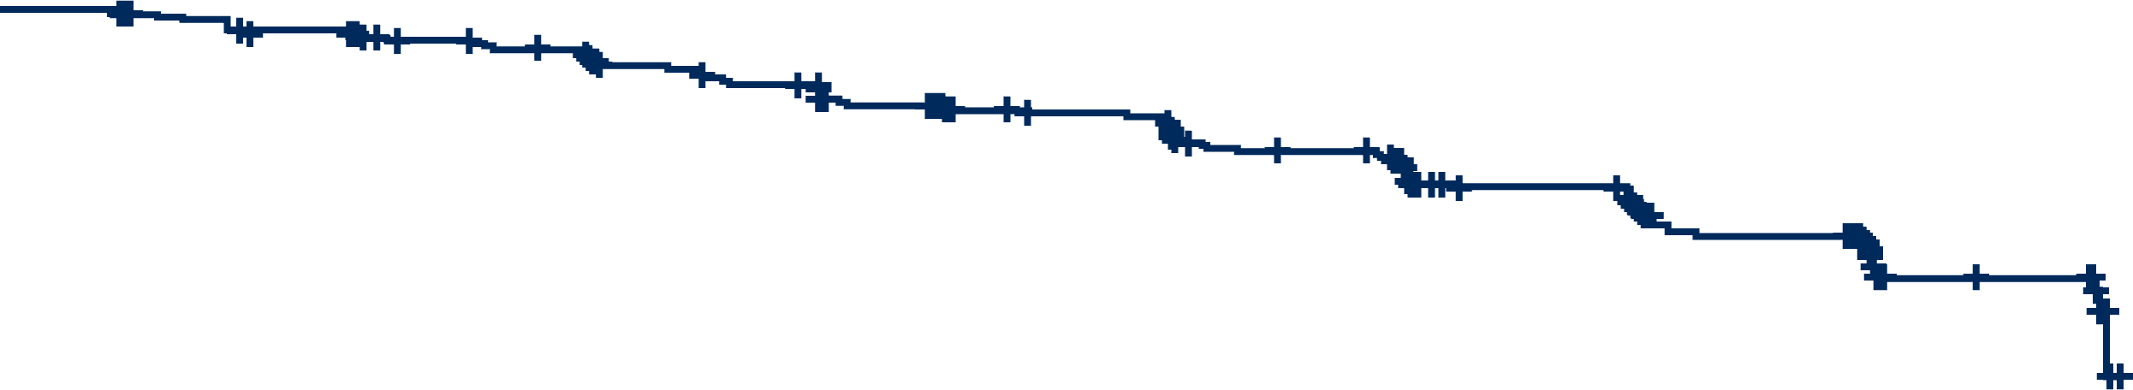
Progression-free survival probability
PFS in patients with del(17p)/TP53^{mut}
PFS across sensitivity analyses
Sensitivity analyis | Zanubrutinib n (%) | Ibrutinib n (%) | HR (95% CI) | 2-sided P-value
Accounting only PD and death events that occurred during active treatment | 76 (23.2) | 85 (26.2) | 0.69 (0.50, 0.95) | 0.0206
Censoring for new CLL/SLL therapies | 129 (39.4) | 157 (48.3) | 0.68 (0.54, 0.86) | 0.0014
Censoring for death due to COVID-19 | 115 (35.2) | 142 (43.7) | 0.66 (0.52, 0.85) | 0.0013
58.6%
PFS events, n (%)
Zanubrutinib | 31 (41.3)
Ibrutinib | 46 (61.3)
41.3%
Hazard ratio (95% CI)=0.52 (0.33-0.83)
Two-sided P=0.0047
No. at risk
Zanubrutinib | 75 | 71 | 68 | 66 | 64 | 61 | 55 | 52 | 51 | 49 | 45 | 43 | 30 | 22 | 22 | 6 | 6 | 0
Ibrutinib | 75 | 70 | 68 | 59 | 54 | 48 | 45 | 41 | 38 | 36 | 30 | 29 | 16 | 10 | 9 | 2 | 1 | 0
No. at risk
Zanubrutinib | 327 | 308 | 296 | 289 | 278 | 263 | 254 | 242 | 231 | 228 | 208 | 201 | 145 | 118 | 113 | 38 | 37 | 0 | 0 | 0
Ibrutinib | 325 | 291 | 276 | 259 | 245 | 226 | 218 | 204 | 183 | 182 | 167 | 162 | 108 | 84 | 80 | 25 | 21 | 1 | 1 | 0
Improved PFS was demonstrated with zanubrutinib in patients with del(17p)/TP53^{mut}
Zanubrutinib PFS benefit was consistent across multiple sensitivity analyses

Slide 8
Complete responses
0.9
3.7
5.8
6.1
8.3
9.5
10.4
1.5
4.6
4.9
5.8
6.5
7.1
58.8
66.7
78.5
85.3
80.6
85.0
77.8
83.2
77.5
82.9
76.6
81.7
76.3
80.4
75.7
79.8
ORR
Time
58.8
66.7
78.5
86.2
82.2
88.7
82.5
89.0
82.5
89.0
82.5
89.9
82.8
89.9
82.8
90.2
PR+PR-L+nPR
CR+CRi
A higher proportion of patients achieved CR/CRi with zanubrutinib than ibrutinib
Complete responses deepen over time in both arms

Slide 9
Adverse events
Overall safety/tolerability summary
Most common adverse events by Grade occurring ≥15% of patients in both arms
 | Zanubrutinib (n=324) | Ibrutinib (n=324)
Median treatment duration, months | 38.3 (0.4, 54.9) | 35.0 (0.1, 58.4)
Any Grade adverse event Grade 3 to 5 Grade 5 | 320 (98.8) 235 (72.5) 41 (12.7) | 323 (99.7) 251 (77.5) 40 (12.3)
Serious adverse event | 165 (50.9) | 191 (59.0)
Adverse events leading to Dose reduction Dose interruption Treatment discontinuation Hospitalization | 47 (14.5) 196 (60.5) 64 (19.8) 150 (46.3) | 59 (18.2) 201 (62.0) 85 (26.2) 180 (55.6)
Ibrutinib
Zanubrutinib
COVID-19 related^{a,b}
Neutropeniaª
Grade
Hypertensionª
1
Upper respiratory tract infection
2
Diarrhea
3
Arthralgia
4
Anemiaª
5
50
40
30
20
10
0
10
20
30
40
50
Frequency, %
Zanubrutinib safety profile remained favorable versus ibrutinib

Slide 10
Cardiac safety profile
 | Zanubrutinib (n=324) | Ibrutinib (n=324)
Cardiac adverse events | 80 (24.7) | 112 (34.6)
Serious cardiac adverse events | 11 (3.4) | 31 (9.6)
Cardiac adverse events leading to treatment discontinuation | 3 (0.9) | 15 (4.6)
Ventricular extrasystoles | 1 (0.3) | 0
Atrial fibrillation/flutter | 1 (0.3) | 6 (1.9)
Cardiac failure | 1 (0.3) | 2 (0.6)
Cardiac arrest | 0 | 2 (0.6)^{b}
Cardiac failure acute | 0 | 1 (0.3)^{b}
Congestive cardiomyopathy | 0 | 1 (0.3)^{b}
Myocardial infarction | 0 | 1 (0.3)^{b}
Palpitations | 0 | 1 (0.3)
Ventricular fibrillation | 0 | 1 (0.3)
Serious cardiac adverse events were lower with zanubrutinib vs ibrutinib
  Atrial fibrillation/flutter (3 vs 13)
  Ventricular fibrillation(0 vs 2)
  MIª/acute coronary syndrome
  (3 vs 3)
Fatal cardiac events^{b}:
  Zanubrutinib, n=0 (0%)
  Ibrutinib, n=6 (1.9%)

Slide 11
Adverse events of special interestª occurring in ≥2 patients
 | Zanubrutinib (n=324) |  | Ibrutinib (n=324)
 | Any Grade | Grade ≥3 | Any Grade | Grade ≥3
Infection | 264 (81.5) | 115 (35.5) | 260 (80.2) | 111 (34.3)
Opportunistic infections | 8 (2.5) | 6 (1.9) | 13 (4.0) | 5 (1.5)
COVID-19 related^{b} | 145 (44.8) | 56 (17.3) | 105 (32.4) | 38 (11.7)
Bleeding | 142 (43.8) | 12 (3.7) | 144 (44.4) | 13 (4.0)
Major hemorrhage | 13 (4.0) | 12 (3.7) | 16 (4.9) | 13 (4.0)
Hypertension | 86 (26.5) | 53 (16.4) | 80 (24.7) | 47 (14.5)
Atrial fibrillation/flutter | 22 (6.8) | 10 (3.1) | 53 (16.4) | 16 (4.9)
Anemia | 53 (16.4) | 7 (2.2) | 59 (18.2) | 11 (3.4)
Neutropenia | 100 (30.9) | 72 (22.2) | 94 (29.0) | 72 (22.2)
Thrombocytopenia | 43 (13.3) | 12 (3.7) | 53 (16.4) | 19 (5.9)
Second primary malignancies | 46 (14.2) | 26 (8.0) | 52 (16.0) | 19 (5.9)

Slide 12
Conclusions
ALPINE is the only study to demonstrate PFS superiority in a head-to-head comparison of BTK inhibitors
Zanubrutinib demonstrated sustained PFS benefit over ibrutinib in patients with R/R CLL/SLL with a median follow-up of 39 months
  Durable PFS benefits seen across major subgroups, including the del(17p)/TP53^{mut} population
  PFS benefit is consistent across multiple sensitivity analyses demonstrating that PFS advantage with zanubrutinib was primarily driven by efficacy and not tolerability
While responses deepened over time in both arms, ORR was higher with zanubrutinib with increased rates of CR/CRi compared with ibrutinib
Zanubrutinib continues to demonstrate a more favorable safety/tolerability profile compared with ibrutinib
  Lower rate of Grade ≥3 and serious AEs, fewer AEs leading to treatment discontinuation, and dose reduction
  Safer cardiac profile than ibrutinib with significantly lower rates of atrial fibrillation, serious cardiac events, cardiac events leading to treatment discontinuation, and no fatal cardiac events
With over 3 years of follow-up, these data reconfirm zanubrutinib improved efficacy over ibrutinib and a more favorable safety profile in patients with R/R CLL/SLL

Slide 13
ALPINE
Acquired mutations with BTKi in R/R CLL:

Slide 14
ALPINE mutation analysis background
Patients administered cBTK inhibitors for CLL can develop acquired drug resistance, leading to disease progression
Often, cBTK inhibitor resistance results from the emergence of subclones with BTK mutations at the cBTK inhibitor binding site (C481) and/or PLCG2 mutations
Less frequently, non-C481 BTK mutations, including gatekeeper residue T474 and kinase-impaired L528 mutations, have been reported in patients with progression on cBTK inhibitors
Most previous reports of cBTK inhibitor resistance mutations have been retrospective or in small patient populations
To gain further insight into the genetic mechanisms of cBTK inhibitor resistance in a randomized population of patients with CLL, NGS was performed on samples from patients who progressed on zanubrutinib or ibrutinib in the Phase 3 ALPINE study¹
A total of 57 patients with PD assessed by either investigator and/or the independent review committee (40.2% based on investigator assessment [53/132]) had PD samples collected for this post hoc biomarker analysis. PFS final analysis data cut-off: August 8, 2022
Peripheral blood samples were collected at baseline and at or after PD and prior to subsequent therapy. A total of 52 patients with paired baseline and PD samples and without Richter’s transformation as assessed at PD were included in this analysis
NGS was performed using a 106-gene PredicineHEME panel (the limit of detection was 0.1% for hotspot mutations and 0.25% for non-hotspot mutations); 27 CLL driver genes identified by Knisbacher² et al were represented in this panel. Data reported include all BTK and PLCG2 mutations with a VAF of ≥0.25%. For all other genes, pathogenic mutations with a VAF ≥1% were reported

Slide 15
PD samples and BTK and PLCG2 mutation distribution
57 PD samples
No mutations
C481 + L528
Zanubrutinib arm
C481 only
C481 + A428
8%
4%
C481 + PLCG2
Only PLCG2
4%
L528 only
4%
Zanubrutinib n=26
Ibrutinib
n=31
81%
PD during treatment
n=16
PD after treatment
n=10
PD during treatment
n=21
PD after treatment
n=10
Zanu PD sample
n=26
No PD sample available
n=75
Influenced by drug holdª
n=0
Not influenced by drug holdª
n=16
BTK mutations n=0
Influenced by drug hold^{a,b}
n=4
Not influenced by drug holdª
n=17
BTK mutations n=1
Ibr PD sample
n=31
6%
3%
3%
87%
BTK mutations
n=5
No BTK mutations
n=11
BTK mutations
n=2
(1 PLCG2 mutation)
No BTK mutations n=15
(1 PLCG2 mutation)
Ibrutinib arm
No BTK mutations were identified at baseline
At PD, 8 patients had acquired mutations in BTK, with half of these patients having 2 or more BTK mutations

Slide 16
VAF of acquired BTK mutations
80
n=15
n=2
n=1
The VAF of the 2 BTK L528 mutations was similar to that of the BTK C481 mutations
60
VAF, %
30
10
8
Mutations at disease progression
6
4
Zanubrutinib arm
2
Ibrutinub arm
0
C481
L528
A428

Slide 17
Acquired BTK and PLCG2 mutations by patient
Patient ID | Treatment arm | Acquired BTK mutation at PD: Coding DNA description (VAF, %) | Acquired BTK mutation at PD: Protein description | Acquired PLCG2 mutation at PD: Coding DNA description (VAF, %) | Acquired PLCG2 mutation at PD: Protein description | Duration of treatment, months
1 | Ibrutinib | 1442G>C (1.29) | C481S | Not detected | Not detected | 30.8
2 | Ibrutinib | 1442G>C (7.95) | C481S | Not detected | Not detected | 34.5
3 | Ibrutinib | 1442G>C (0.88) | C481S | 235A>C (0.60) | L845F | 11.8
 |  | 127G>C (0.51) | D43H
4 | Ibrutinib | Not detected | Not detected | 3422T>A (5.69) | M1141K | 18.8
5 | Zanubrutinib | 1442G>C (8.80) | C481S | Not detected | Not detected | 34.2
6 | Zanubrutinib | 1283C>A (31.10) | A428D | Not detected | Not detected | 28.0
 |  | 1442G>C (4.72) | C481S
 |  | 1441T>A (2.48) | C481S
7 | Zanubrutinib | 1442G>C (16.22) | C481S | Not detected | Not detected | 29.7
 |  | 1583T>G (8.22) | L528W
 |  | 1441T>A (4.28) | C481S
 |  | 1442G>A (1.83) | C481Y
 |  | 1442G>T (1.70) | C481F
 |  | 1441T>C (1.01) | C481R
8 | Zanubrutinib | 1583T>G (1.76) | L528W | Not detected | Not detected | 33.8
9 | Zanubrutinib | 1442G>C (74.39) | C481S | Not detected | Not detected | 18.4
 |  | 1441T>C (2.30) | C481R
 |  | 1441T>A (0.45) | C481S
Among the 24 patients in this analysis who progressed on zanubrutinib, 5 acquired BTK mutations (L528W only, n=1; C481 only, n=2; L528W and C481, n=1; A428D and C481, n=1)
Among the patients with BTK mutations at PD (zanubrutinib, n=5; ibrutinib n=3), median treatment duration was 29.7 months (range, 18.4-34.2 months) in those treated with zanubrutinib vs 30.8 months (range, 11.8-34.5 months) in those treated with ibrutinib
77.8% (14/18) of BTK mutations were at C481. One patient had a sole PLCG2 mutation at PD

Slide 18
Treatment duration stratified by treatment arm and BTK and/or PLCG2 mutation status
10
Zanubrutinib, acquired BTK mutation only
Compared to patients with BTK mutations, median treatment duration at disease progression was shorter in patients with wild-type BTK in both the zanubrutinib (n=19, 16.8 months [range, 5.0-33.3 months], P<.01) and ibrutinib (n=25, 15.9 months [range, 5.9-29.4 months], P=.21) treatment arms
11
12
Zanubrutinib, no acquired BTK or PLCG2 mutations
13
14
Ibrutinib, acquired BTK and PLCG2 mutations
15
16
Ibrutinib, acquired BTK mutation only
17
18
Ibrutinib, acquired PLCG2 mutation only
19
3
Ibrutinib, no acquired BTK or PLCG2 mutations
20
21
22
23
24
25
Patient ID
26
27
28
29
30
31
32
33
35
34
36
37
38
9
4
39
40
41
42
43
44
45
46
47
48
49
50
51
52
6
53
7
54
1
55
8
5
2
56
57
0
10
20
30
40
Duration of treatment, months

Slide 19
Driver gene alterations and their molecular pathways by treatment arm
Alterations |  |  |  |  |  |  |  |  |  |  |  |  |  |  |  |  |  |  |  |  |  |  |  |  |  |  |  |  |  |  |  |  |  |  |  |  |  |  |  |  |  |  |  |  |  |  |  |  |  |  |  |  |  | Arm | Baseline mutation rate |  | PD mutation rate
 |  |  |  |  |  |  |  |  |  |  |  |  |  |  |  |  |  |  |  |  |  |  |  |  |  |  |  |  |  |  |  |  |  |  |  |  |  |  |  |  |  |  |  |  |  |  |  |  |  |  |  |  |  | BTK/PLCG2 status | Zanu | Ibr | Zanu | Ibr
CCND2 |  |  |  |  |  |  |  |  |  |  |  |  |  |  |  |  |  |  |  |  |  |  |  |  |  |  |  |  |  |  |  |  |  |  |  |  |  |  |  |  |  |  |  |  |  |  |  |  |  |  |  |  |  |  | ‒ | 7% | - | 4%
CREBBP |  |  |  |  |  |  |  |  |  |  |  |  |  |  |  |  |  |  |  |  |  |  |  |  |  |  |  |  |  |  |  |  |  |  |  |  |  |  |  |  |  |  |  |  |  |  |  |  |  |  |  |  |  |  | 4% | 4% | 4% | -
KMT2D |  |  |  |  |  |  |  |  |  |  |  |  |  |  |  |  |  |  |  |  |  |  |  |  |  |  |  |  |  |  |  |  |  |  |  |  |  |  |  |  |  |  |  |  |  |  |  |  |  |  |  |  |  |  | - | 4% | - | -
ARID1A |  |  |  |  |  |  |  |  |  |  |  |  |  |  |  |  |  |  |  |  |  |  |  |  |  |  |  |  |  |  |  |  |  |  |  |  |  |  |  |  |  |  |  |  |  |  |  |  |  |  |  |  |  |  | 4% | - | 4% | -
ATM |  |  |  |  |  |  |  |  |  |  |  |  |  |  |  |  |  |  |  |  |  |  |  |  |  |  |  |  |  |  |  |  |  |  |  |  |  |  |  |  |  |  |  |  |  |  |  |  |  |  |  |  |  |  | 8% | 21% | 8% | 14%
TP53 |  |  |  |  |  |  |  |  |  |  |  |  |  |  |  |  |  |  |  |  |  |  |  |  |  |  |  |  |  |  |  |  |  |  |  |  |  |  |  |  |  |  |  |  |  |  |  |  |  |  |  |  |  |  | 38% | 36% | 33% | 25%
BIRC3 |  |  |  |  |  |  |  |  |  |  |  |  |  |  |  |  |  |  |  |  |  |  |  |  |  |  |  |  |  |  |  |  |  |  |  |  |  |  |  |  |  |  |  |  |  |  |  |  |  |  |  |  |  |  | 13% | 4% | 8% | -
BRAF |  |  |  |  |  |  |  |  |  |  |  |  |  |  |  |  |  |  |  |  |  |  |  |  |  |  |  |  |  |  |  |  |  |  |  |  |  |  |  |  |  |  |  |  |  |  |  |  |  |  |  |  |  |  | 21% | 18% | 21% | 11%
KRAS |  |  |  |  |  |  |  |  |  |  |  |  |  |  |  |  |  |  |  |  |  |  |  |  |  |  |  |  |  |  |  |  |  |  |  |  |  |  |  |  |  |  |  |  |  |  |  |  |  |  |  |  |  |  | 8% | 7% | 8% | -
MAP2K1 |  |  |  |  |  |  |  |  |  |  |  |  |  |  |  |  |  |  |  |  |  |  |  |  |  |  |  |  |  |  |  |  |  |  |  |  |  |  |  |  |  |  |  |  |  |  |  |  |  |  |  |  |  |  | 8% | - | 4% | -
NRAS |  |  |  |  |  |  |  |  |  |  |  |  |  |  |  |  |  |  |  |  |  |  |  |  |  |  |  |  |  |  |  |  |  |  |  |  |  |  |  |  |  |  |  |  |  |  |  |  |  |  |  |  |  |  | 4% | 4% | - | -
FBXW7 |  |  |  |  |  |  |  |  |  |  |  |  |  |  |  |  |  |  |  |  |  |  |  |  |  |  |  |  |  |  |  |  |  |  |  |  |  |  |  |  |  |  |  |  |  |  |  |  |  |  |  |  |  |  | - | 7% | - | 7%
NOTCH1 |  |  |  |  |  |  |  |  |  |  |  |  |  |  |  |  |  |  |  |  |  |  |  |  |  |  |  |  |  |  |  |  |  |  |  |  |  |  |  |  |  |  |  |  |  |  |  |  |  |  |  |  |  |  | 46% | 36% | 25% | 18%
PTPN11 |  |  |  |  |  |  |  |  |  |  |  |  |  |  |  |  |  |  |  |  |  |  |  |  |  |  |  |  |  |  |  |  |  |  |  |  |  |  |  |  |  |  |  |  |  |  |  |  |  |  |  |  |  |  | - | 4% | - | 4%
DDX3X |  |  |  |  |  |  |  |  |  |  |  |  |  |  |  |  |  |  |  |  |  |  |  |  |  |  |  |  |  |  |  |  |  |  |  |  |  |  |  |  |  |  |  |  |  |  |  |  |  |  |  |  |  |  | 17% | - | 4% | -
SETD2 |  |  |  |  |  |  |  |  |  |  |  |  |  |  |  |  |  |  |  |  |  |  |  |  |  |  |  |  |  |  |  |  |  |  |  |  |  |  |  |  |  |  |  |  |  |  |  |  |  |  |  |  |  |  | - | - | - | 4%
SF3B1 |  |  |  |  |  |  |  |  |  |  |  |  |  |  |  |  |  |  |  |  |  |  |  |  |  |  |  |  |  |  |  |  |  |  |  |  |  |  |  |  |  |  |  |  |  |  |  |  |  |  |  |  |  |  | 13% | 18% | 8% | 18%
XPO1 |  |  |  |  |  |  |  |  |  |  |  |  |  |  |  |  |  |  |  |  |  |  |  |  |  |  |  |  |  |  |  |  |  |  |  |  |  |  |  |  |  |  |  |  |  |  |  |  |  |  |  |  |  |  | 8% | 18% | 13% | 18%
ASXL1 |  |  |  |  |  |  |  |  |  |  |  |  |  |  |  |  |  |  |  |  |  |  |  |  |  |  |  |  |  |  |  |  |  |  |  |  |  |  |  |  |  |  |  |  |  |  |  |  |  |  |  |  |  |  | 8% | 7% | 8% | 14%
CCND2 |  |  |  |  |  |  |  |  |  |  |  |  |  |  |  |  |  |  |  |  |  |  |  |  |  |  |  |  |  |  |  |  |  |  |  |  |  |  |  |  |  |  |  |  |  |  |  |  |  |  |  |  |  |  | 38% | 4% | 25% | 4%
CDKN1B |  |  |  |  |  |  |  |  |  |  |  |  |  |  |  |  |  |  |  |  |  |  |  |  |  |  |  |  |  |  |  |  |  |  |  |  |  |  |  |  |  |  |  |  |  |  |  |  |  |  |  |  |  |  | 4% | - | 13% | 4%
KMT2D |  |  |  |  |  |  |  |  |  |  |  |  |  |  |  |  |  |  |  |  |  |  |  |  |  |  |  |  |  |  |  |  |  |  |  |  |  |  |  |  |  |  |  |  |  |  |  |  |  |  |  |  |  |  | 21% | 4% | 13% | -
ATM |  |  |  |  |  |  |  |  |  |  |  |  |  |  |  |  |  |  |  |  |  |  |  |  |  |  |  |  |  |  |  |  |  |  |  |  |  |  |  |  |  |  |  |  |  |  |  |  |  |  |  |  |  |  | 17% | 14% | 8% | 7%
TP53 |  |  |  |  |  |  |  |  |  |  |  |  |  |  |  |  |  |  |  |  |  |  |  |  |  |  |  |  |  |  |  |  |  |  |  |  |  |  |  |  |  |  |  |  |  |  |  |  |  |  |  |  |  |  | 8% | 14% | - | 4%
BIRC3 |  |  |  |  |  |  |  |  |  |  |  |  |  |  |  |  |  |  |  |  |  |  |  |  |  |  |  |  |  |  |  |  |  |  |  |  |  |  |  |  |  |  |  |  |  |  |  |  |  |  |  |  |  |  | - | - | - | 7%
KRAS |  |  |  |  |  |  |  |  |  |  |  |  |  |  |  |  |  |  |  |  |  |  |  |  |  |  |  |  |  |  |  |  |  |  |  |  |  |  |  |  |  |  |  |  |  |  |  |  |  |  |  |  |  |  | 4% | - | 17% | -
MAP2K1 |  |  |  |  |  |  |  |  |  |  |  |  |  |  |  |  |  |  |  |  |  |  |  |  |  |  |  |  |  |  |  |  |  |  |  |  |  |  |  |  |  |  |  |  |  |  |  |  |  |  |  |  |  |  | - | - | 4% | -
NRAS |  |  |  |  |  |  |  |  |  |  |  |  |  |  |  |  |  |  |  |  |  |  |  |  |  |  |  |  |  |  |  |  |  |  |  |  |  |  |  |  |  |  |  |  |  |  |  |  |  |  |  |  |  |  | - | - | - | 7%
TRAF3 |  |  |  |  |  |  |  |  |  |  |  |  |  |  |  |  |  |  |  |  |  |  |  |  |  |  |  |  |  |  |  |  |  |  |  |  |  |  |  |  |  |  |  |  |  |  |  |  |  |  |  |  |  |  | - | - | - | 4%
FBXW7 |  |  |  |  |  |  |  |  |  |  |  |  |  |  |  |  |  |  |  |  |  |  |  |  |  |  |  |  |  |  |  |  |  |  |  |  |  |  |  |  |  |  |  |  |  |  |  |  |  |  |  |  |  |  | - | - | 4% | -
NOTCH1 |  |  |  |  |  |  |  |  |  |  |  |  |  |  |  |  |  |  |  |  |  |  |  |  |  |  |  |  |  |  |  |  |  |  |  |  |  |  |  |  |  |  |  |  |  |  |  |  |  |  |  |  |  |  | 4% | - | 4% | -
PTPN11 |  |  |  |  |  |  |  |  |  |  |  |  |  |  |  |  |  |  |  |  |  |  |  |  |  |  |  |  |  |  |  |  |  |  |  |  |  |  |  |  |  |  |  |  |  |  |  |  |  |  |  |  |  |  | 8% | 4% | 4% | -
SETD2 |  |  |  |  |  |  |  |  |  |  |  |  |  |  |  |  |  |  |  |  |  |  |  |  |  |  |  |  |  |  |  |  |  |  |  |  |  |  |  |  |  |  |  |  |  |  |  |  |  |  |  |  |  |  | 4% | 7% | - | -
XPO1 |  |  |  |  |  |  |  |  |  |  |  |  |  |  |  |  |  |  |  |  |  |  |  |  |  |  |  |  |  |  |  |  |  |  |  |  |  |  |  |  |  |  |  |  |  |  |  |  |  |  |  |  |  |  | - | - | - | 4%
del(17p)
del(11q)
Trisomy 12
del(13q)
IGHV
CK
Alterations
Among the 48 patients who had baseline CLL driver gene mutations, 18 mutated driver genes were identified; the median number of driver genes mutated per patient was 3 (range, 1-5)
  Mutations were most frequently observed in NOTCH1 (n=21), TP53 (n=19), BRAF (n=10), SF3B1 (n=8), and ATM (n=8) at baseline
  Acquired driver gene mutations were observed in 1 patient in the zanubrutinib arm (with TP53 and XPO1 mutation) and 5 patients in the ibrutinib arm (1 with TP53, 1 with SETD2, 1 with SF3B1, and 2 with ASXL1 mutation)
No associations between driver gene mutations and BTK mutational status were detected
Driver gene mutations at either baseline or PD were not associated with del(17p), IGHV mutation, or CK status
SC
PD
Cell cycling
SC + PD
Chromatin modification
SNV
CNV
DNA damage
Arm
Inflammation signaling
Ibrutinib
MAPK signaling
Zanubrutinib
BTK/PLCG2
mutation status
BTK
NOTCH signaling
BTK and PLCG2
PLCG2
Phosphatase
Wild type
RNA splicing
del(17p)
With
Transcriptional regulation
Without
Cell cycling
del(11q)
Chromatin modification
With
DNA damage
Without
Inflammation signaling
Trisomy 12
MAPK signaling
With
Without
NFkB
del(13q)
NOTCH signaling
With
Without
Phosphatase
IGHV
RNA splicing
Mutated
Unmutated
Baseline
alteration status
CK
<3
≥3

Slide 20
Next line of treatment after discontinuation of study treatment
Next line of treatment after discontinuing study treatment | Patients, n | Zanubrutinib (n=26) Outcome | Patients, n | Ibrutinib (n=31) Outcome
Chemotherapy | 1 | Ongoing/completed | 0 | N/A
Chemoimmunotherapyª | 4 | Ongoing/completed, n=2 (BTK C481 mutation, n=1; RT when completing study treatment, n=1); discontinued due to AE, n=2 | 3 | Ongoing/completed
cBTK inhibitor therapy | 2 | Ongoing/completed, n=1; PD, n=1 | 5 | Ongoing/completed, n=3; PD, n=1 (BTK C481 mutation); discontinued due to AE, n=1
Noncovalent BTK inhibitor therapy^{b} | 2 | Ongoing/completed, n=1; PD, n=1 (BTK C481 and L528 mutations) | 2 | Ongoing/completed, n=1; death, n=1
BCL2i monotherapy | 3 | Ongoing/completed, n=2; discontinued due to AE, n=1 | 5 | Ongoing/completed, n=2 (BTK C481 mutation, n=1); PD, n=1; discontinued due to AE, n=1; death, n=1
BCL2i plus mCD20Ab therapy | 3 | PD, n=1 (BTK L528 mutation); discontinued due to AE, n=1 (BTK C481 mutation); death, n=1 | 2 | Ongoing/completed, n=1; PD, n=1 (PLCG2 mutation)
BCL2i plus BTK inhibitor therapy^{c} | 0 | N/A | 3 | Patients, n=3 Outcome: Ongoing/completed, n=1; PD, n=1 (RT when completing study treatment); discontinued due to AE, n=1 (BTK C481 and PLCG2 mutations)
mCD20Ab plus BCL2i plus noncovalent BTK inhibitor | 1 | Ongoing/completed | 0 | N/A
Other^{d} | 2 | Ongoing/completed, n=1; unknown, n=1 (BTK C481 and A428 mutations) | 1 | PD
No known treatment after study treatment discontinuation | 8 | (RT when completing study treatment, n=1) | 10 | (RT when completing study treatment, n=1)
The majority of patients in this study population received additional treatment following study treatment discontinuation (zanubrutinib, 18/26 [69.2%]; ibrutinib, 21/31 [67.7%]), including all patients with acquired BTK and/or PLCG2 mutations

Slide 21
Conclusions
Of the patients who progressed in ALPINE and were included in this analysis, most (82.6%) did not acquire BTK or PLCG2 mutations
Among the 24 patients in this analysis who progressed on zanubrutinib, 5 acquired BTK mutations
These data suggest that BTK and/or PLCG2 mutations are not the main factors driving PD in this population
Given the low incidence to date of non-C481 mutations in patients with PD in ALPINE, patients with CLL who have been treated with cBTK inhibitors are likely to remain sensitive to other BTK-targeting therapies

Slide 22
Acalabrutinib in CLL
Extended follow-up and resistance mutations

Slide 23
Acalabrutinib in CLL – Extended follow-up and resistance mutations background
Aim: To investigate clonal evolution in patients treated with acalabrutinib and to identify genetic mechanisms of resistance to acalabrutinib
Samples were collected in a Phase 2 study of TN CLL or SLL with deletion (del) 17p, or TP53 or NOTCH1 mutations, or R/R CLL/SLL regardless of cytogenetics or somatic mutations
  CD19+ enriched PBMC at baseline, after 6 months, then annually on treatment until PD
  Paired baseline and PD BM and LN samples based on availability
Targeted NGS of ~700 recurrently mutated genes in hematological malignancies
VAF ≥1% for BTK and PLCG2, and ≥5% for putative CLL driver genes

Slide 24
Progression-free survival
After a median follow-up of 6.51 years (95% CI 5.13, 6.98), 23/48 (48%) patients developed PD (20 CLL and 3 RT)
Median progression-free survival was reached at 6.01 years (95% CI 4.26, 6.95)

Slide 25
Sample overview
A
0
6
12
24
36
48
60
A total of 241 samples from 45/48 enrolled patients (excluding 3 patients who developed RT) at baseline and during treatment at the indicated time points were analyzed
Paired PBMC, BM, and LN samples at baseline and PD were included based on availability
Months on
acalabrutinib
# Patients analyzed
45
44
40
38
31
19
10
B
PBMC
Bone marrow
Lymph node
Sample type
# Samples analyzed
20
6
2

Slide 26



Distributions of mutations over time
At baseline, 35 CLL driver genes were mutated in 41/45 (91%) patients
During acalabrutinib treatment but before PD, newly acquired mutations in 17 driver genes were detected in 19/45 (42%; 12 R/R and 7 TN) patients
At the time of PD, 16/20 (80%; 11 R/R and 5 TN) patients had newly acquired mutations in 5 genes
Before
acalabrutinib
During acalabrutinib
treatment
After progression on
acalabrutinib

Slide 27
BTK and PLCG2 mutations at relapse
R/R
BTK C481S | 81% | 12% |  | 10% | 4% | 14% | 16% | 11%
BTK T474I |  | 27% |  | 31%
BTK C481R |  | 49% | 31%
BTK C481Y |  |  |  | 20% | 3%
PLCG2 |  |  |  |  |  |  |  |  | 10% | 1%
BTK C481 mutations were detected in 11/20 (55%) patients and T474I in 4/20 (20%) patients. BTK L528W was not detected
PLCG2 mutations were found in 5/20 (25%) patients
BTK T474I co-occurred with C481S in all cases with VAF ≥1%, but on different sequencing reads, suggesting independent subclones
Paired BM and LN samples showed the same BTK and PLCG2 mutations as PBMC with similar VAFs
Tissue VAF, %
Sum of VAFs
within sample
TN
BTK C481S | 68% | 5% |  |  | 2%
BTK T474I | 4% | 46% |  | 0.9%*
BTK C481R
BTK C481Y
PLCG2 |  | 1% | 31% | 7%
PBMC VAF, %
Tissue
Bone marrow
Lymph node

Slide 28
Conclusions
In high-risk TN and R/R CLL treated with acalabrutinib, the median PFS was 6.01 years (95% CI 4.26, 6.95)
Acquisition of mutations in CLL driver genes during treatment was not associated with PD
BTK mutations were detected in 8/14 (57%) R/R patients and 3/6 (50%) TN patients at the time of PD
PLCG2 mutations were found in 2/14 (14%) R/R patients and 3/6 (50%) TN patients at the time of PD
Mutations in BTK and PLCG2 are the predominant resistance mechanism to acalabrutinib, occurring in 75% of patients with PD
Among BTK mutations, C481 was the most common. All T474I mutations co-occurred with C481

Slide 29
SEQUOIA
Zanubrutinib vs bendamustine + rituximab in TN CLL: Biomarker subgroup analysis

Slide 30
SEQUOIA biomarker subgroup analysis background
Zanubrutinib is a BTK inhibitor with high potency, selectivity, efficacy, and a favorable toxicity profile
In the Phase 3 SEQUOIA study (NCT03336333), zanubrutinib treatment demonstrated superior PFS in TN patients with CLL/SLL and without del(17p) (Cohort 1) compared with BR treatment (HR, 0.42; 95% CI, 0.28-0.63; 2-sided P<.0001)¹
Genetic features were assessed and PFS was evaluated in patients with CLL/SLL without del(17p) who were treated with zanubrutinib or BR in Cohort 1 of the SEQUOIA trial
A total of 479 patients without del(17p) were randomized to receive either zanubrutinib (n=241) or BR (n=238)
Blood (CLL) or bone marrow (SLL) samples collected at screening were used for fluorescence in situ hybridization for chromosome abnormalities, cytogenetic analysis for CKT, NGS per the European Research Initiative on CLL for IGHV gene mutation and expressed clones, and ultrasensitive targeted NGS for mutation analysis of 106 genes
All pathogenic mutations detected by NGS with variant allele frequency ≥1% were included in the analysis
The association between biomarkers and PFS by investigator was determined using the log-rank test and HR, and summarized by the Kaplan-Meier method. Data cutoff was October 31, 2022

Slide 31
Molecular features of CLL/SLL in both treatment arms
Mutation
uIGHV
Zanubrutinib
CLL/SLL molecular features were similarly distributed between both treatment arms
mlGHV
del(11q)
BR
del(13q)
Trisomy 12
CKT ≥3
CKT ≥5
ASXL1 SNV
ATM SNV
BIRC3 SNV
BRAF SNV
CARD11 SNV
CHEK2 SNV
DDX3X SNV
DNMT3A SNV
EP300 SNV
FBXW7 SNV
IRF2BP2 SNV
KMT2D SNV
KRAS SNV
MYD88 SNV
NOTCH1 SNV
RPS15 SNV
SF3B1 SNV
TET2 SNV
TP53 SNV
XPO1 SNV
0
20
40
60
Mutation frequency

Slide 32
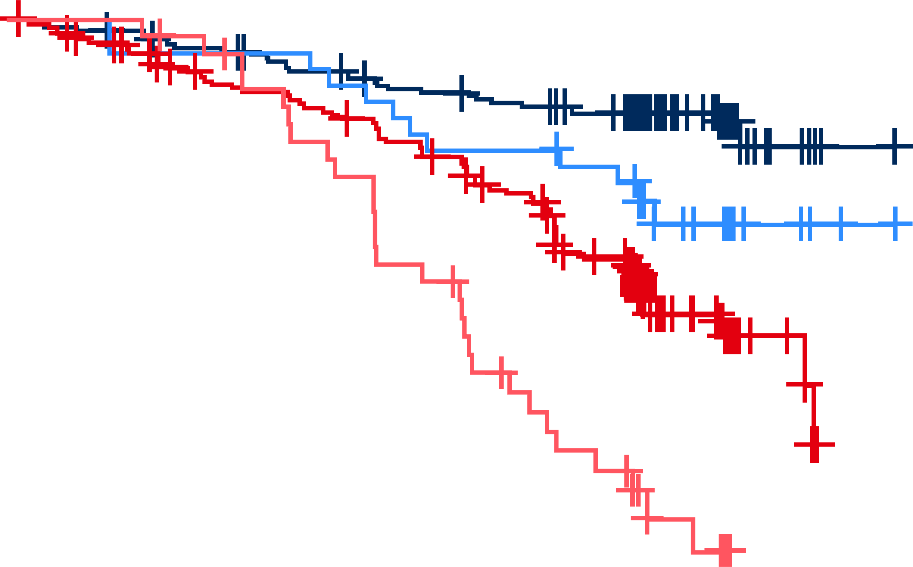
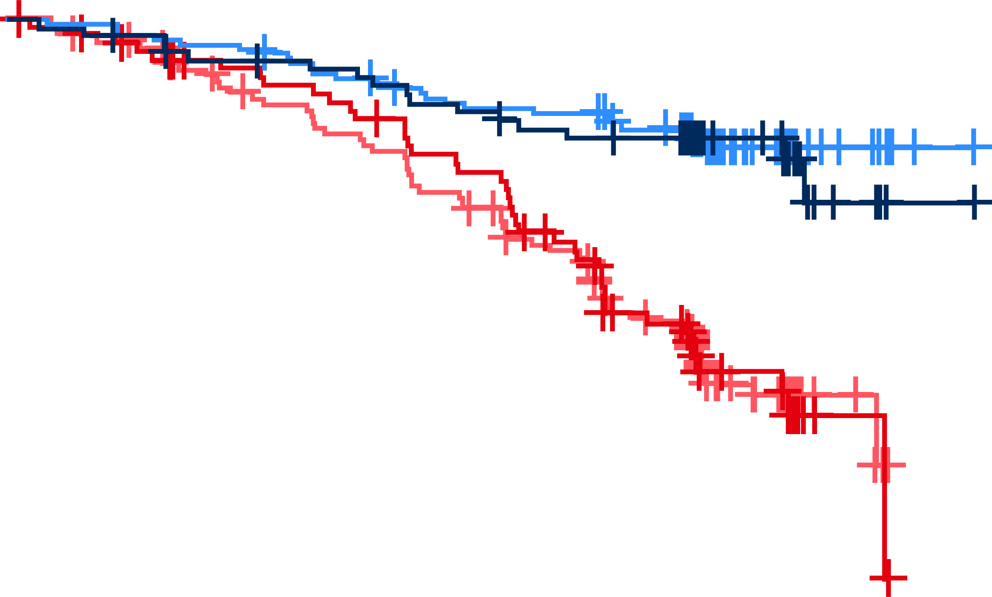
PFS by cytogenic abnormalities
del(11q)
del(13q)
1.00
1.00
0.75
0.75
0.50
0.50
 | mPFS, mo
Zanu del(11q) | NR
Zanu w/o del(11q) | NR
BR del(11q) | 29.2
BR w/o del(11q) | 50.3
 | mPFS, mo
Zanu del(13q) | NR
Zanu w/o del(13q) | NR
BR del(13q) | 40.8
BR w/o del(13q) | 44.9
0.25
0.25
 | BR del (11q) | Zanu w/o del(11q)
Zanu del(11q) | P<.001 | P=.05
 | BR del (13q) | Zanu w/o del(13q)
Zanu del(13q) | P<.001 | P=.77
0.00
0.00
Zanubrutinib demonstrated significantly better (P<.01) median PFS than BR, regardless of the cytogenetic abnormalities evaluated
  In the zanubrutinib arm, median PFS was not reached in any of the patient subgroups evaluated and did not significantly differ between patients with or without del(11q) or del(13q)

Slide 33
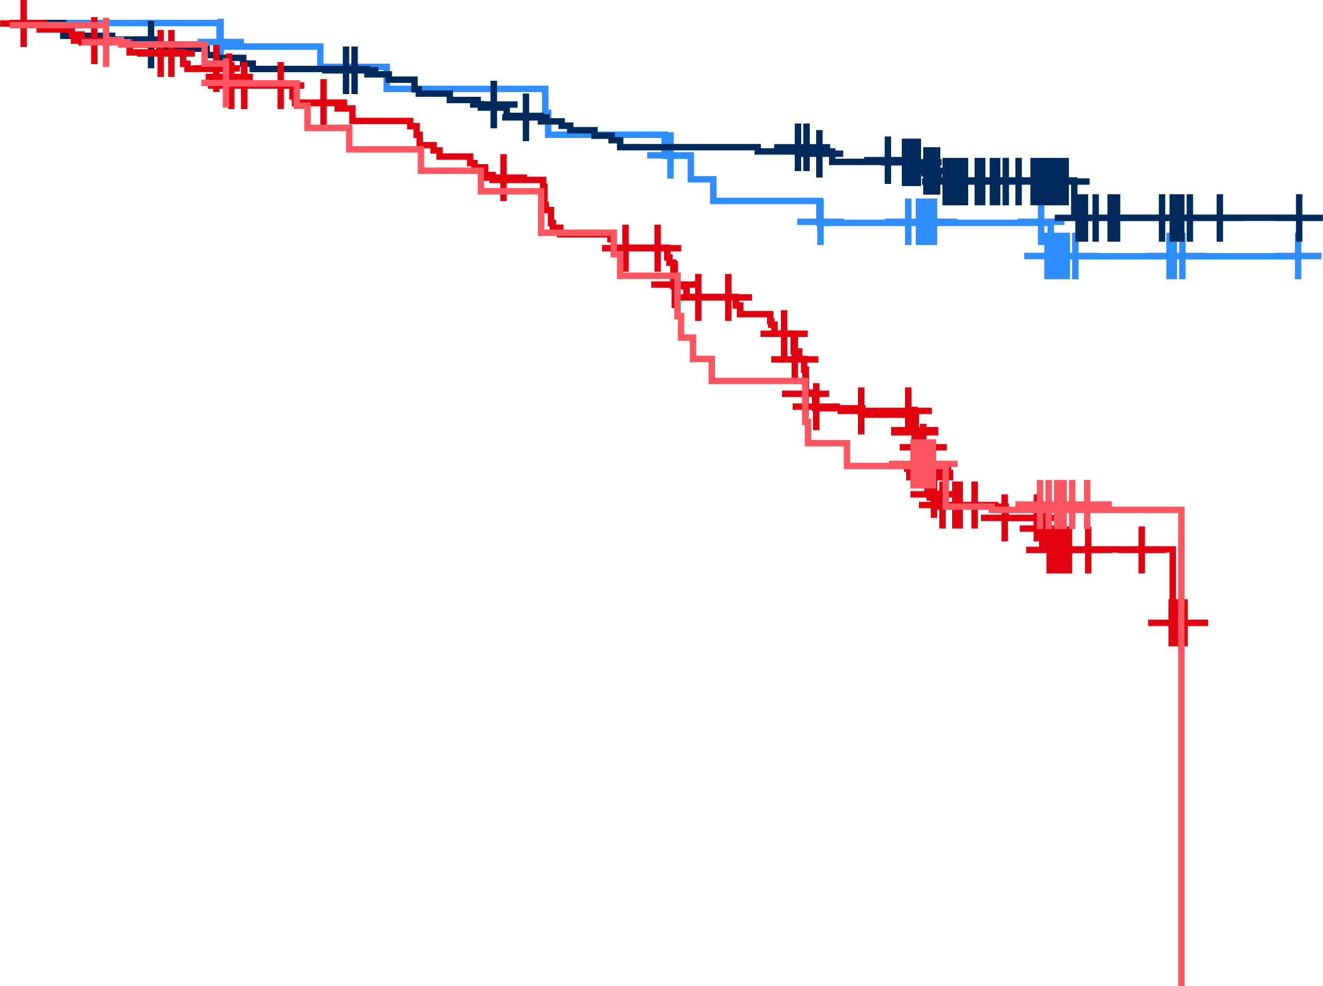
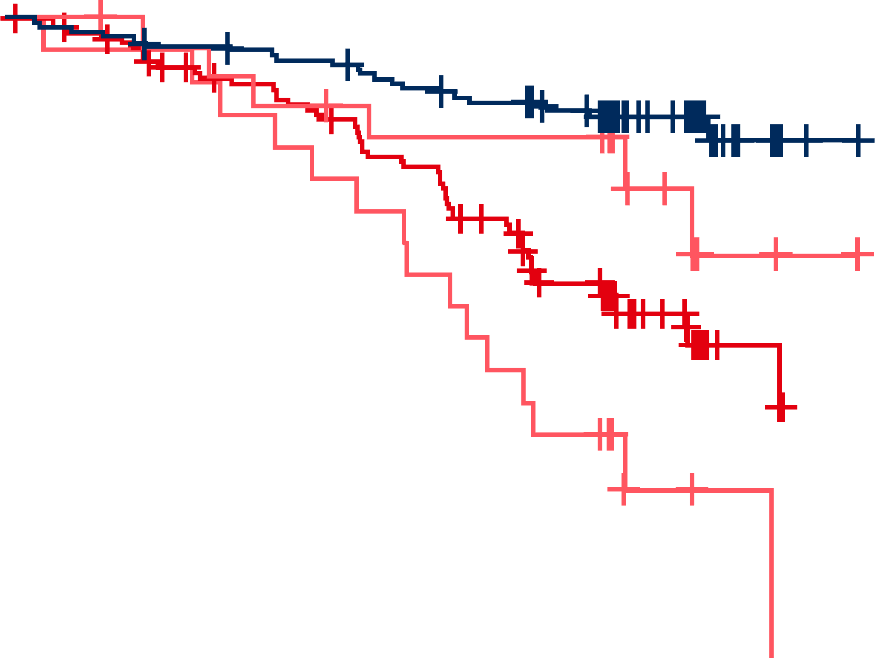
PFS by cytogenic abnormalities
Trisomy 12
CKT ≥3
1.00
1.00
0.75
0.75
0.50
0.50
 | mPFS, mo
Zanu trisomy 12 | NR
Zanu w/o trisomy 12 | NR
BR trisomy 12 | 40.7
BR w/o trisomy 12 | 40.8
 | mPFS, mo
Zanu CKT ≥3 | NR
Zanu normal | NR
BR CKT ≥3 | 31.1
BR normal | 45.4
0.25
0.25
 | BR trisomy 12 | Zanu w/o trisomy 12
Zanu trisomy 12 | P<.01 | P=.40
 | BR CKT ≥3 | Zanu normal
Zanu CKT ≥3 | P<.01 | P=.18
0.00
0.00
  In the zanubrutinib arm, median PFS was not reached in any of the patient subgroups evaluated and did not significantly differ between patients with or without trisomy 12 or CKT ≥3

Slide 34
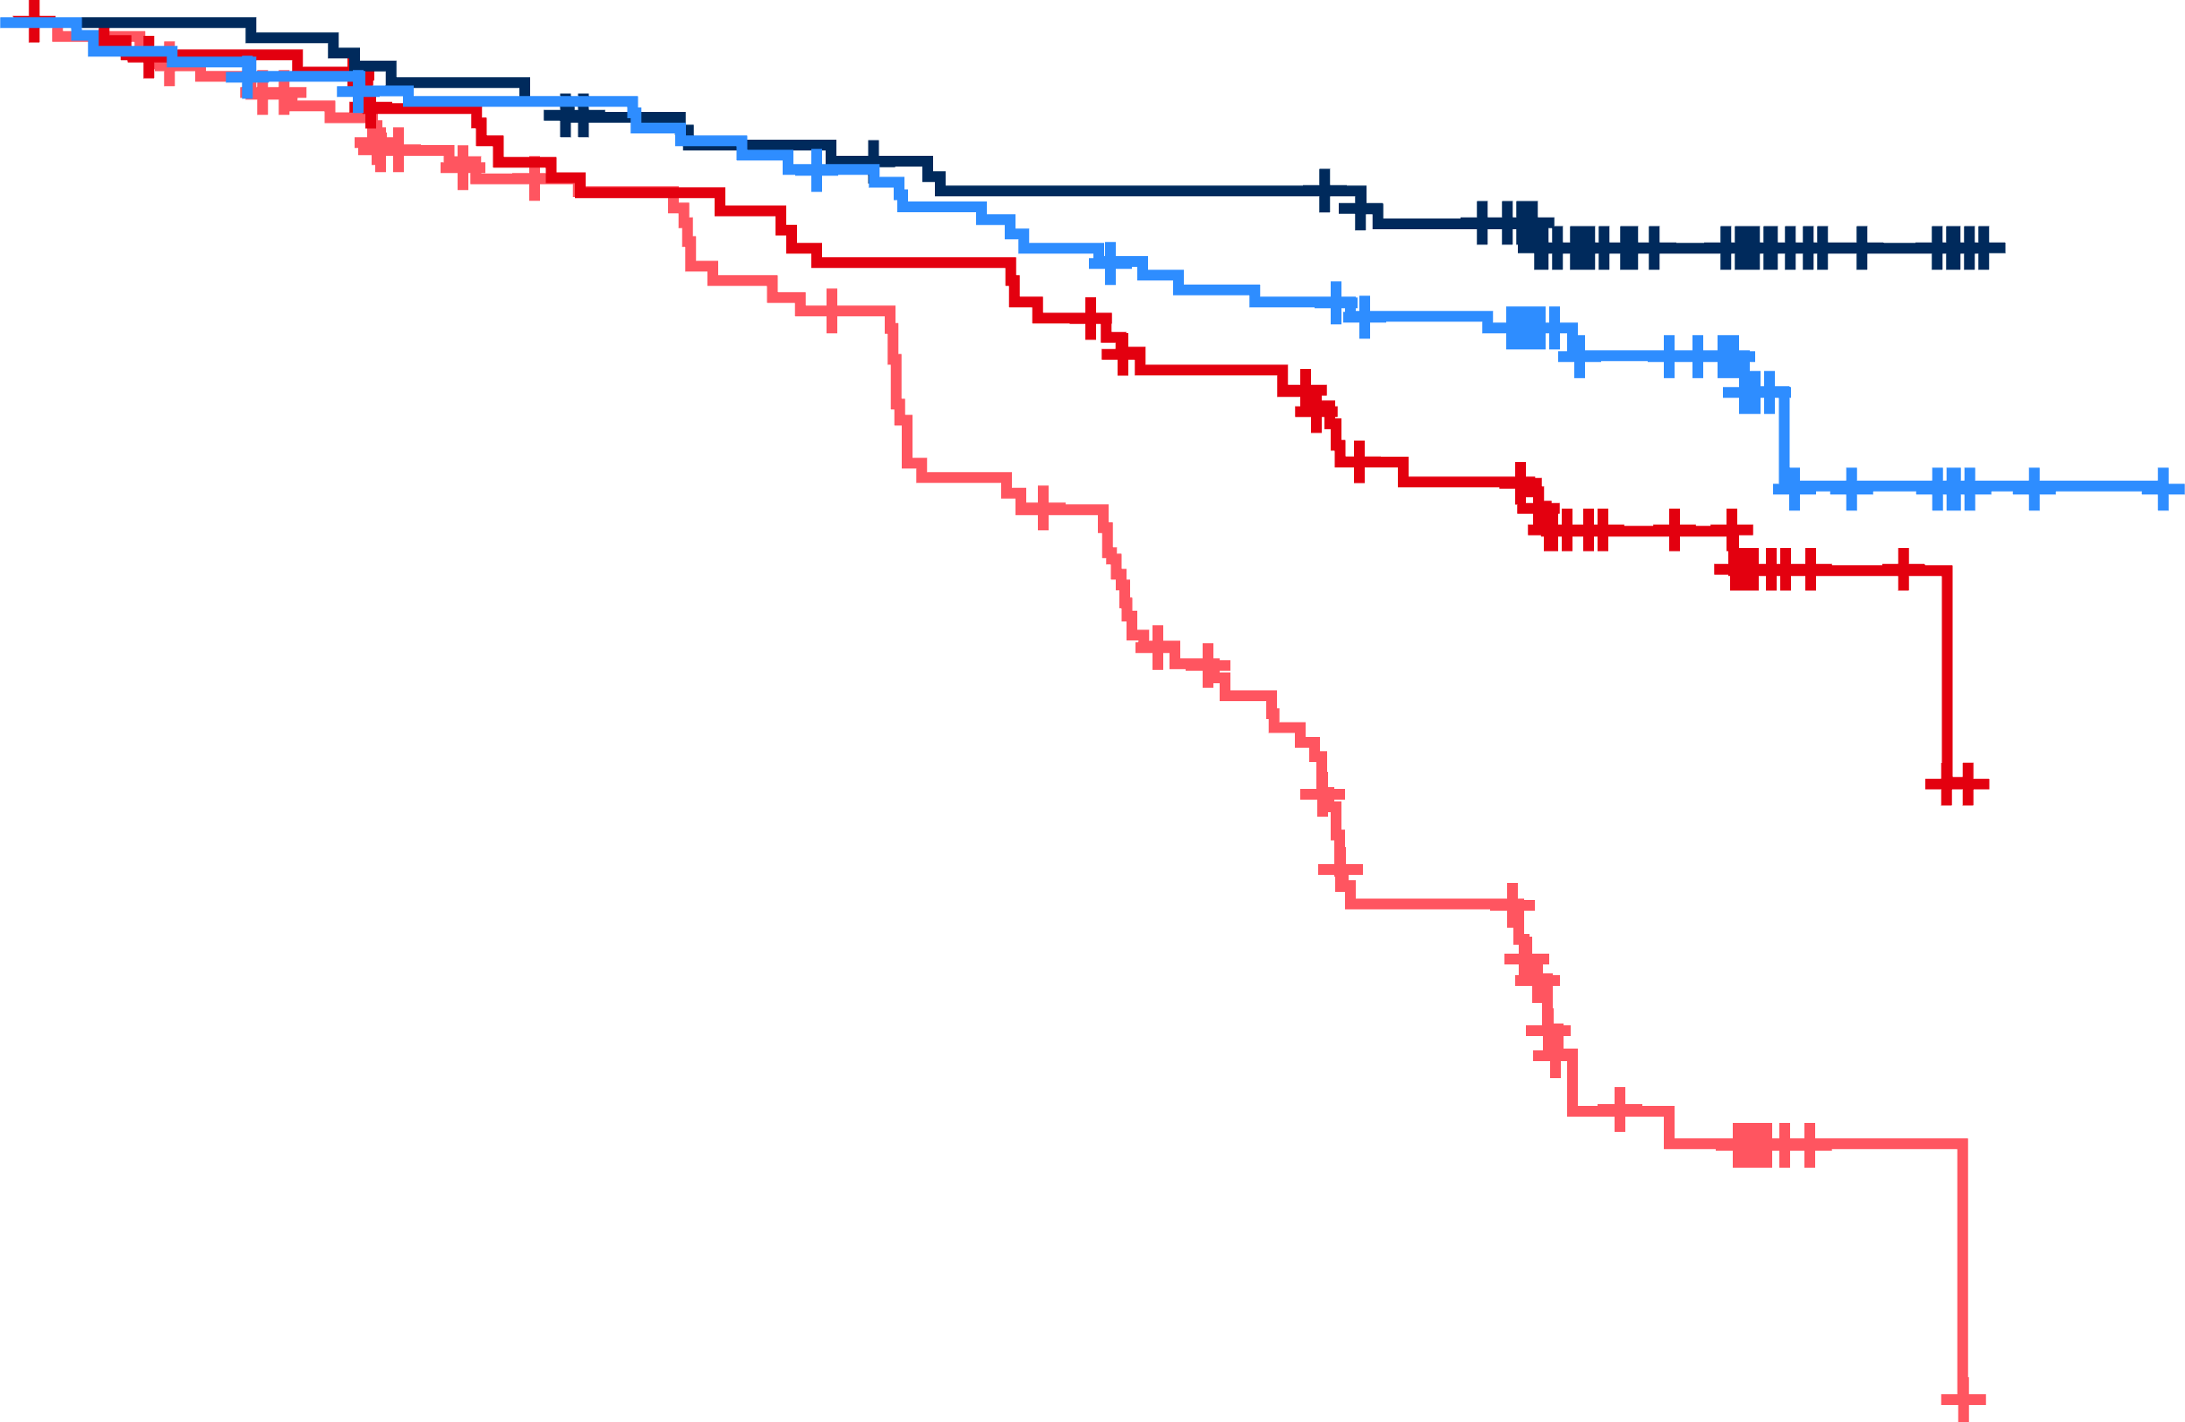
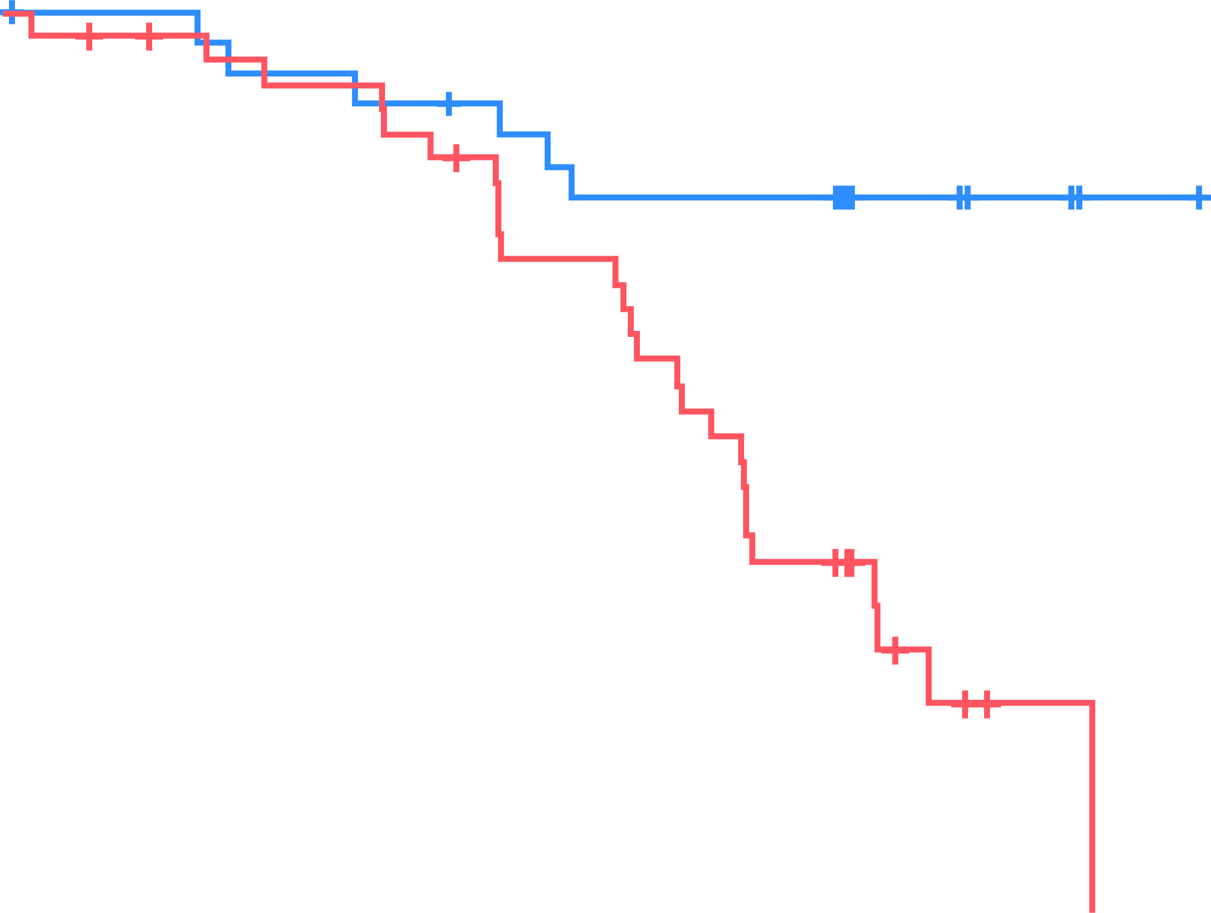
PFS by IGHV mutation status
PFS by IGHV mutation status
PFS by expression of unmutated IGHV1-69
1.00
1.00
1.00
0.75
0.75
0.75
0.50
0.50
0.50
 | mPFS, mo
Zanu ulGHV | NR
Zanu mlGHV | NR
BR ulGHV | 34.6
BR mlGHV | NR
0.25
0.25
0.25
 | mPFS, mo
Zanu IGHV1-69 | NR
BR IGHV1-69 | 34.6
 | BR mlGHV | Zanu ulGHV
Zanu mlGHV | P<.01 | P=.12
BR ulGHV |  | P<.0001
0.00
0.00
HR, 0.23; 95% CI, 0.1-0.57; P=.00048
0.00
Median PFS in the zanubrutinib arm was not significantly different between patients with vs without IGHV mutation but was significantly better than in the BR arm regardless of IGHV mutational status
In both arms, IGHV1-69 was the most prevalent gene utilized in patients with unmutated IGHV (zanubrutinib: 24.6% [31/126]; BR: 30.7% [39/127]); these patients showed significantly better PFS with zanubrutinib vs BR

Slide 35
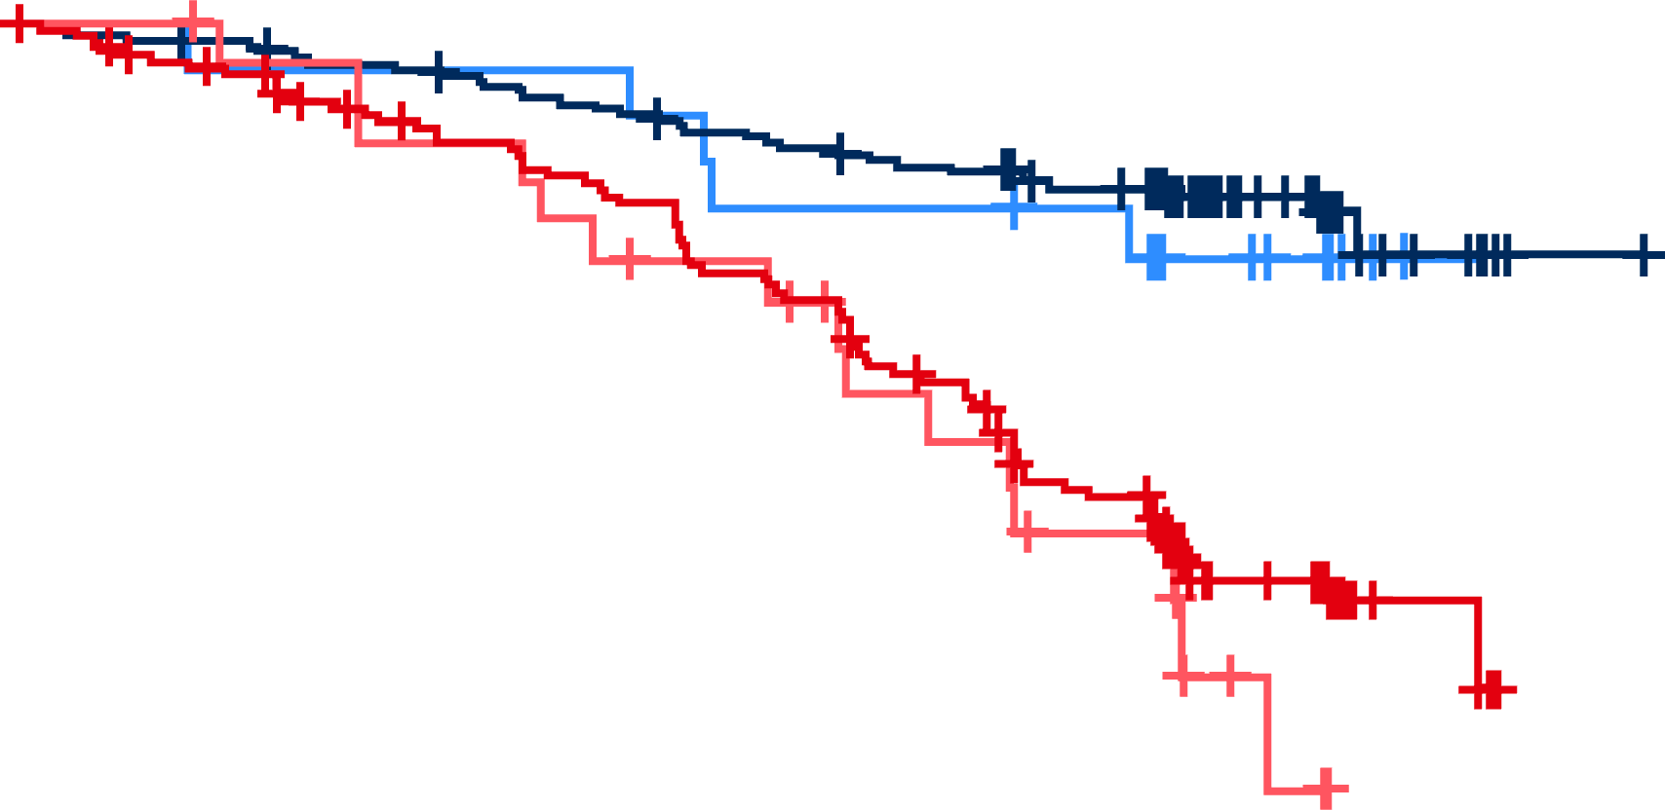
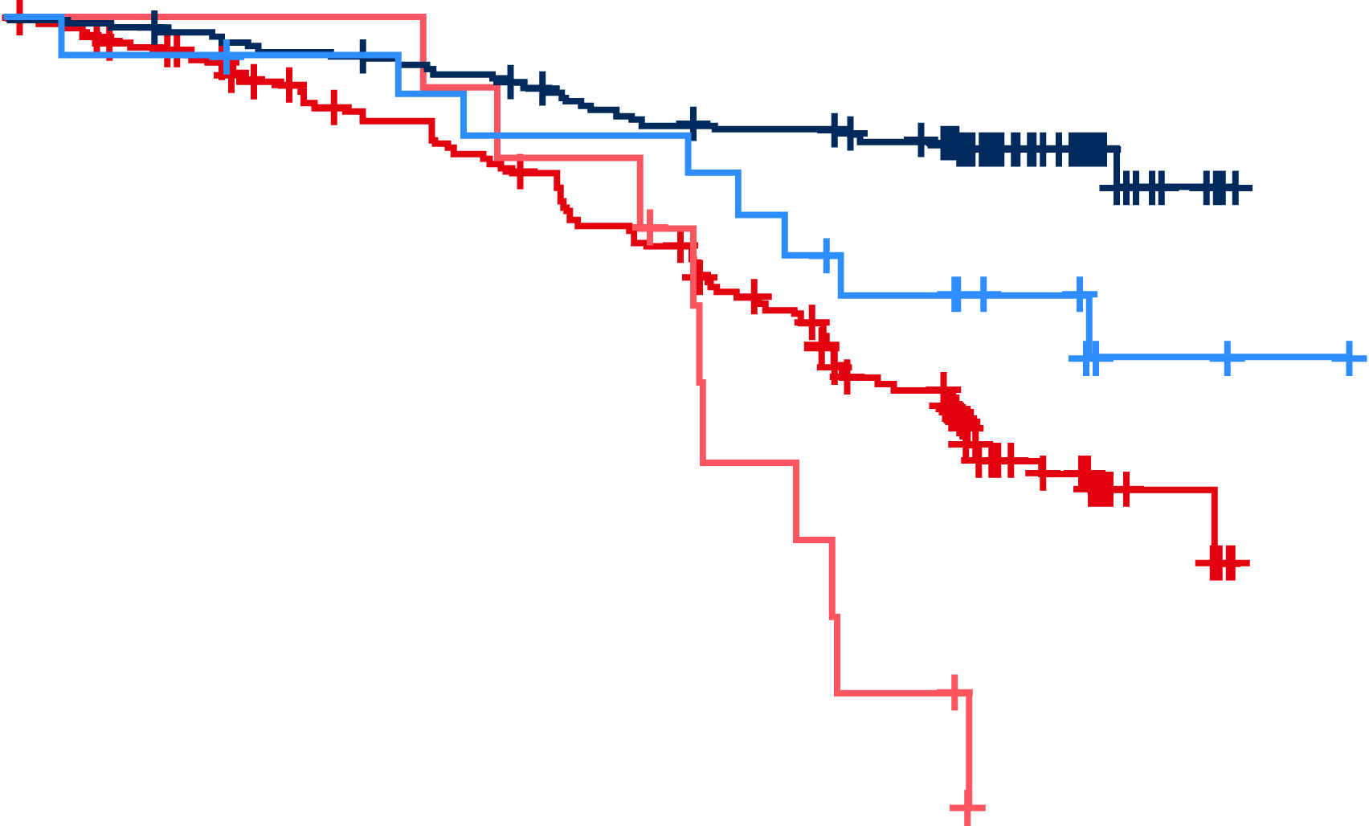
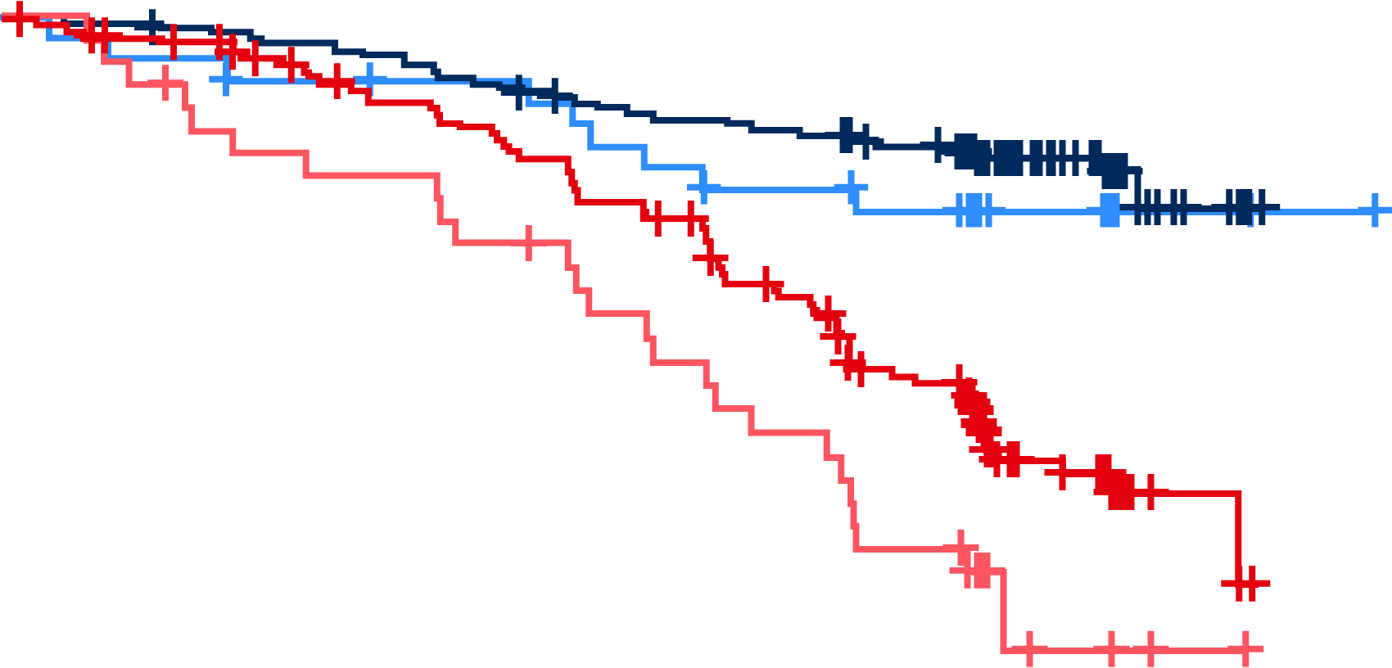
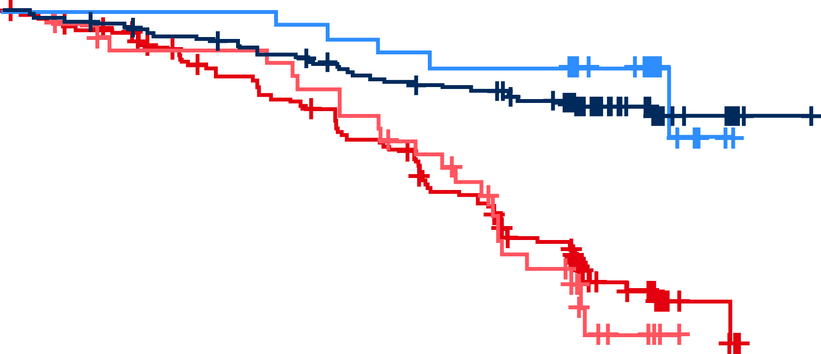
PFS in patients with mutations in ATM and BRAF, NOTCH1 and SF3B1
ATM
BRAF
NOTCH1
1.00
1.00
1.00
0.75
0.75
0.75
 | mPFS, mo
Zanu mBRAF | NR
Zanu wtBRAF | NR
BR mBRAF | 33.0
BR wtBRAF | 43.2
0.50
 | mPFS, mo
Zanu mATM | NR
Zanu wtATM | NR
BR mATM | 40.1
BR wtATM | 40.8
0.50
0.50
 | mPFS, mo
Zanu mNOTCH1 | NR
Zanu wtNOTCH1 | NR
BR mNOTCH1 | 34.5
BR wtNOTCH1 | 45.4
0.25
0.25
 | BR mBRAF | Zanu wtBRAF
Zanu mBRAF | P=.01 | P=.02
0.25
 | BR mATM | Zanu wtATM
Zanu mATM | P=.02 | P=.58
 | BR mNOTCH1 | Zanu wtNOTCH1
Zanu mNOTCH1 | P<.001 | P=.38
0.00
0.00
0.00
SF3B1
1.00
Across all patients, the most frequently mutated genes were NOTCH1 (zanu, 20%; BR, 20%), SF3B1 (zanu, 17%; BR, 21%), ATM (zanu, 11%; BR, 16%), and BRAF (zanu, 11%; BR, 7%), consistent with reported prevalence for TN CLL
  Patients with gene mutations that are associated with poor prognosis in CLL (ATM, BRAF, NOTCH1, and SF3B1) had significantly better PFS with zanu vs BR treatment
  Notably, median PFS was not reached in zanu-treated patients with or without mutations in ATM, NOTCH1, SF3B1, and BRAF; mutations in ATM (P=.58), NOTCH1 (P=.38), and SF3B1 (P=.39) did not affect PFS in those patients
0.75
0.50
 | mPFS, mo
Zanu mSF3B1 | NR
Zanu wtSF3B1 | NR
BR mSF3B1 | 40.1
BR wtSF3B1 | 43.2
0.25
 | BR mSF3B1 | Zanu wtSF3B1
Zanu mSF3B1 | P<.001 | P=.39
0.00

Slide 36
Summary of biomarker prevalence and associated PFS
Biomarkers | Zanu n/N (%) | BR n/N (%) | PFS, HR of zanu vs BR (95% CI) | PFS in zanu arm, HR of mutated vs unmutated (95% CI)
del(11q) | 41/239 (17) | 46/238 (19) | 0.26 (0.13-0.51) P<.001 | 1.96 (1.00-3.85) P=.05
del(13q) | 149/239 (62) | 142/238 (60) | 0.29 (0.18-0.46) P<.001 | 0.91 (0.49-1.69) P=.77
Trisomy 12 | 45/239 (19) | 49/238 (21) | 0.36 (0.17-0.76) P<.01 | 1.35 (0.66-2.78) P=.40
CKT ≥3 | 23/164 (14) | 22/161 (14) | 0.26 (0.10-0.67) P<.01 | 1.85 (0.75-4.55) P=.18
mIGHV | 107/233 (46) | 103/230 (45) | 0.37 (0.20-0.70) P<.01 | 0.60 (0.31-1.15) P=.12
uIGHV | 126/233 (54) | 127/230 (55) | 0.25 (0.16-0.39) P<.0001
mATM SNV | 24/223 (11) | 35/215 (16) | 0.31 (0.11-0.85) P=.02 | 1.30 (0.51-3.33) P=.58
mBRAF SNV | 24/223 (11) | 14/215 (7) | 0.27 (0.10-0.72) P=.01 | 2.44 (1.10-5.26) P=.02
mNOTCH1 SNV | 45/223 (20) | 43/215 (20) | 0.26 (0.12-0.56) P<.001 | 1.39 (0.66-2.94) P=.38
mSF3B1 SNV | 39/223 (17) | 46/215 (21) | 0.17 (0.06-0.44) P<.001 | 0.66 (0.26-1.69) P=.39

Slide 37
Conclusions
PFS in zanubrutinib-treated patients was favorable to that of BR-treated patients in most biomarker subgroups analyzed, including for known negative prognostic markers in CLL (eg., del(11q), CKT ≥3, uIGHV, and prognostic gene mutations such as ATM and SF3B1)
In the zanubrutinib treatment arm, comparable PFS benefit was observed for patients with or without most negative prognostic biomarkers analyzed
IGHV mutational status did not affect PFS outcome
Contrary to reports in patients with TN or relapsed/refractory CLL who received ibrutinib-based regimens CKT ≥3 was not associated with worse PFS in zanubrutinib-treated patients
This study provides further evidence that zanubrutinib is a potentially best-in-class BTK inhibitor with promising efficacy for front-line treatment in patients with CLL/SLL

Slide 38
BRUIN
Pirtobrutinib in post-cBTKi CLL/SLL

Slide 39
BRUIN study design
Open-label, multi-center Phase 1/2 study of pirtobrutinib in patients with CLL/SLL or NHL who have failed or are intolerant to standard of care
Phase 1 escalation + expansion (25 to 300 mg QD)
Phase 2 (200 mg QD)
N=778
Phase 1 3+3 design
28-day cycles
Intra-patient dose escalation allowed
Cohort expansion permitted at doses deemed safe
MCL
n=166
CLL/SLL
n=317
Otherª
n=295
Eligibility
Age ≥18
ECOG PS 0-2
Active disease and in need of treatment
Previously treated
BTKi naïve
n=35
Prior cBTKi
n=282
Key endpoints
Safety/tolerability
Determine MTD and RP2D
Pharmacokinetics
Efficacy (ORR according to iwCLL 2018 criteria, DoR, PFS, and OS)
No prior BCL2i
(Naïve: BCL2i-N)
n=154
Prior BCL2i
(Exposed: BCL2i-E)
n=128

Slide 40
Efficacy in CLL/SLL patients who received prior cBTKi
100
Prior cBTKi | n=282^{b}
ORRª incl. PR-L, % (95% CI) | 81.6 (76.5-85.9)
Best response, n (%)
CR | 5 (1.8)
nPR | 2 (0.7)
PR | 196 (69.5)
PR-L | 27 (9.6)
75
50
25
0
Change in sum of products of
diameters from baseline, %
-25
-50
-75
-100
Number of patients (n=252)*

Slide 41
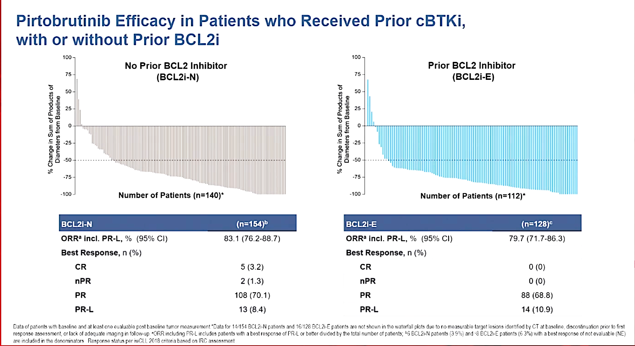
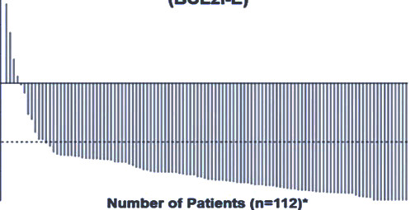
Efficacy in CLL/SLL patients who received prior cBTKi, with or without prior BCL2i
100
No prior BCL2 inhibitor
(BCL2i-N)
100
Prior BCL2 inhibitor
(BCL2i-E)
75
75
50
50
25
25
Change in sum of products of
diameters from baseline, %
% Change in sum of products of
diameters from baseline
0
0
-25
-25
-50
-50
-75
-75
-100
Number of patients (n=140)*
-100
Number of patients (n=112)*
BCL2i-N | (n=154)
ORRª incl. PR-L, % (95% CI) | 83.1 (76.2-88.7)
Best response, n (%)
CR | 5 (3.2)
nPR | 2 (1.3)
PR | 108 (70.1)
PR-L | 13 (8.4)
BCL2i-E | (n=128)
ORRª incl. PR-L, % (95% CI) | 79.7 (71.7-86.3)
Best response, n (%)
CR | 0 (0)
nPR | 0 (0)
PR | 88 (68.8)
PR-L | 14 (10.9)

Slide 42
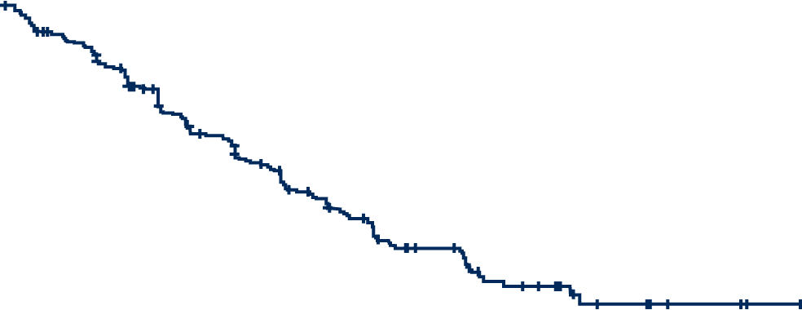
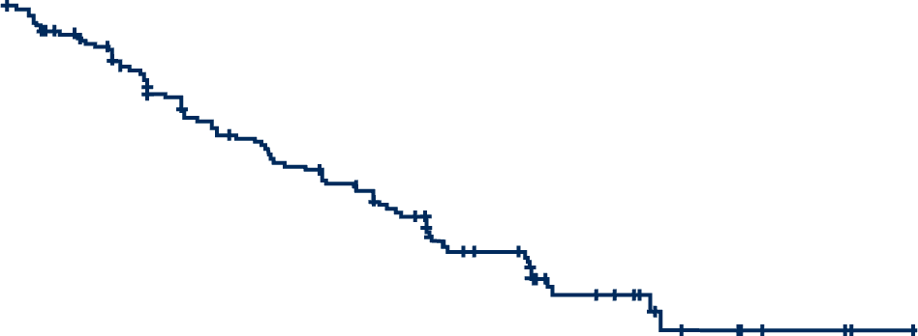
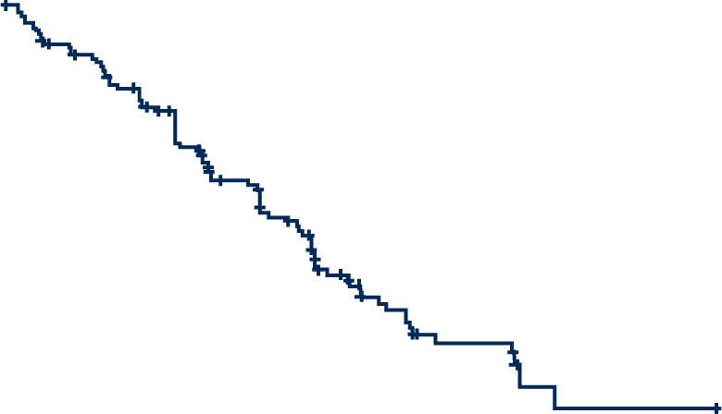
Progression-free survival
PFS in patients with prior cBTKi
PFS in patients with prior cBTKi without prior BCL2i
PFS in patients with prior cBTKi and prior BCL2i
Median | 19.4 months
95% Cl | 16.6-22.1
Median follow-up | 27.5 months
Events/total | 160/282
Median | 23 months
95% Cl | 19.6-28.4
Median follow-up | 27.6 months
Events/total | 79/154
Median | 15.9 months
95% Cl | 13.6-17.5
Median follow-up | 22.2 months
Events/total | 81/128
84.9%
87.1%
82.2%
67.4%
72.8%
62.5%
60.7%
52.8%
48.3%
38.6%
39.6%
24.3%
No. at risk
282 | 258 | 242 | 223 | 202 | 180 | 160 | 144 | 136 | 118 | 99 | 90 | 59 | 56 | 29 | 24 | 23 | 12 | 9 | 9 | 3 | 3 | 3 | 1 | 0
No. at risk
154 | 143 | 134 | 124 | 114 | 104 | 99 | 92 | 89 | 84 | 74 | 70 | 47 | 44 | 26 | 22 | 21 | 10 | 7 | 7 | 3 | 3 | 3 | 1 | 0
No. at risk
128 | 115 | 108 | 99 | 88 | 76 | 61 | 52 | 47 | 34 | 25 | 20 | 12 | 12 | 3 | 2 | 2 | 2 | 2 | 2 | 0 | 0 | 0 | 0 | 0
Patients with prior cBTKi (n=282) had a median PFS of 19.4 months and an 18-month PFS rate of 52.8%
Patients naïve to BCL2i (n=154) had a median PFS of 23.0 months and an 18-month PFS rate of 62.5%
Patients exposed to BCL2i (n=128) had a median PFS of 15.9 months and an 18-month PFS rate of 39.6%

Slide 43
Progression-free survival
OS in patients with prior cBTKi
OS in patients with prior cBTKi without prior BCL2i
OS in patients with prior cBTKi and prior BCL2i
Median | NE months
95% Cl | NE-NE
Median follow-up | 29.3 months
Events/total | 85/282
Median | NE months
95% Cl | NE-NE
Median follow-up | 31.6 months
Events/total | 35/154
Median | NE months
95% Cl | 28.4-NE
Median follow-up | 27.4 months
Events/total | 50/128
92.9%
85.6%
94.4%
90.0%
87.3%
89.8%
79.8%
73.2%
83.1%
80.2%
70.7%
60.6%
No. at risk
282 | 271 | 265 | 257 | 250 | 239 | 230 | 219 | 213 | 204 | 190 | 173 | 166 | 135 | 116 | 95 | 73 | 52 | 31 | 24 | 14 | 10 | 6 | 4 | 1 | 0
No. at risk
154 | 149 | 146 | 142 | 139 | 134 | 133 | 131 | 129 | 126 | 124 | 117 | 113 | 89 | 82 | 67 | 56 | 41 | 28 | 21 | 13 | 9 | 6 | 4 | 1 | 0
No. at risk
128 | 122 | 119 | 115 | 111 | 105 | 97 | 88 | 84 | 78 | 66 | 56 | 53 | 46 | 34 | 28 | 17 | 11 | 3 | 3 | 1 | 1 | 0 | 0 | 0 | 0

Slide 44
Safety profile of patients who received prior cBTKi
 | Treatment-emergent AEs in patients with CLL/SLL (n=282)
 | All cause AEs, (≥20%), % |  | Treatment-related AEs, %
Adverse event | Any Grade | Grade ≥3 | Any Grade | Grade ≥3
Fatigue | 36.9 | 1.8 | 3.5 | 0.0
Neutropenia^{a,b} | 34.4 | 28.4 | 19.5 | 15.2
Diarrhea | 28.4 | 0.4 | 7.8 | 0.0
Cough | 27.3 | 0.0 | 1.8 | 0.0
Contusion | 26.2 | 0.0 | 17.4 | 0.0
COVID-19 | 25.9 | 4.6 | 0.7 | 0.0
Dyspnea | 22.3 | 2.1 | 0.7 | 0.4
Nausea | 22.0 | 0.0 | 3.5 | 0.0
Abdominal pain | 21.3 | 1.8 | 2.1 | 0.4
AEs of interest^{c} | Any Grade | Grade ≥3 | Any Grade | Grade ≥3
Infections^{d} | 74.1 | 30.9 | 12.8 | 4.3
Bruising^{e} | 30.1 | 0.0 | 19.1 | 0.0
Rash^{f} | 24.5 | 1.1 | 5.7 | 0.4
Arthralgia | 22.7 | 1.4 | 4.3 | 0.0
Hemorrhage^{g} | 13.5 | 2.1 | 4.6 | 1.1
Hypertension | 14.2 | 4.3 | 3.5 | 0.4
Atrial fibrillation/flutter^{h,i} | 4.6 | 1.8 | 1.4 | 0.7
Median time on treatment was 18.7 months (with prior cBTKi), 24.3 months
(BCL2i-N) and 15.3 months (BCL2i-E)
11 (3.9%; 9 BCL2i-N),
2 BCL2i-E) patients had TRAEs leading to pirtobrutinib dose reduction
7 (2.5%; 4 BCL2i-N, 3 BCL2i-E) patients had TRAEs leading to pirtobrutinib discontinuation
Safety profiles of BCL2i-N and BCL2i-E subgroups were similar

Slide 45
Conclusions
With median follow-up of 30 months, pirtobrutinib continues to demonstrate clinically meaningful and durable efficacy in heavily pretreated patients with CLL/SLL who received prior cBTKi
  ORR including PR-L was ~80% regardless of prior BCL2 inhibitor exposure
  Median PFS was 19.4 months overall, with 23.0 months for BCL2i-N patients and 15.9 months for BCL2i-E patients
Pirtobrutinib was well-tolerated with low-rates of discontinuation due to drug-related toxicity among both BCL2i-N and BCL2i-E patients
These results suggest that continuation of BTK pathway inhibition may be an important sequencing approach to consider in the treatment of CLL/SLL
On December 1, 2023, the FDA granted accelerated approval to pirtobrutinib for adults with CLL/SLL who have received at least two prior lines of therapy, including a BTKi and a BCL2i

Slide 46
BRUIN
Phase 1b study of pirtobrutinib + venetoclax ± rituximab in R/R CLL

Slide 47
BRUIN study design
Phase 1b dose expansion study of fixed-duration pirtobrutinib combined with venetoclax ± rituximab
in R/R CLL
PV dosing regimen
Pirtobrutinib
200 mg QD starting cycle 1 day 1
Venetoclax
Starting cycle 2 day 1 with a standard 5-week dose ramp to 400 mg QD, n=15
Phase 1b Design
A 3+3 safety assessment for each combination arm
No plan for dose escalation of any study drug
Enrolment could be expanded by up to 30 additional patients
Phase 1 dose escalation and expansion (25 to 300 mg once daily)
Phase 1b of pirtobrutinib and venetoclax ± rituximab
N=25
Eligibility
Age ≥18
ECOG PS 0-2
Histologically confirmed R/R CLL/SLL
Active disease and in need of treatment
Prior covalent BTK inhibitors permitted.
Prior venetoclax or other BCL-2 inhibitors were not permitted
PVR dosing regimen
Rituximab
375 mg/m² on cycle 1 day 1 and then 500 mg/m² on day 1 of cycles 2-6.
Pirtobrutinib
200 mg QD starting cycle 1 day 3
Venetoclax
Starting cycle 2 day 1 with a standard 5-week dose ramp to 400 mg QD, n=10
Key endpointsª
Safety assessed by TEAEs graded by CTCAE v5.0
ORR and PFS based on investigator assessment
Undetectable MRD defined as <1 CLL cell/10,000 nucleated cells in peripheral blood via clonoSEQ assay
Pharmacokinetics for pirtobrutinib and venetoclax
Pirtobrutinib and venetoclax were given in combination in a fixed duration for 24 cycles
Each cycle was 28 days

Slide 48
Responses
Efficacy of pirtobrutinib combination therapy
SPD
Response | PV (n=15) | PVR (n=10) | Total (N=25)
ORRª, % (95% CI) | 93.3 (68.1-99.8) | 100 (69.2-100) | 96 (79.6-99.9)
Best response, n (%)
CR | 7 (46.7) | 3 (30.0) | 10 (40.0)
PR | 7 (46.7) | 7 (70.0) | 14 (56.0)
SD | 1 (6.7) | 0 | 1 (4.0)
Change in sum of products of diameters from baseline, %
PV cohort
PVR cohort
Changes in SPD were similar among patients who were BTKi naïve and previously BTKi treated
Median time to best response was 2.4 months (IQR, 1.87-14.32) for all patients
Median time on treatment was 23.0 months (IQR, 21.98-23.29)
Median time on study was 25.3 months (IQR, 23.34-28.44)
Treatment has been discontinued for 22 patients and is ongoing for 3 (PV:1; PVR: 2)

Slide 49
Undetectable minimal residual disease
uMRD at a sensitivity threshold <10⁻⁴
 |  |  |  |  |  |  |  |  |  |  |  | BORª | Status^{b}
PV COHORT | 1 |  |  |  |  |  |  |  |  |  |  | CR-CYCLE 16 | COMPLETED
 | 2 |  |  |  |  |  |  |  |  |  |  | CR-EOT | COMPLETED
 | 3 |  |  |  |  |  |  |  |  |  |  | PR-CYCLE 3 | D/C-OTHER
 | 4 |  |  |  |  |  |  |  |  |  |  | PR-CYCLE 3 | COMPLETED
 | 5 |  |  |  |  |  |  |  |  |  |  | PR-CYCLE 3 | COMPLETED
 | 6 |  |  |  |  |  |  |  |  |  |  | CR-CYCLE 25 | COMPLETED
 | 7 |  |  |  |  |  |  |  |  |  |  | CR-CYCLE 5 | COMPLETED
 | 8 |  |  |  |  |  |  |  |  |  |  | PR-CYCLE 3 | COMPLETED
 | 9 |  |  |  |  |  |  |  |  |  |  | R-CYCLE 5 | D/C-PD
 | 10 |  |  |  |  |  |  |  |  |  |  | PR-CYCLE 3 | ONGOING
 | 11 |  |  |  |  |  |  |  |  |  |  | CR-CYCLE 13 | D/C-OTHER
 | 12 |  |  |  |  |  |  |  |  |  |  | CR-CYCLE 19 | COMPLETED
 | 13 |  |  |  |  |  |  |  |  |  |  | CR-CYCLE 16 | D/C-PD
 | 14 |  |  |  |  |  |  |  |  |  |  | PR-CYCLE 3 | COMPLETED
PVR COHORT | 1 |  |  |  |  |  |  |  |  |  |  | PR-CYCLE 3 | D/C-AE
 | 2 |  |  |  |  |  |  |  |  |  |  | PR-CYCLE 3 | D/C-DEATH
 | 3 |  |  |  |  |  |  |  |  |  |  | CR-CYCLE 25 | COMPLETED
 | 4 |  |  |  |  |  |  |  |  |  |  | PR-CYCLE 3 | COMPLETED
 | 5 |  |  |  |  |  |  |  |  |  |  | CR-CYCLE 22 | COMPLETED
 | 6 |  |  |  |  |  |  |  |  |  |  | PR-CYCLE 3 | D/C-AE
 | 7 |  |  |  |  |  |  |  |  |  |  | PR-CYCLE 3 | COMPLETED
 | 8 |  |  |  |  |  |  |  |  |  |  | PR-CYCLE 3 | COMPLETED
 | 9 |  |  |  |  |  |  |  |  |  |  | PR-CYCLE 3 | ONGOING
 | 10 |  |  |  |  |  |  |  |  |  |  | CR-CYCLE 13 | ONGOING
70.8% (PV=10; PVR=7) of patients achieved uMRD rate at cycle 13
87.5% of patients (PV=12; PVR=9) achieved uMRD at some time during the trial
Median time-to-first uMRD was 4.3 months for PV and 3.7 months for PVR
All but one patient sustained uMRD during subsequent MRD assessments
MRD <10⁻⁴
Detectable
Undetectable
Missing data
Cycle
3
5
7
9
11
13
16
19
22
25^{c}
MRD assessments from cycles 3 to 25

Slide 50
Progression-free survival
PFS of pirtobrutinib-based combination regimens
100.0%
92.9%
Median (IQR) duration of follow-up for PFS was 22.1 months (20.1-23.0) for all patients
PFS rate at 18 months was 87.5% (95% CI: 66.1-95.8) for all patients
The 24-month PFS rate was 79.5% (95% CI: 52.0-92.3) for all patients
90.0%
91.7%
92.9%
87.5%
80.0%
79.5%
No. at risk
PV | 15 | 15 | 15 | 14 | 14 | 14 | 13 | 13 | 12 | 12 | 11 | 8 | 3 | 2 | 1 | 0
PVR | 10 | 10 | 10 | 10 | 9 | 9 | 9 | 8 | 7 | 7 | 6 | 6 | 0 | 0 | 0 | 0
Total | 25 | 25 | 25 | 24 | 23 | 23 | 22 | 21 | 19 | 19 | 17 | 14 | 3 | 2 | 1 | 0

Slide 51
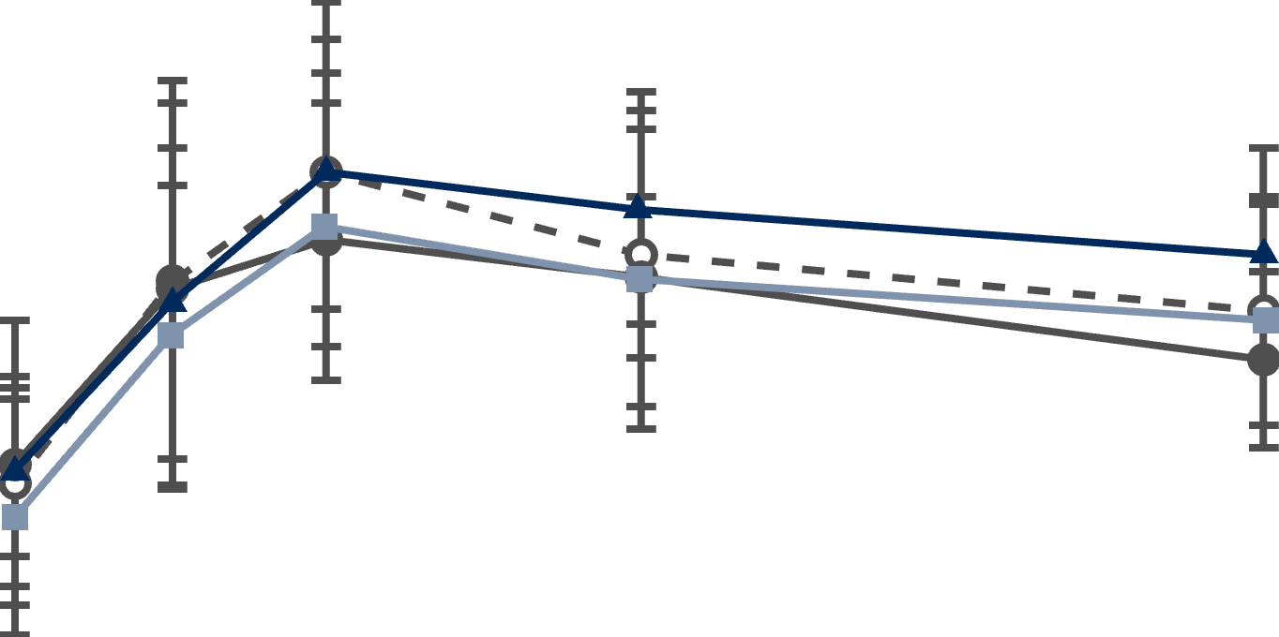
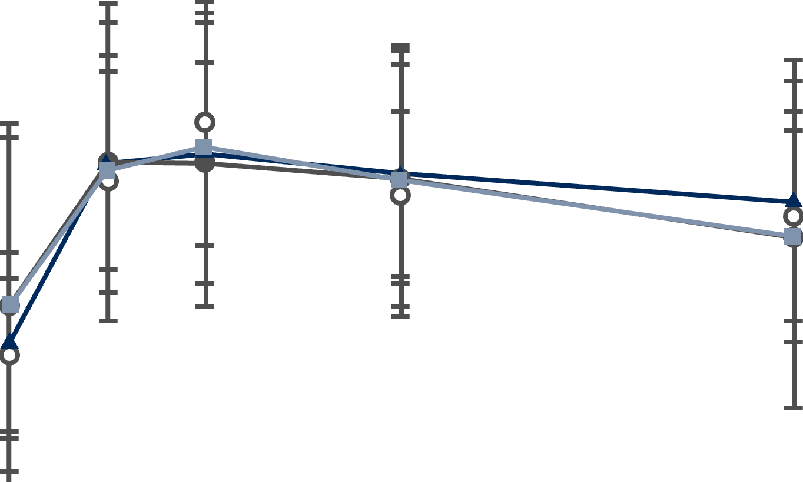
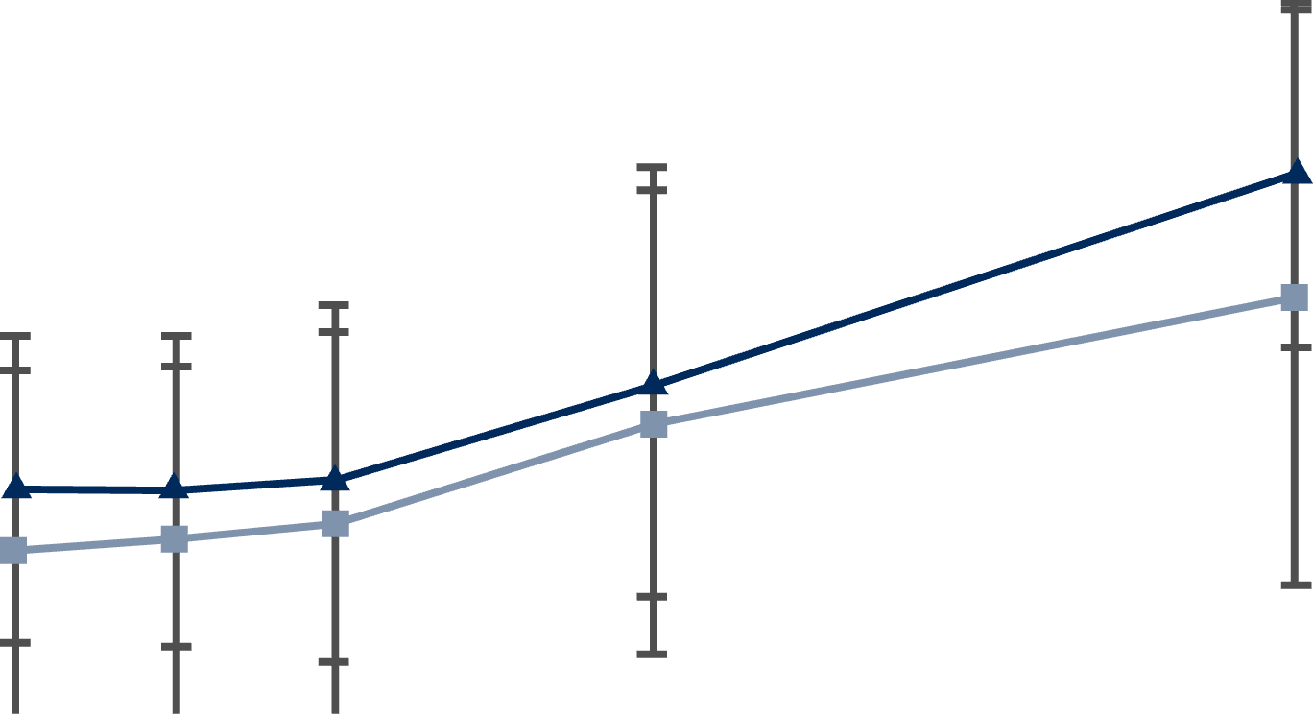
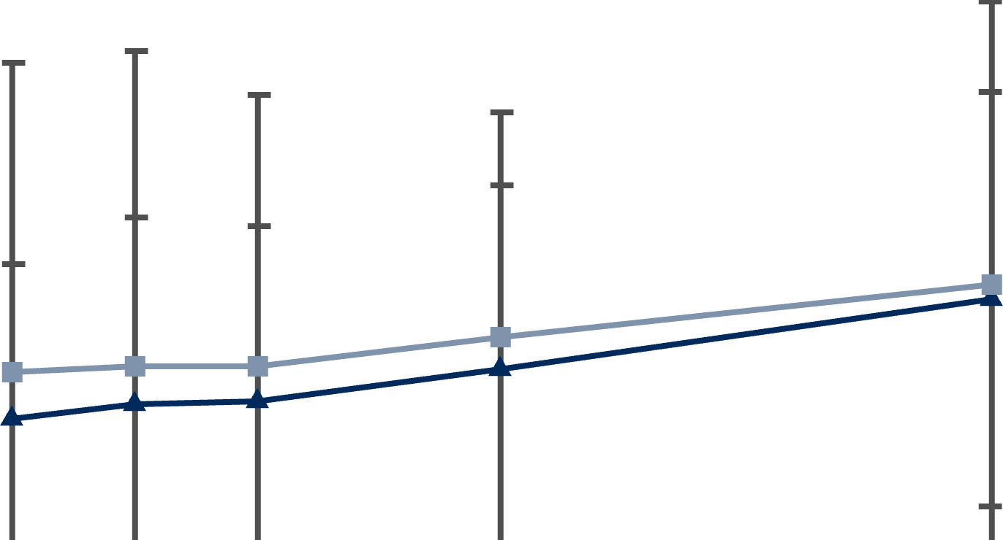
Pharmacokinetics
Pirtobrutinib with venetoclax
Pirtobrutinib, venetoclax, and rituximab
Pirtobrutinib plasma
concentration, ng/mL
8000
Pirtobrutinib plasma
concentration, ng/mL
8000
There was no apparent drug-drug interaction between pirtobrutinib and venetoclax
Both combination therapies had PK exposures comparable to pirtobrutinib and venetoclax monotherapies^{1,2}
6000
6000
4000
4000
2000
2000
0
0
0
2
4
6
8
0
2
4
6
8
Time, h
Time, h
Venetoclax plasma
concentration, ng/mL
6000
Venetoclax plasma
concentration, ng/mL
6000
5000
5000
Cycle 1 day 8
4000
4000
3000
3000
Cycle 2 day 8
2000
2000
Cycle 3 day 8
1000
1000
0
0
Cycle 4 day 1
0
2
4
6
8
0
2
4
6
8
Time, h
Time, h
Open circles for cycle 1 day 8 represent pirtobrutinib alone, and closed symbols from cycle 2 and later represent pirtobrutinib and venetoclax.

Slide 52
Pirtobrutinib and Venetoclax safety profile
 | All-cause AEs (≥25%), n (%) |  | Treatment-related AEs, n (%)
Adverse event | Any Grade | Grade ≥3 | Any Grade | Grade ≥3
Neutropeniaª | 7 (46.7) | 7 (46.7) | 7 (46.7) | 7 (46.7)
Nausea | 9 (60.0) | 0 (0.0) | 7 (46.7) | 0 (0.0)
Fatigue | 8 (53.3) | 0 (0.0) | 5 (33.3) | 0 (0.0)
Diarrhea | 7 (46.7) | 2 (13.3) | 4 (26.7) | 2 (13.3)
Hypophosphatemia | 5 (33.3) | 0 (0.0) | 2 (13.3) | 0 (0.0)
Constipation | 4 (26.7) | 0 (0.0) | 3 (20.0) | 0 (0.0)
Cough | 4 (26.7) | 0 (0.0) | 1 (6.7) | 0 (0.0)
Platelet count decreased | 4 (26.7) | 1 (6.7) | 4 (26.7) | 1 (6.7)
Vomiting | 4 (26.7) | 0 (0.0) | 2 (13.3) | 0 (0.0)
Anemia | 3 (20.0) | 3 (20.0) | 2 (13.3) | 2 (13.3)
Tumor lysis syndrome | 2 (13.3) | 2 (13.3) | 2 (13.3) | 2 (13.3)
Pyrexia | 3 (20.0) | 1 (6.7) | 1 (6.7) | 1 (6.7)
AEs of interest^{b} | Any Grade | Grade ≥3 | Any Grade | Grade ≥3
Infections^{c} | 12 (80.0) | 4 (26.7) | 7 (46.7) | 3 (20.0)
Bruising^{d} | 3 (20.0) | 0 (0.0) | 3 (20.0) | 0 (0.0)
Rash^{e} | 1 (6.7) | 0 (0.0) | 1 (6.7) | 0 (0.0)
Arthralgia | 4 (26.7) | 0 (0.0) | 2 (13.3) | 0 (0.0)
Hemorrhage^{f} | 1 (6.7) | 0 (0.0) | 1 (6.7) | 0 (0.0)
Hypertension | 3 (20.0) | 1 (6.7) | 2 (13.3) | 0 (0.0)
Atrial fibrillation/flutter^{g} | 0 (0.0) | 0 (0.0) | 0 (0.0) | 0 (0.0)
TEAEs in the PV cohort (n=15)
No DLTs were observed
Pirtobrutinib dose was reduced in 1 patient who experienced treatment-related diarrhea and platelet count decreased
Two cases of clinical TLS related to venetoclax dose escalation
  Grade 3 case resolved spontaneously after 24 hours
  Grade 4 case resolved after short-term IV fluids and dialysis
    Both TLS patients completed all 24 cycles of combination therapy

Slide 53
Pirtobrutinib and Venetoclax plus rituximab safety profile
 | All-cause AEs (≥25%), n (%) |  | Treatment-related AEs, n (%)
Adverse event | Any Grade | Grade ≥3 | Any Grade | Grade ≥3
Neutropeniaª | 7 (70.0) | 6 (60.0) | 7 (70.0) | 6 (60.0)
Diarrhea | 6 (60.0) | 0 | 6 (60.0) | 0
Fatigue | 5 (50.0) | 1 (10.0) | 2 (20.0) | 0
Nausea | 4 (40.0) | 0 | 4 (40.0) | 0
Constipation | 4 (40.0) | 0 | 1 (10.0) | 0
Infusion related reaction | 4 (40.0) | 2 (20.0) | 4 (40.0) | 2 (20.0)
Anemia | 3 (30.0) | 1 (10.0) | 2 (20.0) | 1 (10.0)
Back pain | 3 (30.0) | 1 (10.0) | 1 (10.0) | 0
Chills | 3 (30.0) | 0 | 3 (30.0) | 0
Dry Niztg | 3 (30.0) | 0 | 1 (10.0) | 0
Platelet count decreased | 2 (20.0) | 1 (10.0) | 2 (20.0) | 1 (10.0)
Hypertension Urgency | 1 (10.0) | 1 (10.0) | 1 (10.0) | 1 (10.0)
AEs of interest^{b} | Any Grade | Grade ≥3 | Any Grade | Grade ≥3
Infections^{c} | 9 (90.0) | 4 (40.0) | 2 (20.0) | 1 (10.0)
Bruising^{d} | 3 (30.0) | 0 | 2 (20.0) | 0
Rash^{e} | 3 (30.0) | 0 | 1 (10.0) | 0
Arthralgia | 4 (40.0) | 0 | 1 (10.0) | 0
Hemorrhage^{f} | 2 (20.0) | 1 (10.0) | 1 (10.0) | 1 (10.0)
Hypertension | 1 (10.0) | 1 (10.0) | 0 | 0
Atrial fibrillation/flutter^{g} | 0 | 0 | 0 | 0
TEAEs in the PVR cohort (n=10)
  No DLTs were observed
  Treatment-related pitrobrutinib and venetoclax dose reductions occurred in 2 patients (1 patient had count decreased; 1 patient had neutropenia)
  Treatment-related discontinuations occurred in 2 patients (1 patient had neutropenia; 1 had urinary tract infection)

Slide 54
Conclusions
Pirtobrutinib combined with venetoclax ± rituximab has promising efficacy in heavily pretreated patients with R/R CLL, including 68% who were previously treated with a cBTKi
  ORR was 96.0% and CR was 40%
  Undetectable MRD was achieved by 87.5% of patients at some time during the trial
  24-month PFS rate was 79.5% for all patients
Pirtobrutinib combined with venetoclax ± rituximab was well tolerated in patients with R/R CLL
  No DLTs were observed
  Safety profiles were generally similar among both combination treatment groups
  Two patients discontinued treatment because of treatment-related AEs
  No apparent drug-drug interaction was observed between pirtobrutinib and venetoclax
The BRUIN CLL-322 Phase 3 trial comparing PVR vs VR in previously treated CLL is currently enrolling patients (NCT04965493)

Slide 55
FLAIR
Phase 3 study of ibrutinib plus venetoclax vs FCR in previously untreated CLL

Slide 56
FLAIR study design: FCR vs I+V
Phase 3 study of ibrutinib plus venetoclax vs FCR in previously untreated CLL
Patients with CLL
(n=523)ª
Key inclusion criteria
Previously untreated CLL requiring therapy by iwCLL criteria
Considered fit for FCR
≤75 years old
Key exclusion criteria
Prior therapy for CLL
History of Richter’s transformation
>20% TP53 deletion by FISH
Concomitant warfarin (or equivalent)
Symptomatic cardiac failure or angina
F
C
R
Oral fludarabine (24 mg/m²/day x 5 days; C1-6)
Oral cyclophosphamide (150 mg/m²/day x 5 days; C1-6)
Intravenous rituximab (375 mg/m² C1; 500 mg/m² C2-6)
Primary endpoint
To assess whether I+V is superior to FCR in terms of PFS
Key secondary endpoints
Overall survival
Response including MRD
Safety and toxicity
R
I+V given for 2 to 6 years
Venetoclax (400 mg/day)^{b}
Ibrutinib (420 mg/day)

Slide 57
MRD stopping rules for I+V
10¹²
10¹⁰
10⁸
10⁶
10⁴
10²
10⁰
IWCLL CR
The presence of MRD is an important prognostic factor in CLL.
Patients respond to fixed duration treatments at different rates, so an MRD-guided duration of I+V was designed
MRD-negative CR (<0.01%)
MRD-negative
Stop ibrutinib
Potential cure
PB
BM
Testing schedule
(Central lab, MRD flow, MRD negative <1 CLL cell in 10⁴⁾
FCR
I+V
If PB MRD negative, repeat after 3 months and then PB and BM at 6 months –
if all MRD negative, then first PB MRD negative result is time to MRD negativity
Defining treatment duration
2 to 6 years ibrutinib
or both I+V
Double time after MRD
negative
Restart ibrutinib + venetoclax
if MRD becomes positive
prior to year 6

Slide 58
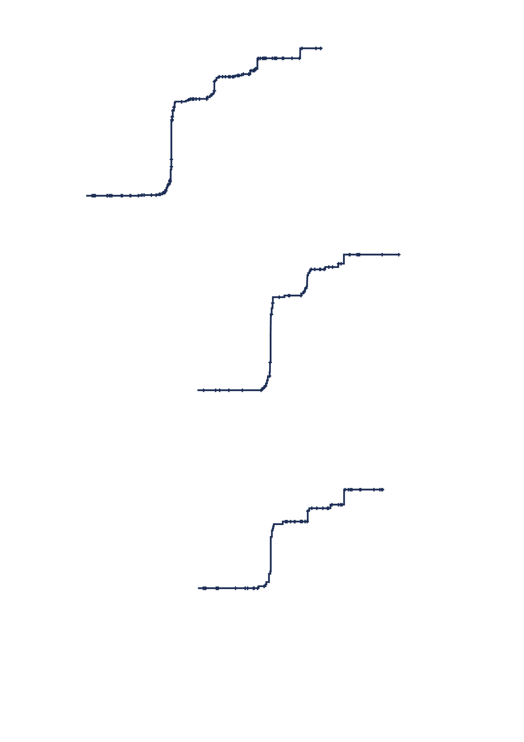
iwCLL response and MRD stopping rules
iwCLL responses
% | CR/CRi |  | Overall response |  | BM uMRD
 | 9 months | Any time | 9 months | Any time | Any time
FCR | 49 | 71.5 | 76.4 | 83.7 | 40.3
I+V | 59.2 | 92.3 | 86.5 | 95.4 | 61.9
100
IGHV unmutated (n=122)
90
83.0%
80
73.7%
70
60
57.0%
Stopping treatment due to MRD stopping rules, %
50
Odds ratio: 1.51
P<0.05
Odds ratio: 2.0
P<0.005
40
30
20
I+V: 24 (95% CI, 24-35)
10
I+V
100
Time to attaining MRD stopping rules in I+V group
0
0
12
24
36
48
60
72
90
Months from starting treatment
80
100
IGHV mutated (n=90)
70
72.9% (51 mo)
90
60
63.1% (39 mo)
80
Stopping treatment due to MRD stopping rules, %
49.9% (27 mo)
70
60.4%
50
60
40
Stopping treatment due to MRD stopping rules, %
49.0%
50
30
40
39.5%
20
30
10
20
I+V: 44 (95% CI, 25-NE)
I+V
10
I+V
0
0
12
24
36
48
60
72
0
Months from starting treatment
0
12
24
36
48
60
72
Months from starting treatment

Slide 59
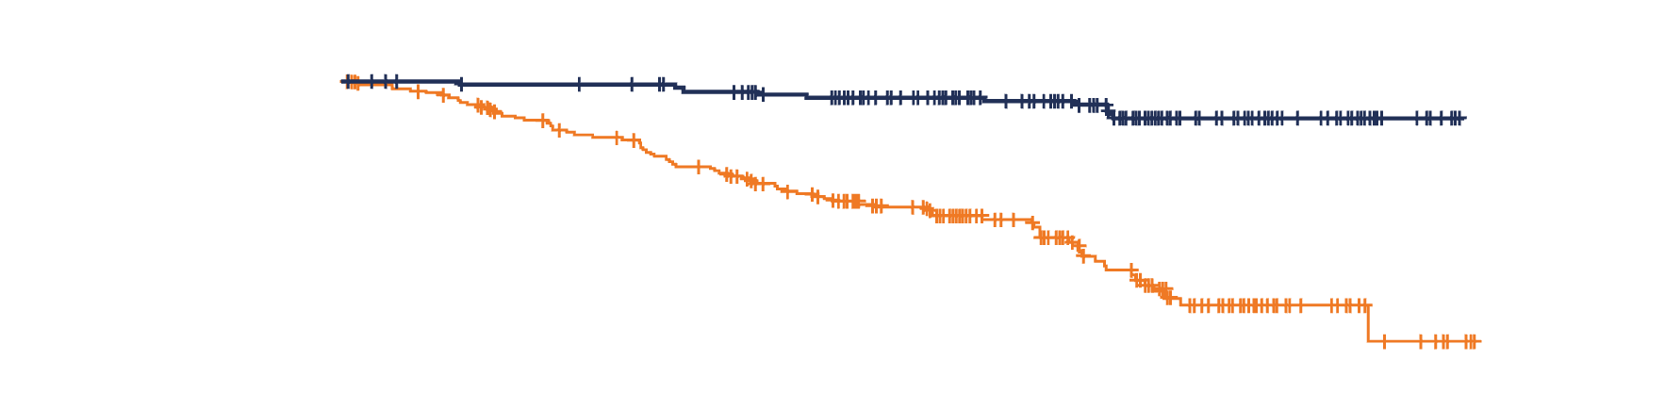
Progression-free survival
100
90
I+V
80
70
60
Median follow-up:
43.7 months
Progression-free and alive, %
FCR
50
40
30
Progression-free at 3 years
I+V (n=260): 97.2% (95% CI, 94.1-98.6)
FCR (n=263): 76.8% (95% CI, 70.8-81.7)
HR: 0.13 [0.07, 0.24], p-value: <0.0001
20
10
0
0
12
24
36
48
60
72
Months
No. at risk
I+V | 260 | 253 | 239 | 183 | 99 | 21 | 0
FCR | 263 | 227 | 194 | 145 | 68 | 12 | 0
There was a significant improvement in PFS for I+V compared to FCR

Slide 60
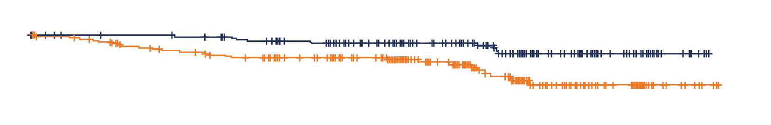
Overall survival
Treatment after progression
100
90
I+V
FCR
 | FCR n=42 | I+V n=5
Irreversible BTKi | 23 | 2
Idelalisib + R | 1 | 0
Venetoclax + R | 11 | 0
CIT | 6 | 1
Allogeneic SCT | 1 | 0
Pirtobrutinib | 0 | 1
Alemtuzumab | 0 | 1
Targeted therapy for CLL | 35/42 (83%) | 3/5 (60%)
80
70
60
Median follow-up:
43.0 months
Surviving, %
50
40
 | Number of deaths | % died at 3 yearsª
I+V (n=260) | 9 | 2.0%
FCR (n=263) | 25 | 7.0%
30
20
10
HR: 0.31 [0.15, 0.67], p-value: <0.005
0
0
12
24
36
48
60
72
Months
No. at risk
I+V | 260 | 254 | 240 | 185 | 100 | 22 | 0
FCR | 263 | 234 | 213 | 166 | 79 | 15 | 0
I+V demonstrated a significant advantage in terms of overall survival compared to FCR
The advantage in overall survival was observed despite the majority of patients that progressed in the FCR arm required further therapy and received targeted treatments

Slide 61
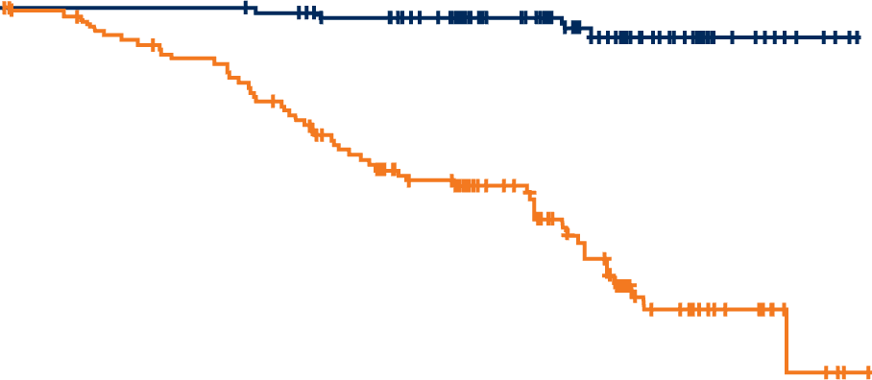

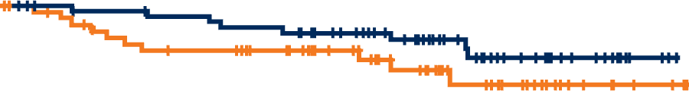
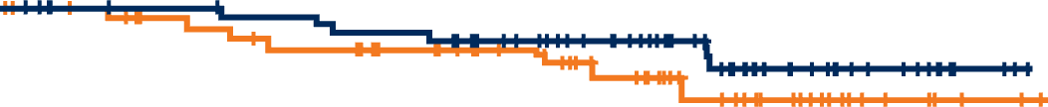
Outcome by IGHV mutation status
PFS
OS
I+V
I+V
The impact of I+V on PFS and OS was significant in IGHV unmutated patients but not in IGHV mutated patients
IGHV unmutated
(excl. subset 2)
FCR
FCR
Progression-free at 3 years
I+V (n=124): 98.3%
FCR (n=139): 70.9%
HR: 0.07 [0.02, 0.19], p-value= <0.001
Alive at 3 years
I+V (n=124): 99.2%
FCR (n=139): 93.9%
HR: 0.23 [0.06, 0.81], p=0.022
I+V
I+V
FCR
FCR
IGHV mutated
(excl. subset 2)
Progression-free at 3 years
I+V (n=92): 94.3%
FCR (n=79): 88.8%
HR: 0.54 [0.21, 1.38], p=0.199
Alive at 3 years
I+V (n=92): 95.5%
FCR (n=79): 92.7%
HR: 0.61 [0.2, 1.82], p=0.374

Slide 62
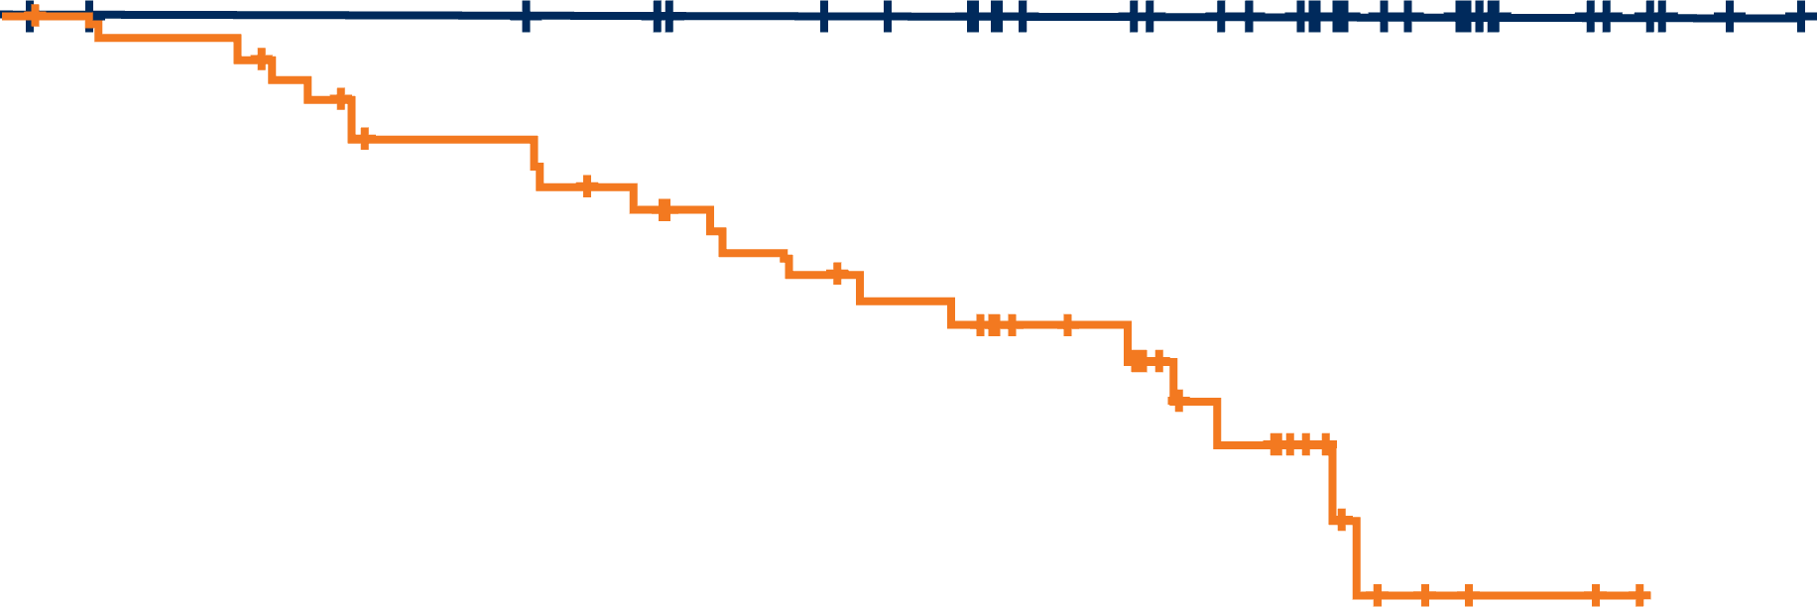
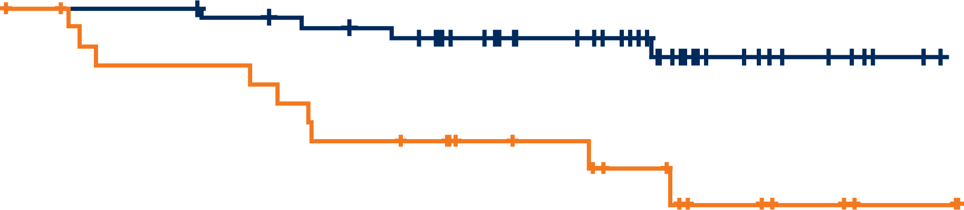
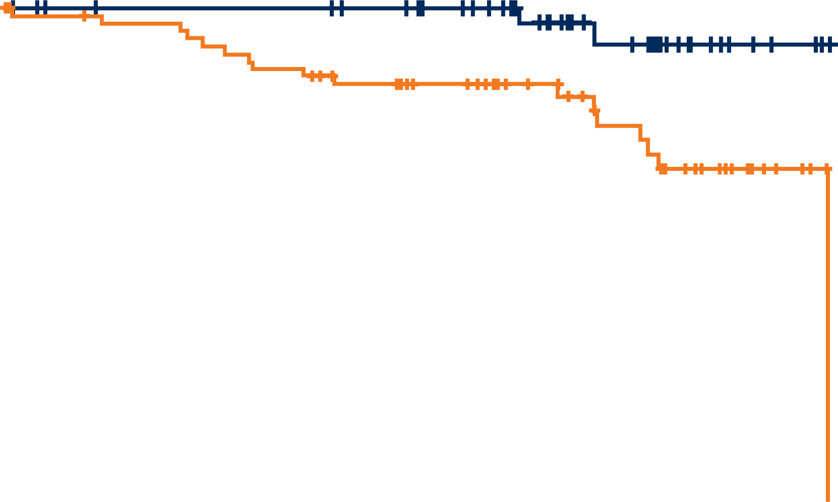
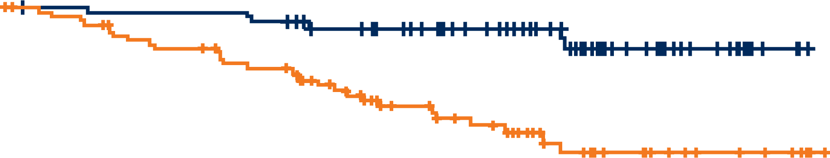
PFS hierarchical FISH abnormality
There was a significant advantage in PFS for I+V compared to FCR treated patients with an 11q or 13q deletion, trisomy 12 or a normal karyotype
Of the 45 patients with an 11q deletion who were randomized to I+V, no patient has relapsed or died in this study
I+V
I+V
FCR
FCR
3-year PFS:
I+V (n=45) : 100%
FCR (n=50): 68.3% P <0.0001
3-year PFS: Hazard ratio: 0.2
I+V (n=57) : 94.5% (95% CI: 0.06-0.67)
FCR (n=29): 74.1% P=0.002
I+V
I+V
FCR
FCR
3-year PFS: Hazard ratio: 0.14
I+V (n=52) : 100% (95% CI: 0.03-0.63)
FCR (n=69): 84.6% P=0.002
3-year PFS: Hazard ratio: 0.2
I+V (n=87) : 95.3% (95% CI: 0.08-0.48)
FCR (n=100): 74.5% P<0.001
ATM, ataxia telangiectasia mutated gene; CI, confidence interval; FCR, fludarabine, cyclophosphamide, rituximab; FISH, fluorescence in situ hybridization; I+V, ibrutinib plus venetoclax; PFS, progression-free survival.
Hillmen et al, Abstract #631 presented at ASH 2023.

Slide 63
Serious AEs and malignancies
SAEs by MedDRA system organ class
Secondary malignancies
n (%) | FCR n=239 | I+V n=252
Infections and infestations | 45 (18.8) | 56 (22.2)
Blood and lymphatic system disorders | 74 (31) | 13 (5.2)
Cardiac disorders | 1 (0.4) | 27 (10.7)
Gastrointestinal disorders | 19 (7.9) | 9 (3.6)
General disorders and administration site conditions | 12 (5) | 4 (1.6)
Neoplasms benign, malignant and unspecified (including cysts and polyps) | 5 (2.1) | 6 (2.4)
Metabolism and nutrition disorders | 0 (0) | 10 (4)
Respiratory, thoracic and mediastinal disorders | 6 (2.5) | 4 (1.6)
Musculoskeletal and connective tissue disorders | 3 (1.3) | 6 (2.4)
Skin and subcutaneous tissue disorders | 5 (2.1) | 4 (1.6)
Nervous system disorders | 2 (0.8) | 5 (2)
Eye disorders | 0 (0) | 6 (2.4)
 | FCR | I+V
Incidence rate of cancers per 100 person-years (95% CIs) | 5.4 (5.11, 5.68) | 2.6 (2.40, 2.79)
BCC/SCC | 16 | 13
MDS/AML | 8 | 1
Lymphoma | 5 | 3
Prostate/urological | 5 | 1
Lung | 3 | 0
GI | 3 | 1
Breast | 1 | 1
Melanoma | 1 | 1
Myeloma | 1 | 0
Endocrine | 0 | 1
Other | 5 | 2
Totalª | 39 | 17

Slide 64
Conclusions
I+V significantly improved responses, PFS and OS compared to FCR in fit patients with previously untreated CLL
More patients achieve an MRD negative remission with I+V than FCR
  the majority of I+V patients achieve the MRD stopping criteria
PFS better in IGHV unmutated, 11q deleted, trisomy 12 and 13q deleted CLL amongst other sub-groups
I+V was well tolerated with no unexpected toxicities
The results seen with I+V indicate that directing the duration of therapy according to individual MRD response maximizes outcomes

Slide 65
ELEVATE-TN
Acalabrutinib ± obinutuzumab vs obinutuzumab + chlorambucil in TN CLL

Slide 66
ELEVATE-TN study design
TN CLL (N=535)
Key inclusion criteria
Age ≥65 years, or >18 to <65 years with:
  Creatinine clearance 30–69 mL/min (by Cockcroft-Gault equation)
  CIRS-G score >6
TN CLL requiring treatment per iwCLL 2008 criteria
ECOG PS ≤2
Key exclusion criteria
Significant cardiovascular disease
Stratification
del(17p), yes vs no
ECOG PS 0–1 vs 2
Geographic region
Primary endpoint
PFS (IRC-assessed): A+O vs O+Clb
Secondary/other endpoints
PFS (IRC-assessed): A vs O+Clb
PFS (INV-assessed)
ORR (IRC- and INV-assessed)
TTNT
OS
MRD
Safety
Aª + O^{b}
R
1:1:1
Aª
O^{b} + Clb^{b}
Crossover from O+Clb to A was allowed after IRC-confirmed progression
Note: After interim analysis, PFS assessments were by investigator only. All analyses are ad-hoc and P-values are descriptive.

Slide 67
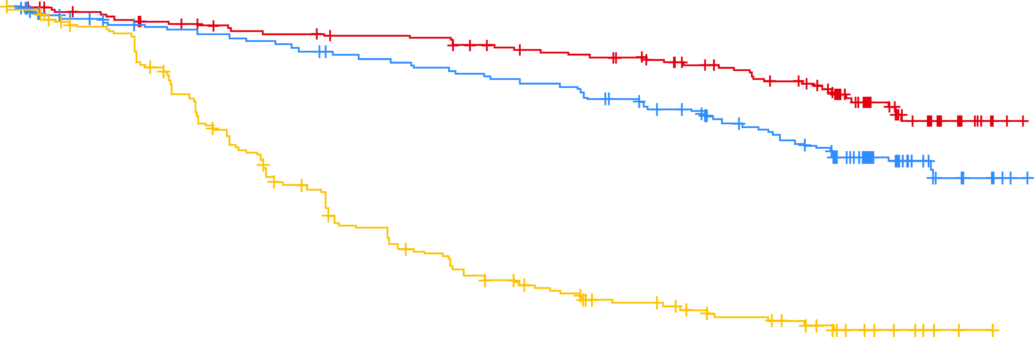
PFS
PFS was significantly higher for A-containing arms vs O+Clb
Median PFS was significantly higher for A+O vs A
78%
Median PFS=NR
A+O vs O+Clb
HRª (95% CI): 0.14
(0.10, 0.20); P<0.0001^{b}
62%
A vs O+Clb
HRª (95% CI): 0.24
(0.17, 0.32); P<0.0001^{b}
Median PFS=NR
A+O vs A
HRª (95% CI): 0.58
(0.39, 0.86); P<0.0229^{b}
17%
Median PFS=27.8 mo
A+O
A
O+ Clb
No. at risk
A+O | 179 | 175 | 170 | 168 | 164 | 163 | 160 | 157 | 156 | 156 | 153 | 152 | 151 | 146 | 144 | 141 | 140 | 138 | 136 | 133 | 127 | 124 | 119 | 116 | 99 | 54 | 39 | 25 | 10 | 2 | 0
A | 179 | 167 | 163 | 158 | 156 | 155 | 153 | 150 | 149 | 146 | 142 | 141 | 137 | 135 | 133 | 130 | 129 | 124 | 121 | 115 | 113 | 103 | 100 | 95 | 85 | 56 | 37 | 22 | 7 | 2 | 0
O+Clb | 177 | 163 | 156 | 153 | 139 | 125 | 110 | 100 | 86 | 82 | 67 | 66 | 56 | 49 | 44 | 41 | 38 | 30 | 29 | 28 | 24 | 21 | 21 | 18 | 14 | 8 | 6 | 3 | 1 | 0 | 0

Slide 68
ORR/CR over time in acalabrutinib-containing arms
ORRª over follow-up period
95%
95%
96%
96%
96%
96%
96%
96%
96%
96%
A+O ORR
A ORR
A+O CR
87%
89%
90%
90%
90%
90%
90%
A CR
82%
82%
80%
ORR difference %, 95% CI
6.1% (0.9, 11.4)
P=0.022
CR difference %, 95% CI
17.9% (8.8, 27.0)
P=0.022
33%
34%
36%
31%
26%
18%
15%
19%
6%
7%
8%
11%
1%
4%
5%
ORR and CR/CRi rates were significantly higher with A+O and A vs O+Clb (P≤0.0499 for both arms of the analyses)
ORR and CR/CRi rates were significantly higher with A+O vs A (P=0.022 for both comparisons)

Slide 69
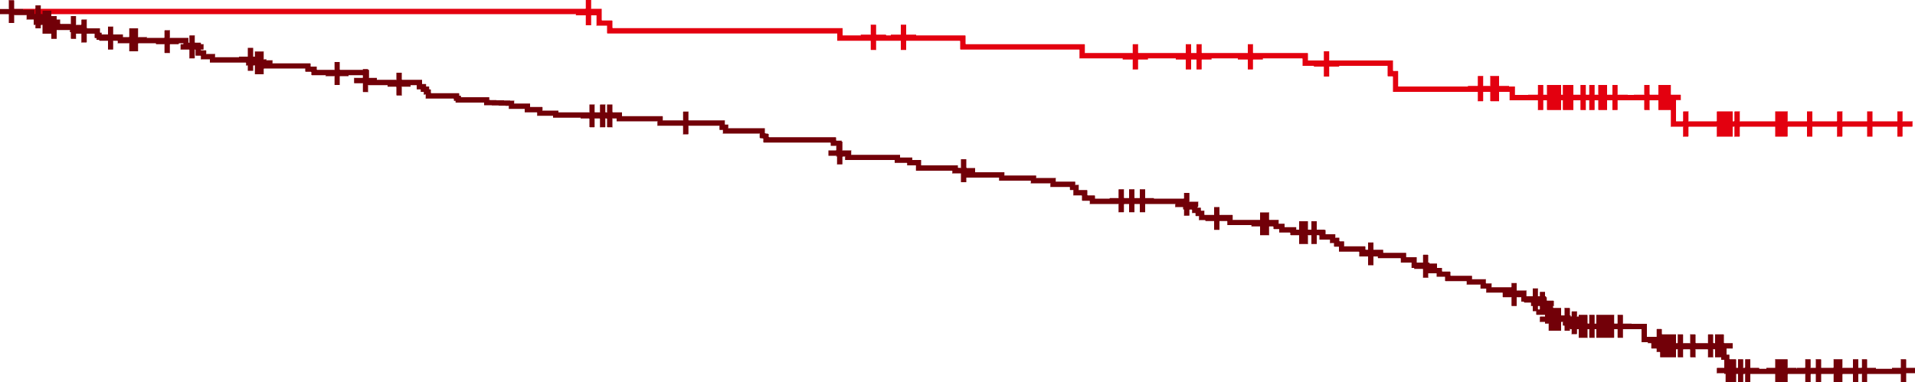
PFS in acalabrutinib-treated patients who achieved CR/CRi
Longer PFS among acalabrutinib-treated patients who achieved CR/CRi
A-treated patients who achieved CR/CRi vs A-treated patients who did not
HR (95% CI): 0.23
(0.12, 0.42); P<0.0001
A-treated patients who achieved CR/CRi
A-treated patients without CR/CRi
No. at risk
A-treated patients who achieved CR/CRi | 100 | 100 | 100 | 100 | 100 | 100 | 100 | 100 | 100 | 100 | 97 | 97 | 97 | 96 | 94 | 93 | 93 | 92 | 91 | 89 | 86 | 84 | 81 | 80 | 70 | 36 | 26 | 14 | 4 | 2 | 0
A-treated patients without CR/CRi | 258 | 242 | 233 | 226 | 220 | 218 | 213 | 207 | 205 | 202 | 198 | 196 | 191 | 185 | 183 | 178 | 176 | 170 | 166 | 159 | 54 | 143 | 138 | 131 | 114 | 74 | 50 | 33 | 13 | 2 | 0

Slide 70
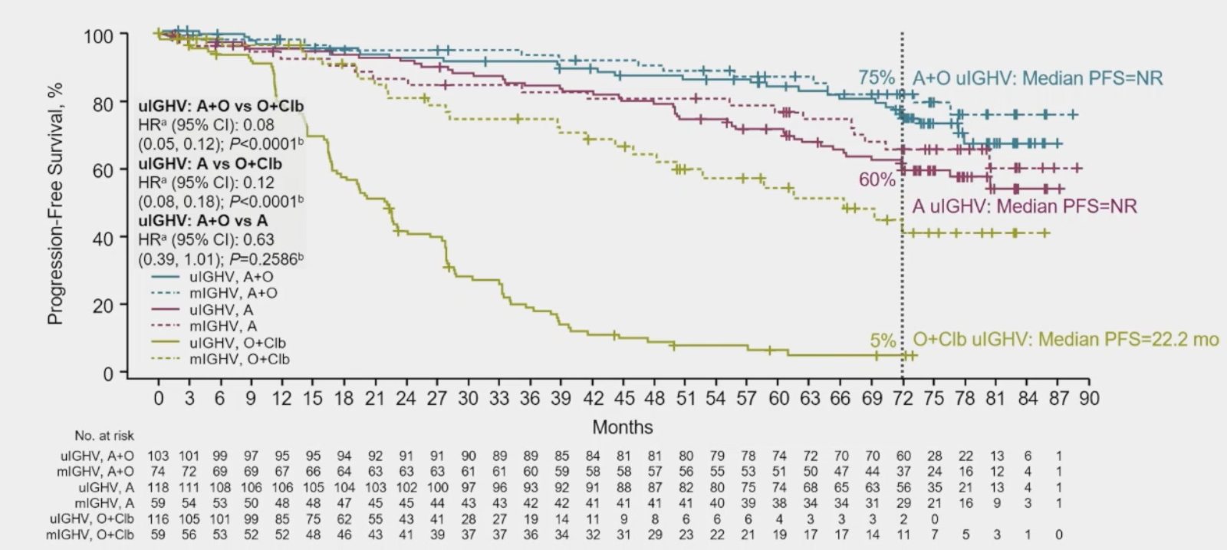
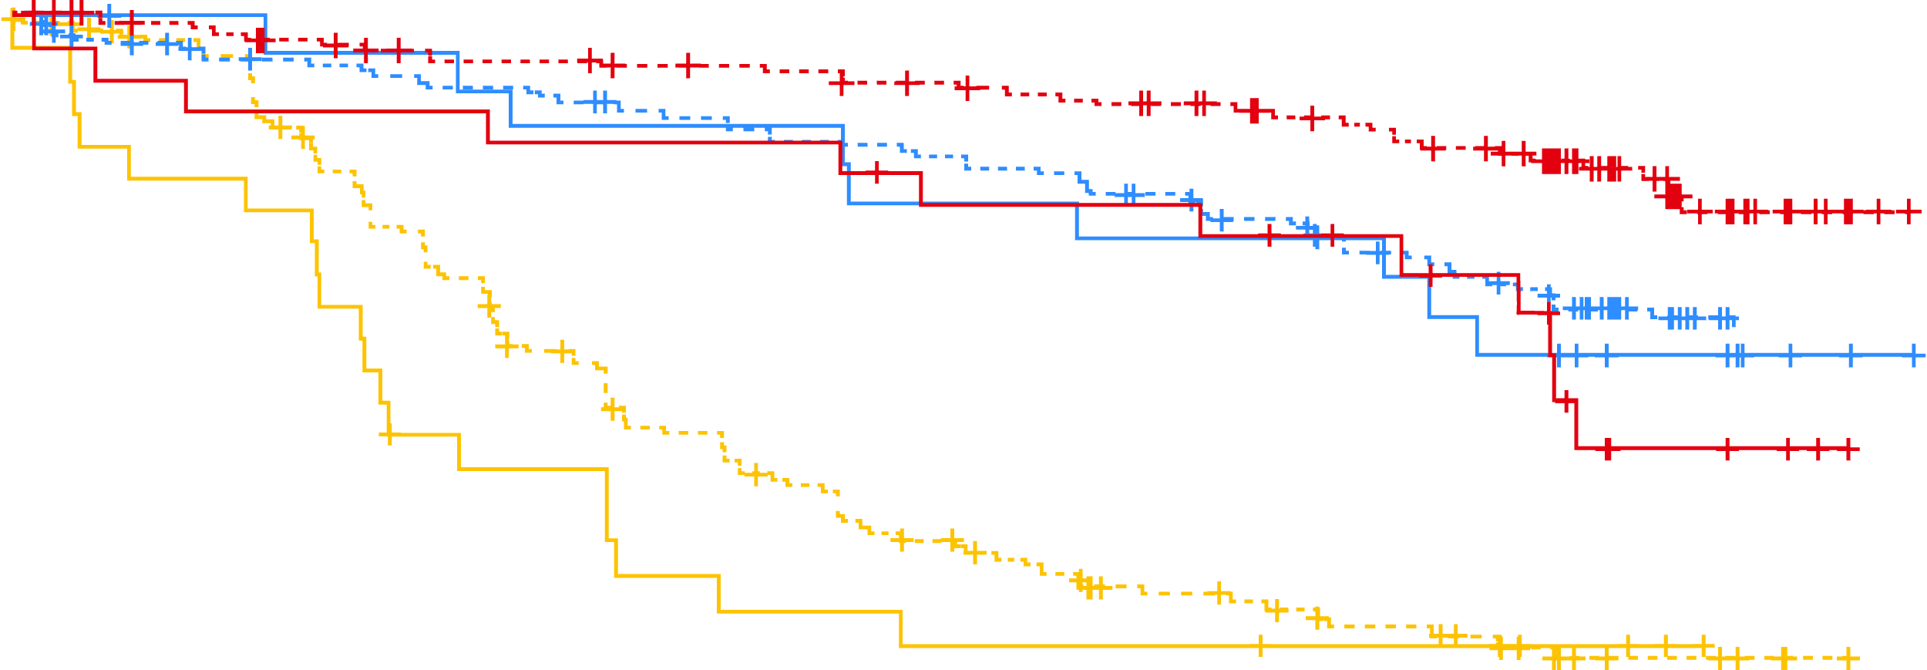
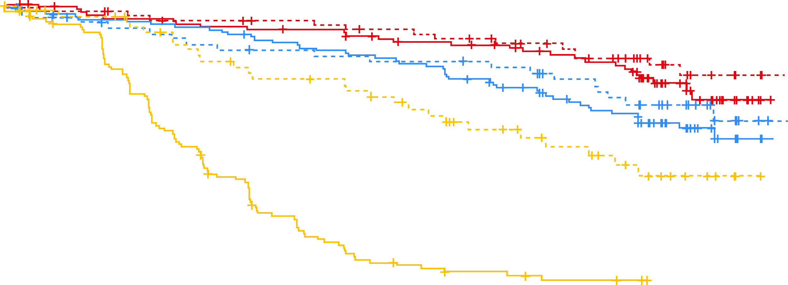
PFS by IGHV and del(17p) and/or TP53m by treatment arm
PFS by IGHV
PFS by del(17p) and/or TP53m by treatment arm
A+O ulGHV:
Median PFS=NR
75%
w/ del(17p)
and/or TP53m
w/ del(17p)
and/or TP53m:
Median PFS=NR
ulGHV: A+O
vs O+Clb
HRª (95% CI): 0.08
(0.05, 0.12); P<0.0001^{b}
A+O vs O+Clb
HRª (95% CI): 0.28
(0.13, 0.59); P=0.0009^{b}
60%
A ulGHV: Median PFS=NR
56%
w/ del(17p)
and/or TP53m:
Median PFS=73.1 mo
ulGHV: A vs O+Clb
HRª (95% CI): 0.12
(0.08, 0.18); P<0.0001^{b}
A vs O+Clb
HRª (95% CI): 0.23
(0.10, 0.52); P=0.0002^{b}
56%
ulGHV: A+O vs A
HRª (95% CI): 0.63
(0.39, 1.01); P=0.2586^{b}
O+Clb ulGHV:
Median PFS=22.2 mo
A+O vs A
HRª (95% CI): 1.21
(0.51, 2.87); P=0.7966^{b}
w/ del(17p)
and/or TP53m:
Median PFS=17.5 mo
5%
18%
w/ del(17p) and/or TP53m, A+O
w/ del(17p) and/or TP53m, A
w/ del(17p) and/or TP53m, O+Clb
ulGHV, A+O
ulGHV, A
ulGHV, O+ Clb
w/o del(17p) and/or TP53m, A+O
w/o del(17p) and/or TP53m, A
w/o del(17p) and/or TP53m, O+Clb
mlGHV, A+O
mlGHV, A
mlGHV, O+ Clb
No. at risk
ulGHV,A+O | 103 | 101 | 99 | 97 | 95 | 95 | 94 | 92 | 91 | 91 | 90 | 89 | 89 | 85 | 84 | 81 | 81 | 80 | 79 | 78 | 74 | 72 | 70 | 70 | 60 | 28 | 22 | 13 | 6 | 1
mlGHV,A+O | 74 | 72 | 69 | 69 | 67 | 66 | 64 | 63 | 63 | 63 | 61 | 61 | 60 | 59 | 58 | 58 | 57 | 56 | 55 | 53 | 51 | 50 | 47 | 44 | 37 | 24 | 16 | 12 | 4 | 1
ulGHV,A | 118 | 111 | 108 | 106 | 106 | 105 | 104 | 103 | 102 | 100 | 97 | 96 | 93 | 92 | 91 | 88 | 87 | 82 | 80 | 75 | 74 | 68 | 65 | 63 | 56 | 35 | 21 | 13 | 4 | 1
mlGHV,A | 59 | 54 | 53 | 50 | 48 | 48 | 47 | 45 | 45 | 44 | 43 | 43 | 42 | 42 | 41 | 41 | 41 | 41 | 40 | 39 | 38 | 34 | 34 | 31 | 29 | 21 | 16 | 9 | 3 | 1
ulGHV, O+Clb | 116 | 105 | 101 | 99 | 85 | 75 | 62 | 55 | 43 | 41 | 28 | 27 | 19 | 14 | 11 | 9 | 8 | 6 | 6 | 6 | 4 | 3 | 3 | 3 | 2 | 0
mlGHV, O+Clb | 59 | 56 | 53 | 52 | 52 | 48 | 46 | 43 | 41 | 39 | 37 | 37 | 36 | 34 | 32 | 31 | 29 | 23 | 22 | 21 | 19 | 17 | 17 | 14 | 11 | 7 | 5 | 3 | 1 | 0
No. at risk
w/ del(17p) and/or TP53m,A+O | 25 | 24 | 23 | 22 | 22 | 22 | 22 | 22 | 21 | 21 | 21 | 21 | 21 | 20 | 19 | 18 | 18 | 18 | 18 | 17 | 16 | 15 | 14 | 13 | 10 | 5 | 5 | 3 | 2 | 0
w/o del(17p) and/or TP53m,A+O | 154 | 151 | 147 | 146 | 142 | 141 | 138 | 135 | 135 | 135 | 132 | 131 | 130 | 126 | 125 | 123 | 122 | 120 | 118 | 116 | 111 | 109 | 105 | 103 | 89 | 49 | 34 | 22 | 8 | 2
w/ del(17p) and/or TP53m,A | 23 | 22 | 21 | 21 | 20 | 20 | 20 | 19 | 18 | 18 | 18 | 18 | 18 | 17 | 16 | 16 | 16 | 15 | 15 | 15 | 14 | 14 | 13 | 11 | 11 | 7 | 7 | 4 | 2 | 1
w/o del(17p) and/or TP53m,A | 156 | 145 | 142 | 137 | 136 | 135 | 133 | 131 | 131 | 128 | 124 | 123 | 119 | 118 | 117 | 114 | 113 | 109 | 106 | 100 | 99 | 89 | 87 | 84 | 74 | 49 | 30 | 18 | 5 | 1
w/ del(17p) and/or TP53m, O+Clb | 25 | 21 | 91 | 19 | 18 | 15 | 10 | 9 | 9 | 9 | 6 | 6 | 5 | 5 | 4 | 4 | 4 | 4 | 4 | 4 | 3 | 3 | 3 | 3 | 3 | 3 | 1 | 0
w/o del(17p) and/or TP53m, O+Clb | 152 | 142 | 137 | 134 | 121 | 110 | 100 | 91 | 77 | 73 | 61 | 60 | 52 | 44 | 40 | 37 | 34 | 26 | 25 | 24 | 21 | 18 | 18 | 15 | 11 | 5 | 5 | 3 | 1 | 0
PFS was not significantly different by IGHV status in patients treated with A+O and A

Slide 71
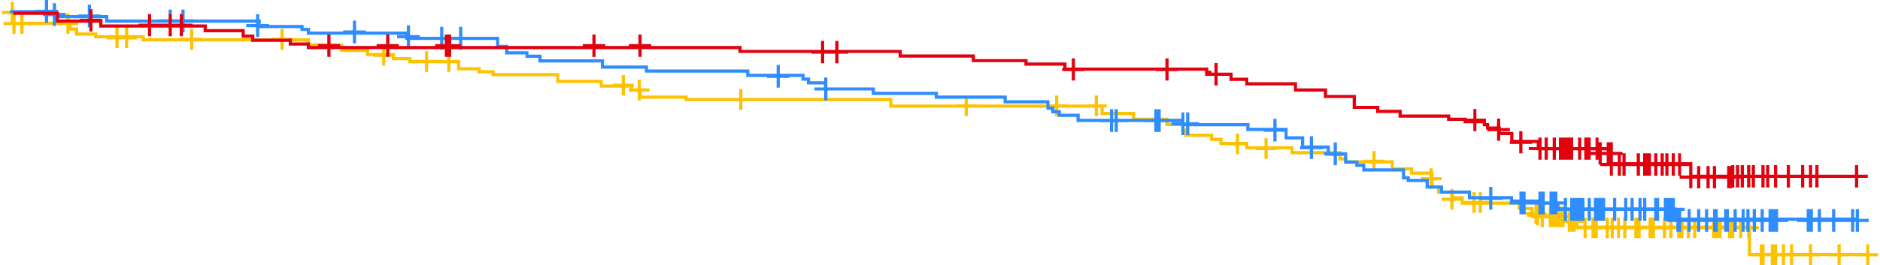
Overall survival
OS was not reached in any treatment arm and was longer with A+O vs O+Clb
87%
Median OS=NR
79%
80%
A+O vs O+Clb
HRª (95% CI): 0.62
(0.39, 0.97); P<0.0349^{b}
Median OS=NR
Median OS=NR
A vs O+Clb
HRª (95% CI): 0.89
(0.58, 1.35); P=0.5868^{b}
A+O vs A
HRª (95% CI): 0.69
(0.44, 1.09); P=0.1220^{b}
A+O
A
O+ Clb
No. at risk
A+O | 179 | 178 | 175 | 173 | 170 | 168 | 167 | 165 | 164 | 164 | 163 | 162 | 161 | 161 | 159 | 158 | 157 | 155 | 154 | 153 | 148 | 147 | 142 | 141 | 133 | 105 | 63 | 41 | 21 | 4 | 0
A | 179 | 175 | 173 | 171 | 169 | 167 | 166 | 163 | 159 | 157 | 156 | 155 | 154 | 151 | 148 | 147 | 146 | 143 | 140 | 135 | 134 | 128 | 122 | 119 | 116 | 91 | 61 | 42 | 19 | 5 | 0
O+Clb | 177 | 166 | 162 | 160 | 160 | 158 | 156 | 152 | 148 | 147 | 144 | 141 | 140 | 140 | 140 | 139 | 138 | 137 | 134 | 130 | 126 | 124 | 121 | 114 | 107 | 87 | 53 | 38 | 18 | 3 | 0

Slide 72
Adverse events of clinical interest
 | A+O (n=178) |  | A (n=179)
 | Any Grade | Grade ≥3 | Any Grade | Grade ≥3
Cardiac events | 49 (27.5) | 22 (12.4) | 42 (23.5) | 21 (11.7)
Atrial fibrillation | 13 (7.3) | 3 (1.7) | 16 (8.9) | 3 (1.7)
Bleeding | 95 (53.4) | 12 (6.7) | 81 (45.3) | 8 (4.5)
Major bleeding | 16 (9.0) | 12 (6.7) | 10 (5.6) | 8 (4.5)
Hypertensionª | 20 (11.2) | 8 (4.5) | 20 (11.2) | 9 (5.0)
Infections | 147 (82.6) | 63 (35.4) | 144 (80.4) | 50 (27.9)
SPMs | 36 (20.2) | 18 (10.1) | 35 (19.6) | 9 (5.0)
SPMs excluding non-melanoma skin | 24 (13.5) | 13 (7.3) | 22 (12.3) | 7 (3.9)
Events of clinical interest were similar in both A-containing arms and consistent with previous results

Slide 73
Adverse events
 | A+O (n=178) |  | A (n=179)
Adverse event | Any Grade | Grade ≥3 | Any Grade | Grade ≥3
Diarrhea | 78 (43.8) | 11 (6.2) | 76 (42.5) | 1 (0.6)
Headache | 72 (40.4) | 2 (1.1) | 70 (39.1) | 2 (1.1)
Arthralgia | 64 (36.0) | 4 (2.2) | 49 (27.4) | 2 (1.1)
Neutropenia | 61 (34.3) | 55 (30.9) | 23 (12.8) | 21 (11.7)
Fatigue | 55 (30.9) | 4 (2.2) | 43 (24.0) | 2 (1.1)
Cough | 50 (28.1) | 1 (0.6) | 45 (25.1) | 1 (0.6)
COVID-19 | 44 (24.7) | 16 (9.0) | 38 (21.2) | 13 (7.3)
Thrombocytopenia | 26 (14.6) | 15 (8.4) | 16 (8.9) | 6 (3.4)
Pneumonia | 25 (14.0) | 13 (7.3) | 27 (15.1) | 11 (6.1)
Hypertension | 17 (9.6) | 8 (4.5) | 19 (10.6) | 9 (5.0)
Syncope^{b} | 12 (6.7) | 9 (5.1) | 5 (2.8) | 4 (2.2)
Most common any-grade AEs and Grade ≥3 AEsª were consistent with earlier analyses

Slide 74
Conclusions
With median follow-up at 74.5 months (~6 years), the efficacy and safety of A+O and A were maintained in patients with TN CLL
  Median PFS was significantly longer for A-containing arms vs O+Clb
  Median PFS was significantly longer in patients treated with A+O vs A
  Addition of O to A resulted in higher complete response rates compared with A monotherapy
  Patients treated with A+O who achieved a complete response had longer PFS than those who did not achieve a complete response
  OS was not reached in any treatment arm and was longer with A+O vs O+Clb
These benefits in outcomes were observed regardless of patients’ genomic marker status
Safety of A+O and A remained consistent with previously reported findings, with low incidences of some Grade ≥3 AEs typically associated with BTKis

Slide 75
Sonrotoclax plus zanubrutinib in TN-CLL/SLL
Phase 1/2 study

Slide 76
BGB-11417-101 study design
BGB-11417-101 is a Phase 1/2 study evaluating sonrotoclax as monotherapy, in combination with zanubrutinib, and in combination with obinutuzumab ± zanubrutinib in patients with B-cell malignancies
Sonrotoclax + zanubrutinib dose-finding
(weekly/daily ramp-up)
Sonrotoclax + zanubrutinib expansion
R/R CLL/SLL, MCL, TN CLL/SLL
R/R CLL/SLL, MCL, TN CLL/SLL
640 mg
320 mg
160 mg and 320 mg selected for expansion
320 mg
160 mg
160 mg
80 mg
40 mg
Main study objectives (TN CLL cohorts): determine safety and tolerability and define the RP2D of sonrotoclax when given in combination with zanubrutinib (160 mg BID or 320 mg QD)
8 to 12 weeks of zanubrutinib monotherapy was given prior to sonrotoclax dosing (12 weeks if high tumor burden)
Sonrotoclax was dosed orally, once daily, using a weekly or daily ramp-up schedule to reach the target dose

Slide 77
Dose modification and AE summary
 | Sonrotoclax 160 mg + zanubrutinib (n=51) | Sonrotoclax 320 mg + zanubrutinib (n=56) | All patients (N=107)
Any AEs, n (%) | 47 (92.2) | 49 (87.5) | 96 (89.7)
Grade ≥3 | 22 (43.1) | 21 (37.5) | 43 (40.2)
Serious AEs | 7 (13.7) | 8 (14.3) | 15 (14.0)
Leading to death | 0 | 0 | 0
Leading to dose reduction of zanubrutinib | 1 (2.0) | 2 (3.6) | 3 (2.8)
Leading to discontinuation of zanubrutinibª | 1 (2.0) | 0 | 1 (0.9)
Treated with sonrotoclax, n (%) | 41 (80.4) | 53 (94.6) | 94 (87.9)
Leading to hold of sonrotoclax | 11 (26.8) | 10 (18.9) | 21 (22.3)
Leading to dose reduction of sonrotoclax | 2 (4.9) | 3 (5.7) | 5 (5.3)
Leading to discontinuation of sonrotoclaxª | 1 (2.4) | 0 | 1 (1.1)
Sonrotoclax in combination with zanubrutinib is well tolerated and generally favorable, with very low rates of treatment discontinuation and dose reductions

Slide 78
Most frequent AEs (incidence ≥5 patients)^{a,b}
Sonrotoclax 160 mg + zanubrutinib (n=51)
Sonrotoclax 320 mg + zanubrutinib (n=56)
Median follow-up, months (range): 7.2 (0.3-21.1)
Median follow-up, months (range): 9.8 (0.5-17.4)
AEs observed with sonrotoclax + zanubrutinib combination therapy were mostly Grade 1 and 2

Slide 79
TEAEs of interest
TEAE | Comment
TLSª | No clinical or laboratory TLS was observed with weekly or daily ramp-up
GI toxicity^{b} | Diarrhea events were mostly Grade 1; no dose reductions occurred
Atrial fibrillation | No atrial fibrillation was observed
Neutropenia | Most frequent AE (and Grade ≥3 AE); 1 dose reduction/no dose holds, 18 patients (17%) used G-CSF^{c}
Febrile neutropenia | Observed in 2 patients (2%) assigned to the 160 mg dose level; events resolved without sequelae
Infections | Low rate of Grade ≥3 infections (8%); pneumonia (n=4) was the only Grade ≥3 infection in more than 1 patient

Slide 80
Overall response rate
Best responseª by week 24
Best responseª by week 48
Best overall response
ORR
100%
ORR
100%
ORR
100%
CR
PR
Response rates improved with time

Slide 81
MRD and PFS
MRD in peripheral blood
PFS
160 mg
320 mg
No. at risk
160 mg | 51 | 42 | 40 | 32 | 31 | 31 | 27 | 24 | 24 | 24 | 22 | 22 | 22 | 19 | 17 | 16 | 7 | 5 | 4 | 3 | 3 | 0
320 mg | 56 | 53 | 51 | 44 | 44 | 44 | 42 | 36 | 31 | 27 | 20 | 17 | 8 | 4 | 2 | 1 | 0 | 0 | 0 | 0 | 0 | 0
High uMRD achieved at both dose levels
Trend for higher uMRD rates with 320 mg
Evidence of deepening response over time
uMRD4
At a median follow-up of 9.7 months, no patient has experienced disease progression or died at either sonrotoclax dose level
MRD4+
Not available

Slide 82
Conclusions
Sonrotoclax 160 or 320 mg in combination with zanubrutinib 320 mg QD was safe and well tolerated
  106/107 of patients remain on both drugs
  No TLS and no cardiac toxicity were observed; low rates of GI AEs (predominantly Grade 1)
  Most commonly reported AEs were neutropenia and infections, mostly transitory, and not requiring dose modifications or interruptions
Efficacy was very promising in this all-comer TN CLL population
  ORR was 100%
  High blood MRD negativity by week 24, with deepening response by week 48 of combination therapy
  No PFS events were observed as of the data cut off
Based on these data, sonrotoclax 320 mg was selected for the Phase 3 study with zanubrutinib in TN CLL

Slide 83
Lisaftoclax in heavily pretreated CLL
Pooled analyses of two clinical trials

Slide 84
Lisaftoclax in CLL background
Investigational agent lisaftoclax is a selective BCL-2 inhibitor that has demonstrated antileukemic activity and favorable tolerability in patients with CLL
Updated efficacy and safety data of patients with CLL treated with lisaftoclax in Phase 1b/2 studies APG2575CN001 (NCT03913949) and APG2575CC101 (NCT04494503) after a 14-month follow-up are reported here
Lisaftoclax was continued until disease progression, intolerable toxicity, or death
A daily ramp-up schedule was used for prevention and early detection of TLS
Flow cytometry was used to analyze MRD at individual sites
  MRD negativity was defined as a threshold of < 10⁻⁴
800 mg
Lisaftoclax administered orally QD in repeated 28-day cycles
600 mg
400 mg
200 mg
100 mg

Slide 85
Baseline characteristics
Population | N=47
Median age, years (range) | 58.0 (34-80)
Sex, n (%)
Female | 15 (31.9)
Male | 32 (68.1)
ECOG status, n (%)
0 | 11 (23.4)
1 | 36 (76.6)
Rai stage III/IV, n (%) | 25 (53.2)
Binet stage C, n (%) | 23 (48.9)
Previous lines of therapy, n (%)
1 | 16 (34.0)
2 | 10 (21.3)
≥ 3 | 21 (44.7)
Median previous therapies, n (range) | 2.0 (1-8)
CD20 antibody, n (%) | 26 (55.3)
BTK inhibitor, n (%) | 11 (23.4)

Slide 86
BOR
BOR of patients with CLL in APG-2575-CN-001 and APG-2575-CC-101 studies
 | Lisatoclax dosage, mg |  |  |  |  | Total
 | 100 | 200ª | 400^{b} | 600 | 800 | -
Efficacy assessment, n | 3 | 2 | 12 | 13 | 15 | 45
Response, n (%)
ORR | 0 | 2 (100.0) | 10 (83.3) | 9 (69.2) | 12 (80.0) | 33 (73.3)
CR/CRi | 0 | 1 (50.0) | 2 (16.7) | 3 (23.1) | 5 (33.3) | 11 (24.4)
PR | 0 | 1 (50.0) | 8 (66.7) | 6 (46.2) | 7 (46.7) | 22 (48.9)
SD | 3 (100.0) | 0 | 2 (16.7) | 2 (15.4) | 0 | 7 (15.6)
PD | 0 | 0 | 0 | 2 (15.4) | 3 (20.0) | 5 (11.1)
MRD in PB assessment, n | - | - | 6 | 7 | 5 | 18
Response, n (%)
MRD | - | - | 2 (33.3) | 2 (28.6) | 3 (60.0) | 7 (38.9)
MRD^{c} |  |  | 2 (16.7) | 2 (15.4) | 3 (20.0) | 7 (15.6)
MRD in BM assessment, n | - | - | 2 | 1 | 3 | 6
Response, n (%)
MRD | - | - | 2 (100.0) | 0 | 2 (66.7) | 4 (66.7)
MRD^{c} |  |  | 2 (16.7) |  | 2 (13.3) | 4 (8.9)
The ORR was 73.3 (33/45)
The CR/CRi rate was 24.4%
The rate of CR/CRi exhibited an upward trend with increases in dose levels

Slide 87
Safety Summary
36 (76.6%) patients experienced Grade 3/4 AEs, and 13 (27.7%) SAEs
The incidence of TEAEs was not dose-dependent
Treatment-related AEs were observed in 45 (95.7%) patients, of whom 32 (68.1%) experienced Grade 3/4 AEs and 7 (14.9%) SAEs
One case of TLS was reported
32 (68.1%) patients discontinued the study because of disease progression (51.1%), patient withdrawal (6.4%), AEs (2.1%), investigator’s decision (2.1%), poor compliance (2.1%), protocol deviation (2.1%), and other reasons (2.1%)

Slide 88
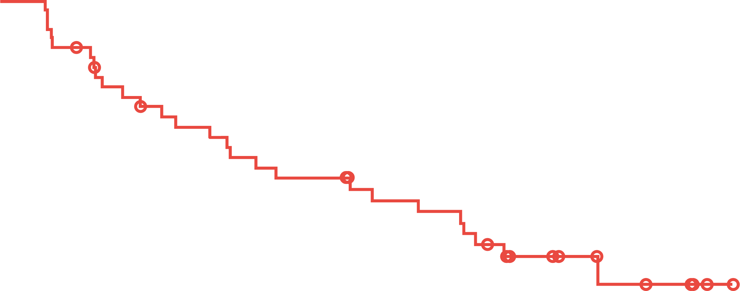
PFS and OS
PFS
OS
No. at risk
45 | 45 | 42 | 40 | 35 | 33 | 31 | 30 | 29 | 28 | 26 | 25 | 24 | 24 | 22 | 20 | 20 | 19 | 19 | 17 | 15 | 9 | 9 | 7 | 7 | 5 | 4 | 4 | 2 | 1 | 0 | 0
No. at risk
45 | 45 | 44 | 43 | 41 | 38 | 36 | 34 | 33 | 33 | 32 | 31 | 31 | 31 | 29 | 27 | 27 | 25 | 24 | 23 | 21 | 16 | 12 | 12 | 8 | 7 | 6 | 5 | 3 | 1 | 1 | 0 | 0
Median PFS was 18.53 (95% CI, 9.13-24.05) months
Median OS was NR; the 30-month OS rate was 86.3%
(95% CI, 66.1%-94.9%)

Slide 89
Conclusions
Lisaftoclax demonstrated significant efficacy in patients with R/R CLL at 400, 600, and 800 mg, and potentially 200 mg
CR/CRi exhibited a trend of positive correlation with escalating dose levels
No significant new or unmanageable safety findings were observed

Slide 90
BGB-16673 in B-cell malignancies
Preliminary results

Slide 91
BGB-16673 in B-cell malignancies study design
Phase 1, first-in-human study of the BTK degrader BGB-16673 in patients with R/R B-cell malignancies
Key eligibility criteria
Received ≥2 prior therapies (≥1 prior therapy for RT)
Received a cBTKi if approved for their disease
ECOG PS 0-2
Adequate end-organ function
No current or history of central nervous system involvement by B-cell malignancy
Part 1: Monotherapy dose-finding (concurrent enrollment)
Part 1a: Dose escalationª
Part 1b: Safety expansion
Selected R/R B-cell malignancies
(MZL, MCL, CLL/SLL, WM) n≤120
Up to 20 patients enrolled at doses that
are cleared in part 1a: dose escalation and recommended for additional evaluation
by the safety monitoring committee
Selected R/R B-cell malignancies
(MZL, FL, MCL, CLL/SLL, WM, DLBCL, RT)
n≤72
600 mg
QD
500 mg
QD
Key study objectives
Primary: safety^{b} and tolerability, define MTD and RP2D
Secondary: characterize PK, pharmacodynamics, and preliminary antitumor activity^{c}
350 mg
QD
200 mg
QD
100 mg
QD
Oral dosing
50 mg
QD

Slide 92
Patient disposition and baseline characteristics
Enrolled (n=51)ª
Parameter | Total (N=50)
Age, median (range), years | 70.5 (26-91)
Sex, n (%)
Male | 33 (66)
Female | 17 (34)
ECOG PS, n (%)
0-1 | 47 (94)
2 | 3 (6)
Disease type, n (%)
CLL/SLL | 24 (48)
MCL | 7 (14)
MZL | 3 (6)
WM | 6 (12)
DLBCL | 2 (4)
FL | 6 (12)
RT | 2 (4)
Prior treatment
Number of prior lines, median (range) | 4 (2-10)
Prior covalent BTK inhibitor | 40 (80)
Prior noncovalent BTK inhibitor | 7 (14)
Discontinued BTK inhibitor due to PD | 28 (56)
Bcl-2 inhibitor | 28 (56)
Treated
(n=50)
50 mg (n=4)
100 mg (n=14)
200 mg (n=15)
350 mg (n=13)
500 mg (n=4)
Off study treatment (n=12)
Disease progression (n=9)
AE (n=2)
Patient withdrawal (n=1)
On study treatment
(n=38)
50 mg (n=2)
100 mg (n=11)
200 mg (n=11)
350 mg (n=10)
500 mg (n=4)
Median follow-up (range)
2.55 months (0.2-17.1 months)

Slide 93
Overall safety summary
Patients, n (%) | All doses (N=50)
Any TEAE | 46 (92)
Any treatment-related | 32 (64)
Grade 3 or higher | 19 (38)
Treatment-related Grade 3 or higher | 11 (22)
Serious | 14 (28)
Treatment-related serious | 5 (10)
Leading to deathª | 2 (4)
Treatment-related leading to death | 0
Leading to treatment discontinuation^{b} | 3 (6)
Treatment-related leading to treatment discontinuation | 1 (2)
Leading to treatment modification | 11 (22)
Dose interruption | 11 (22)
Dose reduction^{c} | 2 (4)
DLT^{d} | 1 (2)
Patients, n (%) | 50 mg (n=4) | 100 mg (n=14) | 200 mg (n=15) | 350 mg (n=13) | 500 mg (n=4) | All doses (N=50
TEAEs in ≥ 10% of all patients or ≥3% for Grade 3 or higher
Contusion | 0 | 6 (43) | 5 (33) | 2 (15) | 2 (50) | 15 (30)
Diarrhea | 2 (50) | 2 (14) | 2 (13) | 4 (31) | 2 (50) | 12 (24)
Fatigue | 0 | 3 (21) | 4 (27) | 1 (8) | 2 (50) | 10 (20)
Amylase increased^{e} | 1 (25) | 3 (21) | 2 (13) | 2 (15) | 0 | 8 (16)
Neutropenia/neutrophil count decreased | 1 (25) | 3 (21) | 2 (13) | 1 (8) | 1 (25) | 8 (16)
Lipase increased^{e} | 1 (25) | 2 (14) | 2 (13) | 2 (15) | 0 | 7 (14)
Pyrexia | 1 (25) | 4 (29) | 1 (7) | 1 (8) | 0 | 7 (14)
Cough | 2 (50) | 2 (14) | 1 (7) | 1 (8) | 0 | 6 (12)
Headache | 0 | 1 (7) | 1 (7) | 1 (8) | 2 (50) | 5 (10)
Thrombocytopenia/platelet count decreased | 1 (25) | 2 (14) | 2 (13) | 0 | 0 | 5 (10)
Pneumonia | 1 (25) | 0 | 1 (7) | 1 (8) | 0 | 3 (6)
COVID-19 pneumonia | 0 | 0 | 1 (7) | 1 (8) | 0 | 2 (4)
Pooled AEs of interest
Any bleeding | 2 (50) | 7 (50) | 6 (40) | 4 (31) | 2 (50) | 21 (42)
Any infection^{f} | 2 (50) | 6 (43) | 7 (47) | 4 (31) | 1 (25) | 20 (40)
Atrial fibrillation/flutter | 0 | 0 | 0 | 0 | 0 | 0
Hypertension | 0 | 0 | 0 | 0 | 0 | 0

Slide 94
BOR by dose in evaluable patients
Patients, n (%) | 50 mg (n=4) | 100 mg (n=10) | 200 mg (n=9) | 350 mg (n=4) | 500 mg (n=1) | All doses (N=28)
Best overall response, n (%)ª
CR | 1 (25) | 0 | 0 | 0 | 0 | 1 (4)
PR | 1 (25) | 4 (40) | 7 (78) | 0 | 1 (100) | 13 (46)
PR-L | 0 | 0 | 1 (11) | 0 | 0 | 1 (4)
MR | 0 | 1 (10) | 0 | 0 | 0 | 1 (4)
SD | 0 | 3 (30) | 1 (11) | 1 (25) | 0 | 5 (18)
PD | 2 (50) | 2 (20) | 0 | 1 (25) | 0 | 5 (18)
Discontinued prior to first assessment | 0 | 0 | 0 | 2 (50) | 0 | 2 (7)
Disease control rate, n (%)^{b} | 2 (50) | 8 (80) | 9 (100) | 1 (25) | 1 (100) | 21 (75)
ORR, n (%)^{c} | 2 (50) | 5 (50) | 8 (89) | 0 | 1 (100) | 16 (57)
Median time to first response, months^{d} | 2.60 | 0.95 | 2.81 | N/A | 2.83 | 2.76

Slide 95
Treatment duration and response assessment: CLL/SLL
Prior therapyª
cBTKi | ncBTKi | BCL2i | BTKmut^{b}
 |  |  | -
 |  |  | -
 |  |  | +
 |  |  | U
 |  |  | -
 |  |  | U
 |  |  | -
 |  |  | +
 |  |  | -
 |  |  | +
 |  |  | U
 |  |  | U
 |  |  | U
 |  |  | -
 |  |  | U
 |  |  | U
 |  |  | +
 |  |  | U
 |  |  | U
 |  |  | U
 |  |  | U
 |  |  | U
 |  |  | +
 |  |  | U
Patients, n (%) | CLL/SLL (n=10)
Best overall response
CR | 0
PR | 6 (60)
PR-L | 1 (10)
MR | 0
SD | 2 (20)
PD | 0
Discontinued prior to first assessment | 1 (10)
Disease control rate, n (%)^{c} | 9 (90)
ORR, n (%)^{d} | 7 (70)
Dose level (mg)
50
PR
100
PR-L
200
SD
350
Ongoing treatment
500
Death

Slide 96
Conclusions
Preliminary results from this ongoing, first-in-human study of the novel BTK degrader BGB-16673 demonstrate meaningful clinical responses with a short time to response in heavily pretreated patients with B-cell malignancies
  In a high-risk, heavily pretreated population of patients with CLL/SLL all treated with covalent BTK inhibitors, the ORR was 70%
The safety profile of BGB-16673 appears tolerable to date with a single DLT (rash) reported and the study continues
  Discontinuations due to TEAEs were low (2 of 50 patients)
  No atrial fibrillation or hypertension has been reported so far
Taken together, these data support further examination of the clinical activity of BGB-16673 across several B-cell malignancies; Phase 2 dose expansions are planned within this study for patients with CLL/SLL and MCL

Slide 97
NX-2127 in B-cell malignancies
First-in-human Phase 1 trial

Slide 98
NX-2127 in B-cell malignancies study design
First-in-human Phase 1a/1b multicenter, open-label study designed to evaluate the safety and
anti-cancer activity of NX-2127 in patients with advanced B-cell malignancies.
Phase 1a
Accelerated titration/ 3+3 escalation (n~60ª)
CLL/SLL, MCL, DLBCL, FL, MZL, WM
Phase 1b
Select cohort expansion^{b}
NX-2127-001 (NCT04830137) is a first-in-human, multicenter, US-based, open-label, Phase 1 dose-escalation (Phase 1a) and cohort-expansion (Phase 1b) trial
The study is evaluating NX-2127 in adults with R/R B-cell malignancies
NX-2127 has a dual mechanism of action – targeted degradation of BTK and IKZF3
Other potential expansion cohorts include patients with FL, MZL and PCNSL
Objectives are to:
  Assess safety and tolerability
  Identify MTD & biologically active dose
  Evaluate PK/PD
300 mg
CLL/SLL (100 mg)
(n=40)
200 mg
150 mg
MCL (300 mg)
(n=20)
100 mg
DLBCL, WM (300 mg)
(n=20)
50 mg
Oral daily dosing
Recommended dose
MTD or biologically active dose

Slide 99
Baseline disease characteristics
Elderly population with multiple prior lines of targeted therapies and acquired mutations
Characteristic | NHL/WM (n=21) | CLL/SLL (n=33) | Overall population (N=54)
Median age, years (range) | 70.0 (50.0–92.0) | 74.0 (58.0–90.0) | 72.5 (50.0–92.0)
Female, n (%) | 6 (28.6) | 11 (33.3) | 17 (31.5)
Male, n (%) | 15 (71.4) | 22 (66.7) | 37 (68.5)
ECOG PS, n (%)
0 | 10 (47.6) | 18 (54.5) | 28 (51.9)
1 | 11 (52.4) | 15 (45.5) | 26 (48.1)
Previous targeted treatmentsª, n (%)
BTKi | 15 (71.4) | 33 (100.0) | 48 (88.9)
Pirtobrutinib | 5 (23.8) | 9 (27.3) | 14 (25.9)
BTKi and BCL2i | 1 (4.8) | 26 (78.8) | 27 (50.0)
cBTKi, ncBTKi, and BCL2i | 0 (0.0) | 8 (24.2) | 8 (14.8)
CAR-T-/NK therapy | 3 (14.3) | 1 (3.0) | 4 (7.4)
Bispecific antibody | 2 (9.5) | 0 (0.0) | 2 (3.7)
Immunomodulatory therapy (lenalidomide) | 4 (19.0) | 4 (12.1) | 8 (14.8)
Median number of lines of prior therapy (median, range) | 4 (2–10) | 5 (2–11) | 4 (2–11)

Slide 100
Baseline disease characteristics
Elderly population with multiple prior lines of targeted therapies and acquired mutations
Mutations | NHL/WM (n=21) | CLL/SLL (n=33) | Overall population (N=54)
BTK, n (%) C481S or C481R L528W T474F or T474I V416L L512V | 3 (14.3) 1 (4.8) 1 (4.8) 1 (4.8) 0 (0.0) 1 (4.8) | 12 (36.4) 7 (21.2) 4 (12.1) 4 (12.1) 1 (3.0) 0 (0.0) | 15 (27.8) 8 (14.8) 5 (9.3) 5 (9.3) 1 (1.9) 1 (1.9)
PLCG2^{b} | 2 (9.5) | 1 (3.0) | 3 (5.6)
BCL2 (G101V) | 0 (0.0) | 4 (12.0) | 4 (7.4)

Slide 101
Safety summary
TEAEs | Any grade | Grade 3+ | SAEs
Fatigue | 25 (46.3) | – | –
Neutropeniaª | 25 (46.3) | 23 (42.6) | –
Hypertension | 18 (33.3) | 8 (14.8) | –
Bruising/contusion^{b} | 16 (29.6) | – | 1 (1.9)
Diarrhea | 16 (29.6) | – | –
Anemia | 13 (24.1) | 8 (14.8) | 1 (1.9)
Dizziness | 13 (24.1) | – | –
Dyspnea | 13 (24.1) | 1 (1.9) | –
Thrombocytopenia^{c} | 13 (24.1) | 4 (7.4) | –
Constipation | 12 (22.2) | – | –
Headache | 11 (20.4) | – | –
Upper GI hemorrhage^{d} | 2 (3.7) | 2 (3.7) | 2 (3.7)
Pruritus | 11 (20.4) | 1 (1.9) | –
COVID-19 | 7 (13.0) | 4 (7.4) | 3 (5.6)
Atrial fibrillation^{e} | 6 (11.1) | 3 (5.6) | 3 (5.6)
Pneumonia | 6 (11.1) | 3 (5.6) | 3 (5.6)
Pain in extremity | 5 (9.3) | 2 (3.7) | 1 (1.9)
Leukocytosis | 3 (5.6) | 3 (5.6) | –
Lymphocyte count increased | 2 (3.7) | 2 (3.7) | –
Sepsis^{f} | 2 (3.7) | 2 (3.7) | 2 (3.7)
2 DLTs have been reported: cognitive disturbance
(300 mg DL) and neutropenia
(300 mg DL)

Slide 102
Duration of treatment and best response in patients with NHL/WM
Prior BTKi
Assigned dose (mg)
Response
100
CR
200
PR
SD
300
PD
Status
Ongoing

Slide 103
Efficacy in patients with CLL/SLL
CLL/SLL disease-evaluable patientsª | n=27
Objective response rate^{b}, % (95% CI) | 40.7 (22.4-61.2)
Best response, n (%)
CR | 0 (0.0)
PR/PR-L | 11 (40.7)
SD | 12 (44.4)
PD | 4 (14.8)
*
*
*
*
*
*
Assigned dose (mg)
*□
*
100
BTK mutation
*
*
150
200
Treatment ongoing
□Patient with SLL

Slide 104
Duration of treatment and best response in patients with CLL/SLL
Responses seen in double- and triple-exposed patients
Prior pirto | Prior BCL2i
*
*
*Mutations were tested at baseline by NGS centrally in those patients with available samples (cutoff ≥5% VAF)
*
*
*
Assigned dose (mg)
Response
100
PR
150
PR-L
*
200
SD
*□
*
300
PD
*
*
Status
BTK mutation
*
*
Ongoing
*

Slide 105
Conclusions
NX-2127 had a manageable safety profile that was consistent with previous reports for BTK-targeted and immunomodulatory therapies
Treatment with NX-2127 resulted in encouraging and durable responses in a heavily pre-treated patient population including patients with BTK resistance mutations
  In NHL
    Rapid (8-week) and durable CRs were observed in 2 patients (DLBCL; MCL)
    Rapid (8-week) PRs were observed in 2 patients (FL; MZL)
  CLL
    PRs were observed in 11 patients (9 PRs; 2 PR-Ls)
    Objective Response Rate was 40.7% as of the cutoff date, and treatment was ongoing in 13 patients
Dose-expansion cohorts of patients with NHL have been initiated at the 300 mg daily dose

